Slide 1
And John, calling two disciples to him, sent them to the Lord, saying, “Are you the one who is to come, or shall we look for another?” And when the men had come to him, they said, “John the Baptist has sent us to you, saying, ‘Are you the one who is to come, or shall we look for another?’”
Luke 7:19-20

Slide 2
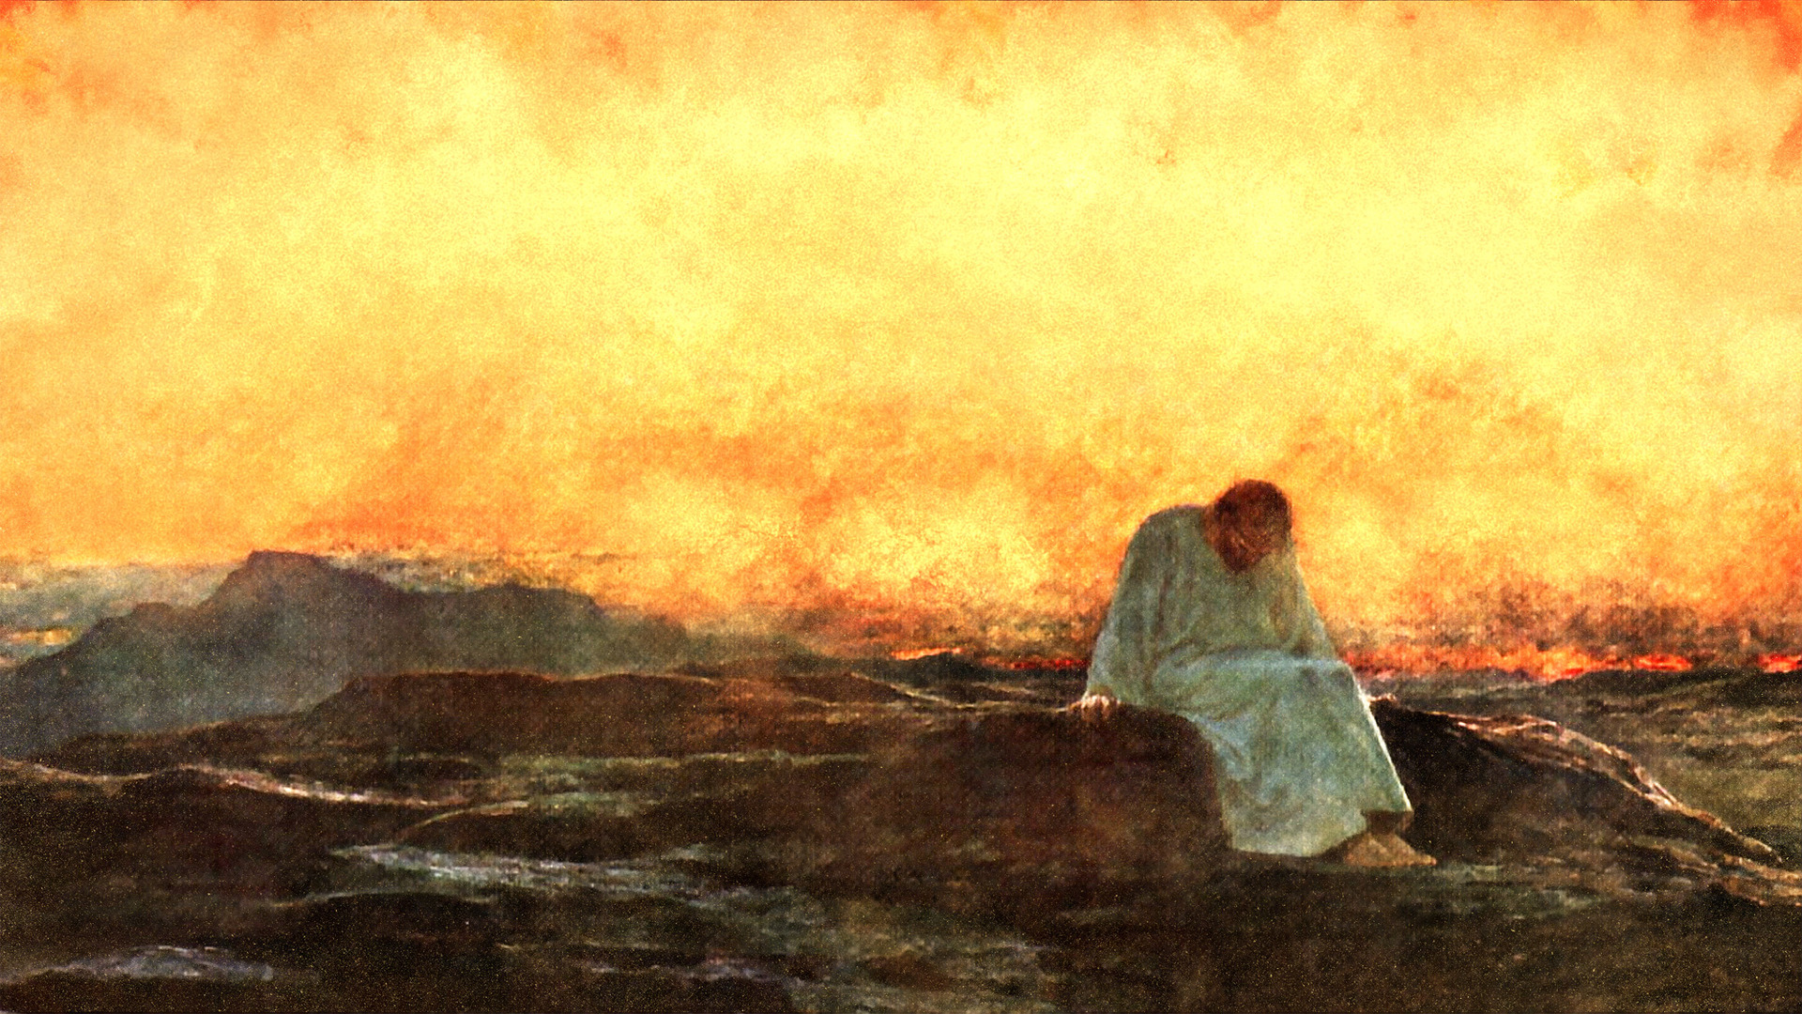
Overcoming the Doubts
of John the Baptist

Slide 3
But the angel said to him, “Do not be afraid, Zechariah, for your prayer has been heard, and your wife Elizabeth will bear you a son, and you shall call his name John. And you will have joy and gladness, and many will rejoice at his birth, for he will be great before the Lord. And he must not drink wine or strong drink, and he will be filled with the Holy Spirit, even from his mother’s womb. And he will turn many of the children of Israel to the Lord their God, and he will go before him in the spirit and power of Elijah, to turn the hearts of the fathers to the children, and the disobedient to the wisdom of the just, to make ready for the Lord a people prepared.”
Luke 1:13-17

Slide 4
And you, child, will be called the prophet of the Most High; for you will go before the Lord to prepare his ways, to give knowledge of salvation to his people in the forgiveness of their sins, because of the tender mercy of our God, whereby the sunrise shall visit us from on high to give light to those who sit in darkness and in the shadow of death, to guide our feet into the way of peace.
Luke 1:76-79

Slide 5
The Expectations
of John the Baptist

Slide 6
Behold, I will send you Elijah the prophet before the great and awesome day of the LORD comes. And he will turn the hearts of fathers to their children and the hearts of children to their fathers, lest I come and strike the land with a decree of utter destruction.
Malachi 4:5-6

Slide 7
Behold, I send my messenger, and he will prepare the way before me. And the Lord whom you seek will suddenly come to his temple; and the messenger of the covenant in whom you delight, behold, he is coming, says the LORD of hosts. But who can endure the day of his coming, and who can stand when he appears? For he is like a refiner’s fire and like fullers’ soap. He will sit as a refiner and purifier of silver…Then I will draw near to you for judgment. I will be a swift witness against the sorcerers, against the adulterers, against those who swear falsely, against those who oppress the hired worker in his wages, the widow and the fatherless, against those who thrust aside the sojourner, and do not fear me, says the LORD of hosts.
Malachi 3:1-5

Slide 8
“You brood of vipers! Who warned you to flee form the wrath to come?”
Luke 3:7
“Even now the axe is laid to the root of the trees. Every tree therefore that does not bear good fruit is cut down and thrown into the fire.”
Luke 3:9
“His winnowing fork is in his hand, to clear his threshing floor and to gather the wheat into his barn, but the chaff he will burn with unquenchable fire.”
Luke 3:17

Slide 9
The Declarations
of John the Baptist

Slide 10
I baptize with water, but among you stands one you do not know, even he who comes after me, the strap of whose sandal I am not worthy to untie.
John 1:26-27

Slide 11
The next day he saw Jesus coming toward him, and said, “Behold, the Lamb of God, who takes away the sin of the world! This is he of whom I said, ‘After me comes a man who ranks before me, because he was before me.’ I myself did not know him, but for this purpose, I came baptizing with water, that he might be revealed to Israel.” And John bore witness: “I saw the Spirit descend from heaven like a dove, and it remained on him. I myself did not know him, but he who sent me to baptize with water said to me, ‘He on whom you see the Spirit descend and remain, this is he who baptizes with the Holy Spirit.’ And I have seen and have borne witness that this is the Son of God.”
John 1:29-34

Slide 12
And they came to John and said to him, “Rabbi, he who was with you across the Jordan, to whom you bore witness—look, he is baptizing, and all are going to him.” John answered, “A person cannot receive even one thing unless it is given him from heaven. You yourselves bear me witness, that I said, ‘I am not the Christ, but I have been sent before him.’ The one who has the bride is the bridegroom. The friend of the bridegroom, who stands and hears him, rejoices greatly at the bridegroom’s voice. Therefore, this joy of mine is now complete. He must increase, but I must decrease.”
John 3:26-30

Slide 13
But Herod the tetrarch, who had been reproved by him for Herodias, his brother’s wife, and for all the evil things that Herod had done, added this to them all, that he locked up John in prison.
Luke 3:19-20

Slide 14
The Doubts
of John the Baptist

Slide 15
The disciples of John reported all these things to him. And John, calling two disciples to him, sent them to the Lord, saying, “Are you the one who is to come, or shall we look for another?” And when the men had come to him, they said, “John the Baptist has sent us to you, saying, ‘Are you the one who is to come, or shall we look for another?’” In that hour he healed many people of diseases and plagues and evil spirits, and on many who were blind he bestowed sight. And he answered them, “Go and tell John what you have seen and heard: the blind receive their sight, the lame walk, lepers are cleansed, and the deaf hear, the dead are raised up, the poor have the good news preached to them. And blessed is the one who is not offended by me.”
Luke 7:18-23

Slide 16
The disciples of John reported all these things to him. And John, calling two disciples to him, sent them to the Lord, saying, “Are you the one who is to come, or shall we look for another?” And when the men had come to him, they said, “John the Baptist has sent us to you, saying, ‘Are you the one who is to come, or shall we look for another?’” In that hour he healed many people of diseases and plagues and evil spirits, and on many who were blind he bestowed sight. And he answered them, “Go and tell John what you have seen and heard: the blind receive their sight, the lame walk, lepers are cleansed, and the deaf hear, the dead are raised up, the poor have the good news preached to them. And blessed is the one who is not offended by me.”
Luke 7:18-23

Slide 17
The Response
to John the Baptist

Slide 18
The disciples of John reported all these things to him. And John, calling two disciples to him, sent them to the Lord, saying, “Are you the one who is to come, or shall we look for another?” And when the men had come to him, they said, “John the Baptist has sent us to you, saying, ‘Are you the one who is to come, or shall we look for another?’” In that hour he healed many people of diseases and plagues and evil spirits, and on many who were blind he bestowed sight. And he answered them, “Go and tell John what you have seen and heard: the blind receive their sight, the lame walk, lepers are cleansed, and the deaf hear, the dead are raised up, the poor have the good news preached to them. And blessed is the one who is not offended by me.”
Luke 7:18-23

Slide 19
The Spirit of the Lord GOD is upon me, because the LORD has anointed me to bring good news to the poor; he has sent me to bind up the brokenhearted, to proclaim liberty to the captives, and the opening of the prison to those who are bound; to proclaim the year of the LORD’s favor, and the day of vengeance of our God; to comfort all who mourn; to grant to those who mourn in Zion—to give them a beautiful headdress instead of ashes, the oil of gladness instead of mourning, the garment of praise instead of a faint spirit; that they may be called oaks of righteousness, the planting of the LORD, that he may be glorified.
Isaiah 61:1-3

Slide 20
Strengthen the weak hands, and make firm the feeble knees. Say to those who have an anxious heart, “Be strong; fear not! Behold, your God will come with vengeance, with the recompense of God. He will come and save you.” Then the eyes of the blind shall be opened, and the ears of the deaf unstopped; then shall the lame man leap like a deer, and the tongue of the mute sing for joy. For waters break forth in the wilderness, and streams in the desert; the burning sand shall become a pool, and the thirsty ground springs of water; in the haunt of jackals, where they lie down, the grass shall become reeds and rushes. And a highway shall be there, and it shall be called the Way of Holiness; the unclean shall not pass over it, I shall belong to those who walk on the way…
Isaiah 35:3-8

Slide 21
The Spirit of the Lord GOD is upon me, because the LORD has anointed me to bring good news to the poor; he has sent me to bind up the brokenhearted, to proclaim liberty to the captives, and the opening of the prison to those who are bound; to proclaim the year of the LORD’s favor, and the day of vengeance of our God; to comfort all who mourn; to grant to those who mourn in Zion—to give them a beautiful headdress instead of ashes, the oil of gladness instead of mourning, the garment of praise instead of a faint spirit; that they may be called oaks of righteousness, the planting of the LORD, that he may be glorified.
Isaiah 61:1-3

Slide 22
The disciples of John reported all these things to him. And John, calling two disciples to him, sent them to the Lord, saying, “Are you the one who is to come, or shall we look for another?” And when the men had come to him, they said, “John the Baptist has sent us to you, saying, ‘Are you the one who is to come, or shall we look for another?’” In that hour he healed many people of diseases and plagues and evil spirits, and on many who were blind he bestowed sight. And he answered them, “Go and tell John what you have seen and heard: the blind receive their sight, the lame walk, lepers are cleansed, and the deaf hear, the dead are raised up, the poor have the good news preached to them. And blessed is the one who is not offended by me.”
Luke 7:18-23

Slide 23
Overcoming the Doubts
of John the Baptist

Slide 24
The disciples of John reported all these things to him. And John, calling two disciples to him, sent them to the Lord, saying, “Are you the one who is to come, or shall we look for another?” And when the men had come to him, they said, “John the Baptist has sent us to you, saying, ‘Are you the one who is to come, or shall we look for another?’” In that hour he healed many people of diseases and plagues and evil spirits, and on many who were blind he bestowed sight. And he answered them, “Go and tell John what you have seen and heard: the blind receive their sight, the lame walk, lepers are cleansed, and the deaf hear, the dead are raised up, the poor have the good news preached to them. And blessed is the one who is not offended by me.”
Luke 7:18-23

