Slide 1
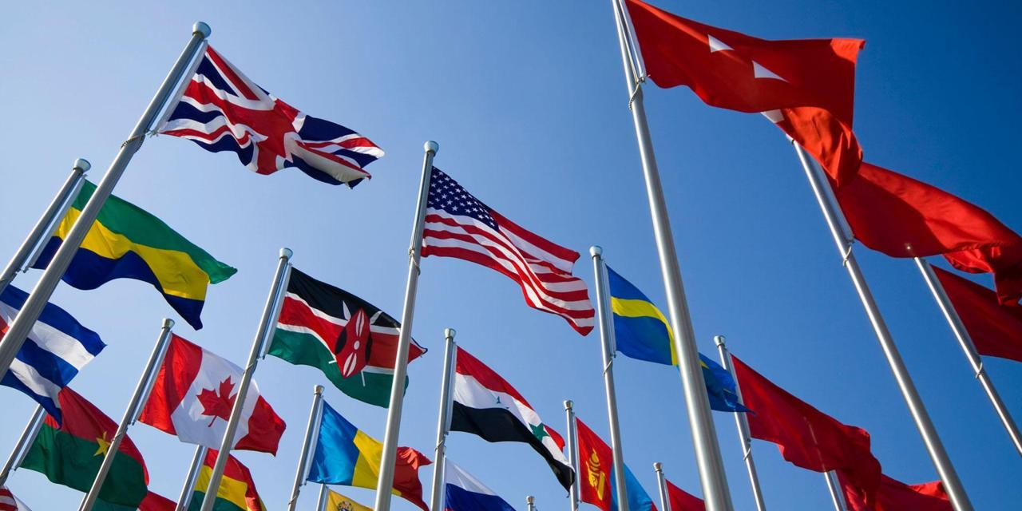
God’s Kingdom
among the Nations
Notes:
Remind of theme of series by showing Kingdom emphasis throughout Acts
1.1-3
28.30-31

Slide 2
Christians hold to the Gospel—Christ raised and reigning—as their ‘platform’
  Prayer of the disciples after government oppression in ch 4 points back to Psalm 2 Kingdom Gospel prophecy
  Athens (17:18b), Ephesus (19:8)
  Focus on the supernatural and supernational elements of the Gospel. (17:24-28)
  Paul rejects apparent opportunity to align with political powers (24:24-27)
Christians did not aim for worldly socio-political revolution (even when receiving injustice).
  Thessalonica – Experience at Jason’s house (17:1-4)
  Corinth – Authorities note peacefulness (18:12-17)
  Ephesus
    Social change created as secondary result, not primary goal of the Kingdom’s influence on the world (19:11-20, 23-27)
    Like Corinth, authorities note peacefulness and hint at a ‘quietness’ of church’s opposition to social ills (19:35-41)
Christians strive to live quietly and peaceably even within an ungodly society.
  Paul avoided socio-political conflict when possible even for the Kingdom’s sake (20:1)
  Paul recounts his own “quiet and peaceable” life of ministry in Ephesus (20:17-35)
Christians show respect (as much as possible) to social and political structures and leadership.
  Paul tried to appease social norms of feasts, vows, etc. (21:20-26)
  Paul uses very respectful language to some less than honorable leaders (21:37; 23:1-5; 24:10-11; 26:1-3)
Christians individually leverage present social and political circumstances to promote the Gospel of the Kingdom.
  Paul frequented synagogues, prayer meetings, Areopagus, etc. which were religious (not political) centers where he engaged people about the Gospel (not political policy).
  Taught Gospel / faith to proconsul rather than talking policy (13:1-12)
  Reputation vindicated in Philippi b/c they were Romans (16:35-40)
  Ministry in Tyrannus’ school in Ephesus (19:8-10)
  Paul used his citizenship and knowledge of socio-political environments to gain greater opportunity with political leaders…to preach the Gospel to them! (21:37-40; 22:23-29; 23:6-11)
  Paul was in Rome 2 years constantly preaching the Kingdom (28:17-31)
Notes:
Sunday AM Principles

Slide 3
Christians hold to the Gospel as their ‘platform’
Christians do not aim for worldly socio-political revolution.
Christians strive to live quietly and peaceably.
Christians show respect (as much as possible) to social and political structures and leadership.
Christians individually leverage present social and political circumstances to promote the Gospel of the Kingdom.
Promotion of Gospel Message
Honor All People
Honor God
Honor Authorities
Spiritual Revolution
(Not Social)
Quiet & Peaceable Lifestyle
Deep Faith in the Gospel
of Christ & Kingdom

Slide 4
Christians hold to the Gospel as their ‘platform’.
Deep Faith in the Gospel of Christ & Kingdom
Notes:
Christians hold to the Gospel—Christ raised and reigning—as their ‘platform’
Athens (17:18b), Ephesus (19:8)
Focus on the SUPERNATURAL and SUPERNATIONAL elements of the Gospel. (17:24-28)
Paul rejects apparent opportunity to align with political powers (24:24-27)

Slide 5
Christians do not aim for worldly socio-political revolution.
Spiritual Revolution
(Not Social)
Deep Faith in the Gospel of Christ & Kingdom
Notes:
Christians did not aim for worldly socio-political revolution (even when receiving injustice).
Thessalonica – Experience at Jason’s house (17:1-4)
Corinth – Authorities note peacefulness (18:12-17)
Ephesus
Social change created as secondary result, not primary goal of the Kingdom’s influence on the world (19:11-20, 23-27)
Like Corinth, authorities note peacefulness and hint at a ‘quietness’ of church’s opposition to social ills (19:35-41)

Slide 6
Christians strive to live quietly and peaceably in society.
Spiritual Revolution
(Not Social)
Quiet & Peaceable Lifestyle
Deep Faith in the Gospel of Christ & Kingdom
Notes:
Christians strive to live quietly and peaceably even within an ungodly society.
Paul avoided socio-political conflict when possible even for the Kingdom’s sake (20:1)
Paul recounts his own “quiet and peaceable” life of ministry in Ephesus (20:17-35)

Slide 7
Christians give respect to God, their neighbors, and (as much as possible) to social and political structures and leadership.
Honor All People
Honor God
Honor Authorities
Spiritual Revolution
(Not Social)
Quiet & Peaceable Lifestyle
Deep Faith in the Gospel of Christ & Kingdom
Notes:
Christians show respect (as much as possible) to social and political structures and leadership.
Paul tried to appease social norms of feasts, vows, etc. (21:20-26)
Paul uses very respectful language to some less than honorable leaders (21:37; 23:1-5; 24:10-11; 26:1-3)

Slide 8
Promotion of Gospel Message
Christians utilize their circumstances in the world to promote the Gospel of the Kingdom.
Honor All People
Honor God
Honor Authorities
Spiritual Revolution
(Not Social)
Quiet & Peaceable Lifestyle
Deep Faith in the Gospel of
Christ & Kingdom
Notes:
Christians individually leverage present social and political circumstances to promote the Gospel of the Kingdom.
Paul frequented synagogues, prayer meetings, Areopagus, etc. which were religious (not political) centers where he engaged people about the Gospel (not political policy).
Taught Gospel / faith to proconsul rather than talking policy (13:1-12)
Reputation vindicated in Philippi b/c they were Romans (16:35-40)
Ministry in Tyrannus’ school in Ephesus (19:8-10)
Paul used his citizenship and knowledge of socio-political environments to gain greater opportunity with political leaders…to preach the Gospel to them! (21:37-40; 22:23-29; 23:6-11)
Paul was in Rome 2 years constantly preaching the Kingdom (28:17-31)

