Slide 1
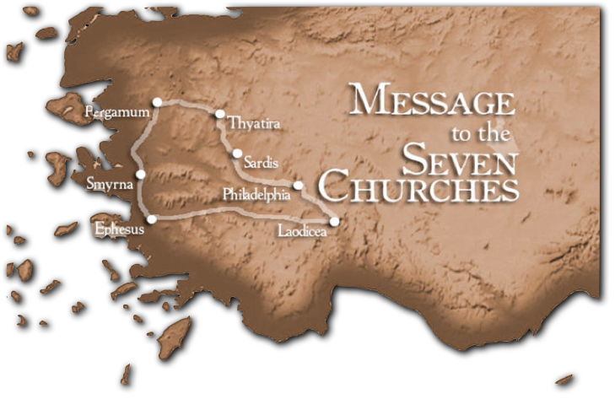
“He who has an ear, let him hear what the Spirit says to the churches.””
1
Ephesus - Rev 2:1-7
Patmos
The Church That Forgot Her First Love
Don McClain
W. 65th St church of Christ - 9/16/2007

Slide 2
Lather – Rinse – Repeat
And you shall love the Lord your God
With all your heart
With all your soul
With all your mind
With all your strength
This is the first commandment
Mark 12:30 / Luke 10:37 / Matthew 22:37
Lather, rinse, repeat is a phrase that is a common part of the instructions on shampoo bottles. It is sometimes also used as a humorous way of saying that a certain set of instructions should be repeated until an explicit or implicit goal is reached (English Language & Usage website)

Slide 3
When Tragedy Comes To A Sinner
Robbers: look to the Thief for hope
Immoral: look to king David for hope
Murderers: look to Paul for hope
Cowards: look to Peter for hope
Prostitutes: look to Rahab for hope
Greedy: look to Zacchaeus for hope

Slide 4
When Tragedy Comes To A Church
Loveless: look to Ephesians for hope
Immoral: look to Pergamos for hope
Compromising: look to Thyatira for hope
Dying: look to Sardis for hope
Lukewarm: look to Laodicea for hope

Slide 5
God Is Patiently Pleading With Grace & Mercy For His People To Return
Israel & Judah
Jeremiah 3:10 "And yet for all this her treacherous sister Judah has not turned to Me with her whole heart, but in pretense," says the LORD.
Jeremiah 24:7 'Then I will give them a heart to know Me, that I am the LORD; and they shall be My people, and I will be their God, for they shall return to Me with their whole heart.

Slide 6
To The Seven Churches Which Are In Asia
Revelation 1:11 (NKJV)
¹¹ "I am the Alpha and the Omega, the First and the Last," and, "What you see, write in a book and send it to the seven churches which are in Asia: to Ephesus, to Smyrna, to Pergamos, to Thyatira, to Sardis, to Philadelphia, and to Laodicea."

Slide 7
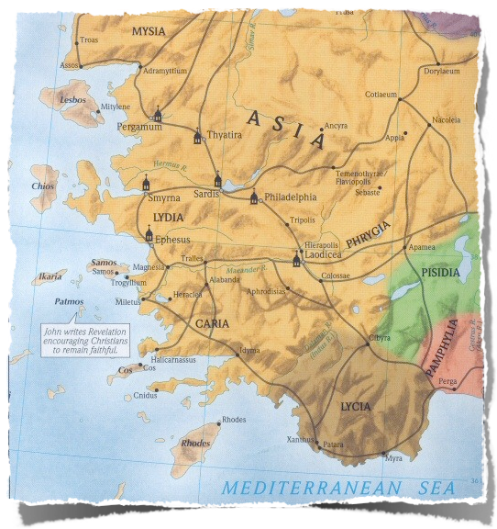
Message to 7 actual churches
There were other churches (Troas, Miletus, Colosse, Hierapolis)
Number 7 is representative for wholeness, completeness
These 7 churches are representative of all
3. Pergamos
4. Thyatira
5. Sardis
2. Smyrna
6. Philadelphia
1. Ephesus
7. Laodicea

Slide 8
Ephesus – Laborous But Loveless
Smyrna – Poor But Rich
Pergamos – Divided (Antipas vs Balaam)
Thyatira – Compromising
Sardis – Dead
Philadelphia – An Open Door
Laodicea – Lukewarm
New Hope – _______?______
What Kind Of Church
Does Jesus Call Us?
3. Pergamos
4. Thyatira
2. Smyrna
5. Sardis
6. Philadelphia
1. Ephesus
7. Laodicea

Slide 9
Ephesus
Background Information
4th Largest city in Roman world (300,000 - 500,000)
Potential: Paul spent 3 years evangelizing (Acts 20:31)
Magical arts & “gods” were prevalent – (19:19)
The temple erected to the goddess Diana {Artemis) – (19:23-41)
Acts 19:9-10 “… reasoning daily in the school of Tyrannus. And this continued for two years, so that all who dwelt in Asia heard the word of the Lord Jesus, both Jews and Greeks.”
Notes:
The passage tells of seven sons of a Jewish priest who were apparently exorcists who tried to cast out an evil spirit using Jesus' name in a magical way. The demon-possessed man beat and stripped all seven! The demonic activity this suggests was very likely stimulated by the devotion of many in Ephesus to occult practices. Many who were now Christians had been involved in such evil, and those who had practiced sorcery publicly burned books of magic worth in our day some $2.5 million! In a city where Satan had gained a foothold and the supernatural was a dominating theme, God's Spirit performed miracles that demonstrated Jesus' power over supernatural powers!— Teacher's Commentary

Slide 10
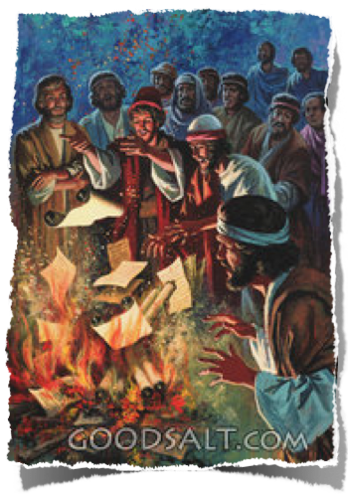
Ac 19:1 ¶ And it happened, while Apollos was at Corinth, that Paul, having passed through the upper regions, came to Ephesus. And finding some disciples…
8 ¶ And he went into the synagogue and spoke boldly for three months, reasoning and persuading concerning the things of the kingdom of God.
… reasoning daily in the school of Tyrannus.
10 And this continued for two years, so that all who dwelt in Asia heard the word of the Lord Jesus, both Jews and Greeks.
Ephesus
Great Beginning
Paul’s first visit – Acts 18 (very short)
Paul second visit – Acts 19 (very long)
Acts 18 19 And he came to Ephesus, and left them there; but he himself entered the synagogue and reasoned with the Jews. 20 When they asked him to stay a longer time with them, he did not consent, 21 but took leave of them, saying, "I must by all means keep this coming feast in Jerusalem; but I will return again to you, God willing." And he sailed from Ephesus.
Acts 19 1 … Paul, having passed through the upper regions, came to Ephesus. And finding some disciples… 8 And he went into the synagogue and spoke boldly for three months, reasoning and persuading concerning the things of the kingdom of God. 9 … reasoning daily in the school of Tyrannus. 10 And this continued for two years, so that all who dwelt in Asia heard the word of the Lord Jesus, both Jews and Greeks.
50,000 pieces of silver
Notes:
The passage tells of seven sons of a Jewish priest who were apparently exorcists who tried to cast out an evil spirit using Jesus' name in a magical way. The demon-possessed man beat and stripped all seven! The demonic activity this suggests was very likely stimulated by the devotion of many in Ephesus to occult practices. Many who were now Christians had been involved in such evil, and those who had practiced sorcery publicly burned books of magic worth in our day some $2.5 million! In a city where Satan had gained a foothold and the supernatural was a dominating theme, God's Spirit performed miracles that demonstrated Jesus' power over supernatural powers!— Teacher's Commentary

Slide 11
Ac 19:1 ¶ And it happened, while Apollos was at Corinth, that Paul, having passed through the upper regions, came to Ephesus. And finding some disciples…
8 ¶ And he went into the synagogue and spoke boldly for three months, reasoning and persuading concerning the things of the kingdom of God.
… reasoning daily in the school of Tyrannus.
10 And this continued for two years, so that all who dwelt in Asia heard the word of the Lord Jesus, both Jews and Greeks.
Ephesus
Paul’s epistle to the Ephesians (“to know the love of Christ”)
Eph. 1 1 Paul, an apostle of Jesus Christ by the will of God, To the saints who are in Ephesus, and faithful in Christ Jesus.
Eph 3 17 that Christ may dwell in your hearts through faith; that you, being rooted and grounded in love, 18 may be able to comprehend with all the saints what is the width and length and depth and height -- 19 to know the love of Christ which passes knowledge; that you may be filled with all the fullness of God.
Eph 4 15 but, speaking the truth in love, may grow up in all things into Him …
Eph 5 2 And walk in love, as Christ also has loved us … 25 Husbands, love your wives as Christ loved the church…”
Eph 6 23 Peace to the brethren, and love with faith, from God the Father and the Lord Jesus Christ. 24 Grace be with all those who love our Lord Jesus Christ in sincerity. Amen.
Notes:
The passage tells of seven sons of a Jewish priest who were apparently exorcists who tried to cast out an evil spirit using Jesus' name in a magical way. The demon-possessed man beat and stripped all seven! The demonic activity this suggests was very likely stimulated by the devotion of many in Ephesus to occult practices. Many who were now Christians had been involved in such evil, and those who had practiced sorcery publicly burned books of magic worth in our day some $2.5 million! In a city where Satan had gained a foothold and the supernatural was a dominating theme, God's Spirit performed miracles that demonstrated Jesus' power over supernatural powers!— Teacher's Commentary

Slide 12
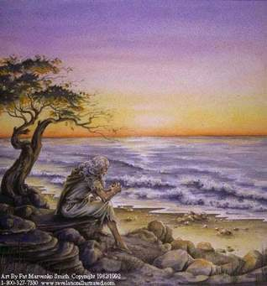
The Church at Ephesus
Great Leadership – Great Membership
Paul stays for three years – (Acts 20:31)
Timothy left in Ephesus – (1 Tim. l:3)
Apollos & Aquila / Priscilla (Ac 18:24-28)
Onesiphorus (2 Tim. 1:18)
Epistle of Ephesians by Paul (@ 61 - 62 AD)
Letter to Ephesians by John (@ 90 - 95 AD)
Elders in Ephesus (Acts 20:17,28)
* John (lived, worked, buried ?)
John on Patmos
Notes:
The passage tells of seven sons of a Jewish priest who were apparently exorcists who tried to cast out an evil spirit using Jesus' name in a magical way. The demon-possessed man beat and stripped all seven! The demonic activity this suggests was very likely stimulated by the devotion of many in Ephesus to occult practices. Many who were now Christians had been involved in such evil, and those who had practiced sorcery publicly burned books of magic worth in our day some $2.5 million! In a city where Satan had gained a foothold and the supernatural was a dominating theme, God's Spirit performed miracles that demonstrated Jesus' power over supernatural powers!— Teacher's Commentary

Slide 13
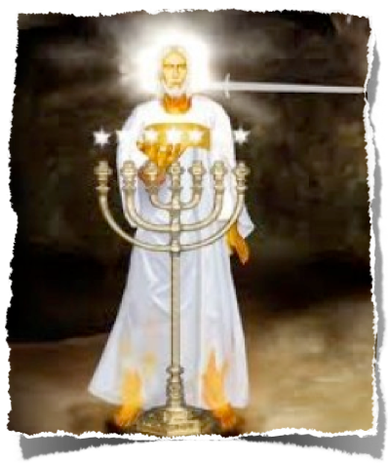
The Church at Ephesus
Their Greatest Member: Jesus Christ !
Revelation 2:1 ^{(NKJV)}
¹ "To the angel of the church of Ephesus write, 'These things says He who holds the seven stars in His right hand, who walks in the midst of the seven golden lampstands:
Lampstand: on fire gives light to darkness

Slide 14
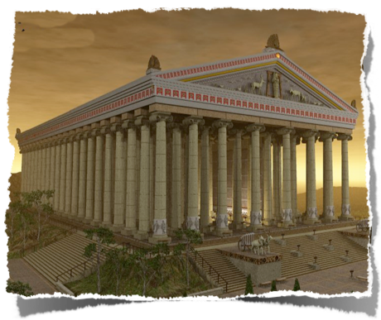
Ephesus
Center of Greek / Roman Paganism
Made of marble
130 x 60 yards (2 ½ million sq. ft.)
127 massive ionic columns 60 feet tall.
4x larger than the Parthenon in Athens
Under construction in 333 BC when Alexander the Great arrived
One of The 7 Wonders Ancient World
Temple of Diana (Artemis)
Diana (Roman) / Artemis (Greek)
Daughter of Zeus & Twin of Apollo
Moon goddess & Hunting goddess
Notes:
Temple of Diana - Ephesus
A rusty sign and some broken columns stacked on a crude cement base commemorate Ephesus Temple of Diana. During Ephesus' heyday, the Temple of Diana covered 130 x 60 yards. Each of the Temple of Diana's 127 massive ionic columns were 60 feet tall. Deemed one of the seven Wonders of the Ancient World, the Temple of Diana in Ephesus was 4 times larger than the Parthenon in Athens. Ephesus' Temple of Diana actually started as the Temple of Artemis, the Greek goddess. By the 1st century AD, however, Romans ruled Ephesus and substituted their goddess Diana for Artemis. The substitution of Diana appears to have been fine with Ephesus' silversmiths as long as they could continue to peddle miniature copies of the Temple of Diana / Artemis. Their profit margin appears to have been squeezed, however, when Paul came to Ephesus and preached against idolatry:

Slide 15
Ephesus
City Landmarks
Ephesus faced Culture
New Hope faces Culture
Notes:
Temple of Diana - Ephesus
A rusty sign and some broken columns stacked on a crude cement base commemorate Ephesus Temple of Diana. During Ephesus' heyday, the Temple of Diana covered 130 x 60 yards. Each of the Temple of Diana's 127 massive ionic columns were 60 feet tall. Deemed one of the seven Wonders of the Ancient World, the Temple of Diana in Ephesus was 4 times larger than the Parthenon in Athens. Ephesus' Temple of Diana actually started as the Temple of Artemis, the Greek goddess. By the 1st century AD, however, Romans ruled Ephesus and substituted their goddess Diana for Artemis. The substitution of Diana appears to have been fine with Ephesus' silversmiths as long as they could continue to peddle miniature copies of the Temple of Diana / Artemis. Their profit margin appears to have been squeezed, however, when Paul came to Ephesus and preached against idolatry:

Slide 16
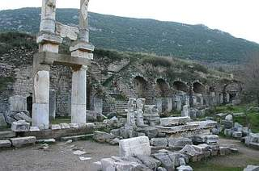
Ephesus
Challenges They Faced
Citizens required to pinch incense & declare “Caesar is Lord”
“You have endured ‘for My name’s sake’ and not grown weary” (2:3)
The Challenge: Matthew 10:32-33 2 Timothy 2:12
Temple to Emperor Domitian
2 Tim. 2:12 “If we endure, we shall also reign with Him. If we deny Him, He also will deny us.”
Notes:
Temple of Diana - Ephesus
A rusty sign and some broken columns stacked on a crude cement base commemorate Ephesus Temple of Diana. During Ephesus' heyday, the Temple of Diana covered 130 x 60 yards. Each of the Temple of Diana's 127 massive ionic columns were 60 feet tall. Deemed one of the seven Wonders of the Ancient World, the Temple of Diana in Ephesus was 4 times larger than the Parthenon in Athens. Ephesus' Temple of Diana actually started as the Temple of Artemis, the Greek goddess. By the 1st century AD, however, Romans ruled Ephesus and substituted their goddess Diana for Artemis. The substitution of Diana appears to have been fine with Ephesus' silversmiths as long as they could continue to peddle miniature copies of the Temple of Diana / Artemis. Their profit margin appears to have been squeezed, however, when Paul came to Ephesus and preached against idolatry:

Slide 17
Ephesus
First – The Good News
Commendations
(1) Works
(2) Labor
(3) Patience
(4) Intolerant of evil
Revelation 2:2 ^{(NKJV)}
² I know your works, your labor, your patience, and that you cannot bear those who are evil. . . .
Acts 20:28-30 “I know this, after my departure savage wolves will come in among you, not sparing the flock. Also, from among yourselves men will rise up, speaking perverse things to draw away the disciples after them. Therefore watch, and remember…”
Notes:
Chart 9
Works can be either good or bad –
Labor – Toiled & sacrificed to carry the work of God
Patience – not giving up when things got tough -
Intolerant – of those who would not conform to the teachings of Jesus Christ.
That is, they had no sympathy with their doctrines or their practices; they were utterly opposed to them. They had lent them no countenance, but had in every way shown that they had no fellowship with them.
If they will not be transformed, let them be transferred . . . (Homer Hailey, 121)
2 John 1:10-11 (NKJV) If anyone comes to you and does not bring this doctrine, do not receive him into your house nor greet him; [11] for he who greets him shares in his evil deeds.
Rev. 2:6 (NKJV) But this you have, that you hate the deeds of the Nicolaitans, which I also hate.
Chart 10
Examined to prove – Those who claimed to be apostles –
Acts 17:11-12 (NKJV) These were more fair-minded than those in Thessalonica, in that they received the word with all readiness, and searched the Scriptures daily to find out whether these things were so. [12] Therefore many of them believed, and also not a few of the Greeks, prominent women as well as men.
2 Cor. 12:12 (NKJV) Truly the signs of an apostle were accomplished among you with all perseverance, in signs and wonders and mighty deeds.
1 John 4:1 (NKJV) Beloved, do not believe every spirit, but test the spirits, whether they are of God; because many false prophets have gone out into the world.
Exposed– them for what they really were . . .
2 Cor. 11:13 (NKJV) For such are false apostles, deceitful workers, transforming themselves into apostles of Christ.
Not antagonistic to love –
2 John 1:6-11 (NKJV) This is love, that we walk according to His commandments. This is the commandment, that as you have heard from the beginning, you should walk in it. [7] For many deceivers have gone out into the world who do not confess Jesus Christ as coming in the flesh. This is a deceiver and an antichrist. [8] Look to yourselves, that we do not lose those things we worked for, but that we may receive a full reward. [9] Whoever transgresses and does not abide in the doctrine of Christ does not have God. He who abides in the doctrine of Christ has both the Father and the Son. [10] If anyone comes to you and does not bring this doctrine, do not receive him into your house nor greet him; [11] for he who greets him shares in his evil deeds.

Slide 18
Ephesus
First – The Good News !
Revelation 2:2 ^{(NKJV)}
² . . . And you have tested those who say they are apostles and are not, and have found them liars; . . .
Commendation
(5) Examined “apostles”
Exposed as liars
2 Cor. 11:13-15 For such are false apostles, deceitful workers, transforming themselves into apostles of Christ. And no wonder! For Satan himself transforms himself into an angel of light. Therefore it is no great thing if his ministers also transform themselves into ministers of righteousness”

Slide 19
Ephesus
First – The Good News !
Revelation 2:3 ^{(NKJV)}
³ and you have persevered and have patience, and have labored for My name's sake and have not become weary.
Commendation
(6) Persevered
(7) Patience
(8) Labored (“for My name’s sake”)
(9) Tireless
1 Cor. 15:58 “Therefore, my beloved brethren, be steadfast, immovable, always abounding in the work of the Lord, knowing that your labor is not in vain in the Lord.
Notes:
Chart 11
“you have not given way to murmuring or complaints in trial; you have not abandoned the principles of truth and yielded to the prevalence of error.” Barnes
we should not tolerate error and sin, but that we should bear up under the trials which they may incidentally occasion us; that we should have such a repugnance to evil that we cannot endure it, as evil, but that we should have such love to the Saviour and his cause as to be willing to bear anything, even in relation to that, or springing from that, that we may be called to suffer in that cause; that while we may be weary in his work-for our bodily strength may become exhausted (compare Matthew 26:41) -we should not be weary of it; and that though we may have many perplexities, and may meet with much opposition, yet we should not relax our zeal, but should persevere with an ardour that never faints, until our Saviour calls us to our reward.
Chart 12
Irenaeus (Adv. Haeres. i. 26) says that their characteristic tenets were the lawfulness of promiscuous intercourse with women, and of eating things offered to idols. Eusebius (Hist. Eccl. iii. 29) states substantially the same thing, and refers to a tradition respecting Nicolaus, that he had a beautiful wife, and was jealous of her, and being reproached with this, renounced all intercourse with her, and made use of an expression which was misunderstood, as implying that illicit pleasure was proper. Tertullian speaks of the Nicolaitanes as a branch of the Gnostic family, and as, in his time, extinct. Mosheim (De Rebus Christian. Ante Con. 69) says that "the questions about the Nicolaitanes have difficulties which cannot be solved."
It is generally agreed, among the writers of antiquity who have mentioned them, that they were distinguished for holding opinions which countenanced gross social indulgences. This is all that is really necessary to be known in regard to the passage before us, for this will explain the strong language of aversion and condemnation used by the Saviour respecting the sect in the epistles to the churches of Ephesus and Pergamos.
Robert Harkrider: “A strong argument has been made for Gnosticism.” Flesh was evil and what the flesh did, did not effect the spirit. This line of reasoning no doubt led to many compromising their faith in order to avoid persecution. This doctrine is prevalent today and can be seen in religious circles where people are willing to compromise sound doctrine and faithfulness to the Lord to gain acceptance from those in the world

Slide 20
Ephesus
First – The Good News !
Commendation
(10) Hate What Christ Hates - Deeds of Nicolaitans
Revelation 2:6 ^{(NKJV)}
⁶ But this you have, that you hate the deeds of the Nicolaitans, which I also hate.
Acts 6:5 (Irenaeus, Hippolytus, Clement) ??? “And they chose Stephen and Philip … and Nicolas, a proselyte from Antioch”
Revelation 2:14-15 (Pergamos Church) “those who hold the doctrine of Balaam, who taught Balak to put a stumbling block before the children of Israel, to eat things sacrificed to idols, and to commit sexual immorality. Thus you also have those who hold the doctrine of the Nicolaitans, which thing I hate.”

Slide 21
Ephesus
Now – The Bad News
Revelation 2:4 ^{(NKJV)}
⁴ Nevertheless I have this against you, that you have left your first love.
Condemnation
Yes – 10 commendations
Yes - Only 1 condemnation
Result? “I am against you”

Slide 22
Ephesus
Now – The Bad News
Condemnation
Left First Love – GOD / CHRIST Timothy left to teach Ephesians:
Revelation 2:4 ^{(NKJV)}
⁴ Nevertheless I have this against you, that you have left your first love.
1 John 4:19 “We love Him because He first loved us.”
I Timothy 1:3-5 Now the purpose of the commandment is love from a pure heart, from a good conscience, and from sincere faith, from which some, having strayed…”
2 Timothy 2:22 “Flee also youthful lusts; but pursue righteousness, faith, love, peace with those who call on the Lord out of a pure heart.”

Slide 23
David: After God’s Own Heart
Whole-Hearted Love
Psa 9:1 A Psalm of David. I will praise You, O LORD, with my whole heart; I will tell of all Your marvelous works.
Psa 111:1 Praise the LORD! I will praise the LORD with my whole heart, In the assembly of the upright and in the congregation.
Psa 119:2 Blessed are those who keep His testimonies, Who seek Him with the whole heart!
Psa 119:10 With my whole heart I have sought You; …
Psa 119:34 … Indeed, I shall observe it with my whole heart.
Psa 119:58 I entreated Your favor with my whole heart; …
Psa 119:69 … But I will keep Your precepts with my whole heart.
Psa 119:145 I cry out with my whole heart; …
Psa 138:1 I will praise You with my whole heart; …

Slide 24
Ephesus
The Remedy
Revelation 2:5 ^{(NKJV)}
⁵ Remember therefore from where you have fallen; repent and do the first works, or else I will come to you quickly and remove your lampstand from its place--unless you repent.
Three Things
Remember – where came from (read Acts 18-19)
Repent – godly sorrow (2 Cor 7:10)
Return – Do first works (read Ephesians)

Slide 25
Ephesus
Their Future – Our Future
Invitation
Listen – open ears, heart, Bible
Overcome – Nike “victorious!”
Paradise – Tree of Life
Revelation 2:7 ^{(NKJV)}
⁷ He who has an ear, let him hear what the Spirit says to the churches. To him who overcomes I will give to eat from the tree of life, which is in the midst of the Paradise of God." '

Slide 26
What Kind Of Church
Does Jesus Call Us?
3. Pergamos
4. Thyatira
Ephesus – (62 – 92) Speaking Truth in Love (Eph. 4:15) to Speaking Truth by Tradition (Rev. 2:4)
New Hope – (2017 – 2047) ____________?___________
2. Smyrna
5. Sardis
6. Philadelphia
1. Ephesus
7. Laodicea

Slide 27
Speaking the Truth in Love
And you shall love the Lord your God
With all your heart
With all your soul
With all your mind
With all your strength
This is the first commandment

