Slide 1
The Sure Steps of My Eternal Salvation
A Study of 2 Peter 1:5-11

Slide 2
Holy Discontent
My Faith
7. Godly Love
6. Brotherly Love
5. Godliness
4. Patience
2 Peter 1:5
But also for this very reason, giving all diligence, add to your faith
3. Temperance
2. Knowledge
2nd Step
1. Virtue
Baptized: die to sin
1st Step
Confess: Lord Jesus
Repent: godly sorrow
Admit: I am a Sinner
Hebrews 6:1 “Therefore, leaving the discussion of the elementary principles of Christ, let us go on to perfection…”
Believe: the Gospel
Hear: the Gospel

Slide 3
My Growing Faith
God’s Grace
2 Peter 1:5-7
But also for this very reason, giving all diligence, add: to your faith virtue, to virtue knowledge,
to knowledge self-control, to self-control perseverance, to perseverance godliness,
to godliness brotherly kindness, to brotherly kindness love.
Patience
Temperance
Knowledge
Virtue
My Faith

Slide 4
My Growing Faith
God’s Grace
2 Peter 1:5-7
But also for this very reason, giving all diligence, add: to your faith virtue, to virtue knowledge,
to knowledge self-control, to self-control perseverance, to perseverance godliness,
to godliness brotherly kindness, to brotherly kindness love.
Godliness
Patience
Temperance
Knowledge
Virtue
My Faith

Slide 5
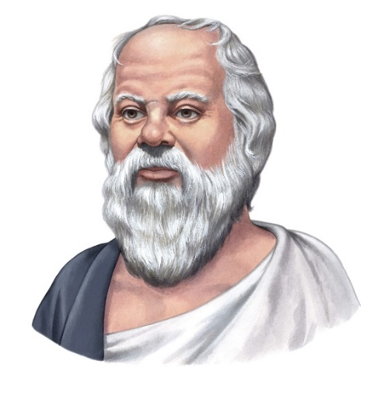
Godliness
EUSEBEIA – “reverence, respect, piety towards God; godliness; holiness”
Greeks hero: Socrates “He was so pious and devoutly religious that he would take no step apart from the will of heaven.
So just and upright that he never did even a trifling injury to any living soul;
so self-controlled, so temperate, that he never at any time chose the sweeter instead of the better;
so sensible, so wise, and so prudent that in distinguishing the better from the worse he never erred.”
“The unexamined life is not worth living”
Spoken at his trial for impiety for corrupting the minds of youth with his quest for truth using Socratic method (questions)
always challenging the status quo

Slide 6
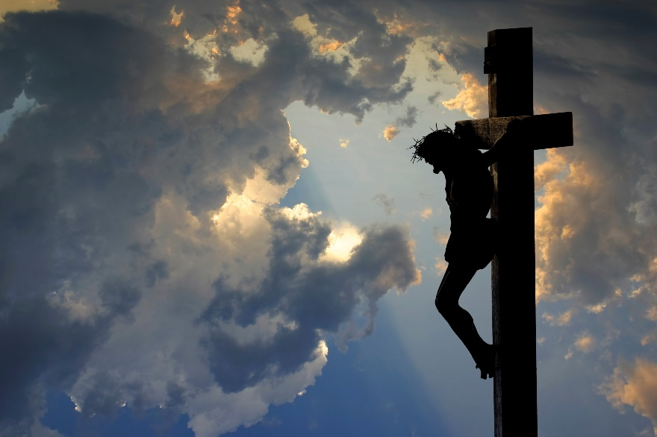
Godliness
EUSEBEIA – “reverence, respect, piety towards God; godliness; holiness”
Our hero: Jesus the Messiah “I and my Father are one.” - John 10:30 "And He who sent Me is with Me. The Father has not left Me alone, for I always do those things that please Him.“ - John 8:29 Jesus said to them, "My food is to do the will of Him who sent Me, and to finish His work. - John 4:34

Slide 7
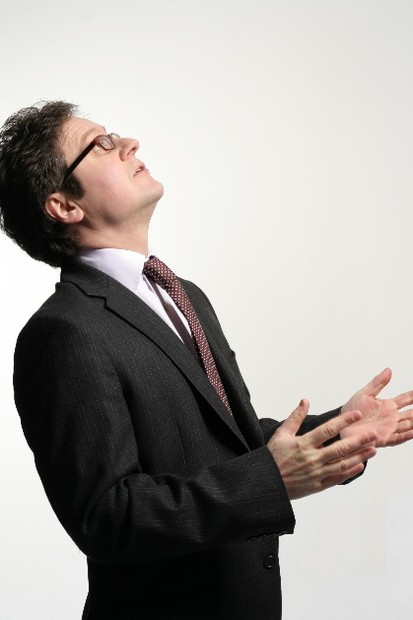
Godliness
EUSEBEIA – “reverence, respect, piety towards God; godliness; holiness”
Godliness = God-toward-ness
I Timothy 2:2 Therefore I exhort first of all that supplications, prayers, intercessions, giving of thanks be made for all men … that we may lead a quiet and peaceable life in all godliness and reverence.
I Timothy 3:16 And without controversy great is the mystery of godliness: …
Heaven’s
Direction

Slide 8
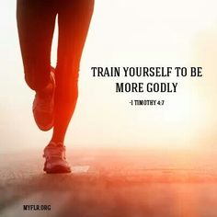
Godliness
EUSEBEIA – “reverence, respect, piety towards God; godliness; holiness”
Godliness = is hard work !
I Timothy 4:7-8 …exercise yourself toward godliness. For bodily exercise profits a little, but godliness is profitable for all things, having promise of the life that now is and of that which is to come.

Slide 9
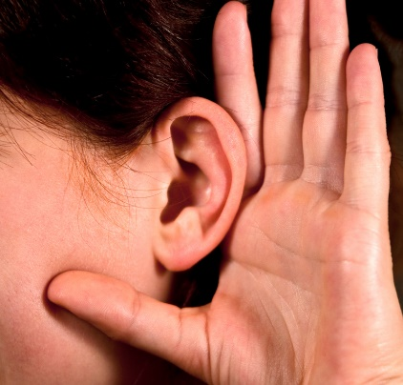
Godliness
EUSEBEIA – “reverence, respect, piety towards God; godliness; holiness”
Godliness = what sound teaching produces in hearers
I Timothy 6:3, 6, 11 3 If anyone teaches otherwise and does not consent to wholesome words, even the words of our Lord Jesus Christ, and to the doctrine which accords with godliness, …
6 Now godliness with contentment is great gain…
11 But you, O man of God, flee these things and pursue righteousness, godliness, faith, love, patience, gentleness

Slide 10
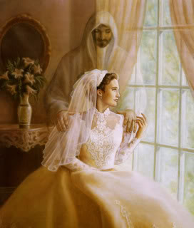
Godliness
EUSEBEIA – “reverence, respect, piety towards God; godliness; holiness”
Godliness = anticipation
2 Peter 3:11-12 Therefore, since all these things will be dissolved, what manner of persons ought you to be in holy conduct and godliness, looking for and hastening the coming of the day of God
Rev. 21:2 Then I, John, saw the holy city, New Jerusalem, coming down out of heaven from God, prepared as a bride adorned for her husband.

Slide 11
Godliness
EUSEBEIA – “reverence, respect, piety towards God; godliness; holiness”
Godliness = living and looking for Him
Titus 2:11-14 “For the grace of God that brings salvation has appeared to all men, teaching us that, denying ungodliness and worldly lusts, we should live soberly, righteously, and godly in the present age, looking for the blessed hope and glorious appearing of our great God and Savior Jesus Christ”

Slide 12
Godliness
EUSEBEIA – “reverence, respect, piety towards God; godliness; holiness”
Awareness of God in all I do
Ephesians 5:22 Wives, submit to your own husbands, as to the Lord.
Ephesians 6:7 Masters…with goodwill doing service, as to the Lord, and not to men.
Colossians 3:23 And whatever you do, do it heartily, as to the Lord, and not to men.

Slide 13
Godliness
EUSEBEIA – “reverence, respect, piety towards God; godliness; holiness”
Awareness of God with a Desire to Please
2 Corinthians 5:9 “Therefore we make it our aim, whether present or absent, to be well pleasing to Him.”
Colossians 1:10 “…that you may walk worthy of the Lord, fully pleasing Him”
I John 3:22 “…we keep His commandments and do those things that are pleasing in His sight.

Slide 14
My Growing Faith
God’s Grace
2 Peter 1:5-7
But also for this very reason, giving all diligence, add: to your faith virtue, to virtue knowledge,
to knowledge self-control, to self-control perseverance, to perseverance godliness,
to godliness brotherly kindness, to brotherly kindness love.
Bro. Love
Godliness
Patience
Temperance
Knowledge
Virtue
My Faith

Slide 15
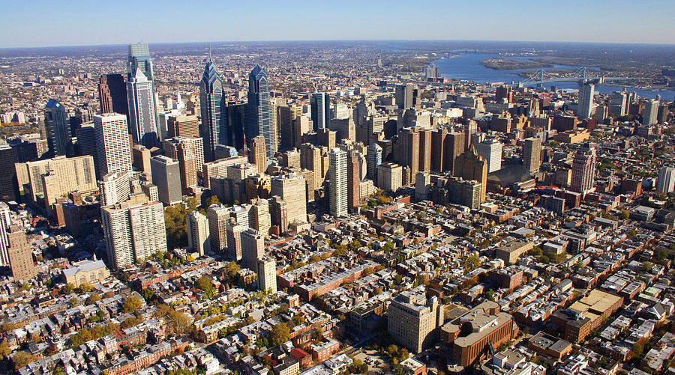
Brotherly
Kindness
PHILADELPHIA – “love of brothers / sisters; fraternal affection; love of the brethren”
City of Brotherly Love (Philadelphia)
PHILADELPHIA | VIOLENT | PROPERTY | TOTAL
Number of Crimes | 16,143 | 49,378 | 65,521
Crime Rate (per 1,000 residents) | 10.30 | 31.50 | 41.80

Slide 16
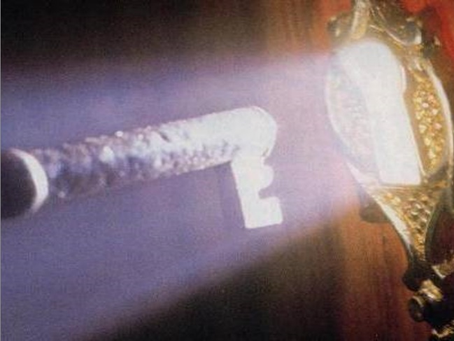
Brotherly
Kindness
PHILADELPHIA – “love of brothers / sisters; fraternal affection; love of the brethren”
New Hope
City of Brotherly Love (Philadelphia)
Revelation 3
7 "And to the angel of the church in Philadelphia write…
8 "I know your works. See, I have set before you an open door, and no one can shut it; for you have a little strength, have kept My word, and have not denied My name. 10 "Because you have kept My command to persevere, I also will keep you from the hour of trial which shall come upon the whole world, to test those who dwell on the earth.

Slide 17
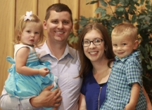
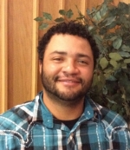
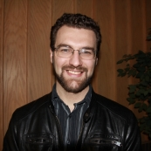
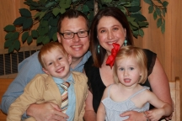
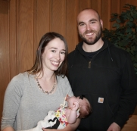
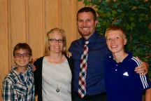
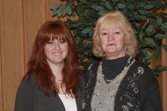
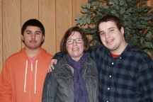
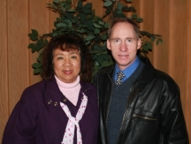
Brotherly
Kindness
PHILADELPHIA – “love of brothers / sisters; fraternal affection; love of the brethren”
City of Brotherly Love (Northwest Church)

Slide 18
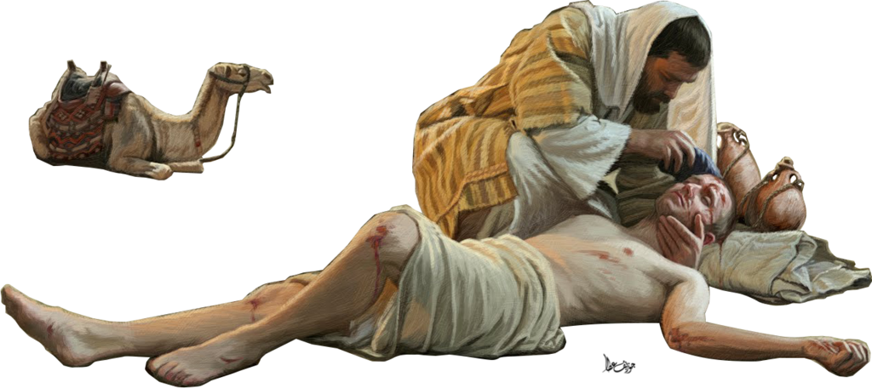
Brotherly
Kindness
Godliness leads to Brotherly Kindness
I John 4:20-21
If someone says, "I love God," and hates his brother, he is a liar; for he who does not love his brother whom he has seen, how can he love God whom he has not seen?
And this commandment we have from Him: that he who loves God must love his brother also.

Slide 19
Brotherly
Kindness
Paul: I Love You, brother!
Romans 12:10
Be kindly affectionate to one another with brotherly love, in honor giving preference to one another”
I Thessalonians 4:9
But concerning brotherly love you have no need that I should write to you, for you yourselves are taught by God to love one another”
Hebrews 13:1
Let brotherly love continue.

Slide 20
Brotherly
Kindness
John: The Apostle of Love
John 13:34
"A new commandment I give to you, that you love one another; as I have loved you, that you also love one another.
John 15:12, 17
"This is My commandment, that you love one another as I have loved you.
"These things I command you, that you love one another.

Slide 21
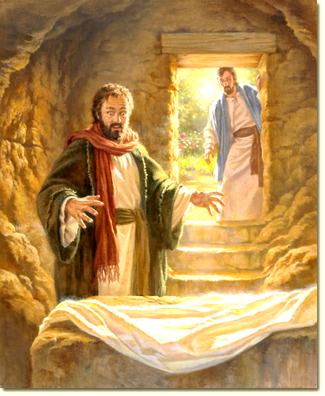
Brotherly
Kindness
Peter: The Apostle Who Learned Love
I Peter 1:22
Since you have purified your souls in obeying the truth through the Spirit in sincere love of the brethren, love one another fervently with a pure heart”

Slide 22
My Growing Faith
God’s Grace
Godly Love
2 Peter 1:5-7
But also for this very reason, giving all diligence, add: to your faith virtue, to virtue knowledge,
to knowledge self-control, to self-control perseverance, to perseverance godliness,
to godliness brotherly kindness, to brotherly kindness love.
Bro. Love
Godliness
Patience
Temperance
Knowledge
Virtue
My Faith

Slide 23
Godly Love
AGAPE – “affection, good will, benevolence, love; a purely Biblical and ecclesiastical word”
The Kind Of Affection God Feels Toward Lost Man
John 3:16
"For God so loved the world that He gave His only begotten Son, that whoever believes in Him should not perish but have everlasting life.”
Romans 5:8
“But God demonstrates His own love toward us, in that while we were still sinners, Christ died for us.”

Slide 24
Godly Love
AGAPE – “affection, good will, benevolence, love; a purely Biblical and ecclesiastical word”
The Most Powerful Force In The Universe
Romans 8:35,39
“Who shall separate us from the love of Christ? Shall tribulation, or distress, or persecution, or famine, or nakedness, or peril, or sword? … For I am persuaded that neither death nor life, nor angels nor principalities nor powers, nor things present nor things to come, nor height nor depth, nor any other created thing, shall be able to separate us from the love of God which is in Christ Jesus our Lord.
I Corinthians 13
“Now abides faith, hope, love, these three; but the greatest of these is love”

Slide 25
Godly Love
AGAPE – “affection, good will, benevolence, love; a purely Biblical and ecclesiastical word”
A New Commandment
Philia – mutual affection between brothers
Eros – mutual affection between lovers
Storge – mutual affection between family
Agape – reversed! Not mutual, but sacrificial on behalf of the person, even undeserved.
John 13:34 "A new commandment I give to you, that you love one another; as I have loved you, that you also love one another.

Slide 26
Godly Love
AGAPE – “affection, good will, benevolence, love; a purely Biblical and ecclesiastical word”
God Loves Me – I Love God
All my heart – emotionally, deeply, personally
All my soul – passionately, who and what I am
All my mind – intellectually, education (Ph.d in “God”)
All my strength – energetically (Col. 3:23)
Mark 12:30 'And you shall love the LORD your God with all your heart, with all your soul, with all your mind, and with all your strength.' This is the first commandment.

Slide 27
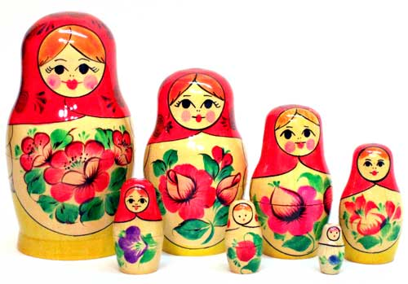
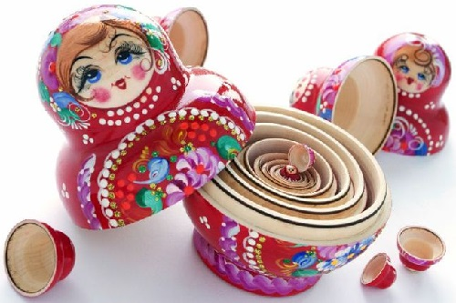
Godly Love
AGAPE – “affection, good will, benevolence, love; a purely Biblical and ecclesiastical word”
God Loves Me – I Love God
613 Laws
10 Commands
2 Principles
Russian Nesting Dolls

Slide 28
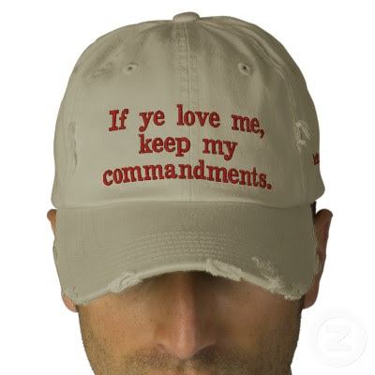
Godly Love
AGAPE – “affection, good will, benevolence, love; a purely Biblical and ecclesiastical word”
God Loves Me – I Love God
I John 5:2 “By this we know that we love the children of God, when we love God and keep His commandments.
John 14:15 “If you love Me, keep My commandments.”

Slide 29
My Growing Faith
God’s Grace
Godly Love
2 Peter 1:5-7
But also for this very reason, giving all diligence, add: to your faith virtue, to virtue knowledge,
to knowledge self-control, to self-control perseverance, to perseverance godliness,
to godliness brotherly kindness, to brotherly kindness love.
Bro. Love
Godliness
Patience
Temperance
Knowledge
Virtue
My Faith

Slide 30
A Sure Thing
God’s Grace
My Faith
2 Peter 1:10-11
Therefore, brethren, be even more diligent to make your call and election sure, for if you do these things you will never stumble; for so an entrance will be supplied to you abundantly into the everlasting kingdom of our Lord and Savior Jesus Christ.
Grand Entrance
Steady
Alert
20/20 Vision
Fruitful
Useful

