Slide 1
Prayer & God’s POWER

Slide 2
Prayers to God: “Meaningless Platitudes”
Inside Article: “Prayers aren’t working.”
“Instead, America needs stricter gun-control laws!”
“Stop thinking. Stop praying. Another mass shooting. Another deluge of tweeted prayers. Seems to have been an ineffective strategy so far.”
“Dear ‘thoughts and prayers’ people: Please shut up and slink away. You are the problem, and everyone knows it.”
Interpretation: Either “There is no God” or “Prayer is useless” or “God is powerless”

Slide 3
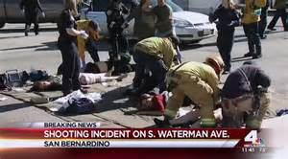
Can God Fix This?
Yes!

Slide 4
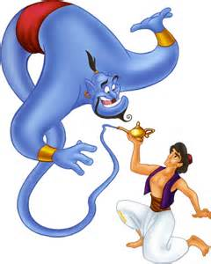
Can God Fix This?
God is not a “Genie”
God hears: I John 5:14
God cares: I Peter 5:6-7
Now this is the confidence that we have in Him, that if we ask anything according to His will, He hears us.
confidence
anything
Therefore humble yourselves under the mighty hand of God, that He may exalt you in due time, casting all your care upon Him, for He cares for you.
in due time

Slide 5
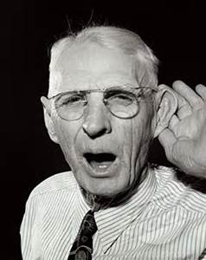
God Is Not The Problem
God is not deaf or hard of hearing
Sin is the problem: Isaiah 59:1-2
Behold, the LORD'S hand is not shortened, That it cannot save; Nor His ear heavy, That it cannot hear. But your iniquities have separated you from your God; And your sins have hidden His face from you, So that He will not hear.
ear heavy

Slide 6
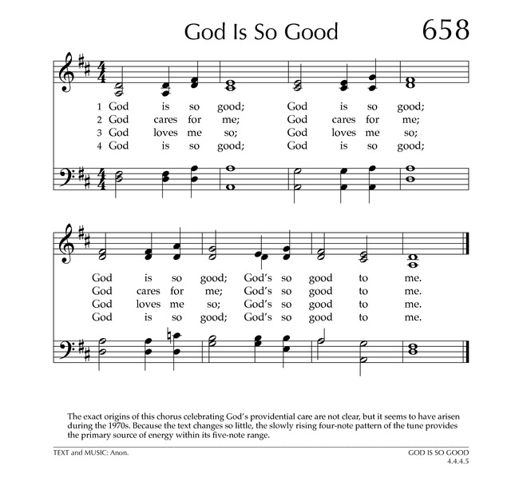
God Is …
God is good: Matthew 19:17
God is love: I John 4:8
God is holy: James 1:13
Why do you call Me good?
No one is good but One, that is, God.
He who does not love does not know God, for God is love.
Let no one say when he is tempted, "I am tempted by God"; for God cannot be tempted by evil, nor does He Himself tempt anyone.

Slide 7
Sinful Man is The Problem
All men sin: Romans 3:12, 23
Comes from the heart: Matthew 15:19
They have all turned aside; They have together become unprofitable; There is none who does good, no, not one."
For out of the heart proceed evil thoughts, murders, adulteries, fornications, thefts, false witness, blasphemies.

Slide 8
God CAN Fix This!
But Not Like Man Wants!
But Not When Man Wants!
And they cried with a loud voice, saying, "How long, O Lord, holy and true, until You judge and avenge our blood on those who dwell on the earth?“ - Revelation 6:10
“knowing this first: that scoffers will come in the last days, walking according to their own lusts, and saying, "Where is the promise of His coming?” - 2 Peter 3:3-4

Slide 9
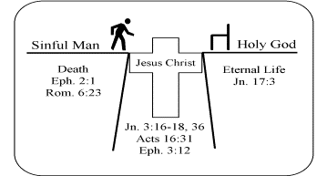
God’s FIX For Evil
Sin’s Remedy: Jesus’ Death!
Christian’s Influence: Salt – Light – Leaven
But God demonstrates His own love toward us, in that while we were still sinners, Christ died for us. - Romans 5:6-10
“You are the salt of the earth … “You are the light of the world - Matt. 5:13-14 “The kingdom of heaven is like leaven” - Matt. 13:33
Years & Generations

Slide 10
God’s Fix: Unorthodox
God’s Ways - - - unsearchable
Israel punishes Canaanites (Exo. 23:23) Assyria punishes Israel (Isa. 41:25; 2 Kgs 17) Babylon punishes Assyria (2 Chron. 32) Persia punishes Babylon (Dan. 5:30) Israel restored to Land by Persia
Romans 11:33-34 “Oh, the depth of the riches both of the wisdom and knowledge of God! How unsearchable are His judgments and His ways past finding out! For who has known the mind of the LORD? Or who has become His counselor?"
America?

Slide 11
God’s Fix: Final Solution
The Day of the Lord: 2 Peter 3:9-13
All Wrongs Are Made Right: 2 Corinth. 5:10
The Lord is not slack concerning His promise, as some count slackness, but is longsuffering toward us, not willing that any should perish but that all should come to repentance.
For we must all appear before the judgment seat of Christ, that each one may receive the things done in the body, according to what he has done, whether good or bad.

Slide 12
He Already Has !
“My thoughts and prayers are with you”

