Slide 2
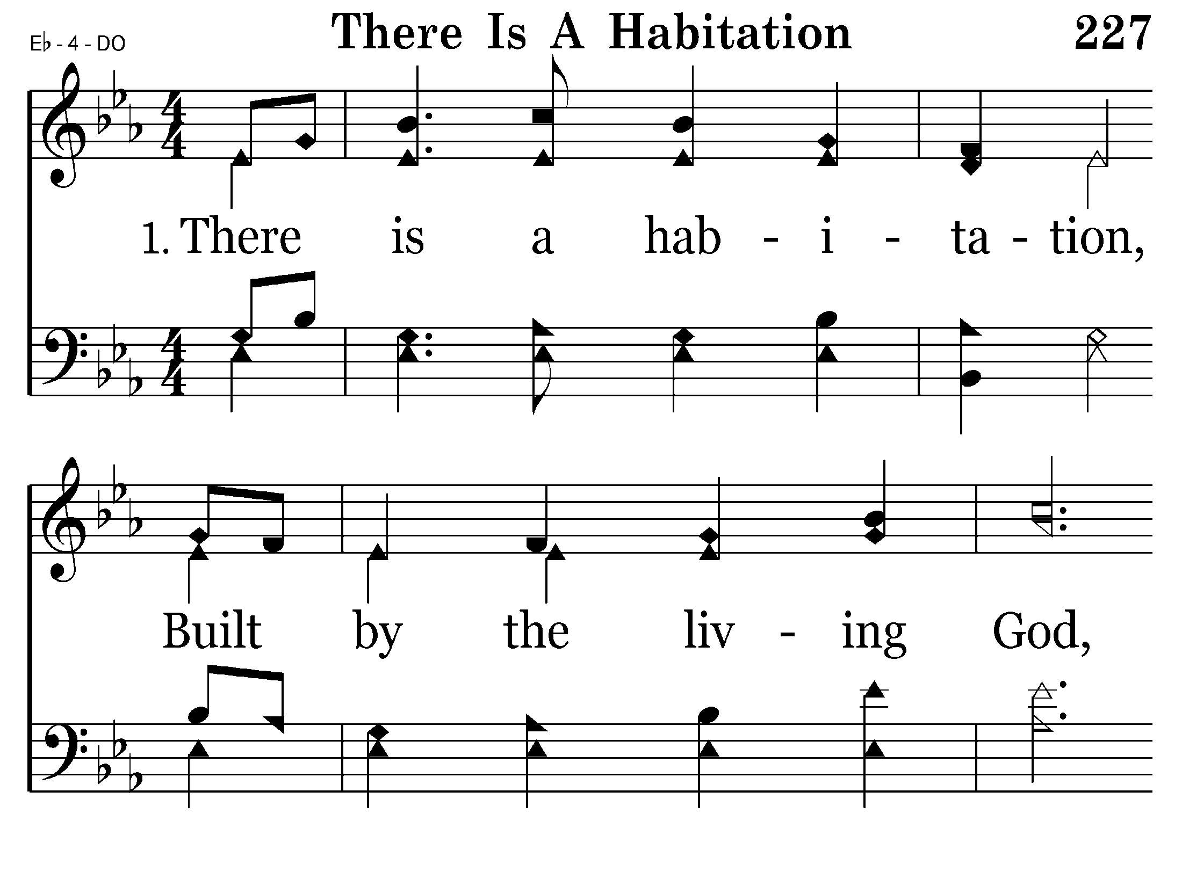
227 - There Is A Habitation - 1.1

Slide 3
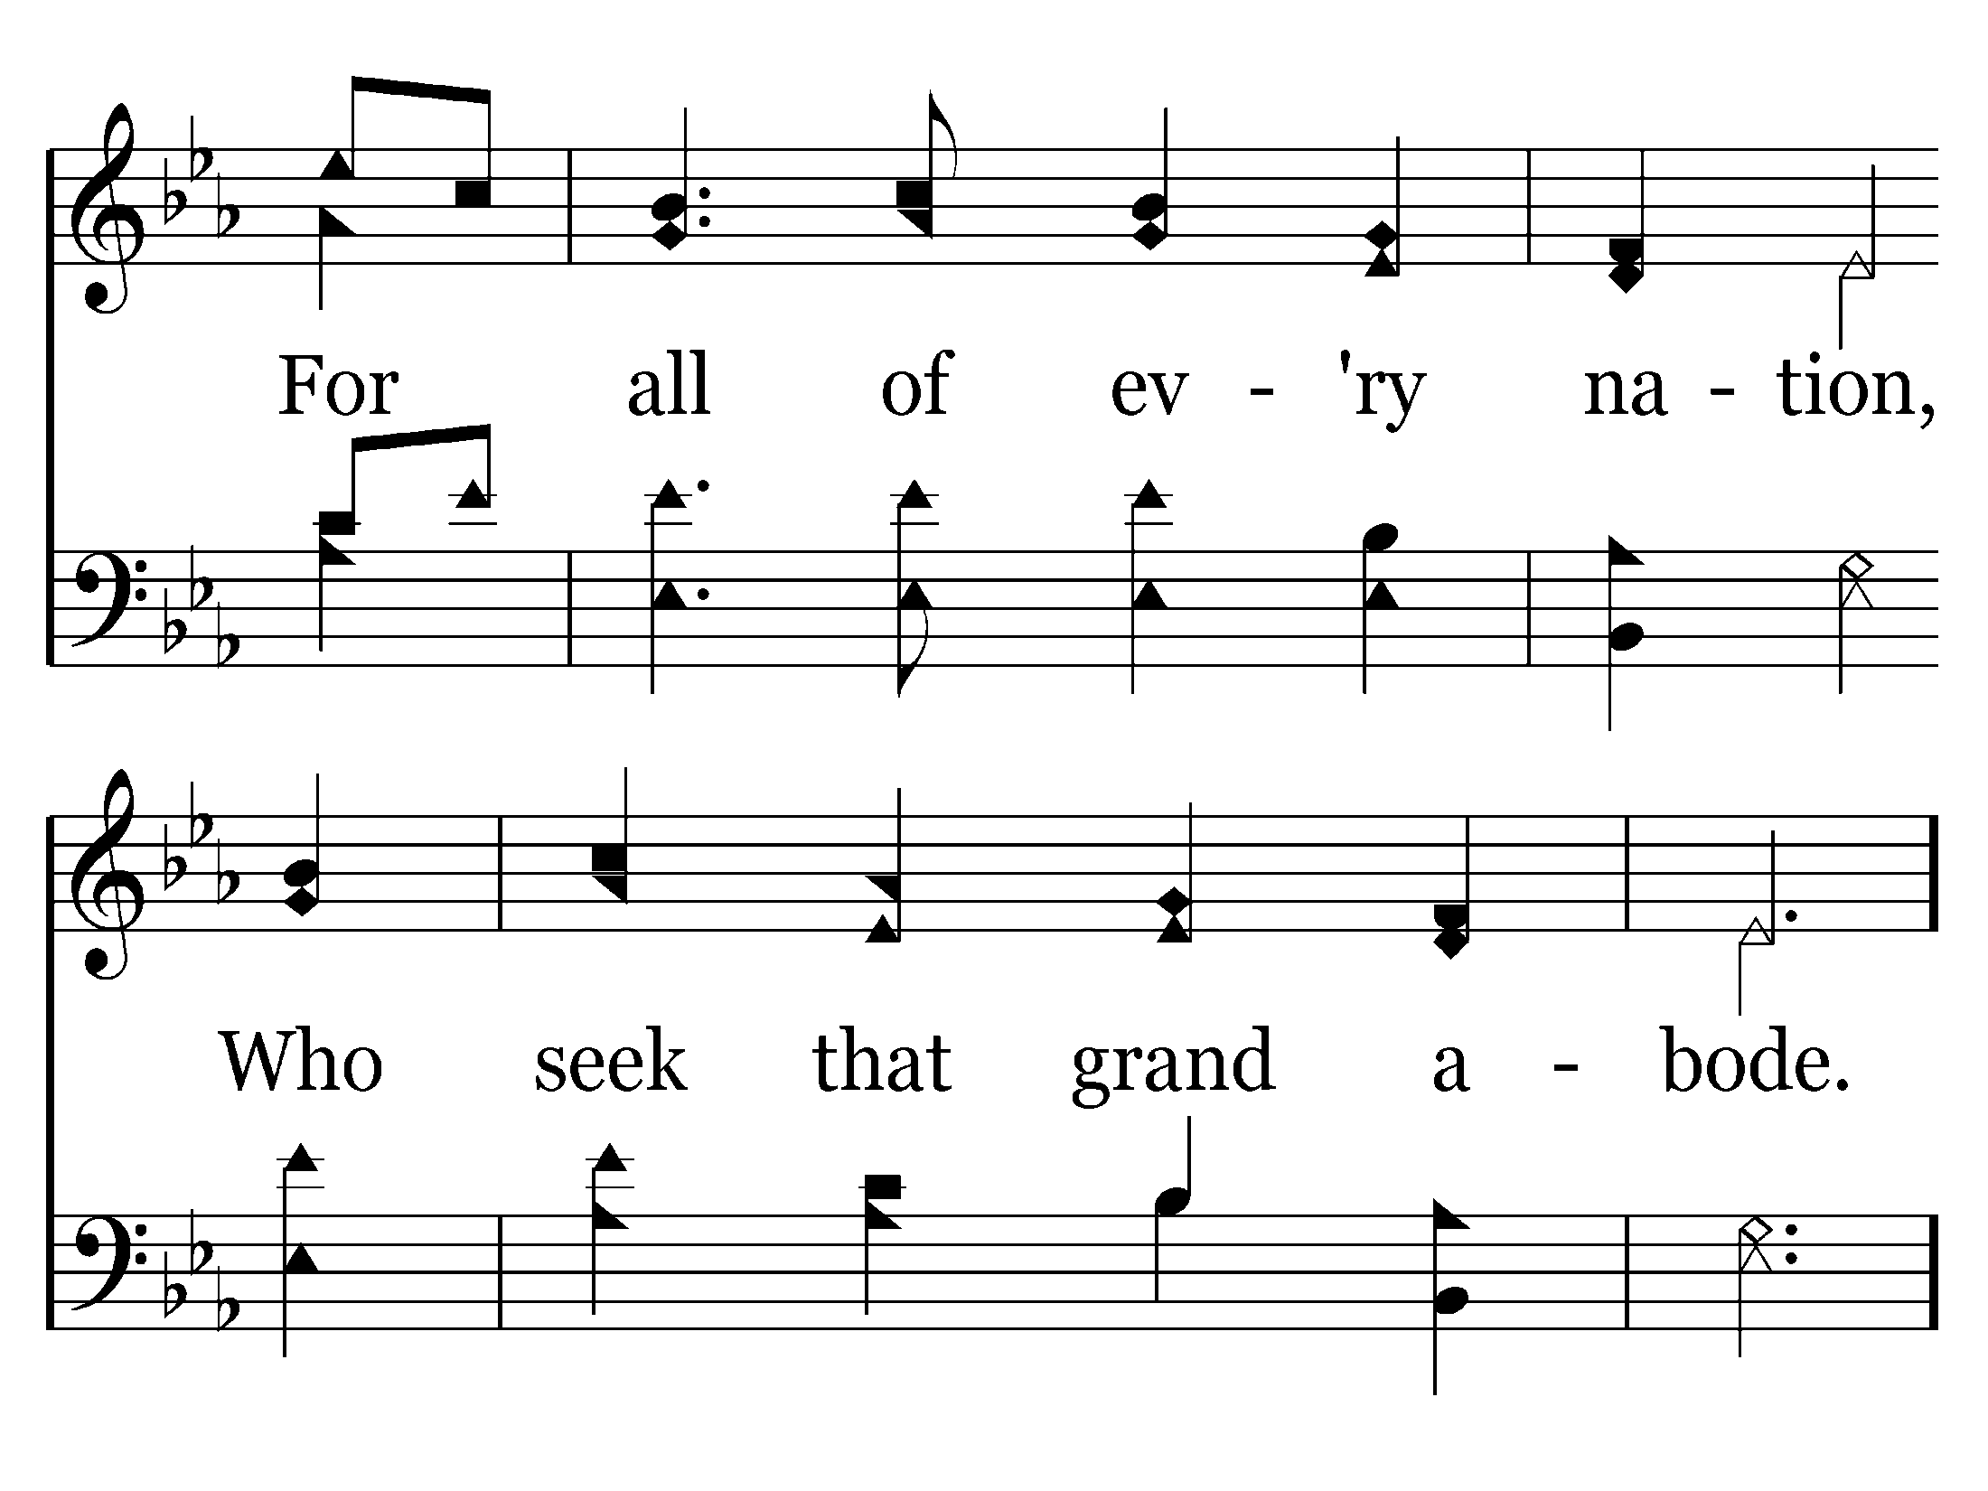
227 - There Is A Habitation - 1.2

Slide 4
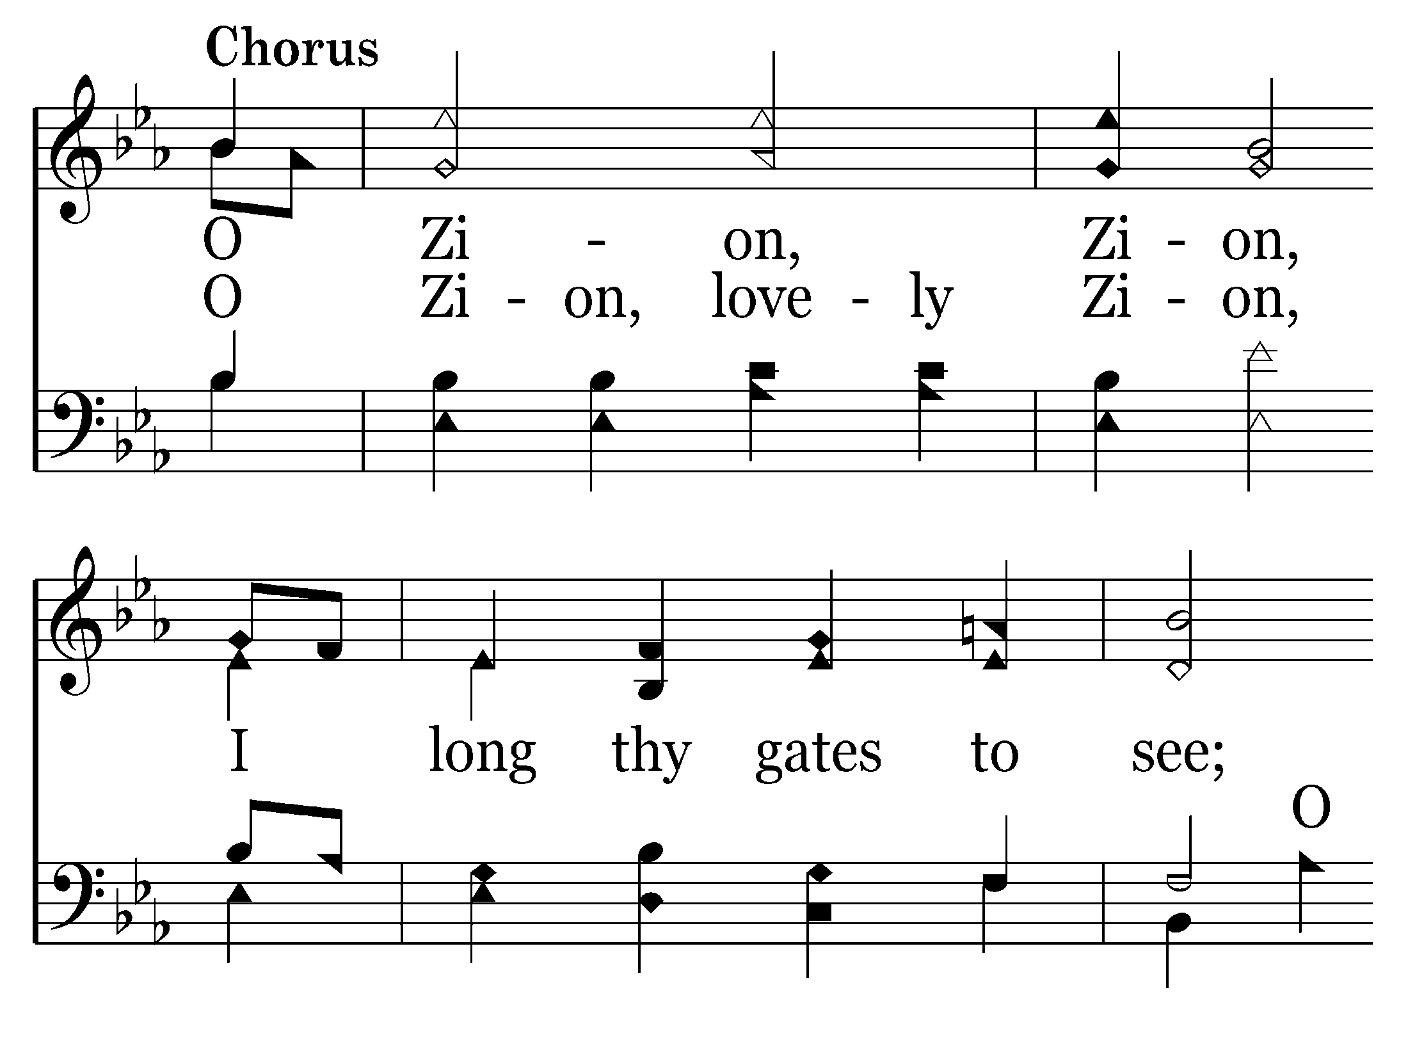
227 - There Is A Habitation - C.1

Slide 5
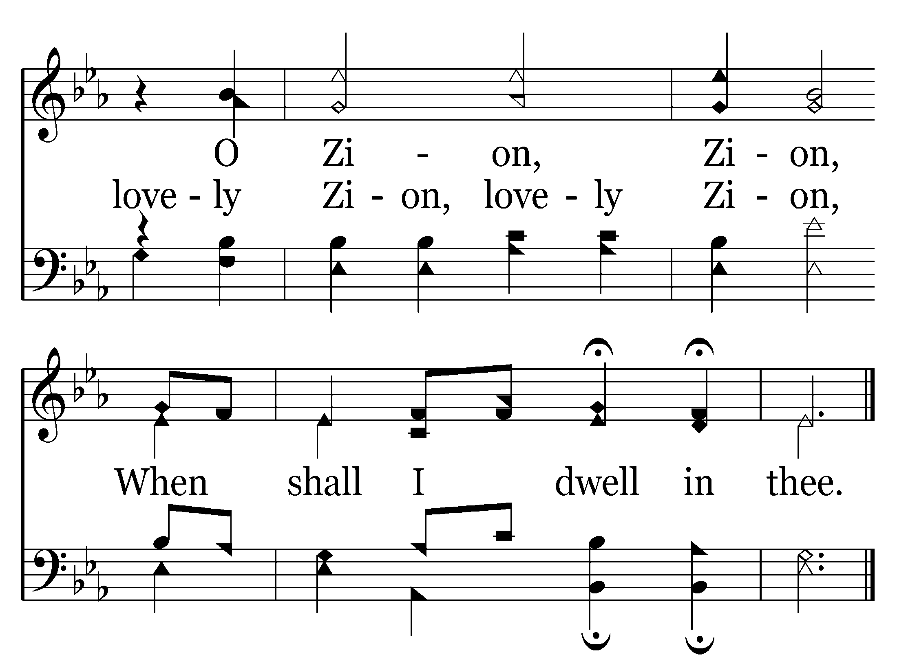
227 - There Is A Habitation - C.2
End of Verse 1

Slide 6
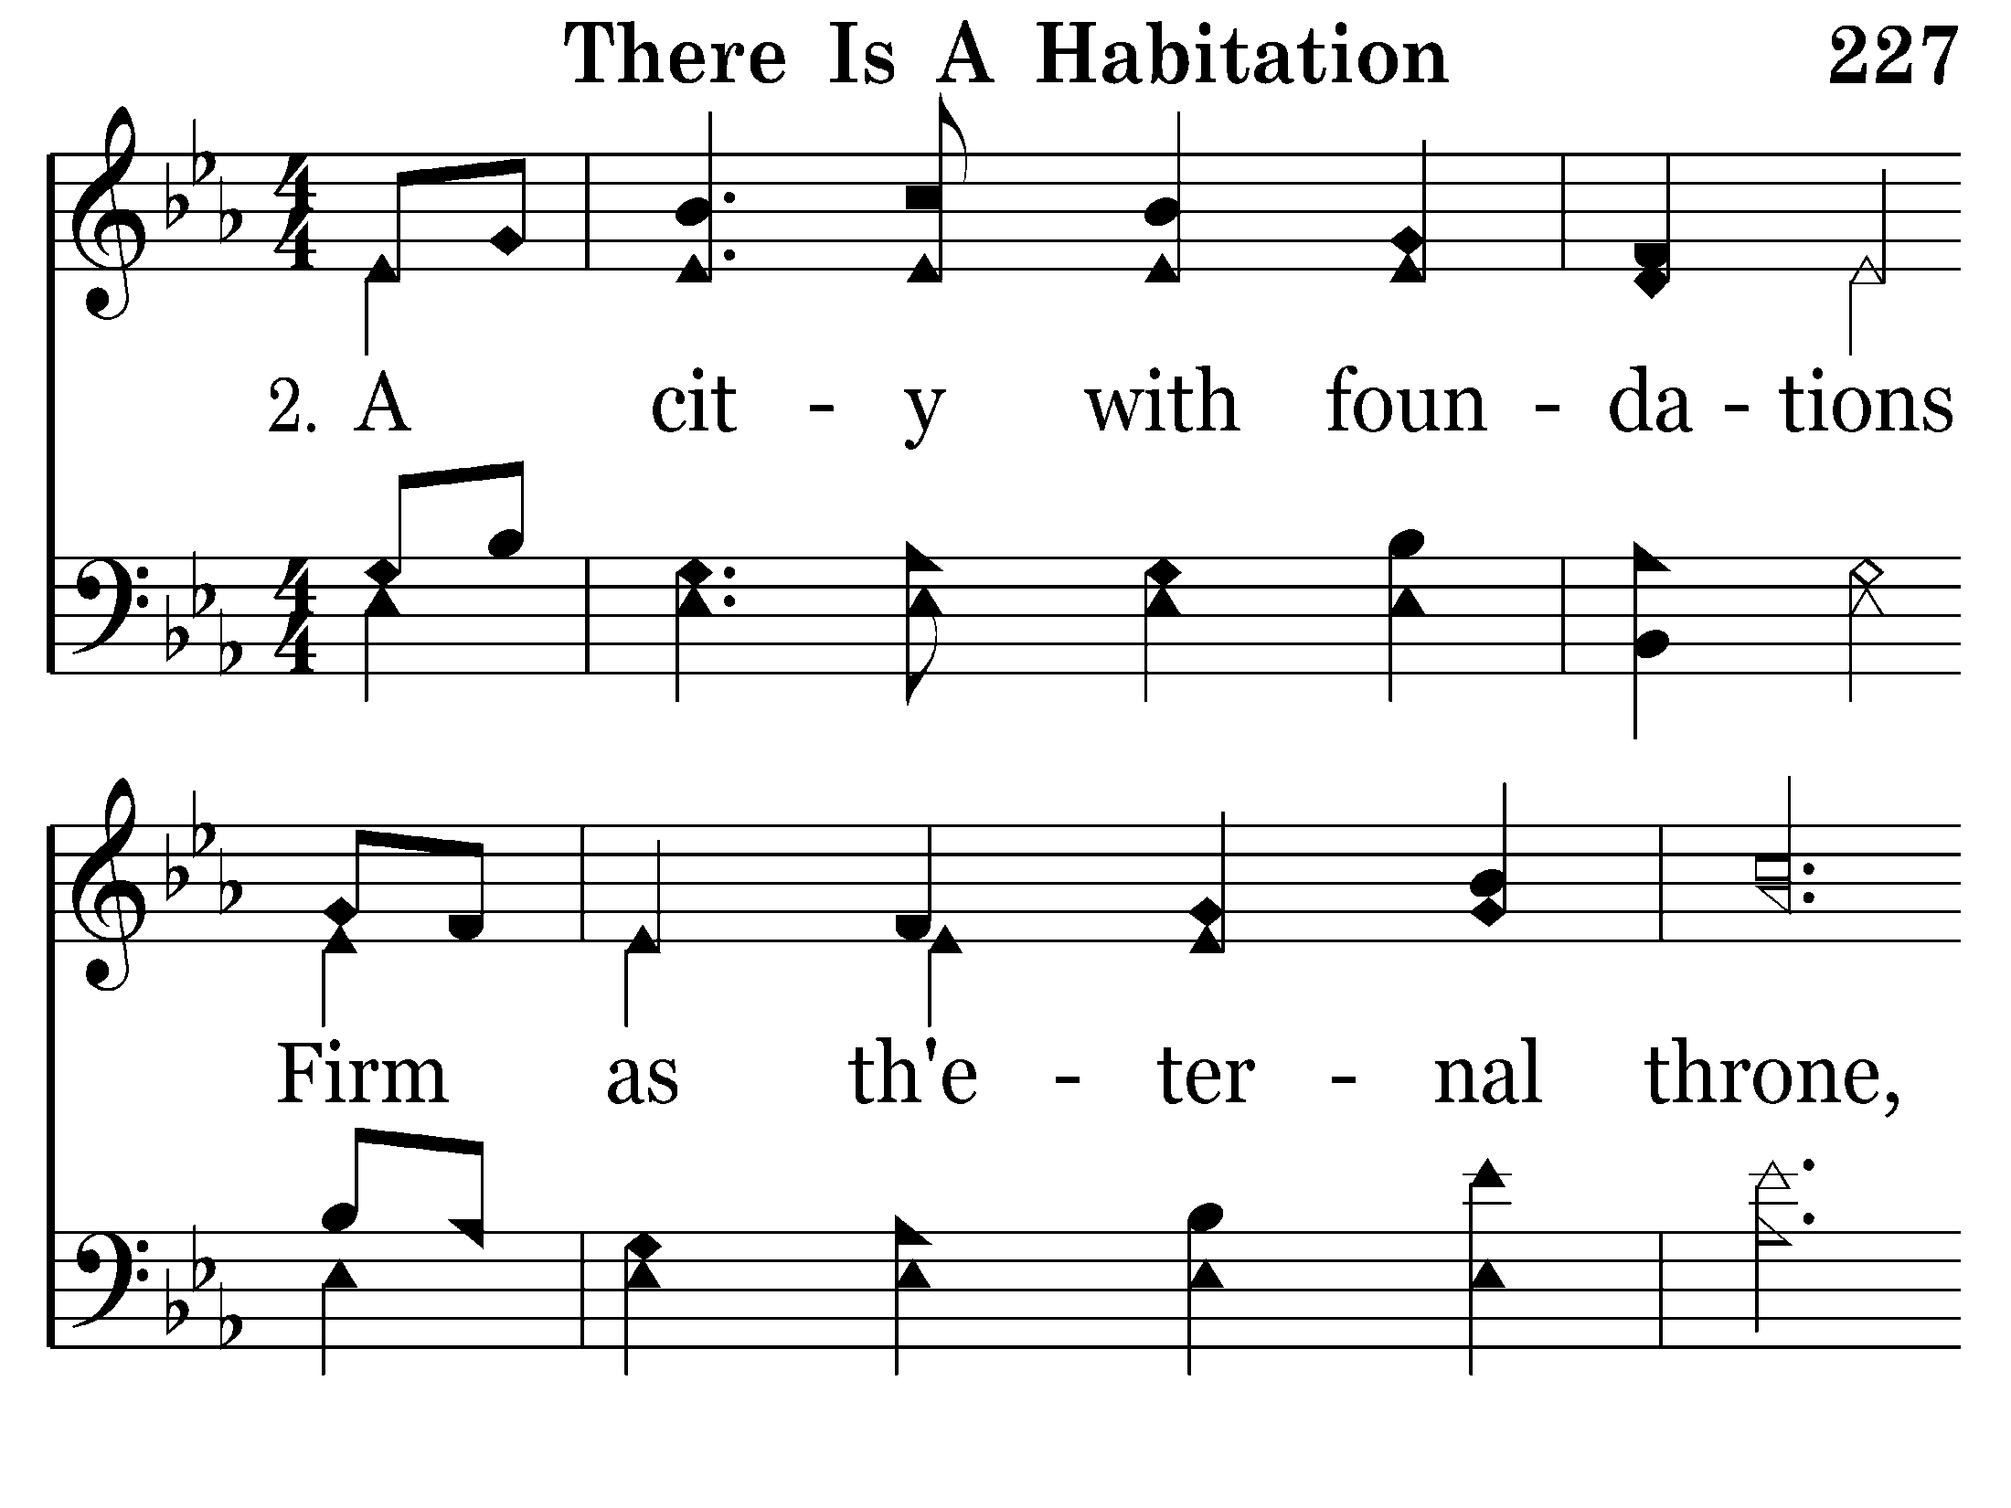
227 - There Is A Habitation - 2.1

Slide 7
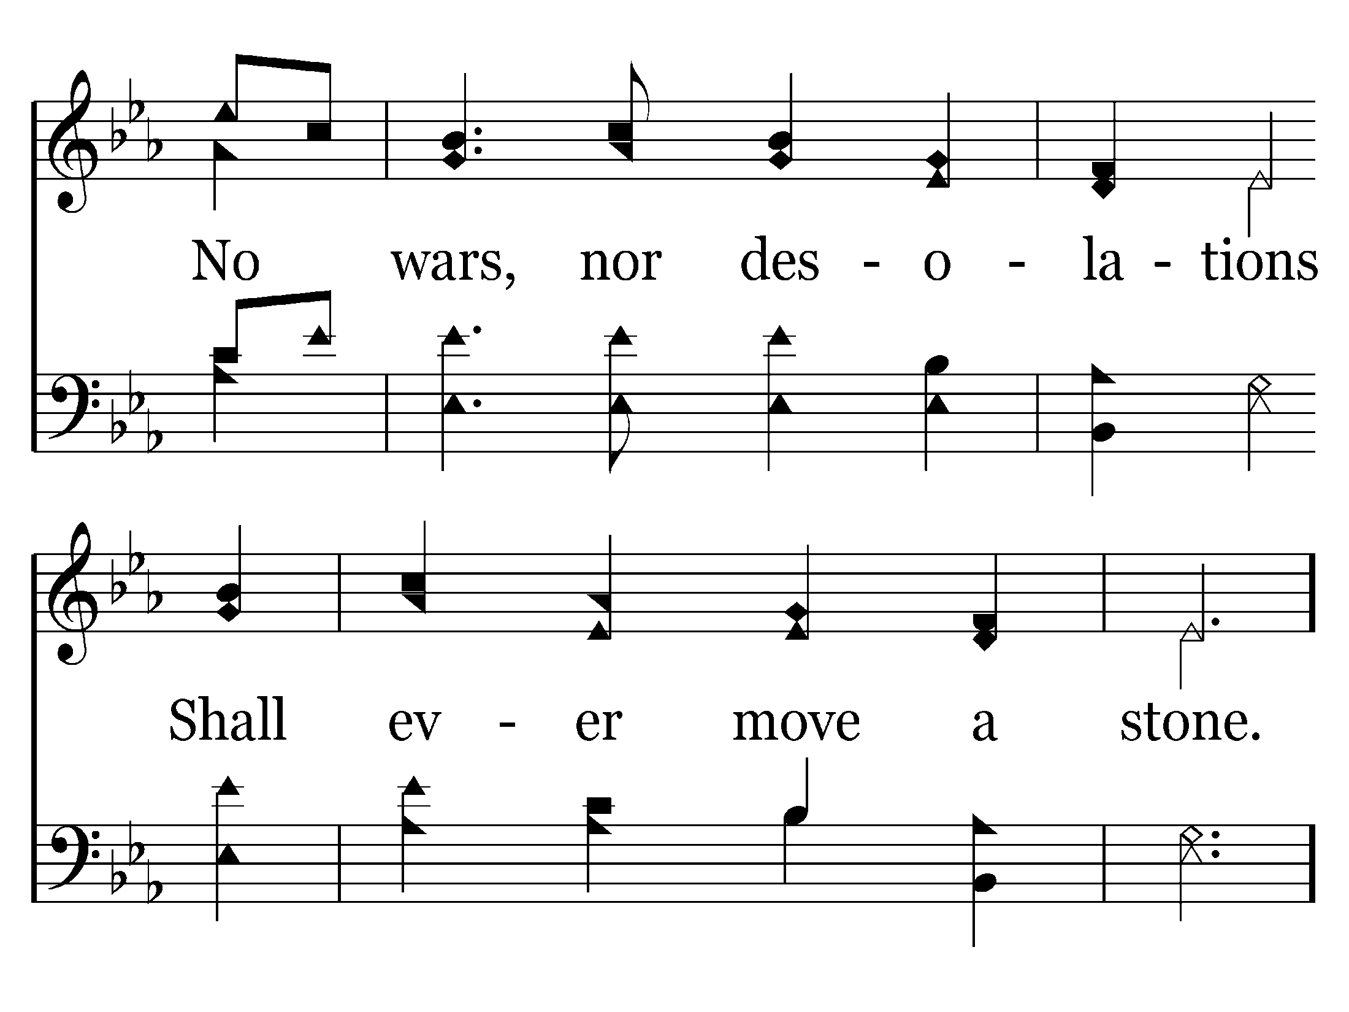
227 - There Is A Habitation - 2.2

Slide 8
227 - There Is A Habitation - C.1

Slide 9
227 - There Is A Habitation - C.2
End of Verse 2

Slide 10
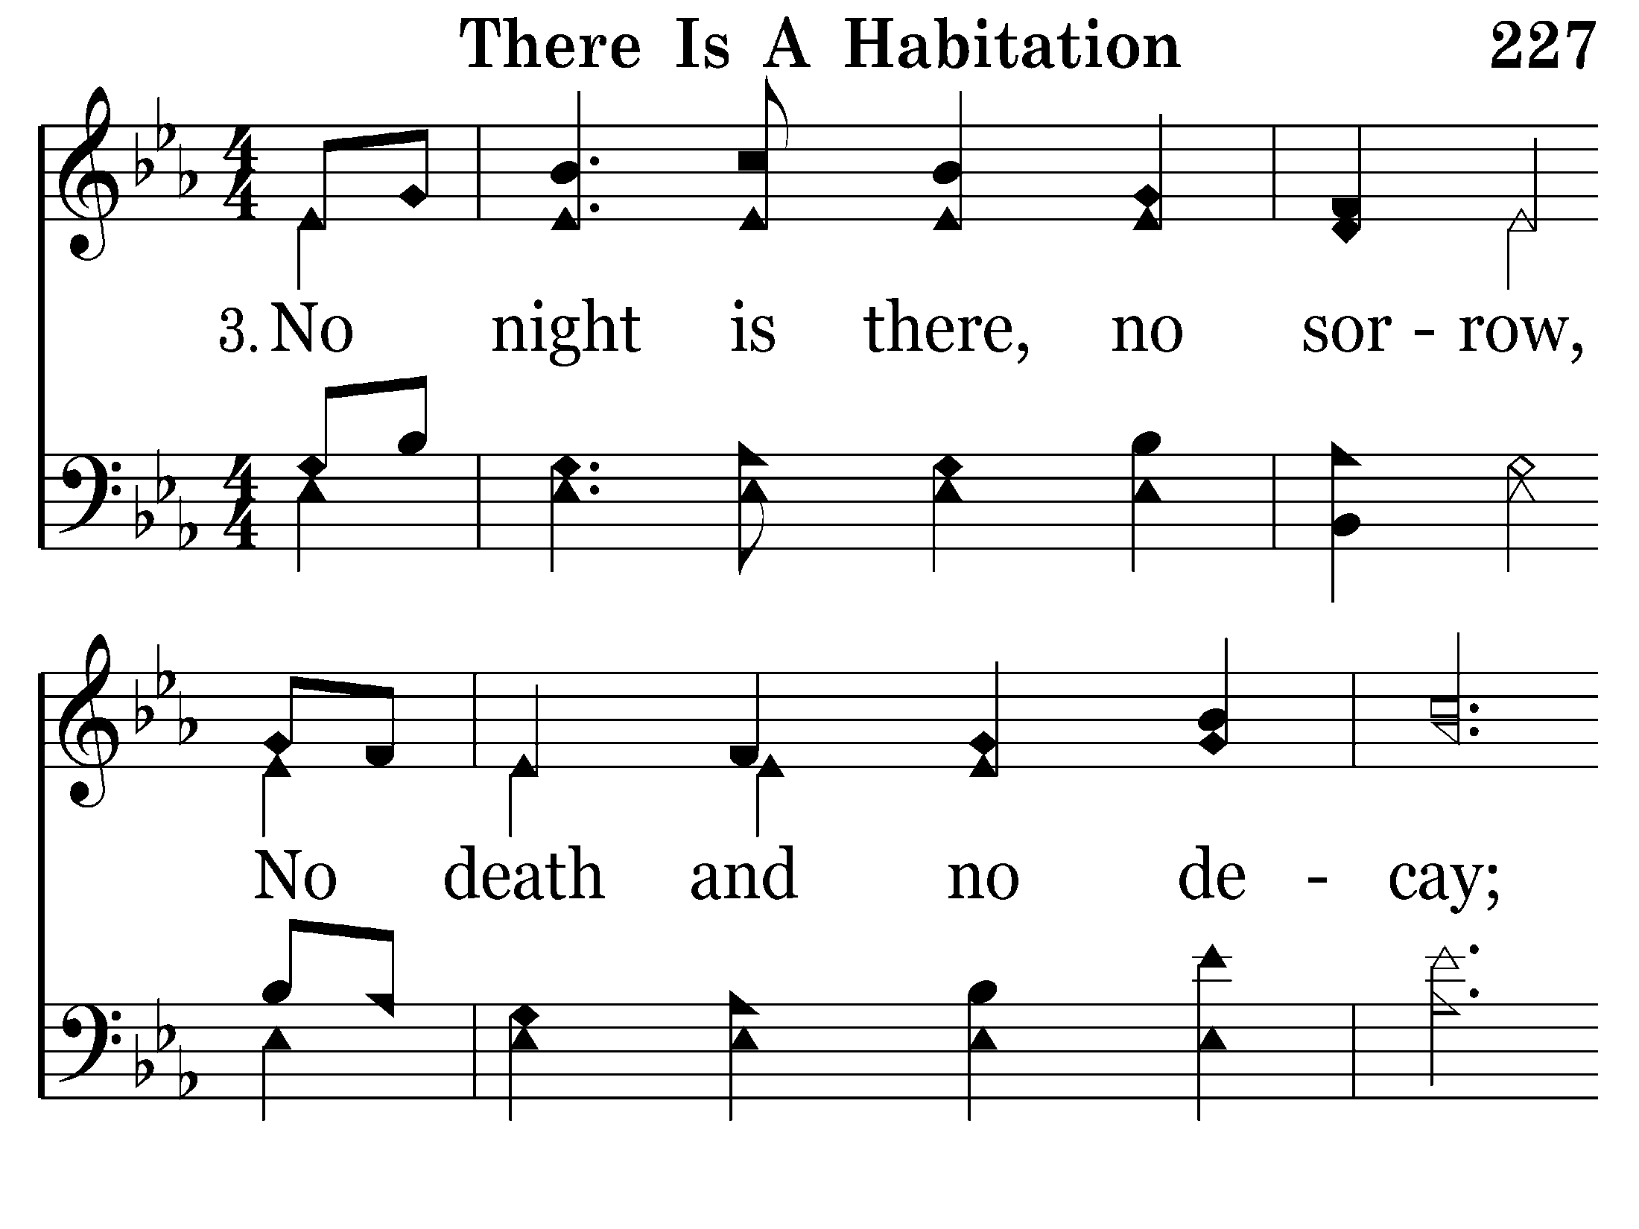
227 - There Is A Habitation - 3.1

Slide 11
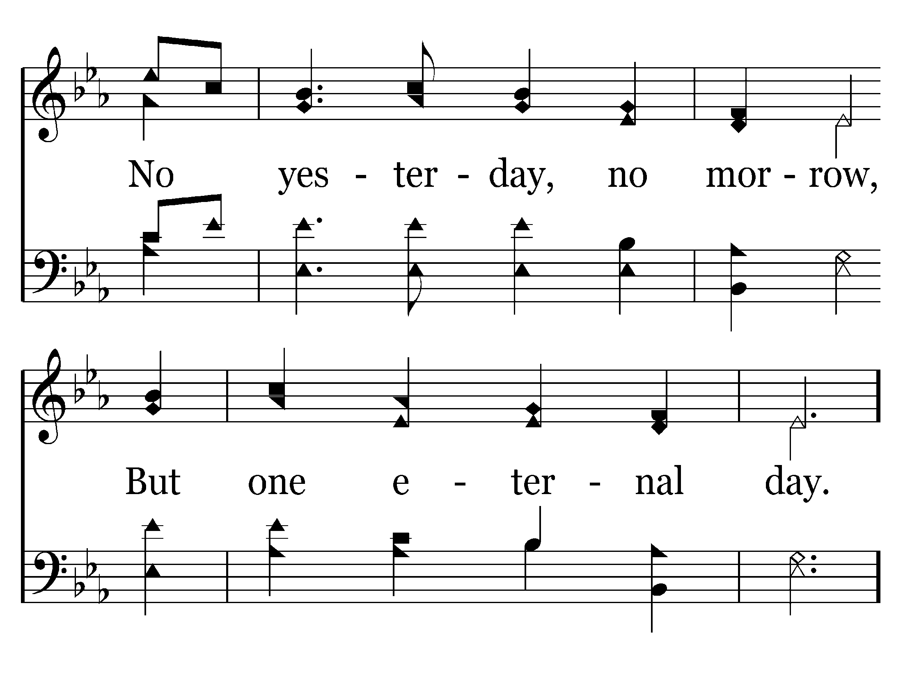
227 - There Is A Habitation - 3.2

Slide 12
227 - There Is A Habitation - C.1

Slide 13
227 - There Is A Habitation - C.2
End of Verse 3

Slide 14
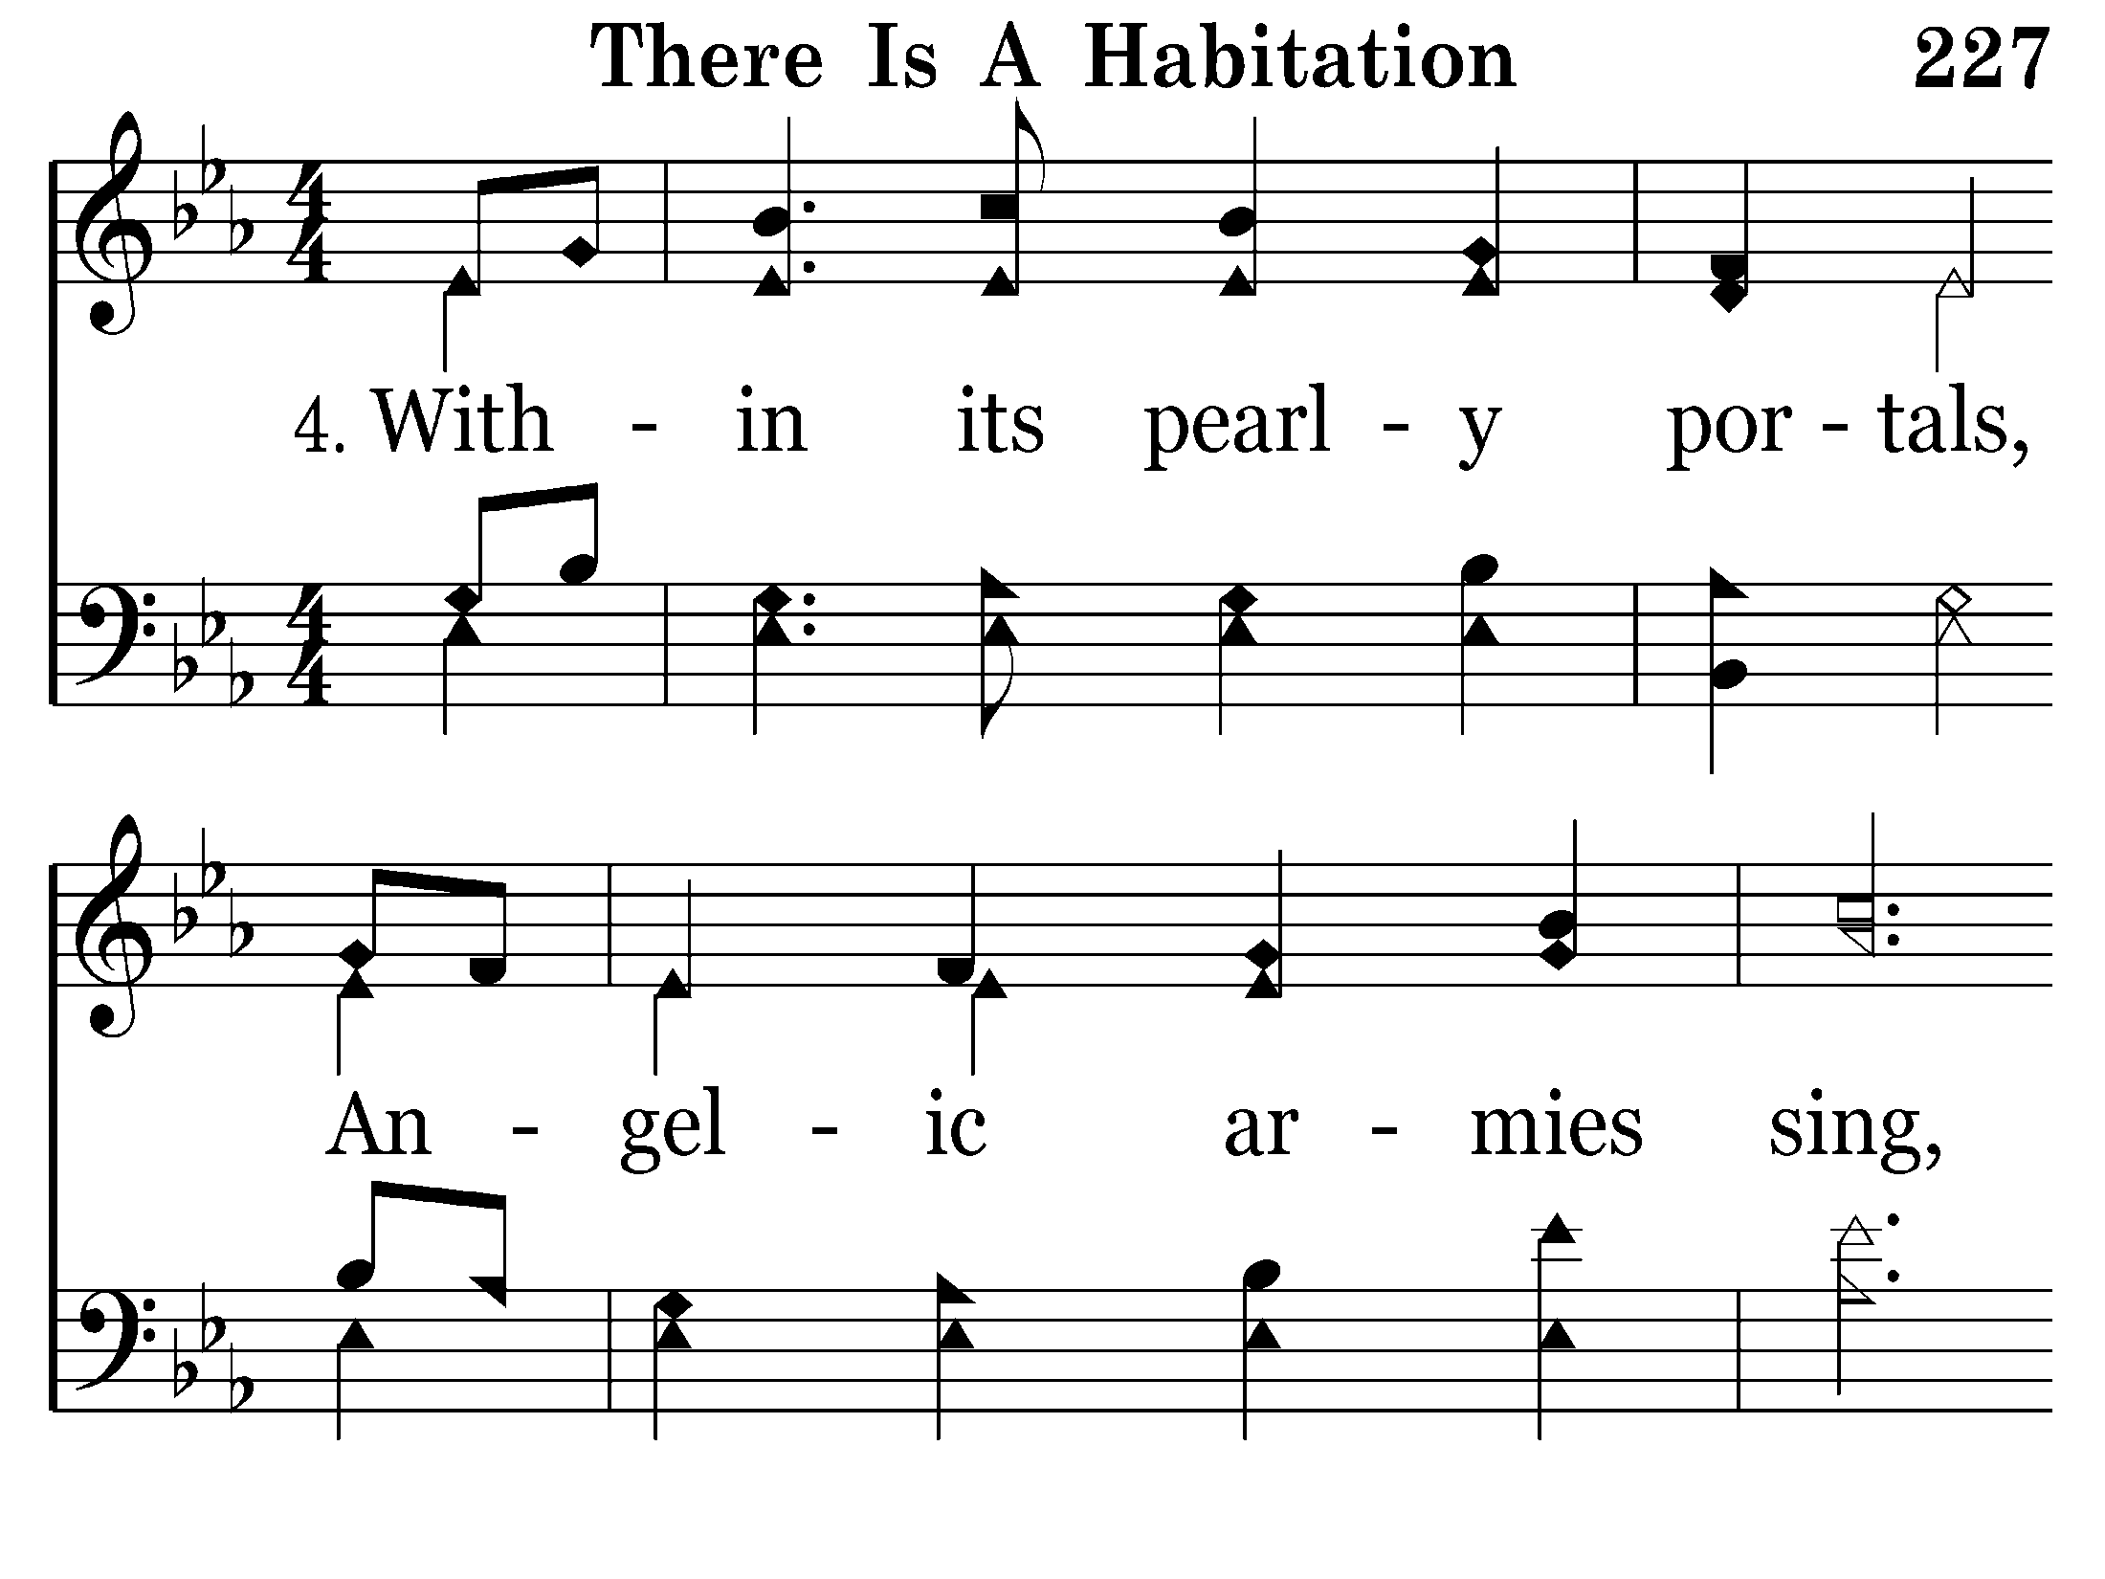
227 - There Is A Habitation - 4.1

Slide 15
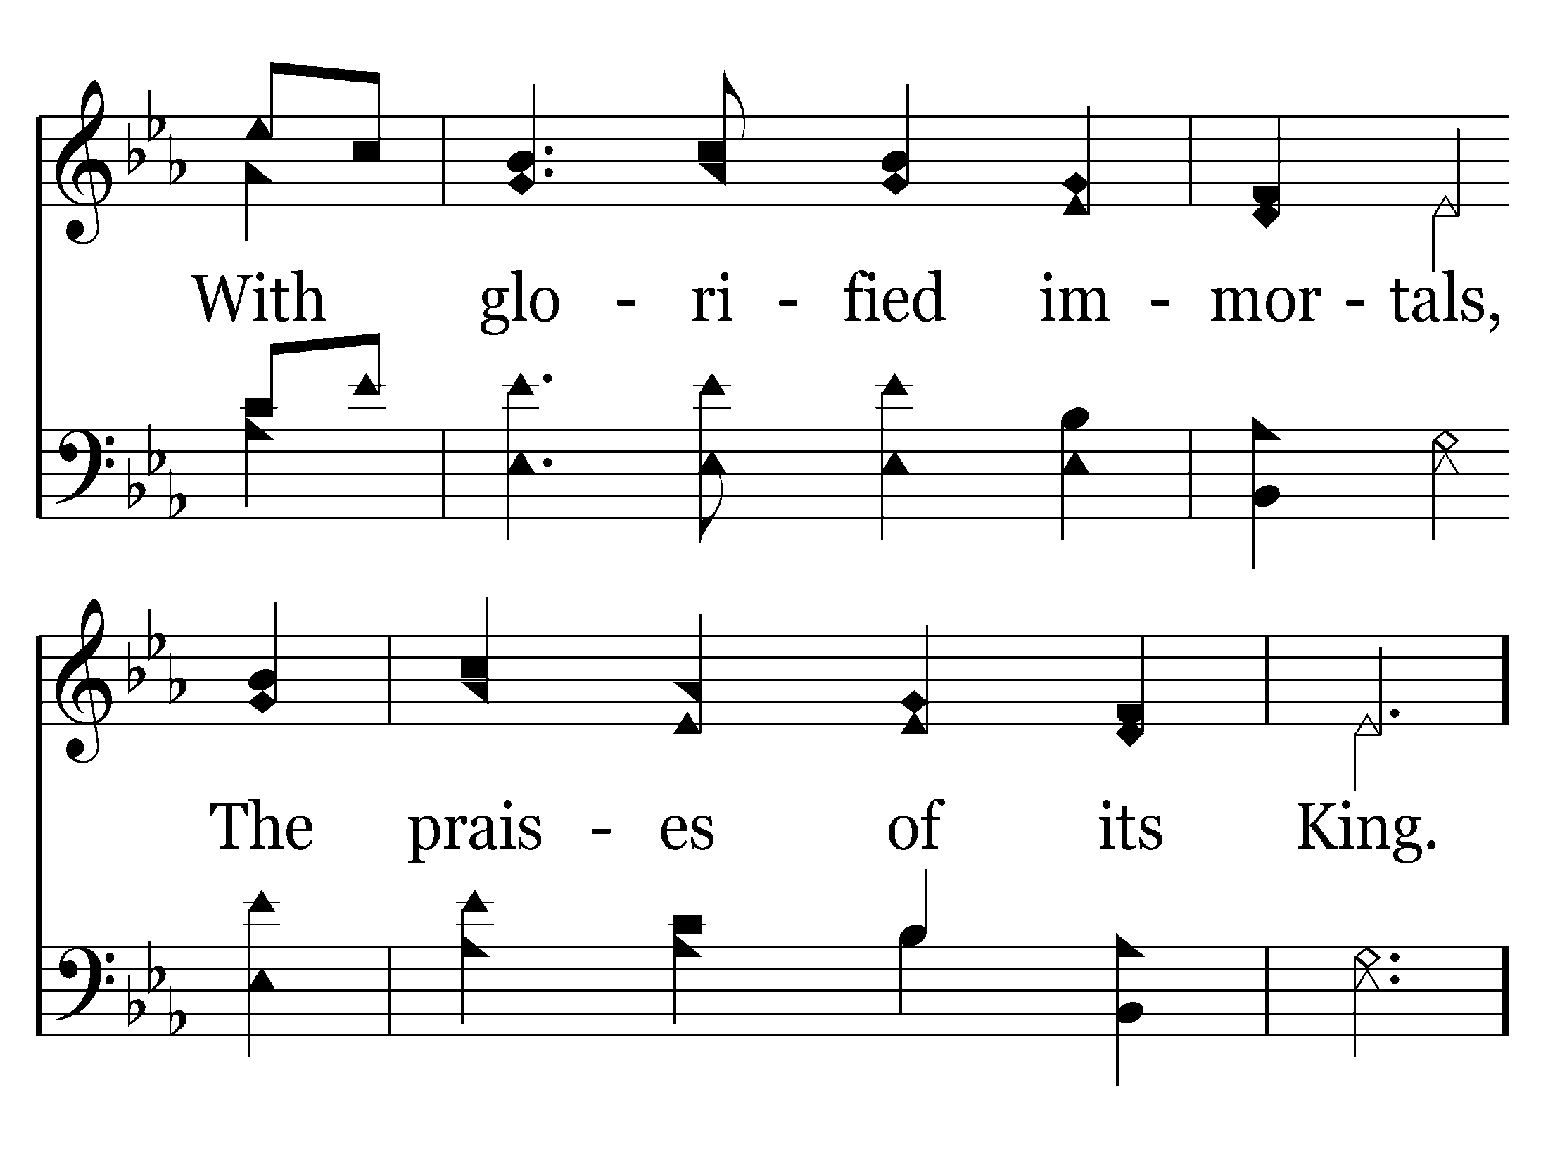
227 - There Is A Habitation - 4.2

Slide 16
227 - There Is A Habitation - C.1

Slide 17
227 - There Is A Habitation - C.2
End of Song

Slide 19
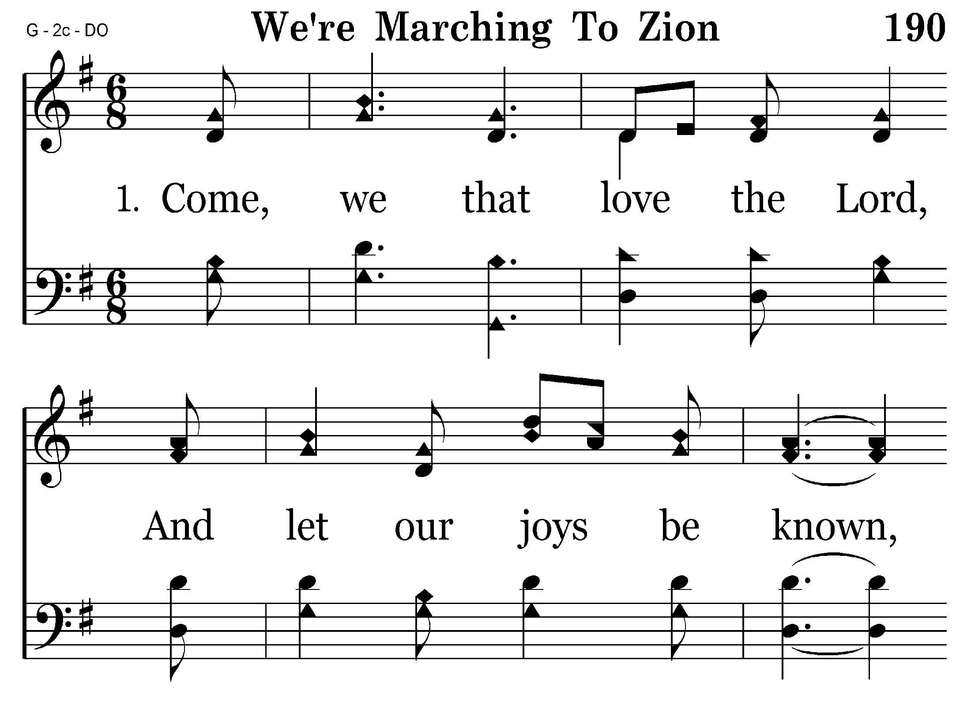
190 - We're Marching To Zion - 1.1

Slide 20
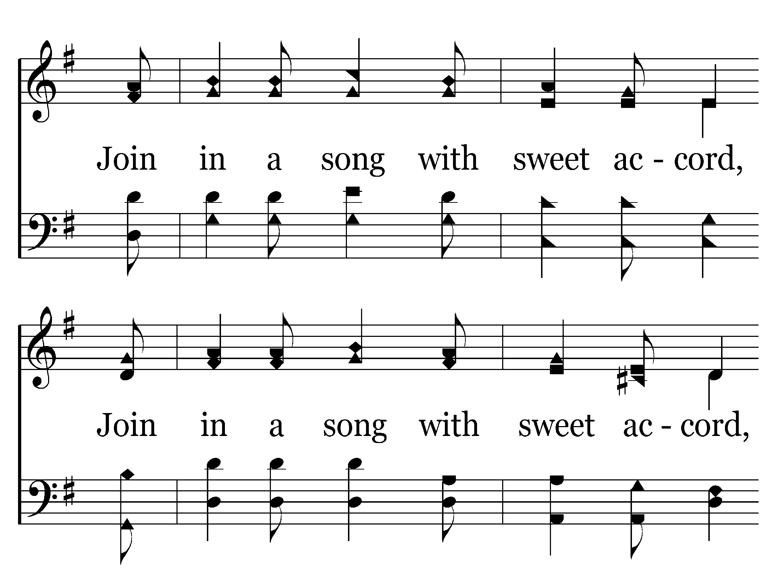
190 - We're Marching To Zion - 1.2

Slide 21
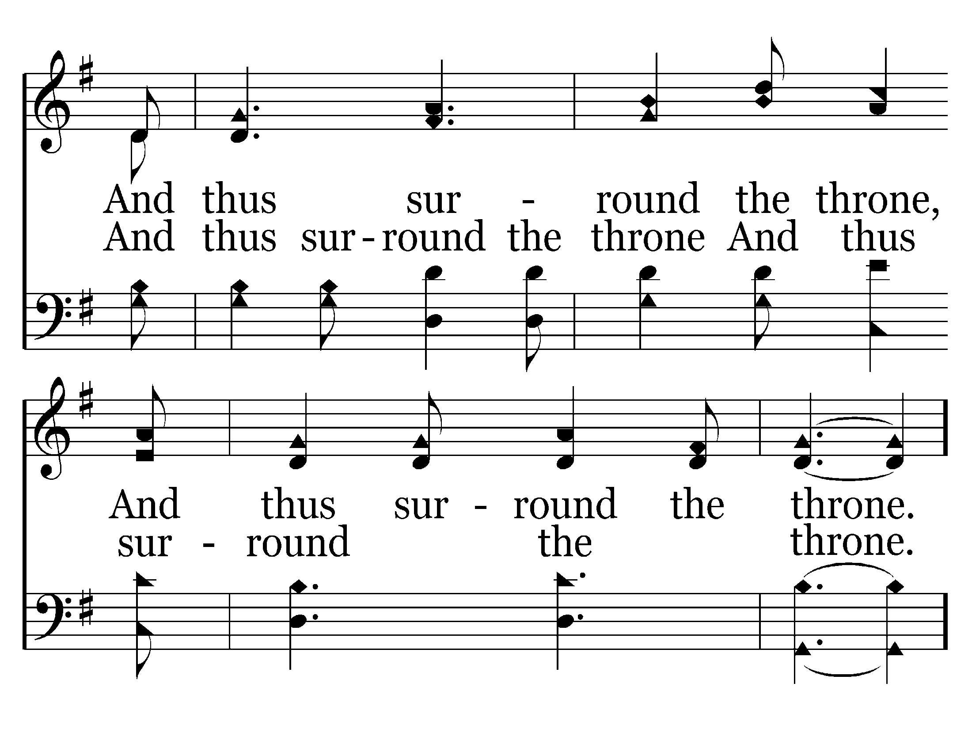
190 - We're Marching To Zion - 1.3

Slide 22
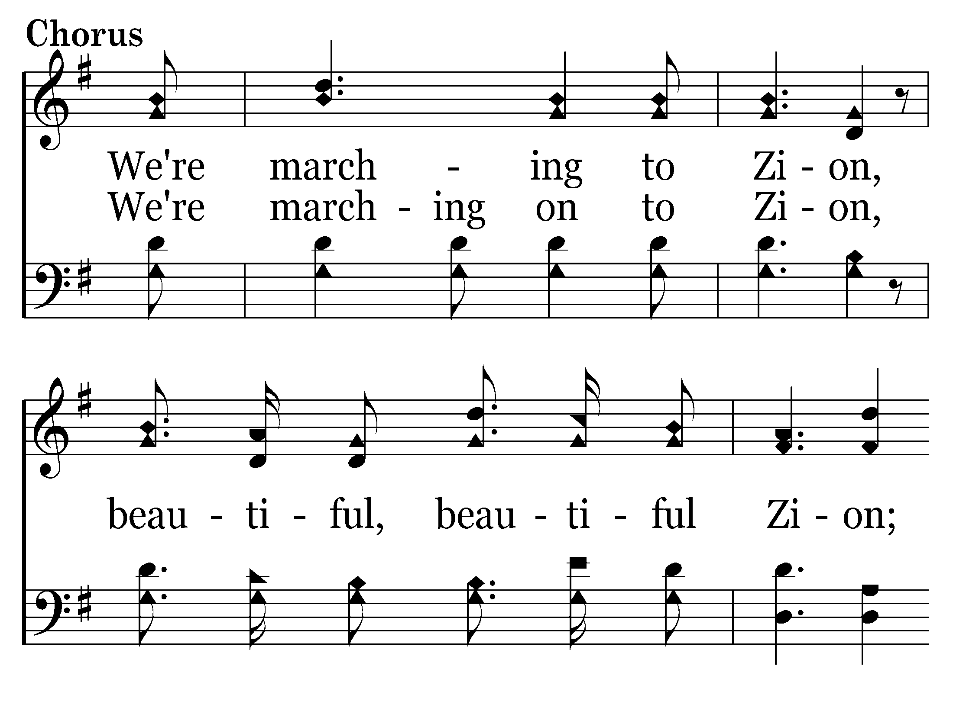
190 - We're Marching To Zion - C.1

Slide 23
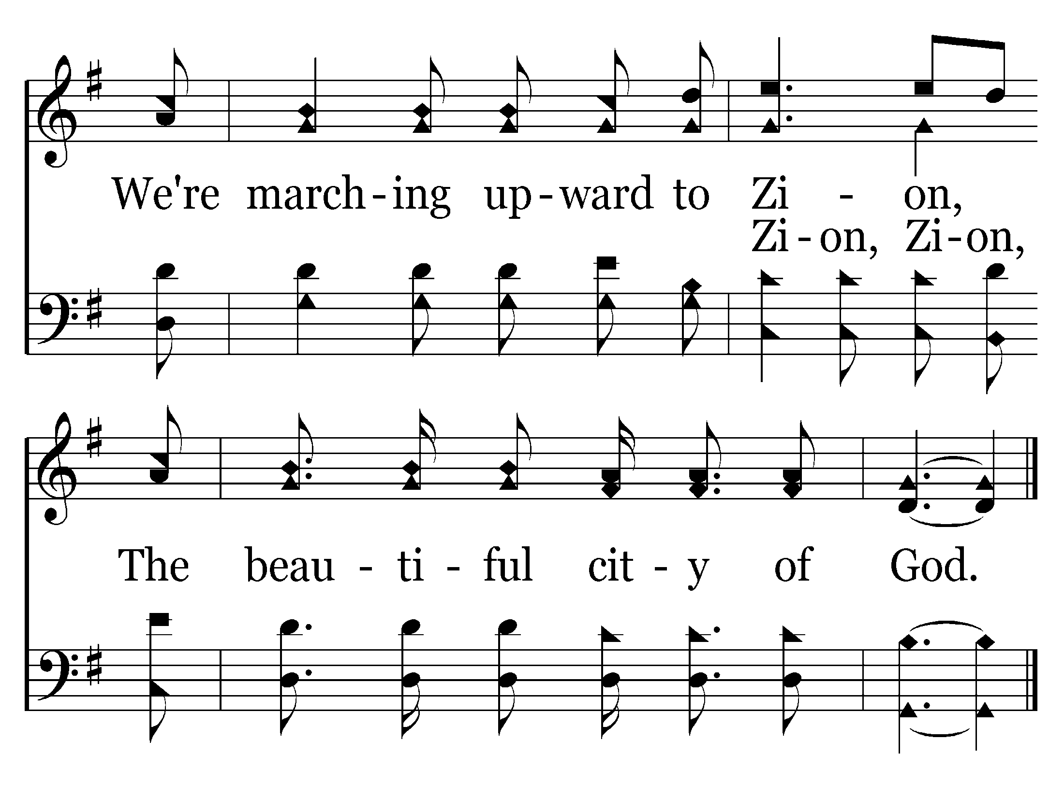
190 - We're Marching To Zion - C.2
End of Verse 1

Slide 24
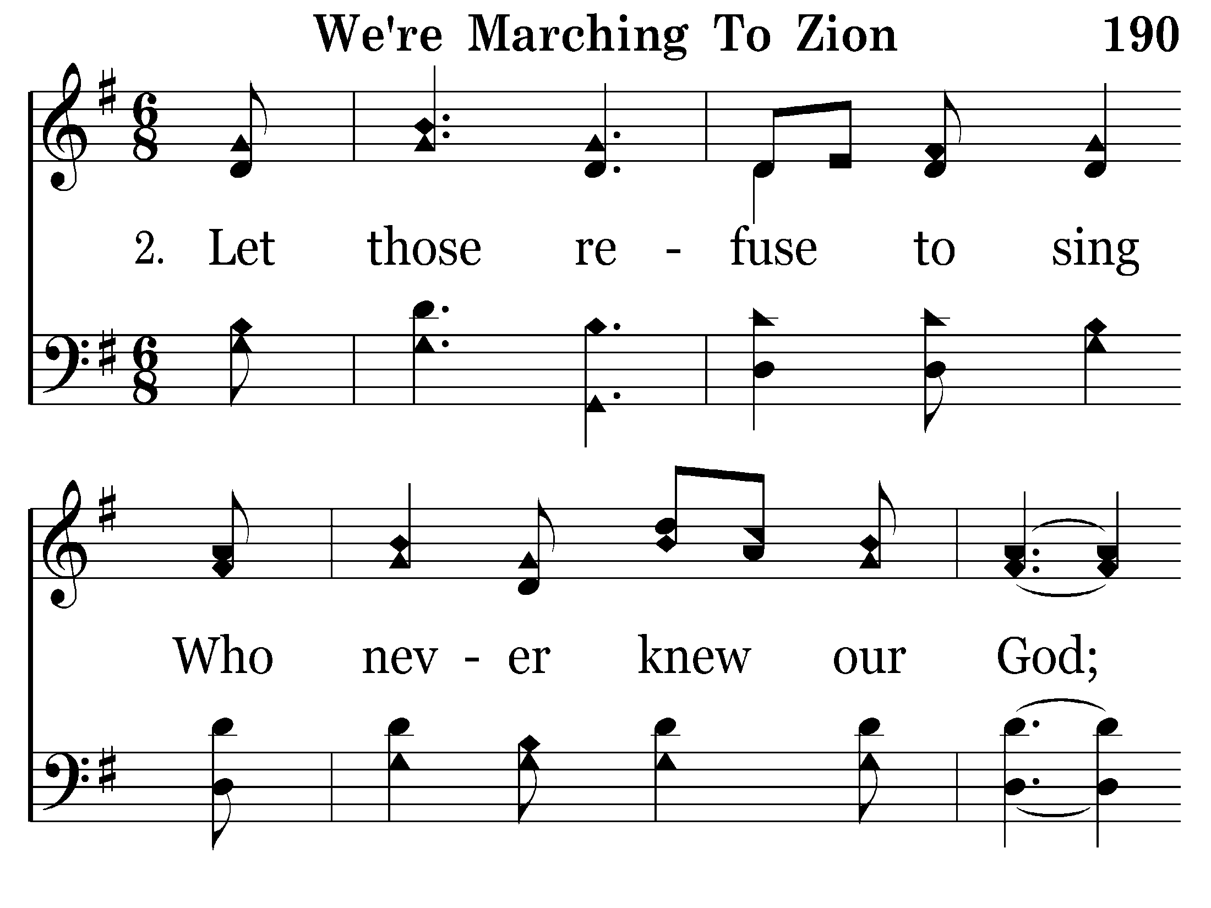
190 - We're Marching To Zion - 2.1

Slide 25
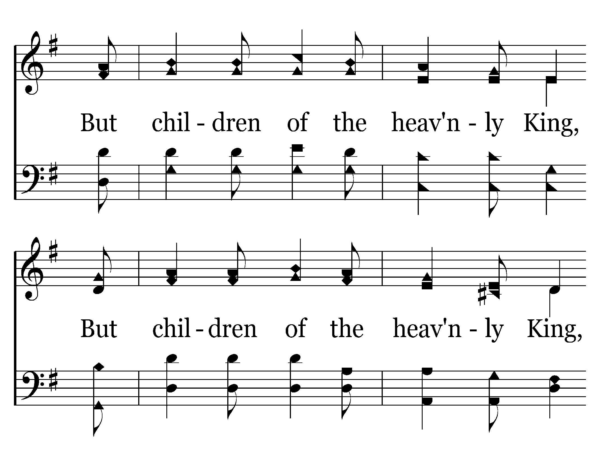
190 - We're Marching To Zion - 2.2

Slide 26
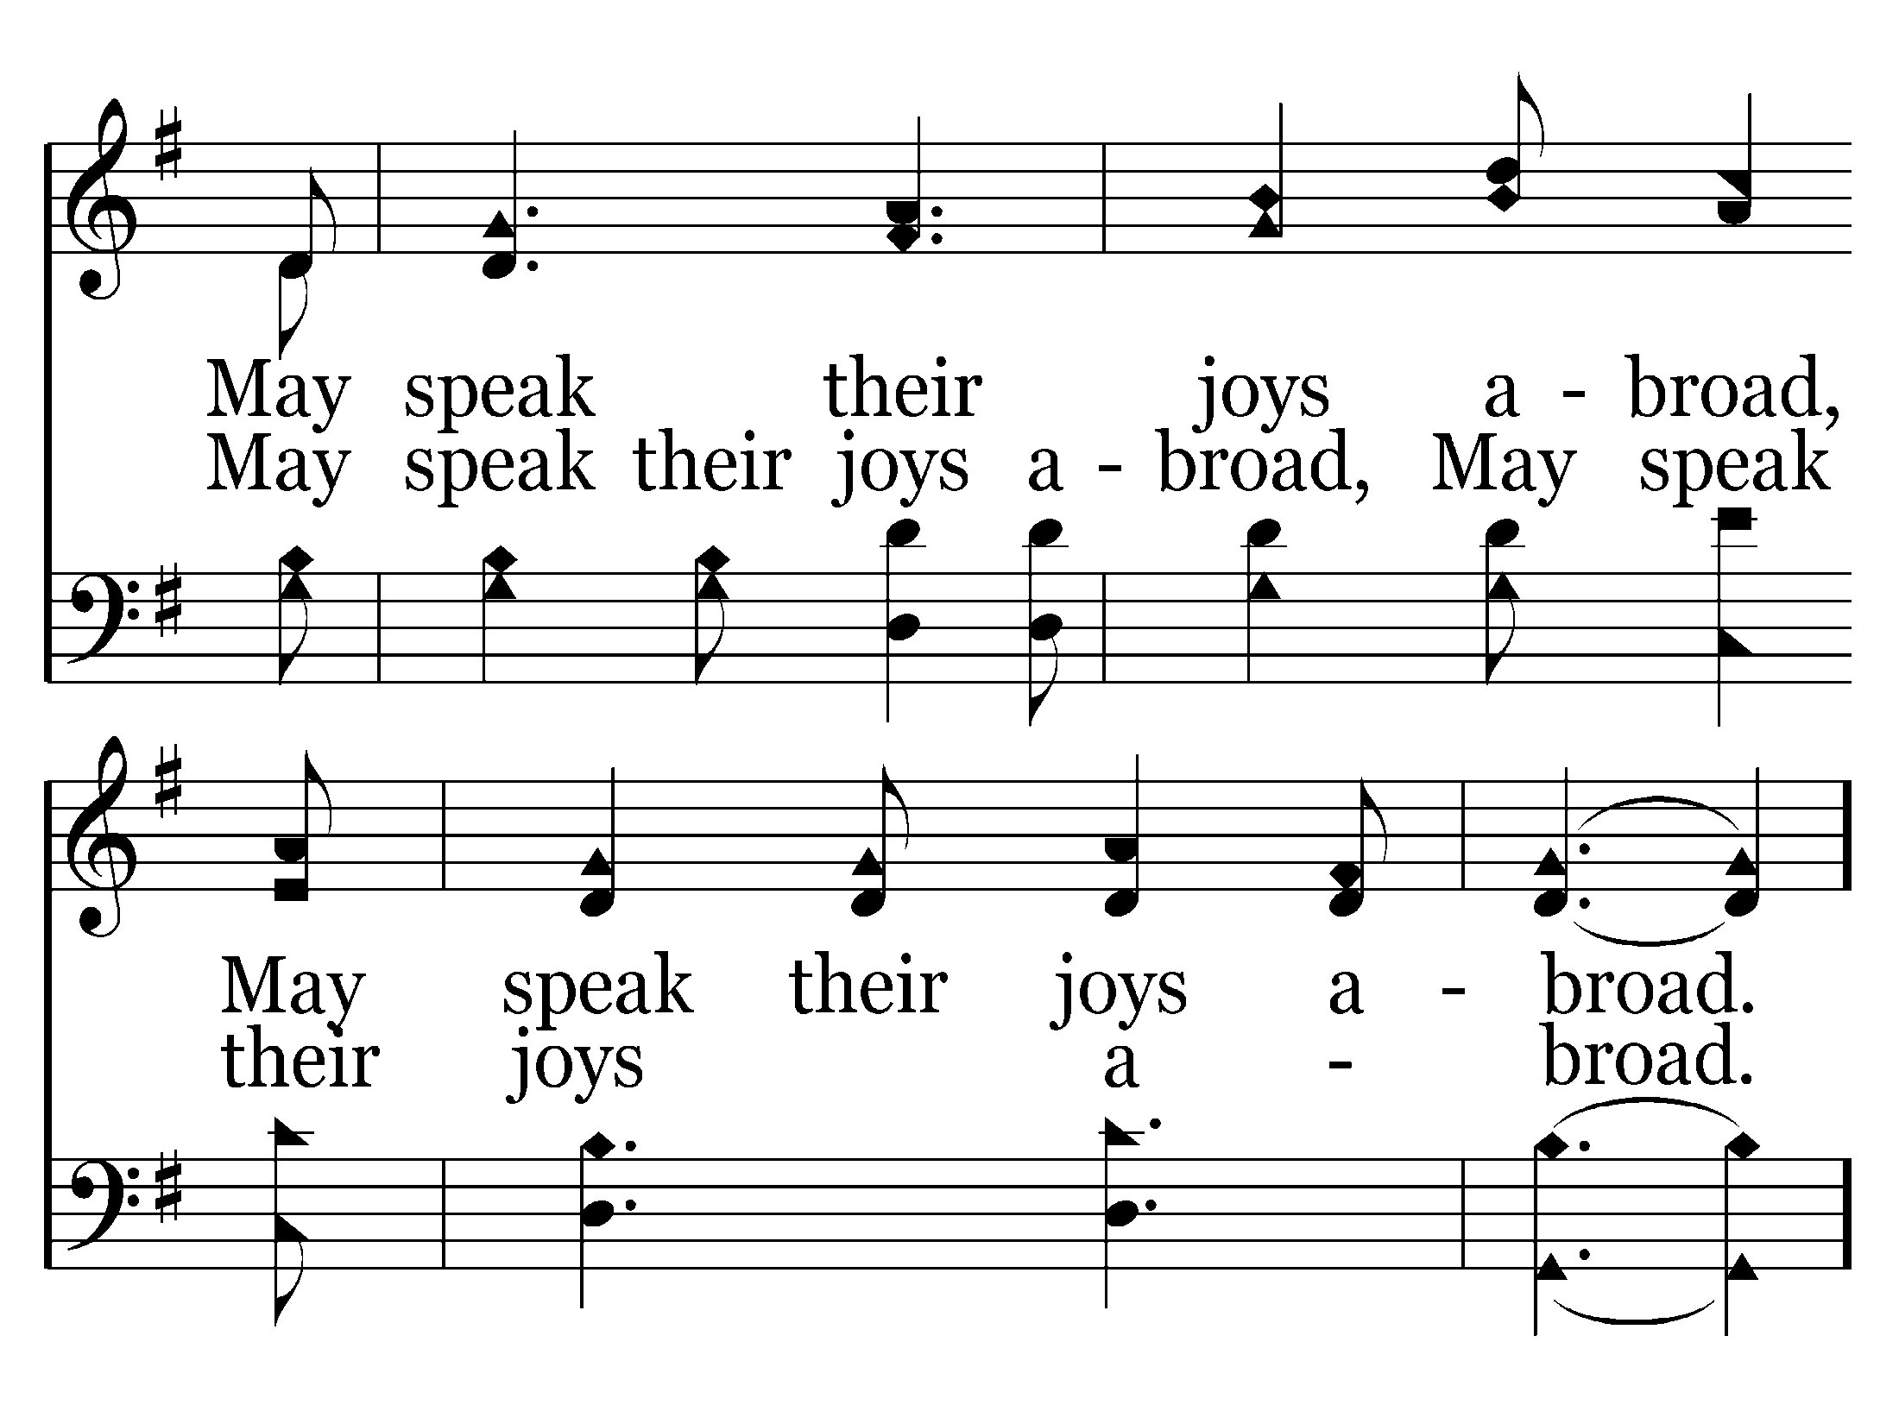
190 - We're Marching To Zion - 2.3

Slide 27
190 - We're Marching To Zion - C.1

Slide 28
190 - We're Marching To Zion - C.2
End of Verse 2

Slide 29
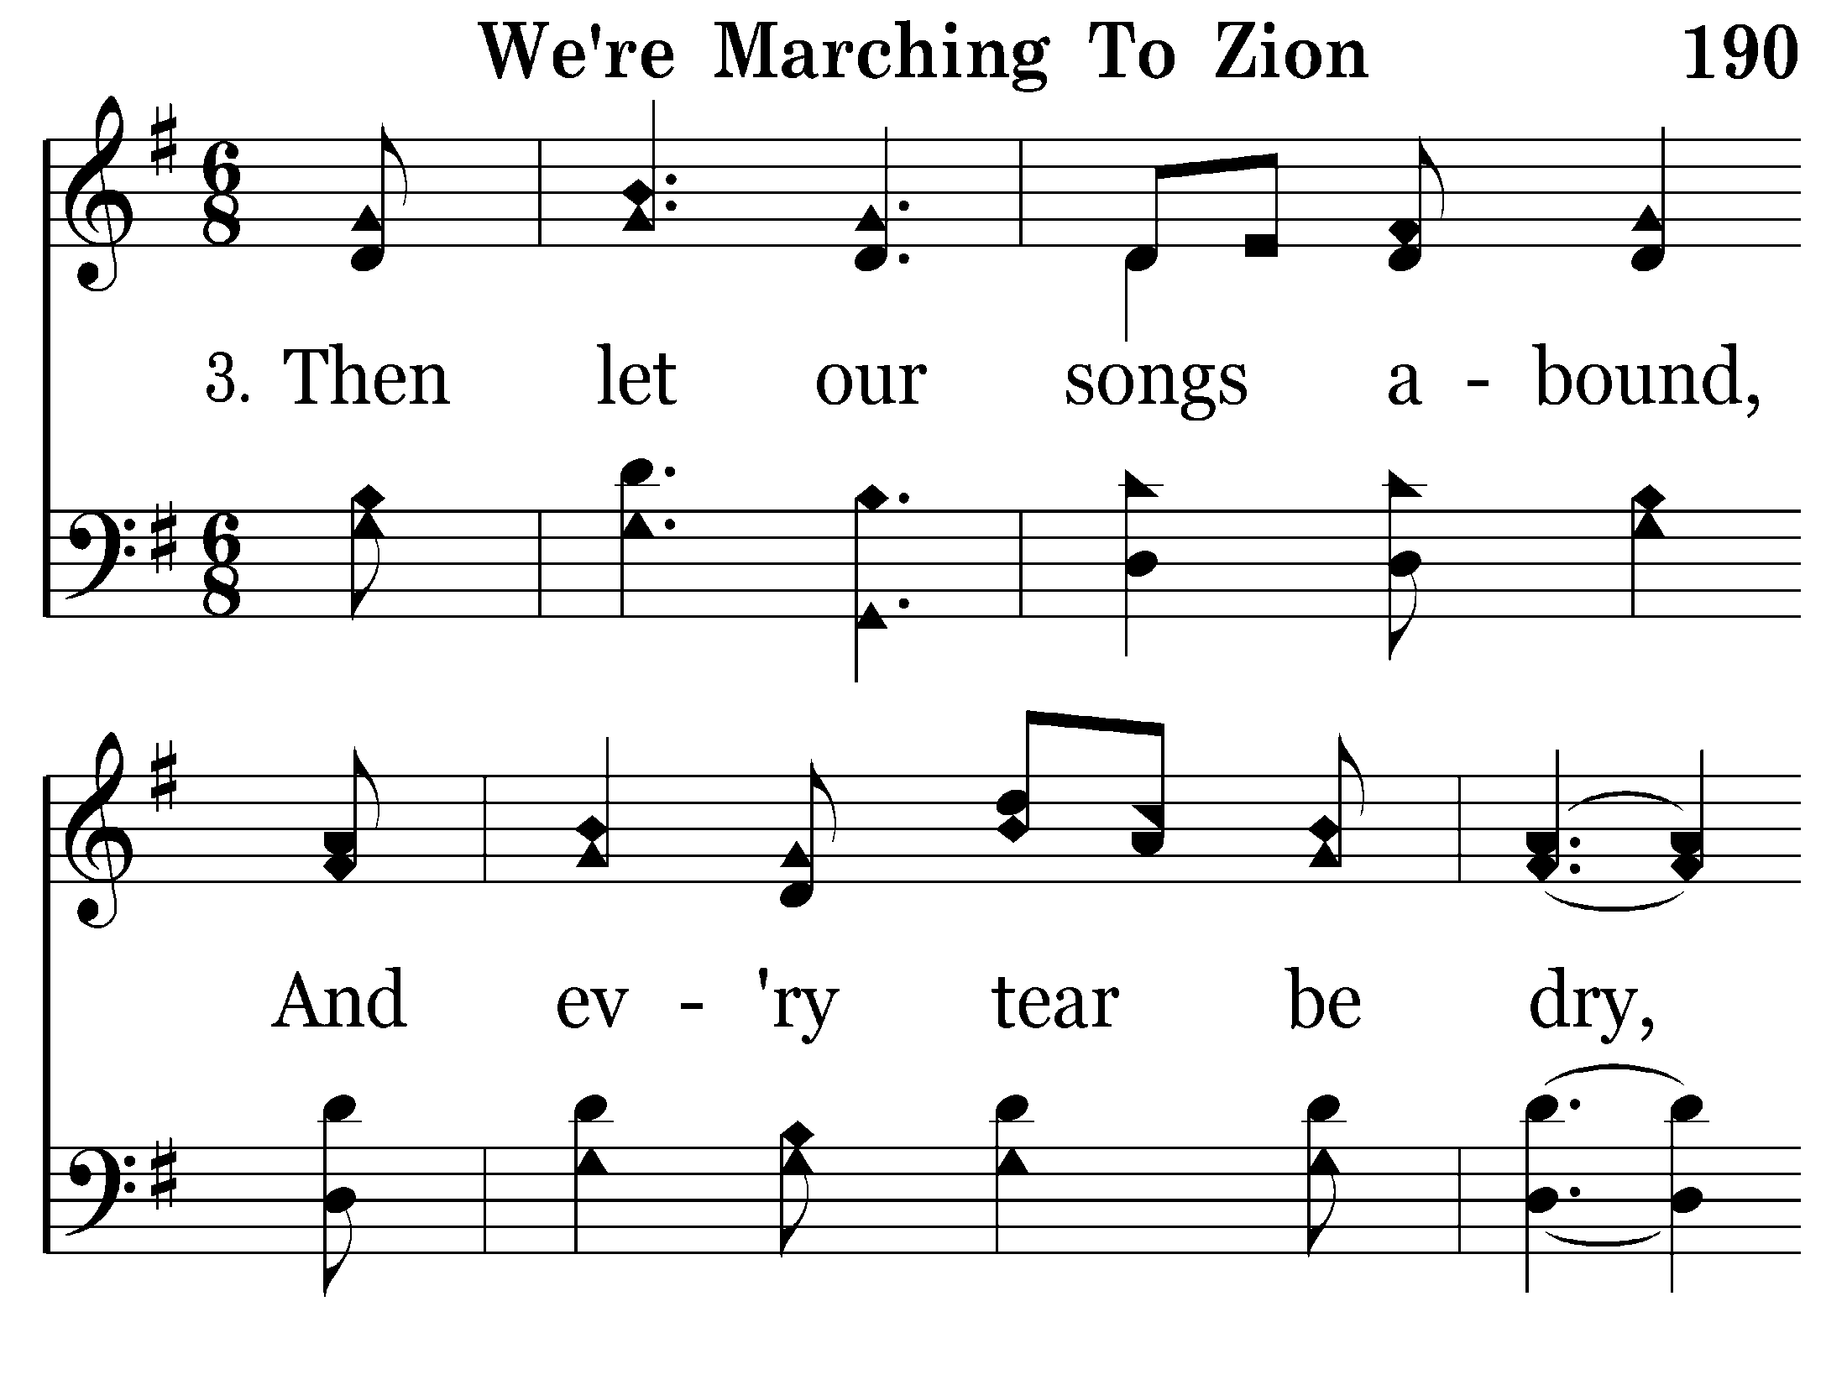
190 - We're Marching To Zion - 3.1

Slide 30
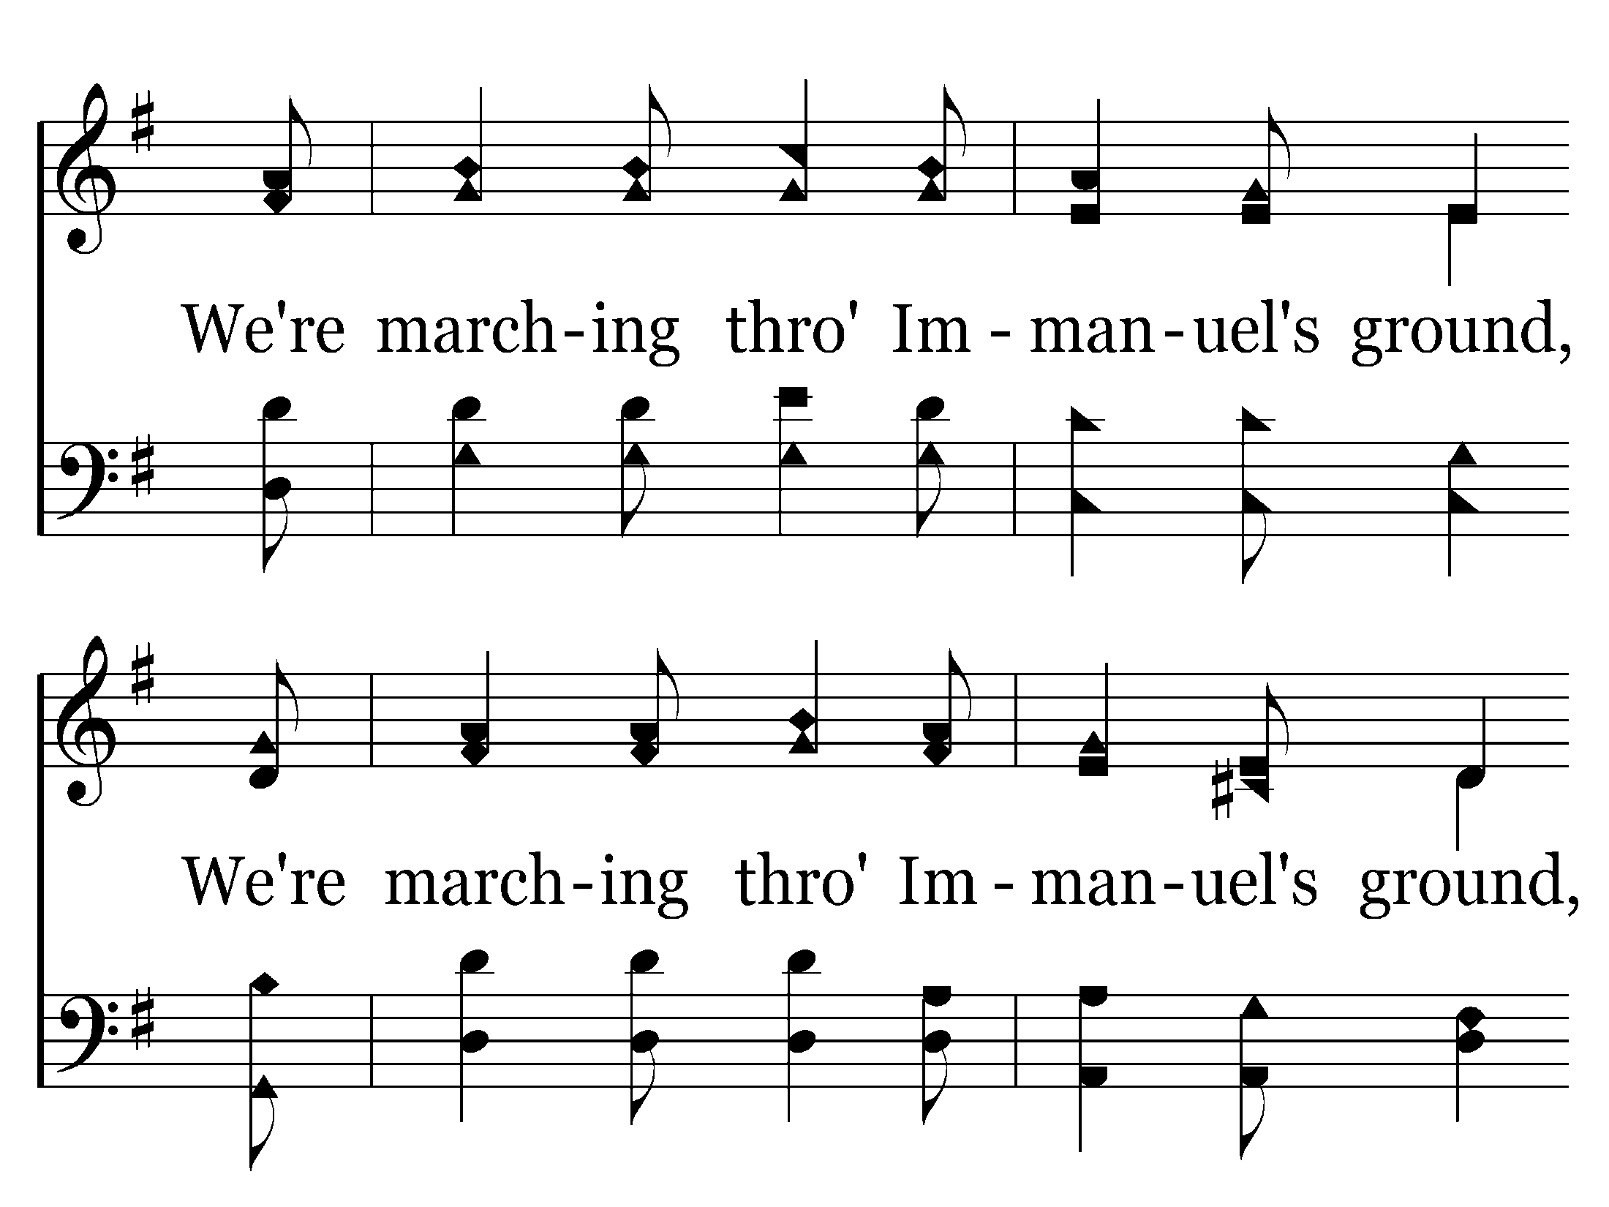
190 - We're Marching To Zion - 3.2

Slide 31
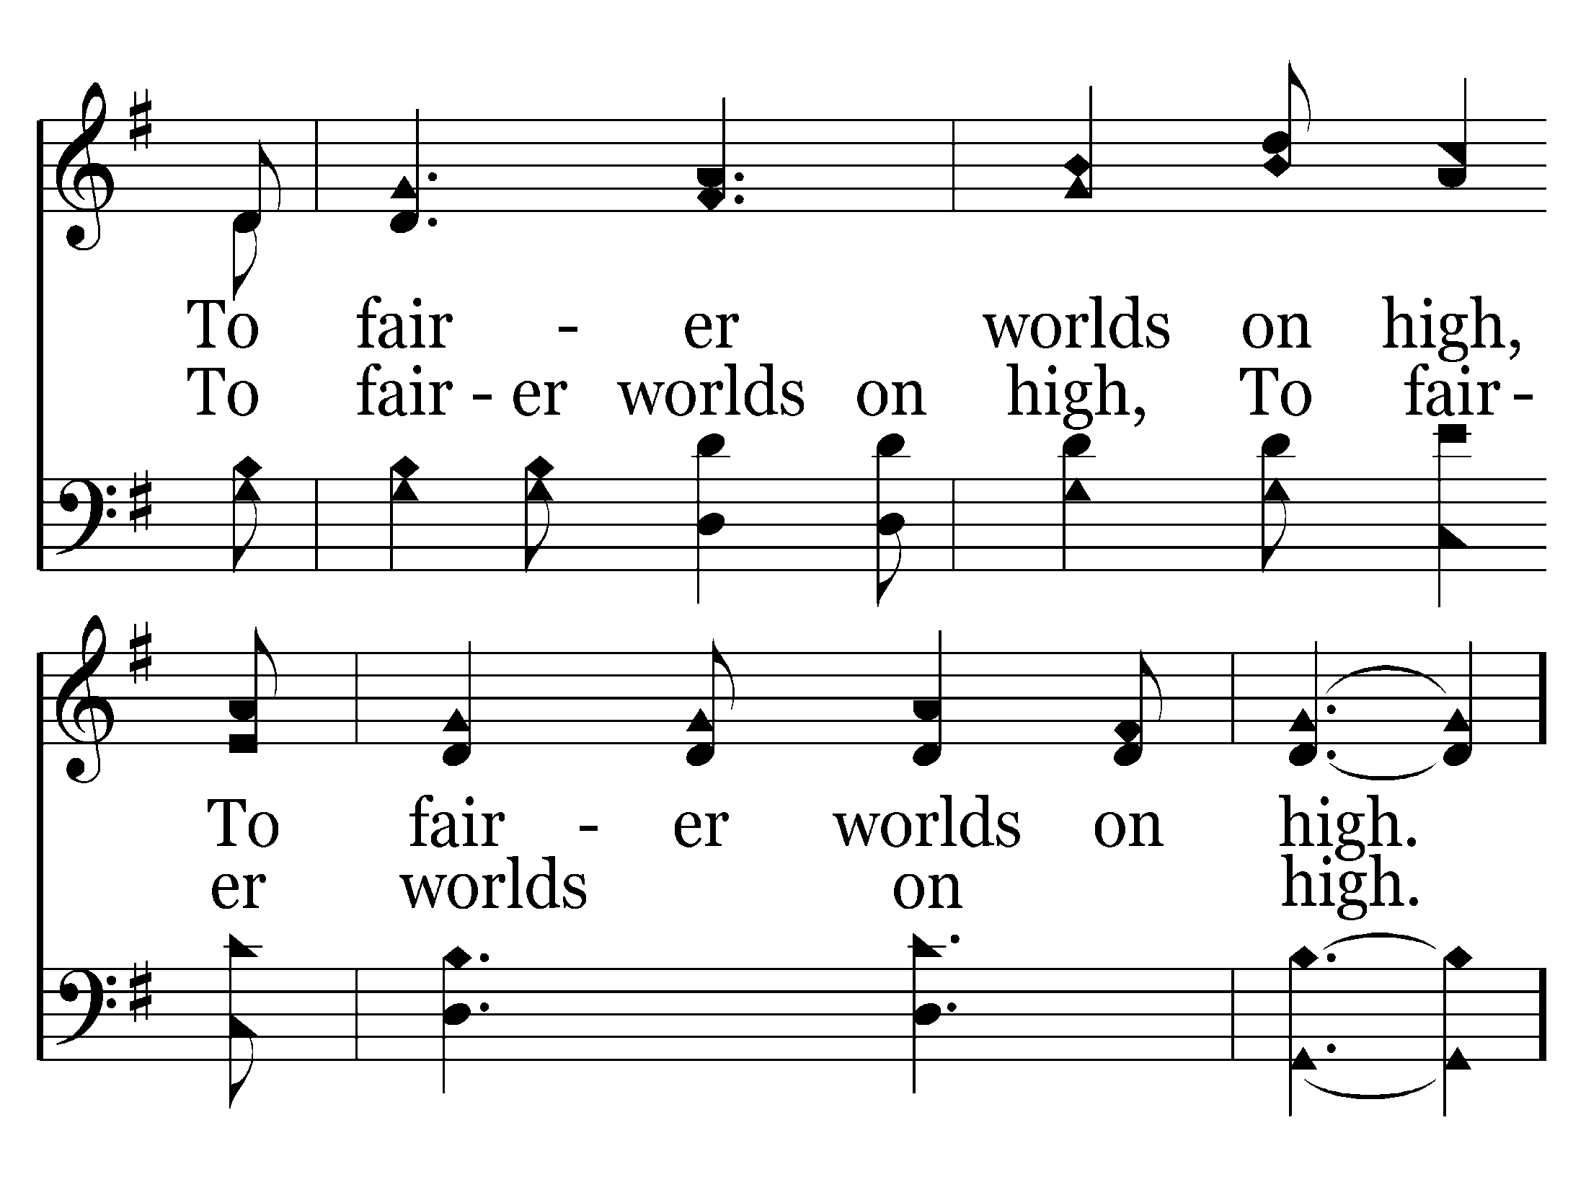
190 - We're Marching To Zion - 3.3

Slide 32
190 - We're Marching To Zion - C.1

Slide 33
190 - We're Marching To Zion - C.2
End of Song

Slide 35
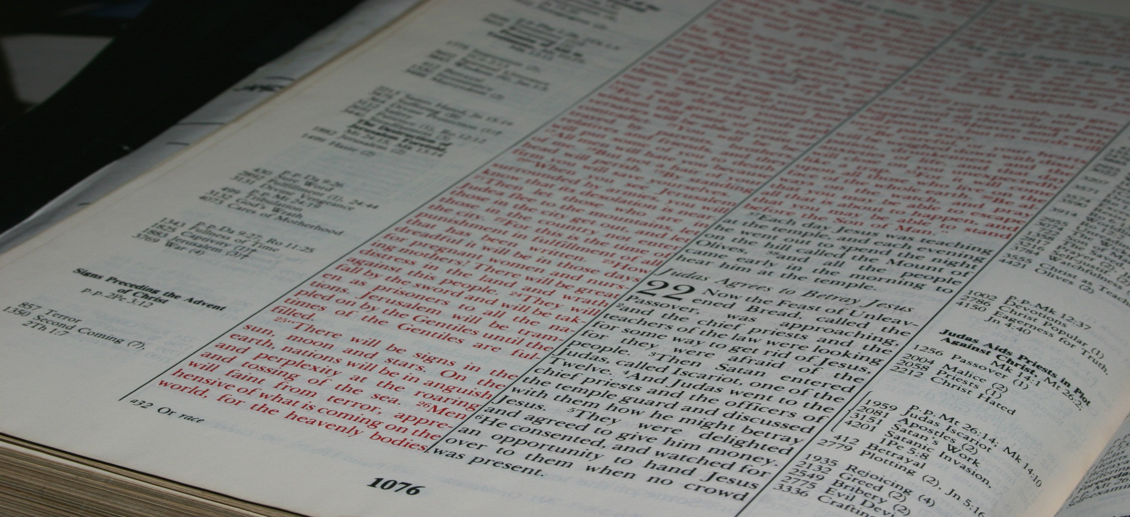
"For which of you, intending to build a tower, does not sit down first and count the cost, whether he has enough to finish it?"
Luke 14:28
Real Life For Everyone!
Northwest Church of Christ April 20-25, 2014

Slide 36
“He began to build..."
People who didn’t finish:
-- Demas
, Peter
, You and Me
What happened?
GOOD NEWS:
It’s not too late!
didn’t really mean it
didn’t have a plan
didn’t count the cost
delayed the plan
got sidetracked
got discouraged
were afraid to try
Philippians
3:7-14

Slide 37
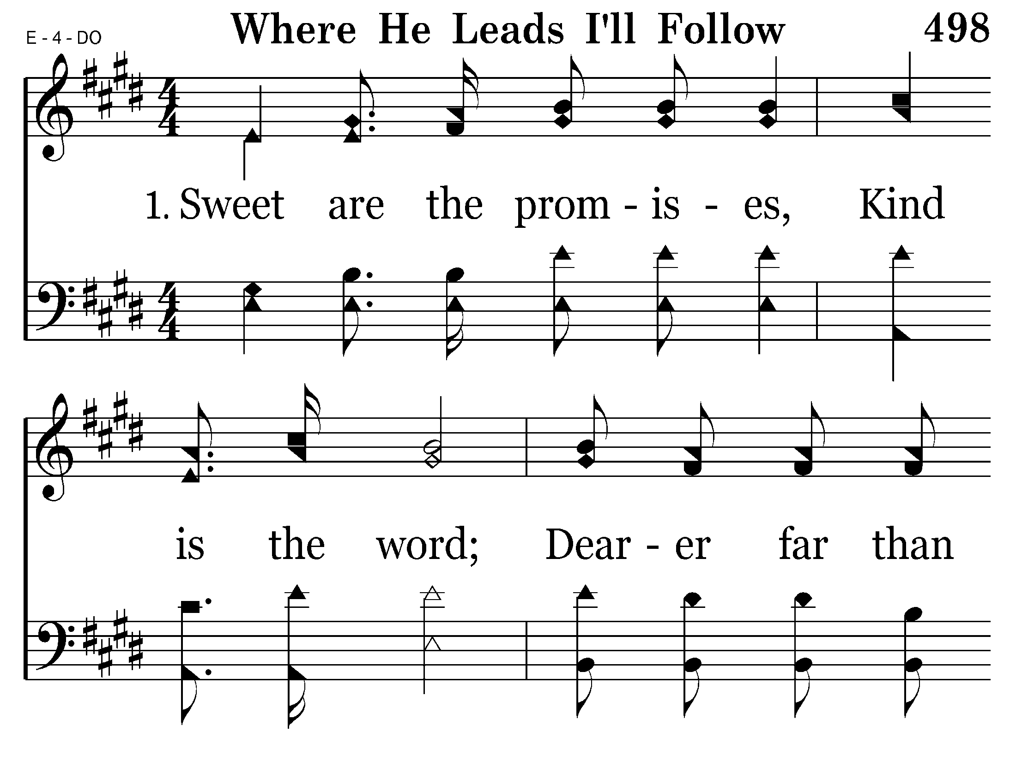
498 - Where He Leads I'll Follow - 1.1

Slide 38
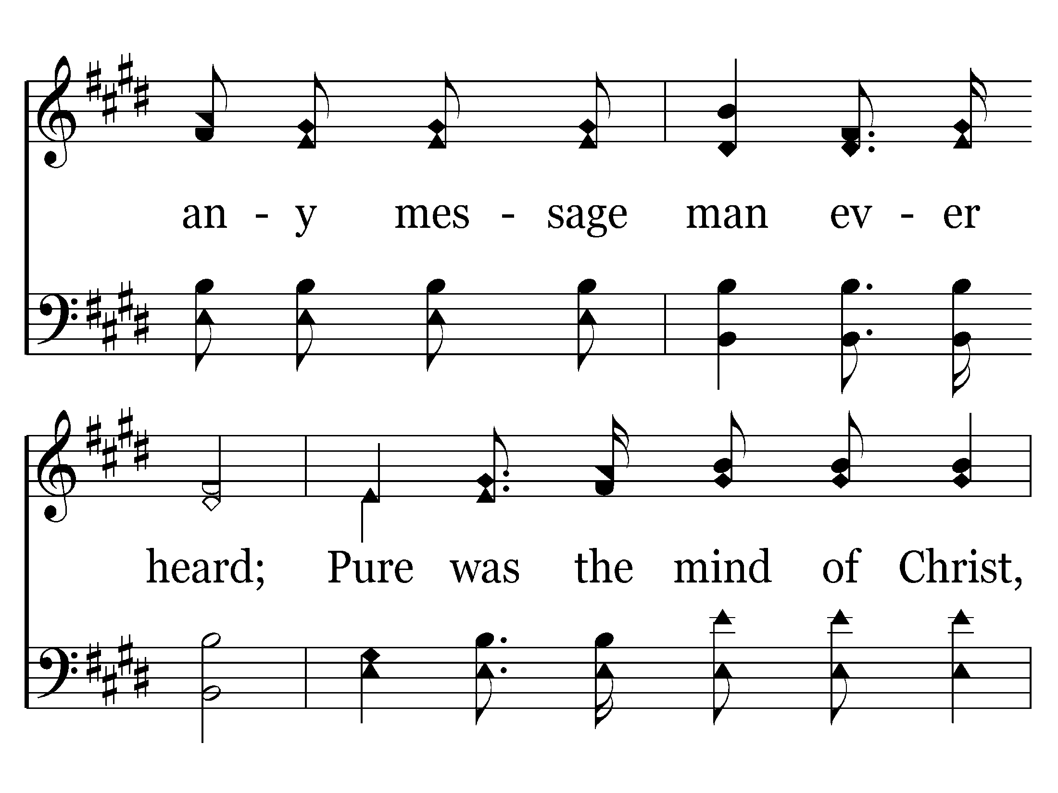
498 - Where He Leads I'll Follow - 1.2

Slide 39
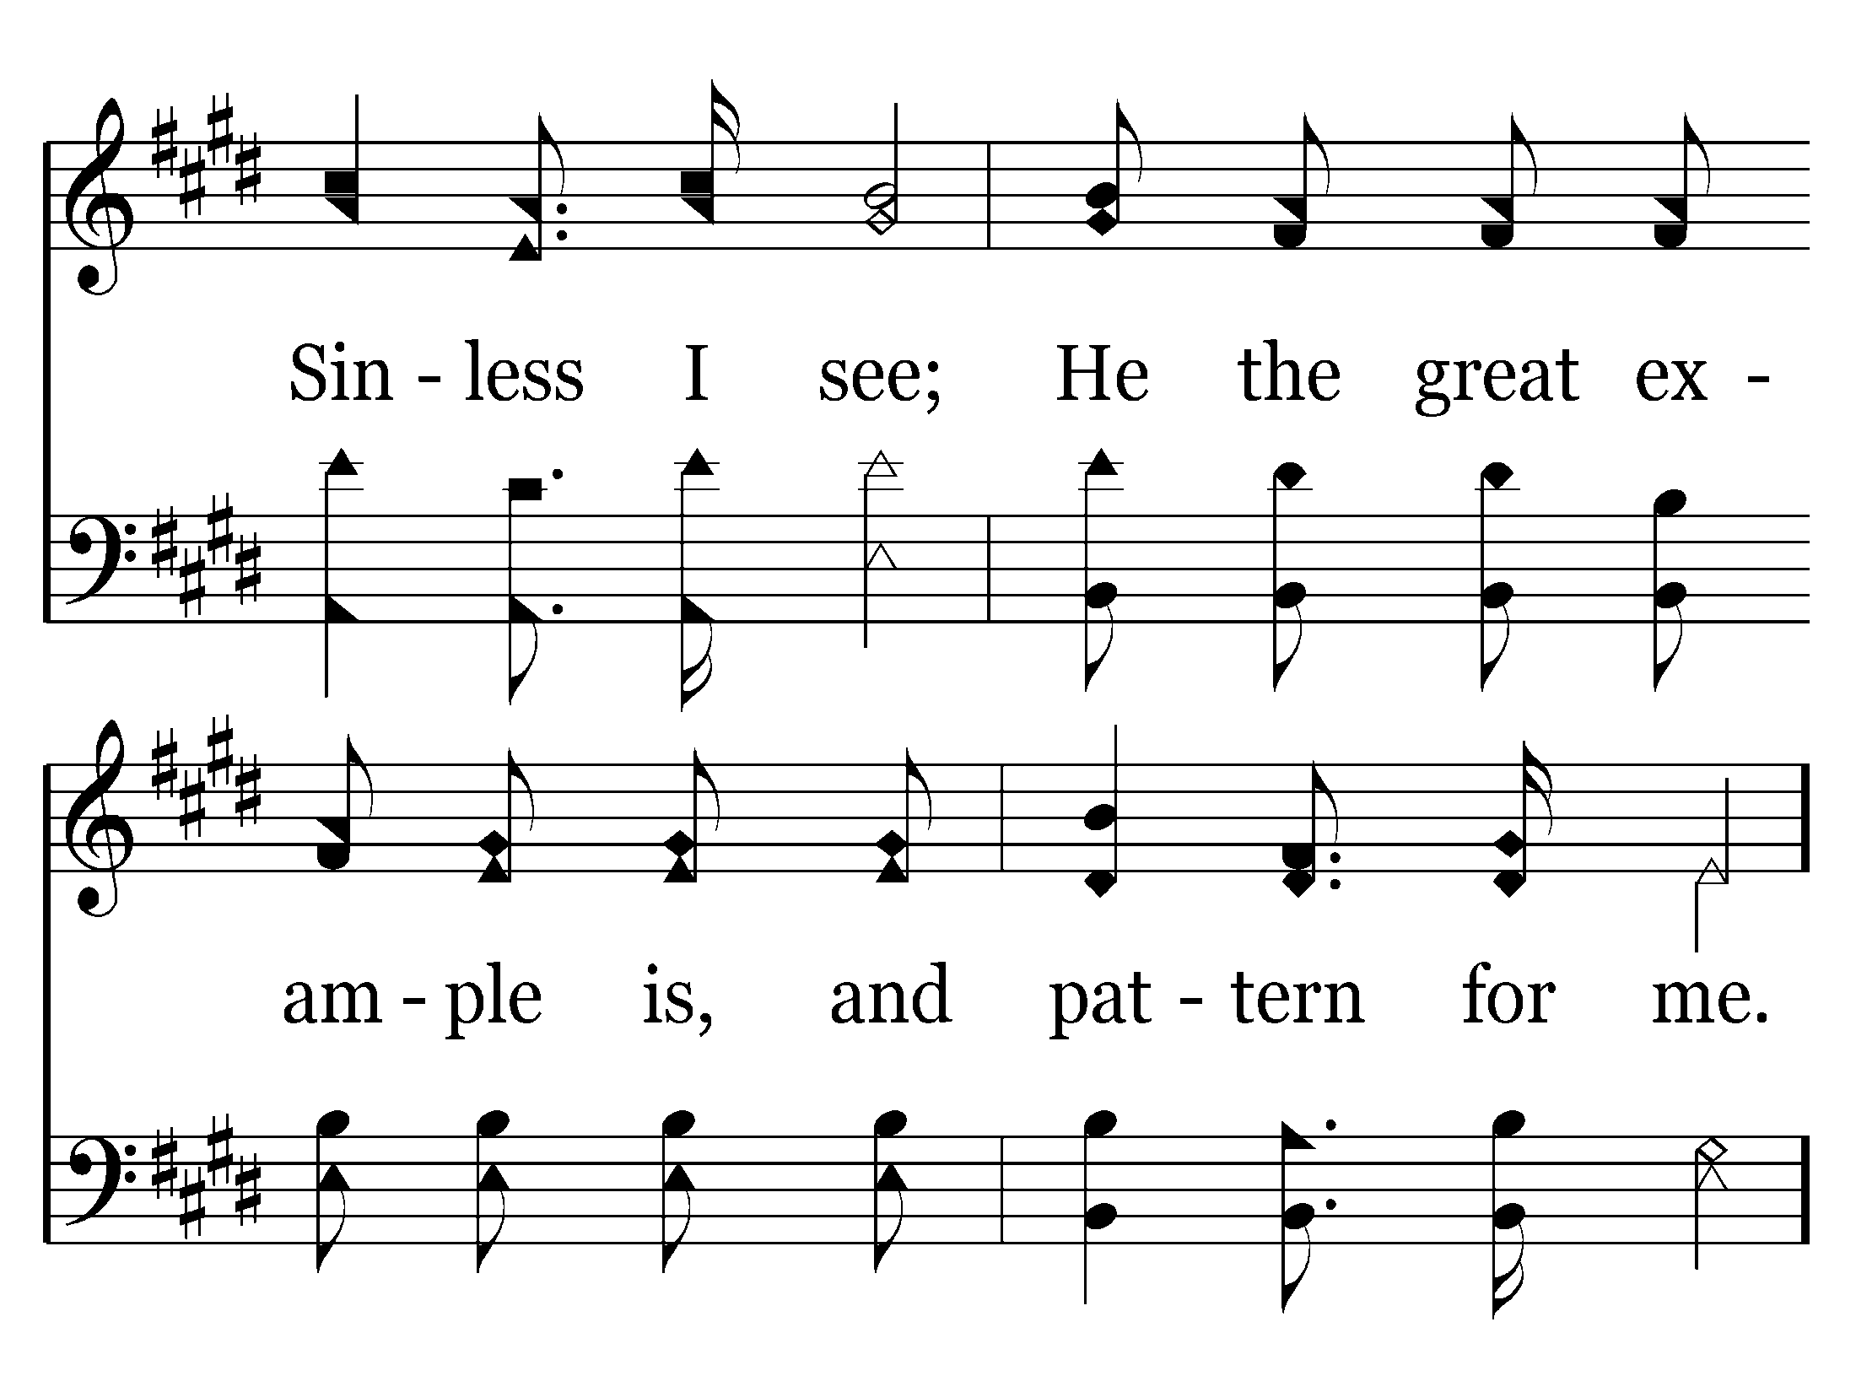
498 - Where He Leads I'll Follow - 1.3

Slide 40
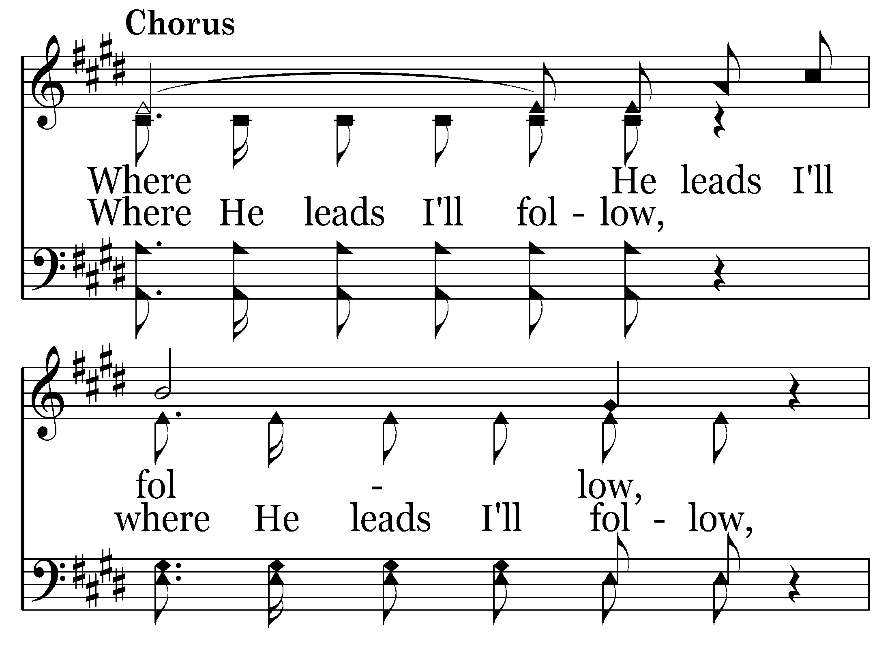
498 - Where He Leads I'll Follow - C.1

Slide 41
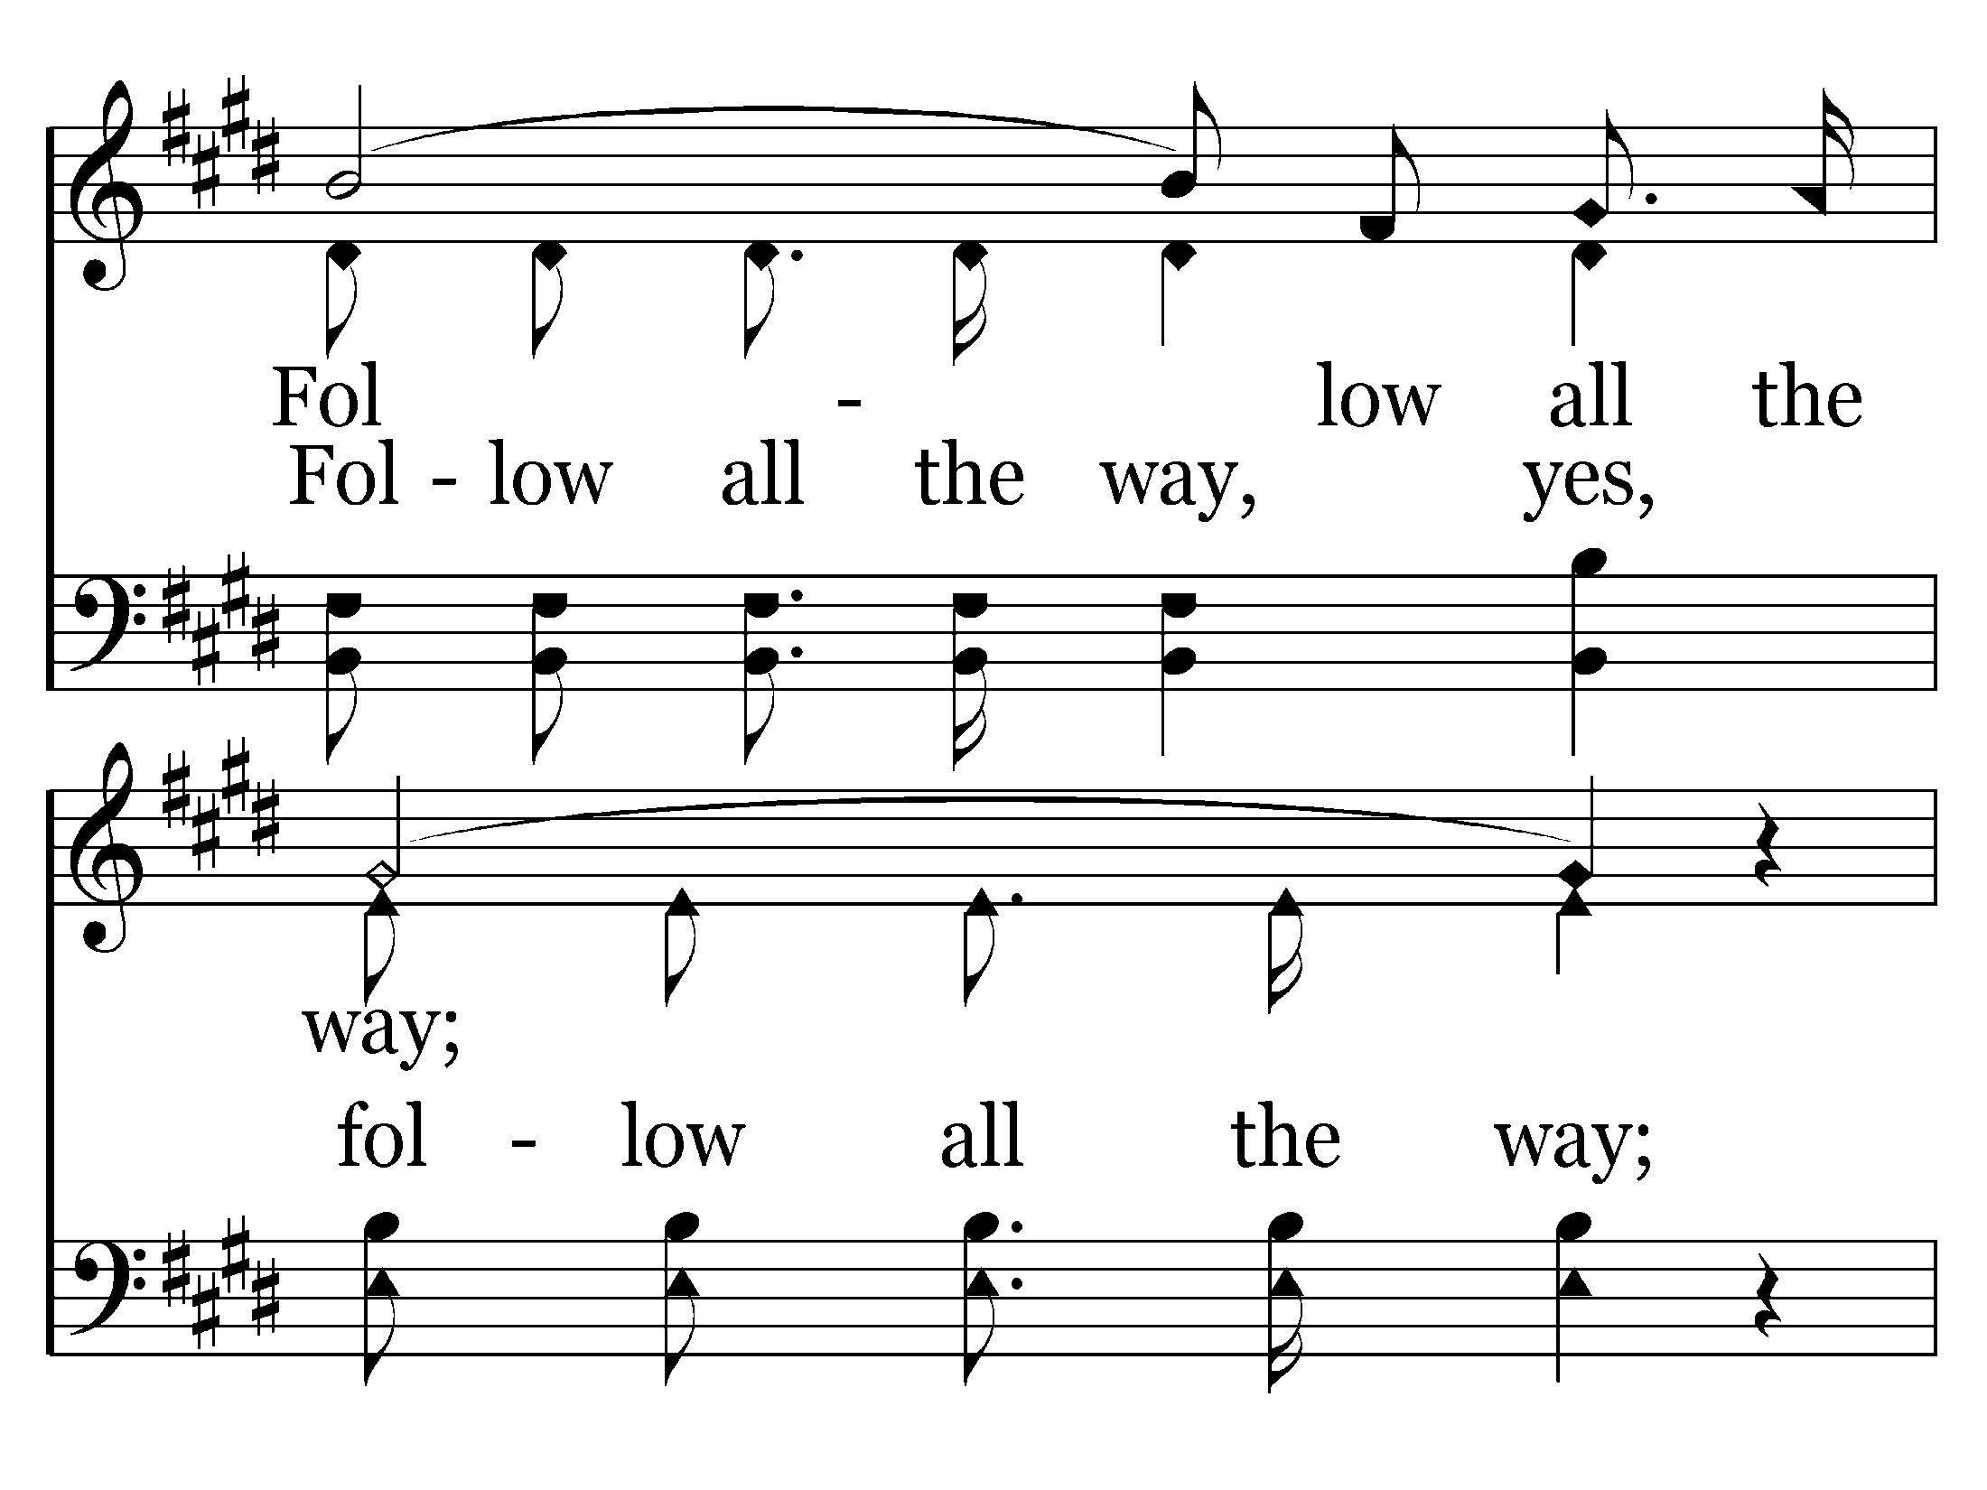
498 - Where He Leads I'll Follow - C.2

Slide 42
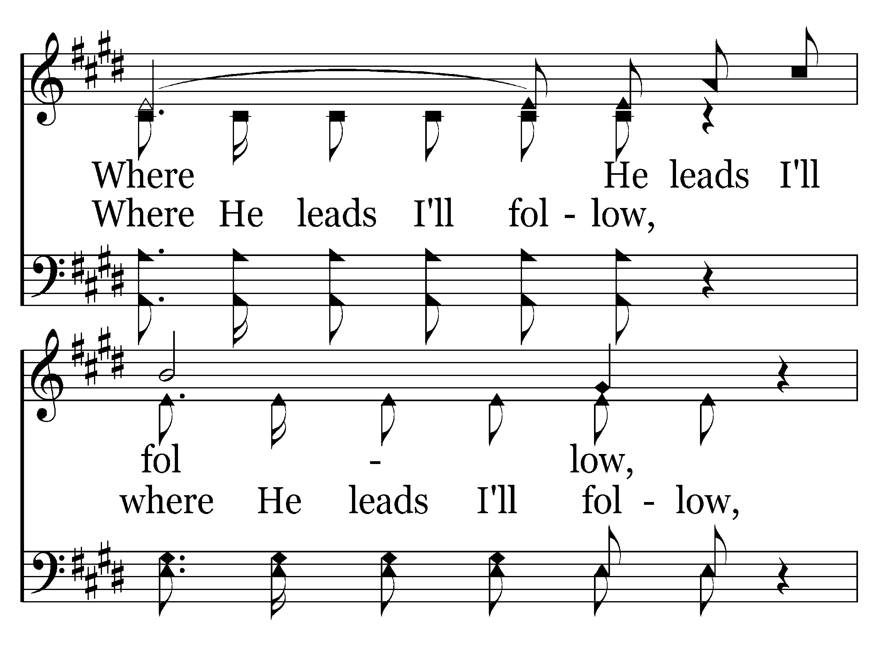
498 - Where He Leads I'll Follow - C.3

Slide 43
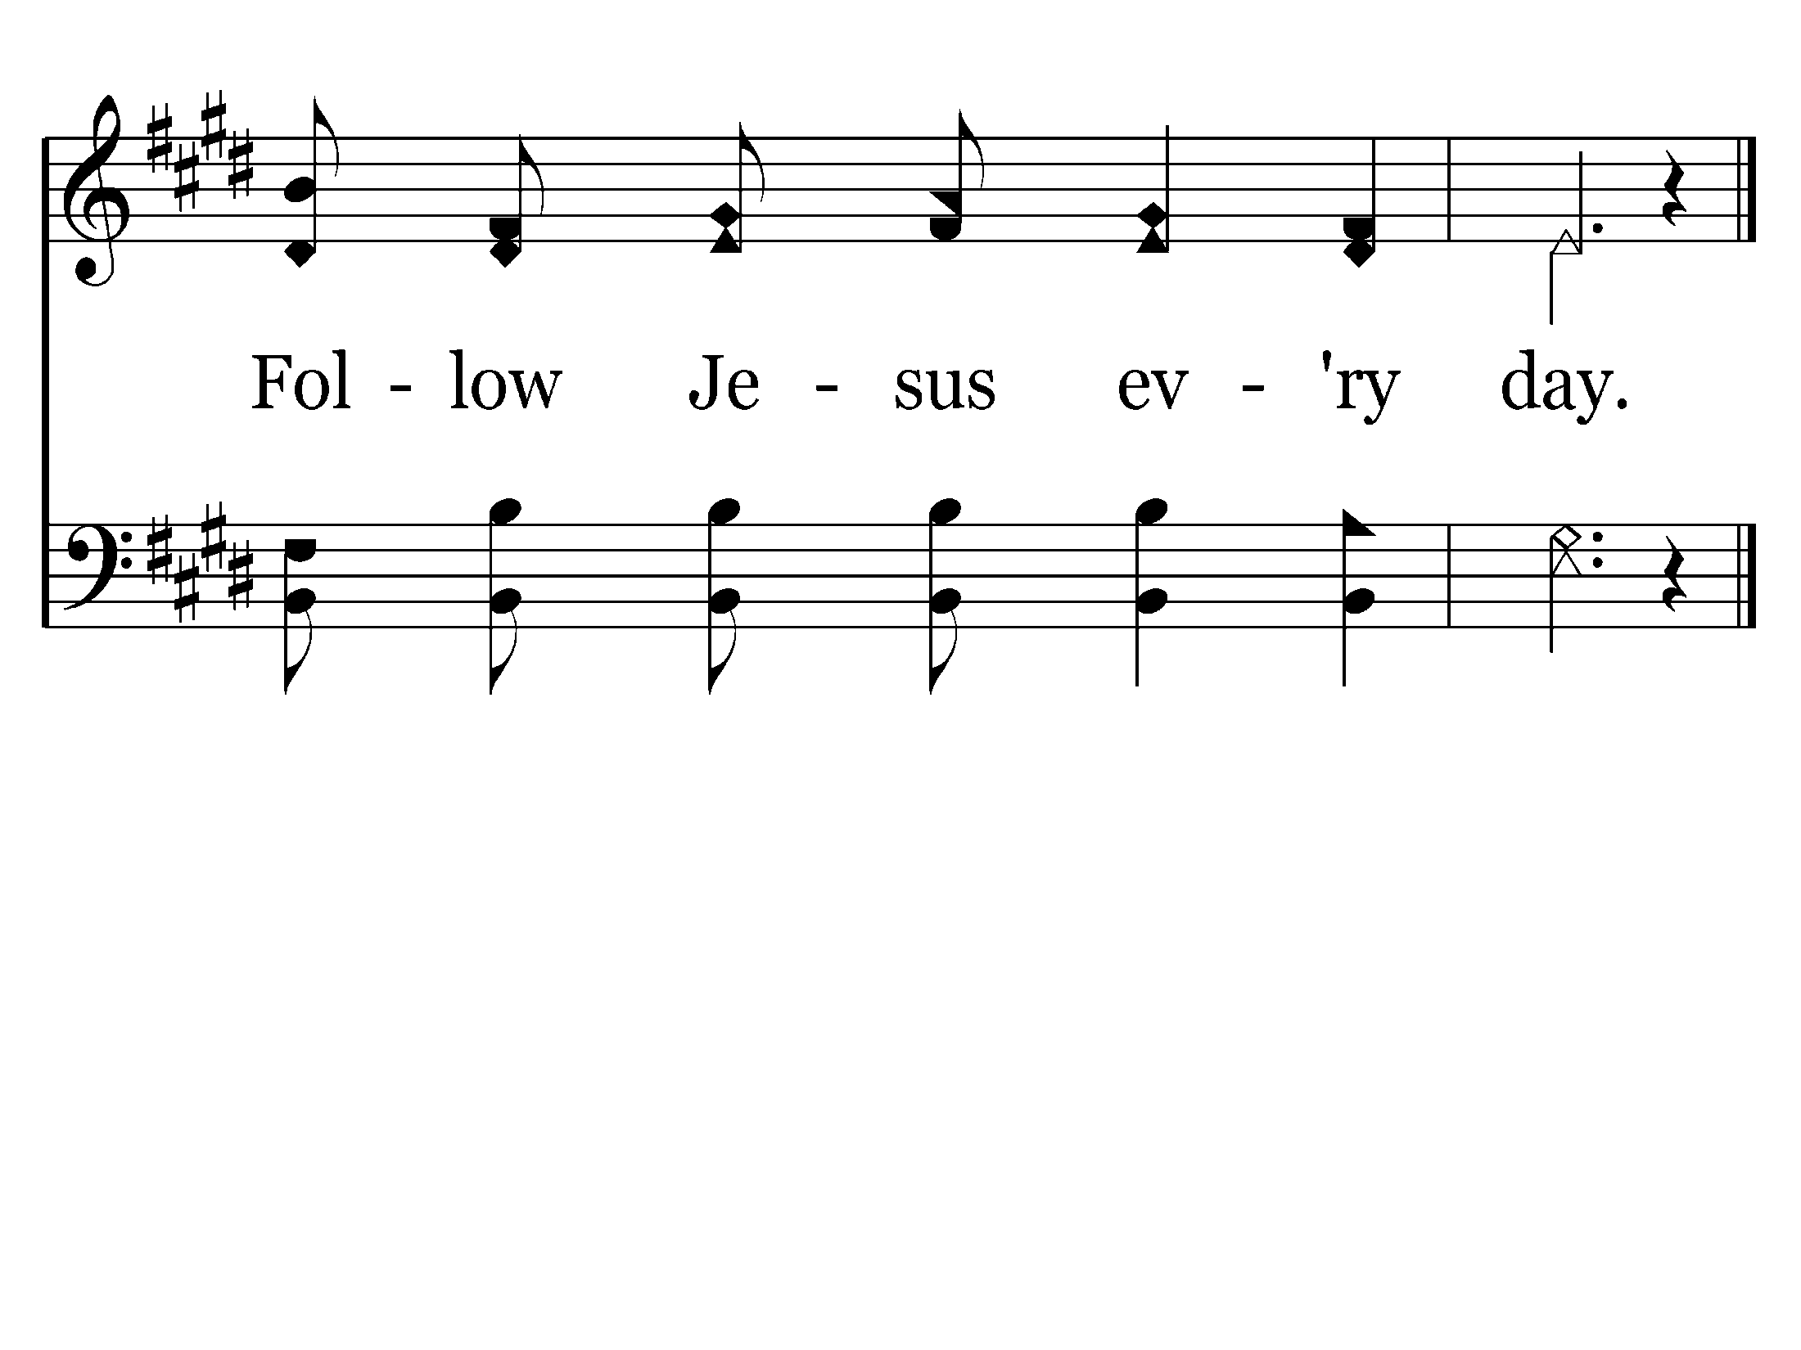
498 - Where He Leads I'll Follow - C.4
End of Verse 1

Slide 44
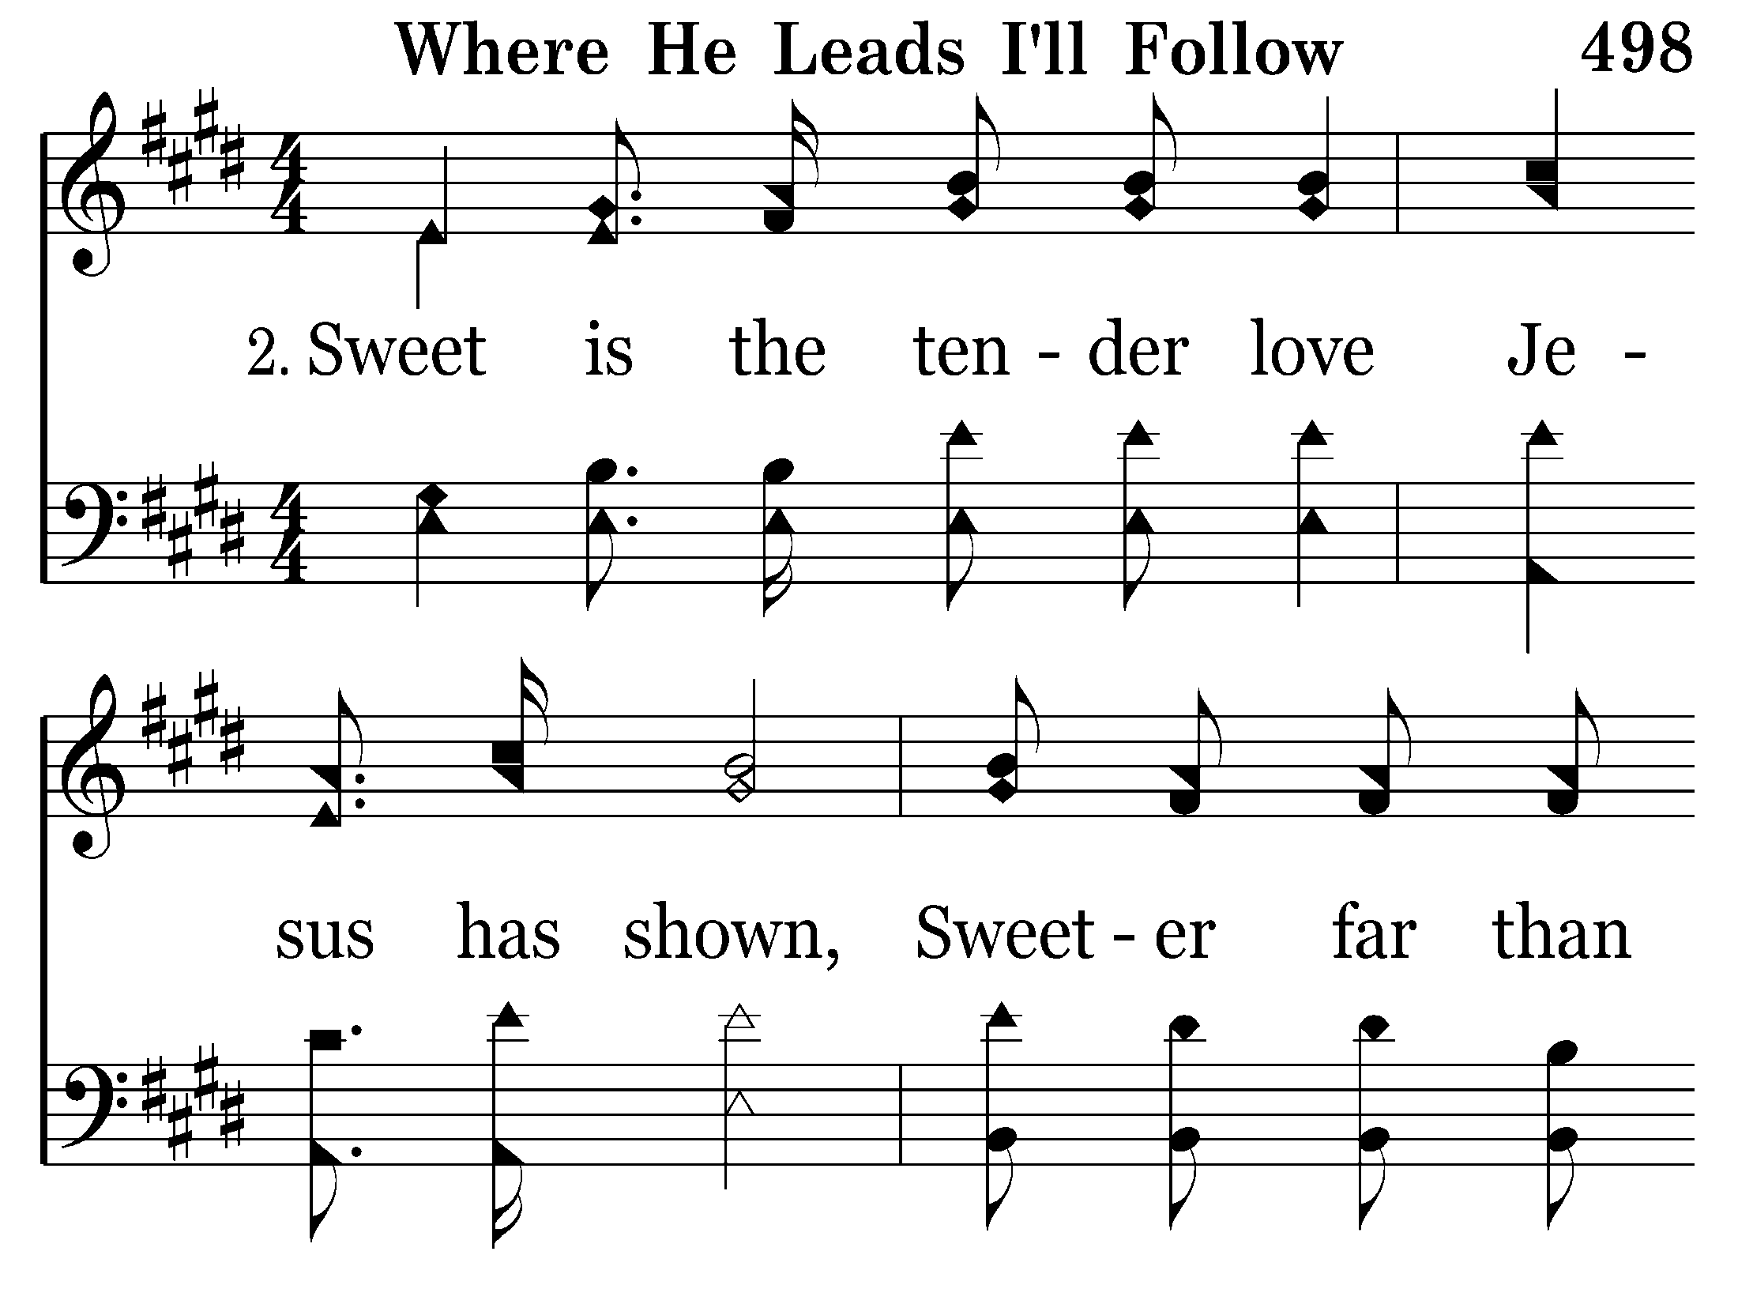
498 - Where He Leads I'll Follow - 2.1

Slide 45
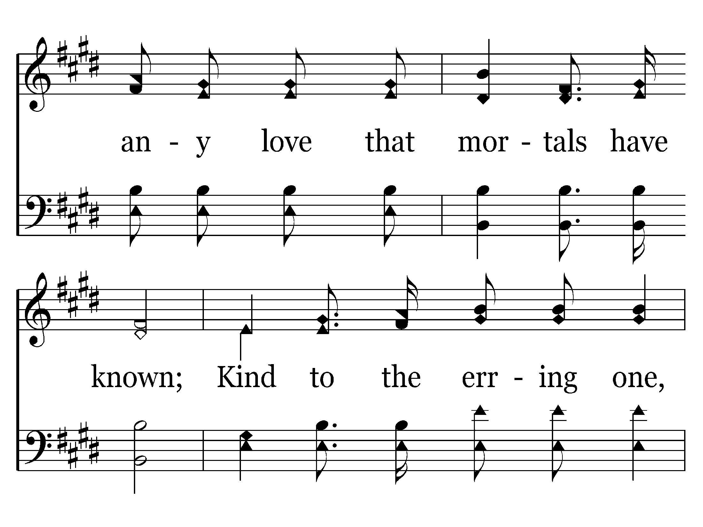
498 - Where He Leads I'll Follow - 2.2

Slide 46
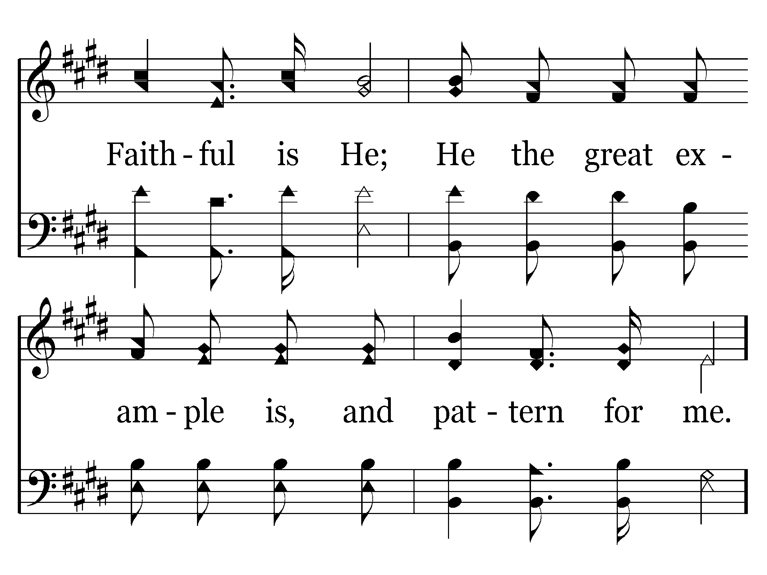
498 - Where He Leads I'll Follow - 2.3

Slide 47
498 - Where He Leads I'll Follow - C.1

Slide 48
498 - Where He Leads I'll Follow - C.2

Slide 49
498 - Where He Leads I'll Follow - C.3

Slide 50
498 - Where He Leads I'll Follow - C.4
End of Verse 2

Slide 51
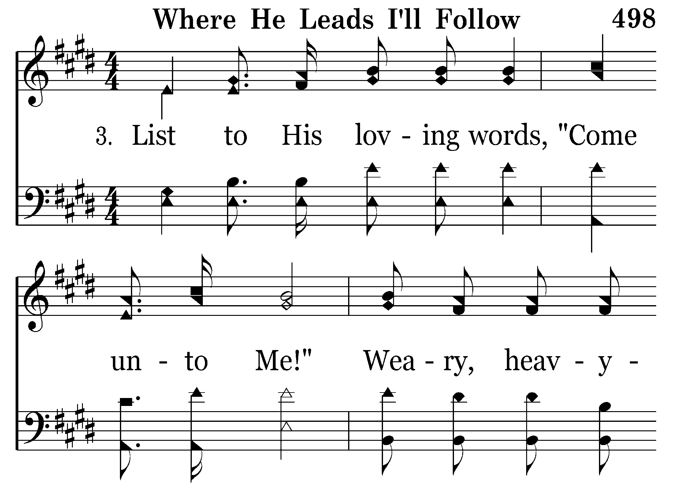
498 - Where He Leads I'll Follow - 3.1

Slide 52
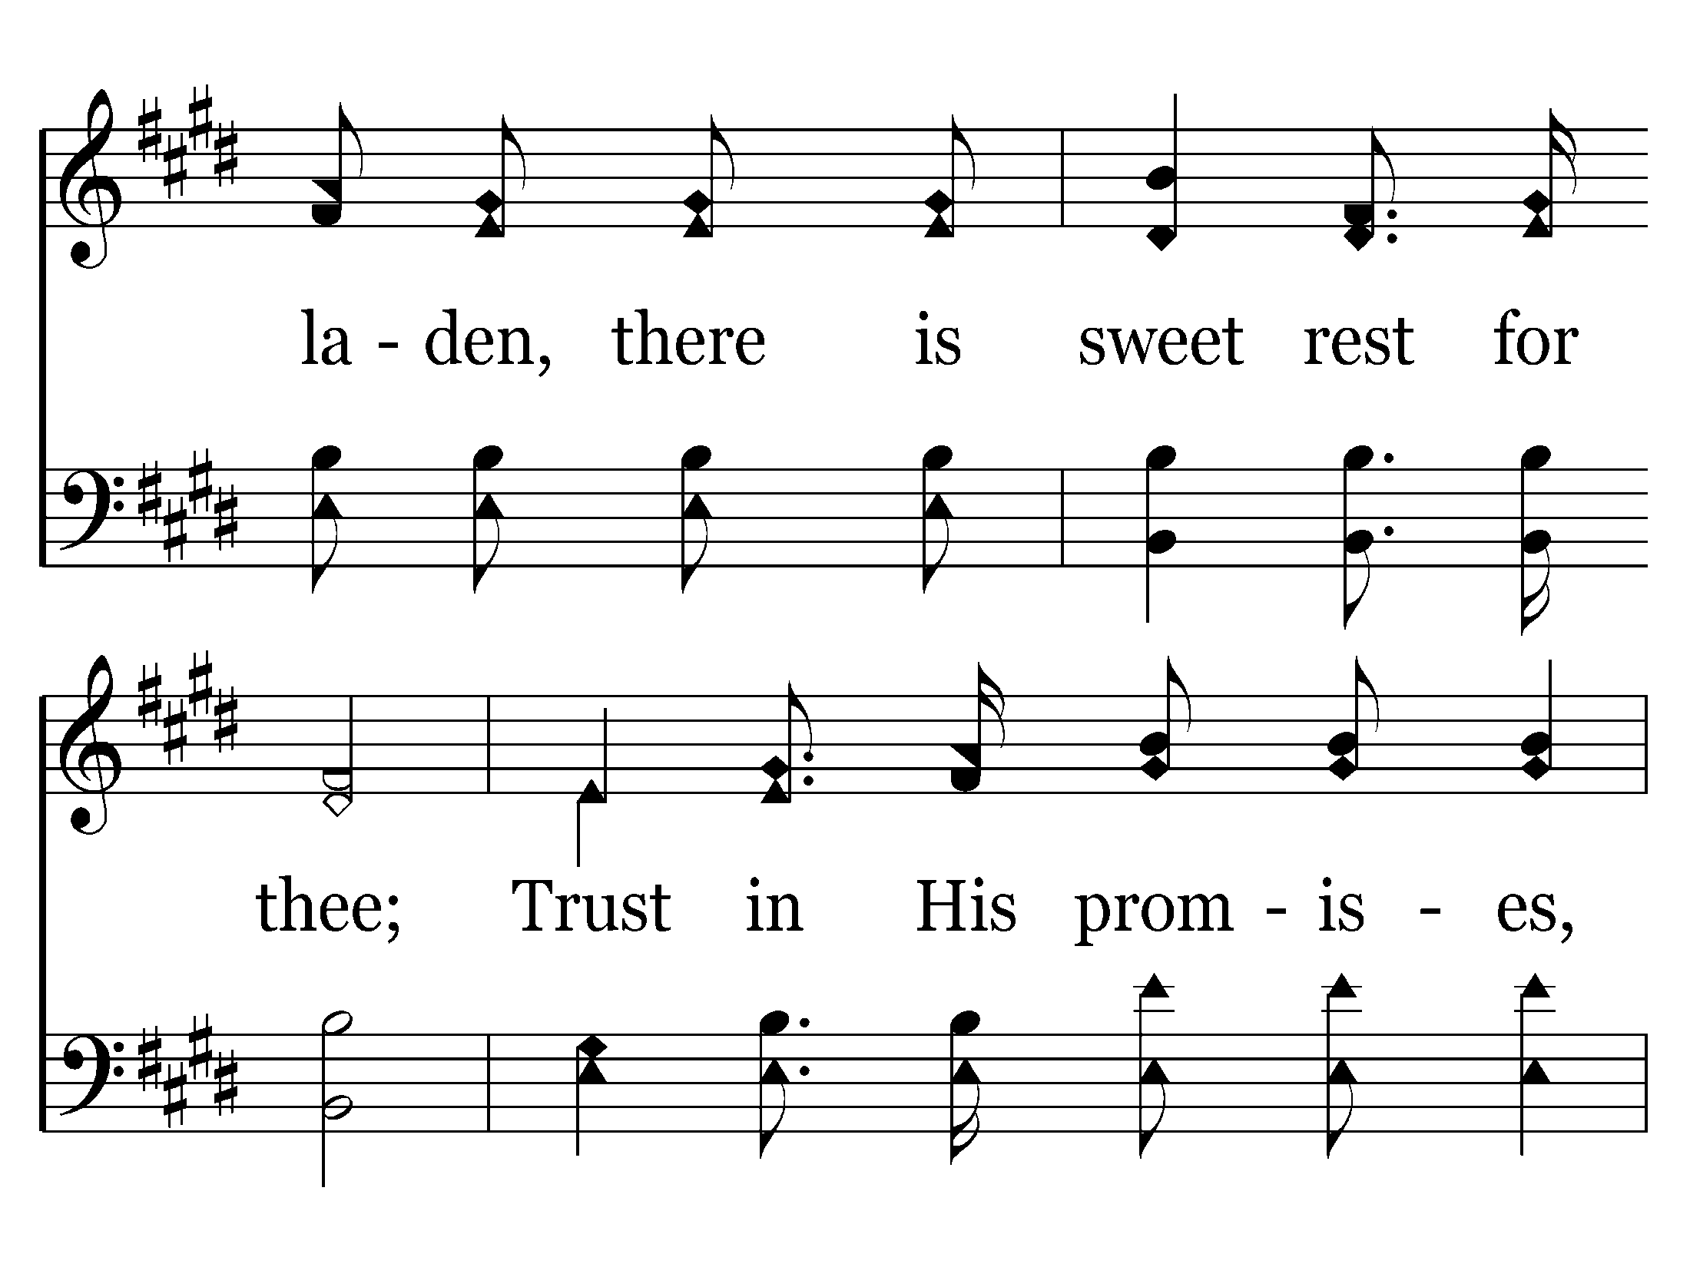
498 - Where He Leads I'll Follow - 3.2

Slide 53
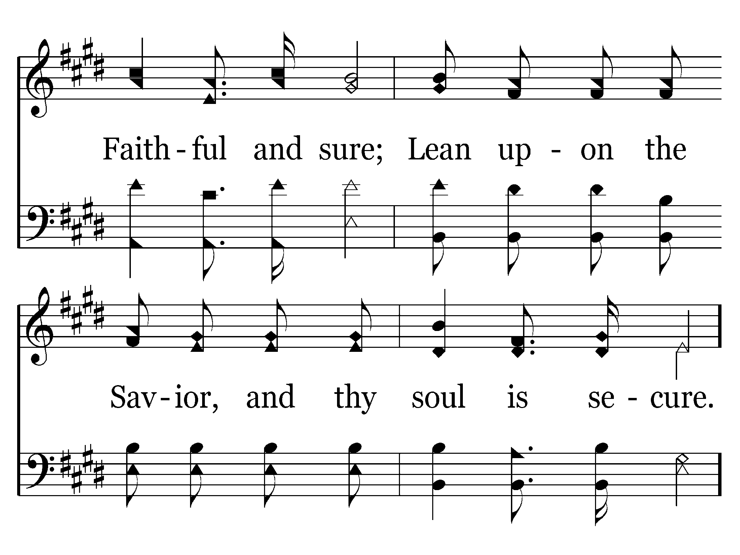
498 - Where He Leads I'll Follow - 3.3

Slide 54
498 - Where He Leads I'll Follow - C.1

Slide 55
498 - Where He Leads I'll Follow - C.2

Slide 56
498 - Where He Leads I'll Follow - C.3

Slide 57
498 - Where He Leads I'll Follow - C.4
End of Song

