Slide 2
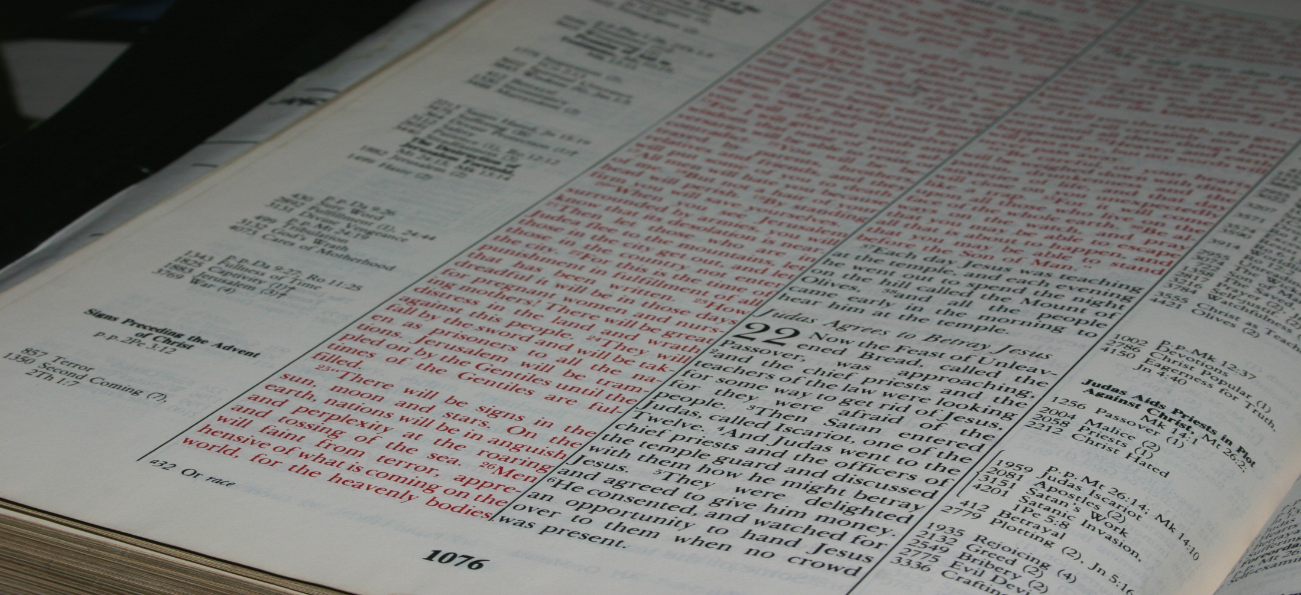
I write so that you may know how you ought to conduct yourself in the house of God, which is the church of the living God, the pillar and ground of the truth.
1 Timothy 3:15
Real Life For Everyone!
Northwest Church of Christ April 20-25, 2014

Slide 3
Stand For Truth Without Compromise
Promote An Evangelistic Culture
Consistently Practice Church Discipline
Reject Cultural Barriers
Promote A Spirit Of Excellence
Promote A Spirit Of Unity
Have Growing Leaders
Believe in the Success
of God's Work
GREAT CHURCHES DO GREAT THINGS

