Slide 2
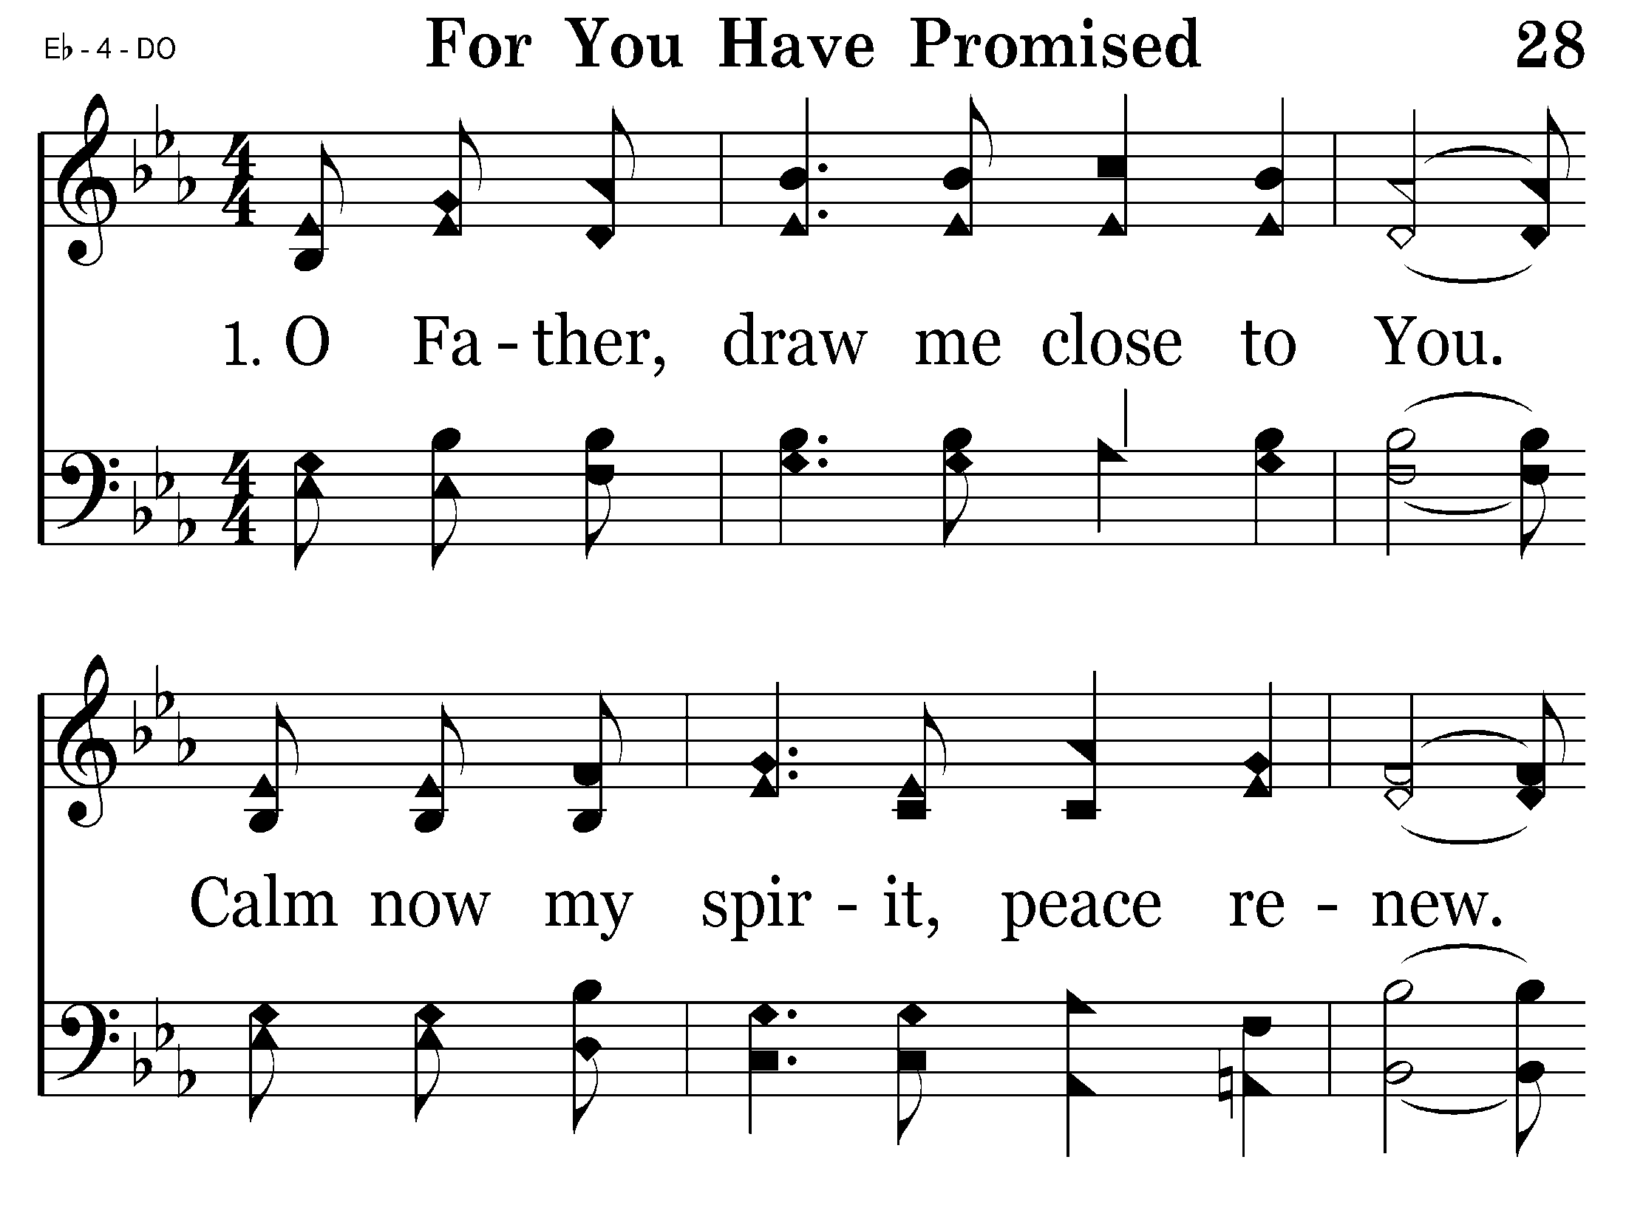
028 - For You Have Promised - 1.1

Slide 3
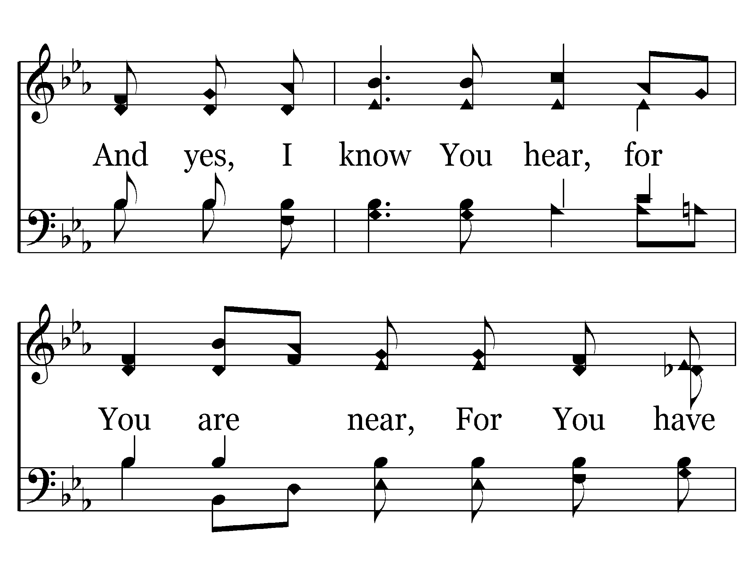
028 - For You Have Promised - 1.2

Slide 4
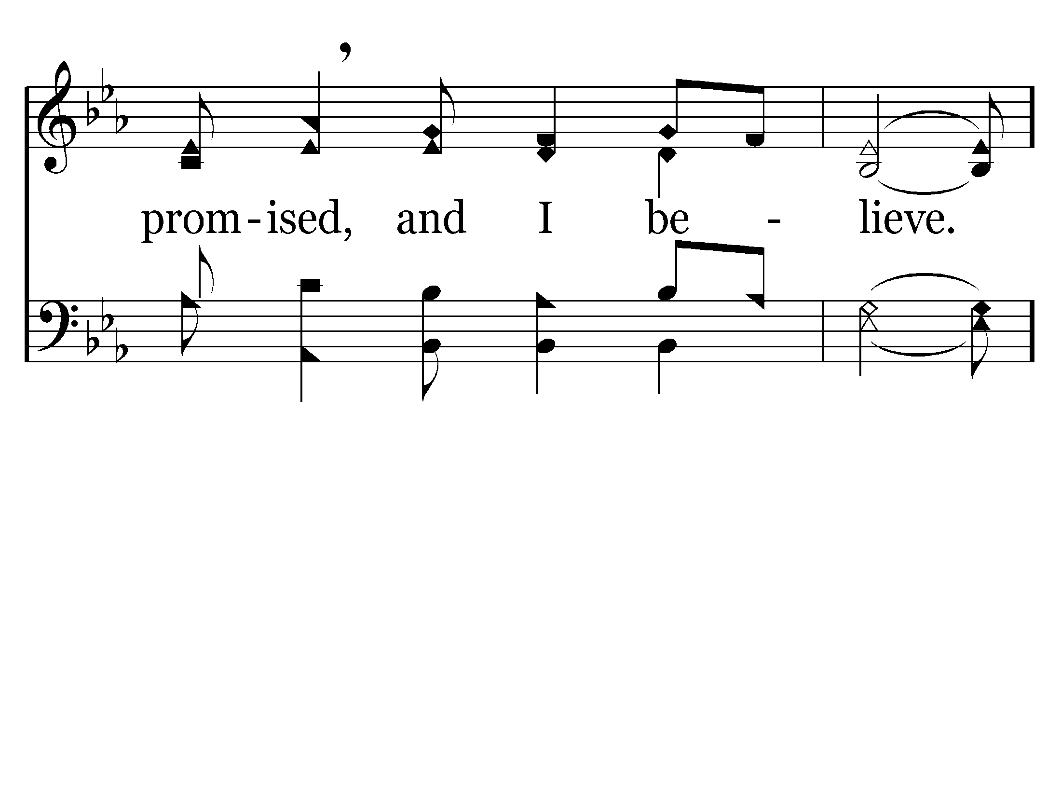
028 - For You Have Promised - 1.3

Slide 5
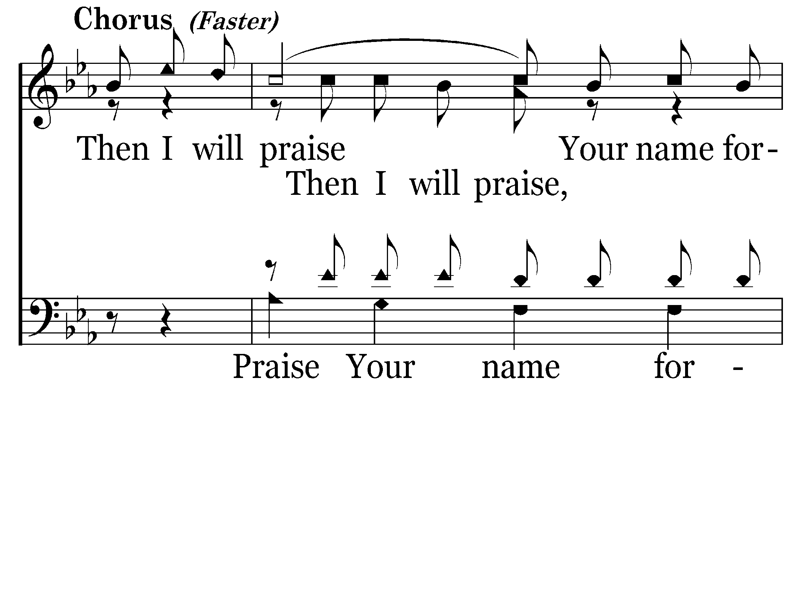
028 - For You Have Promised - C.1

Slide 6
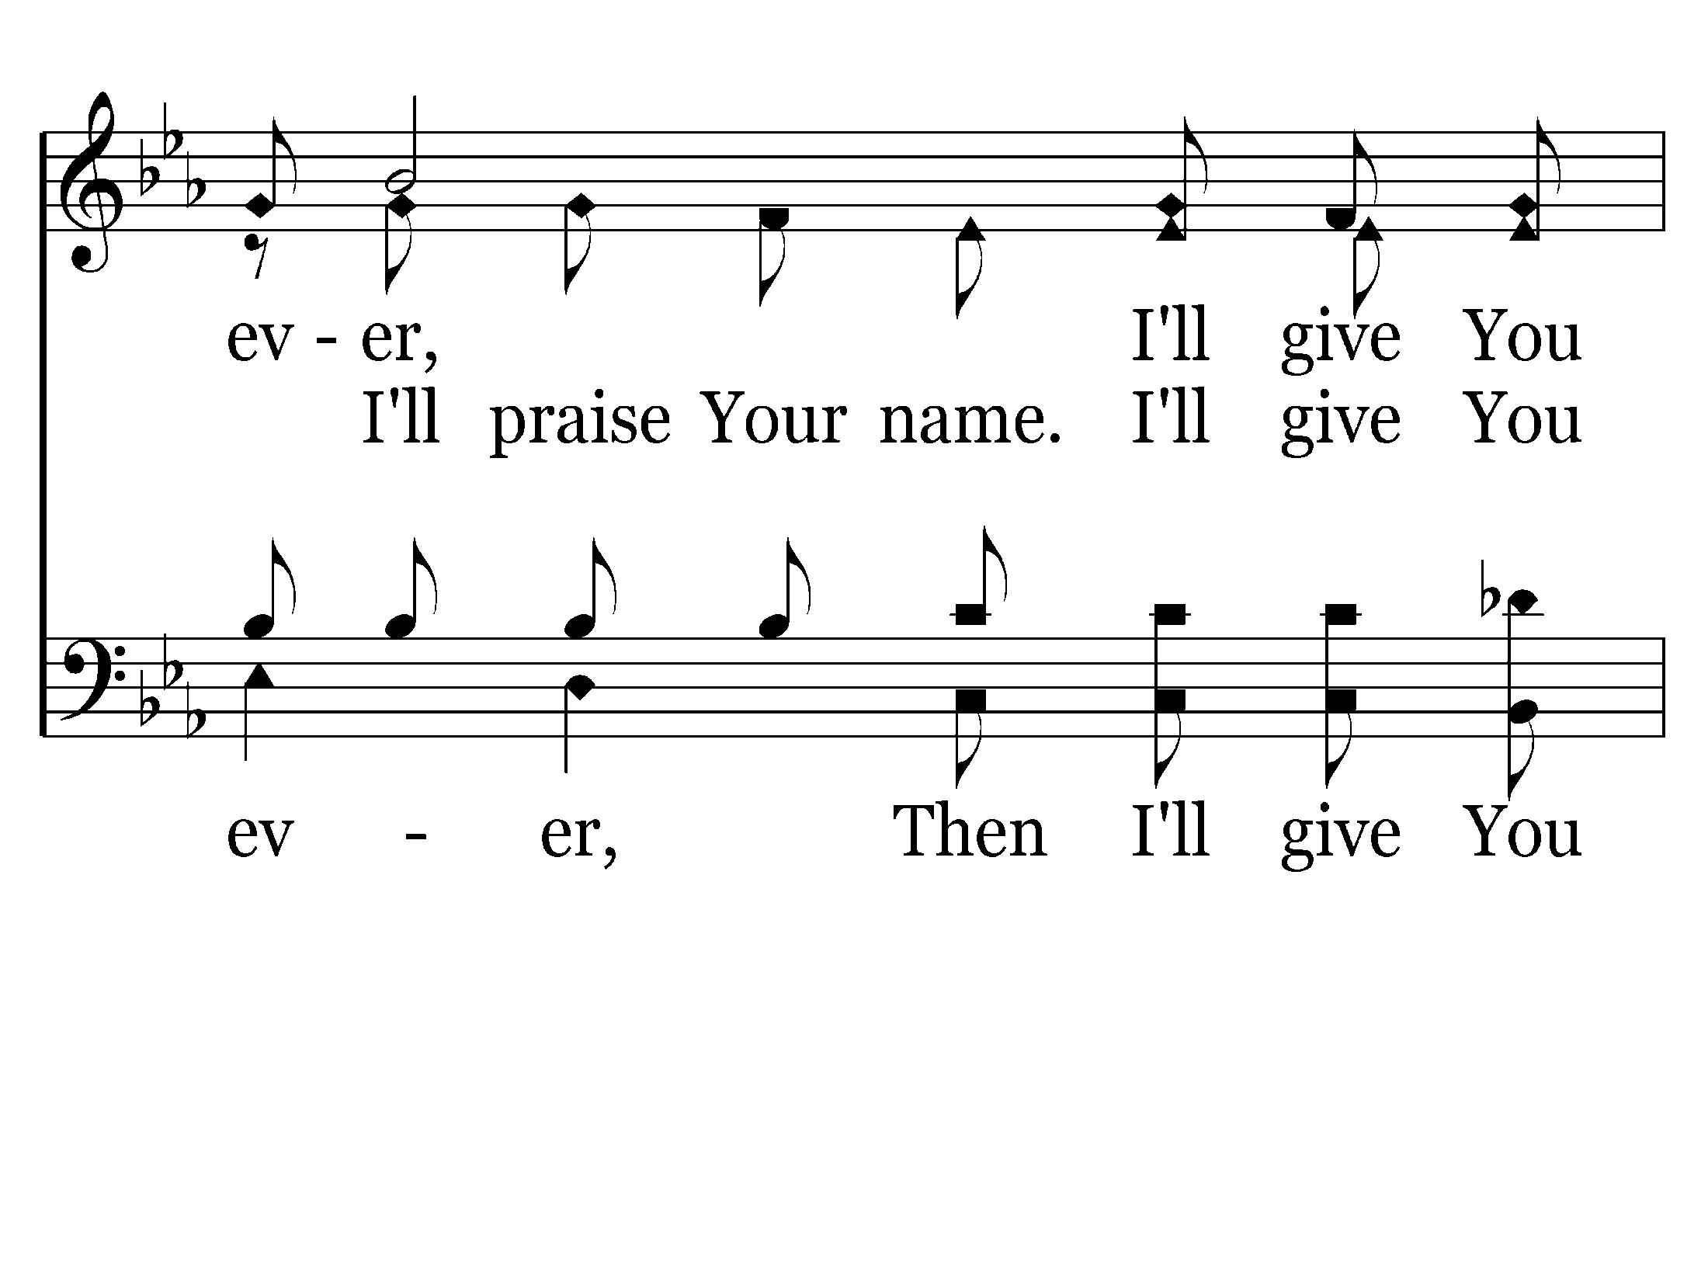
028 - For You Have Promised - C.2

Slide 7
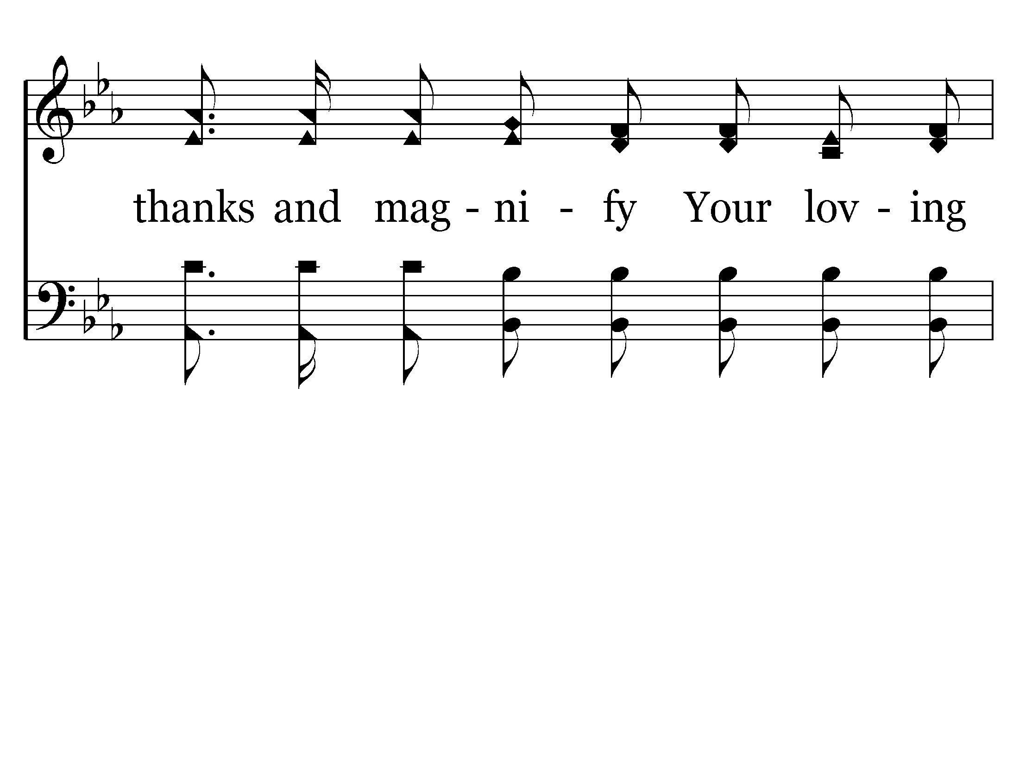
028 - For You Have Promised - C.3

Slide 8
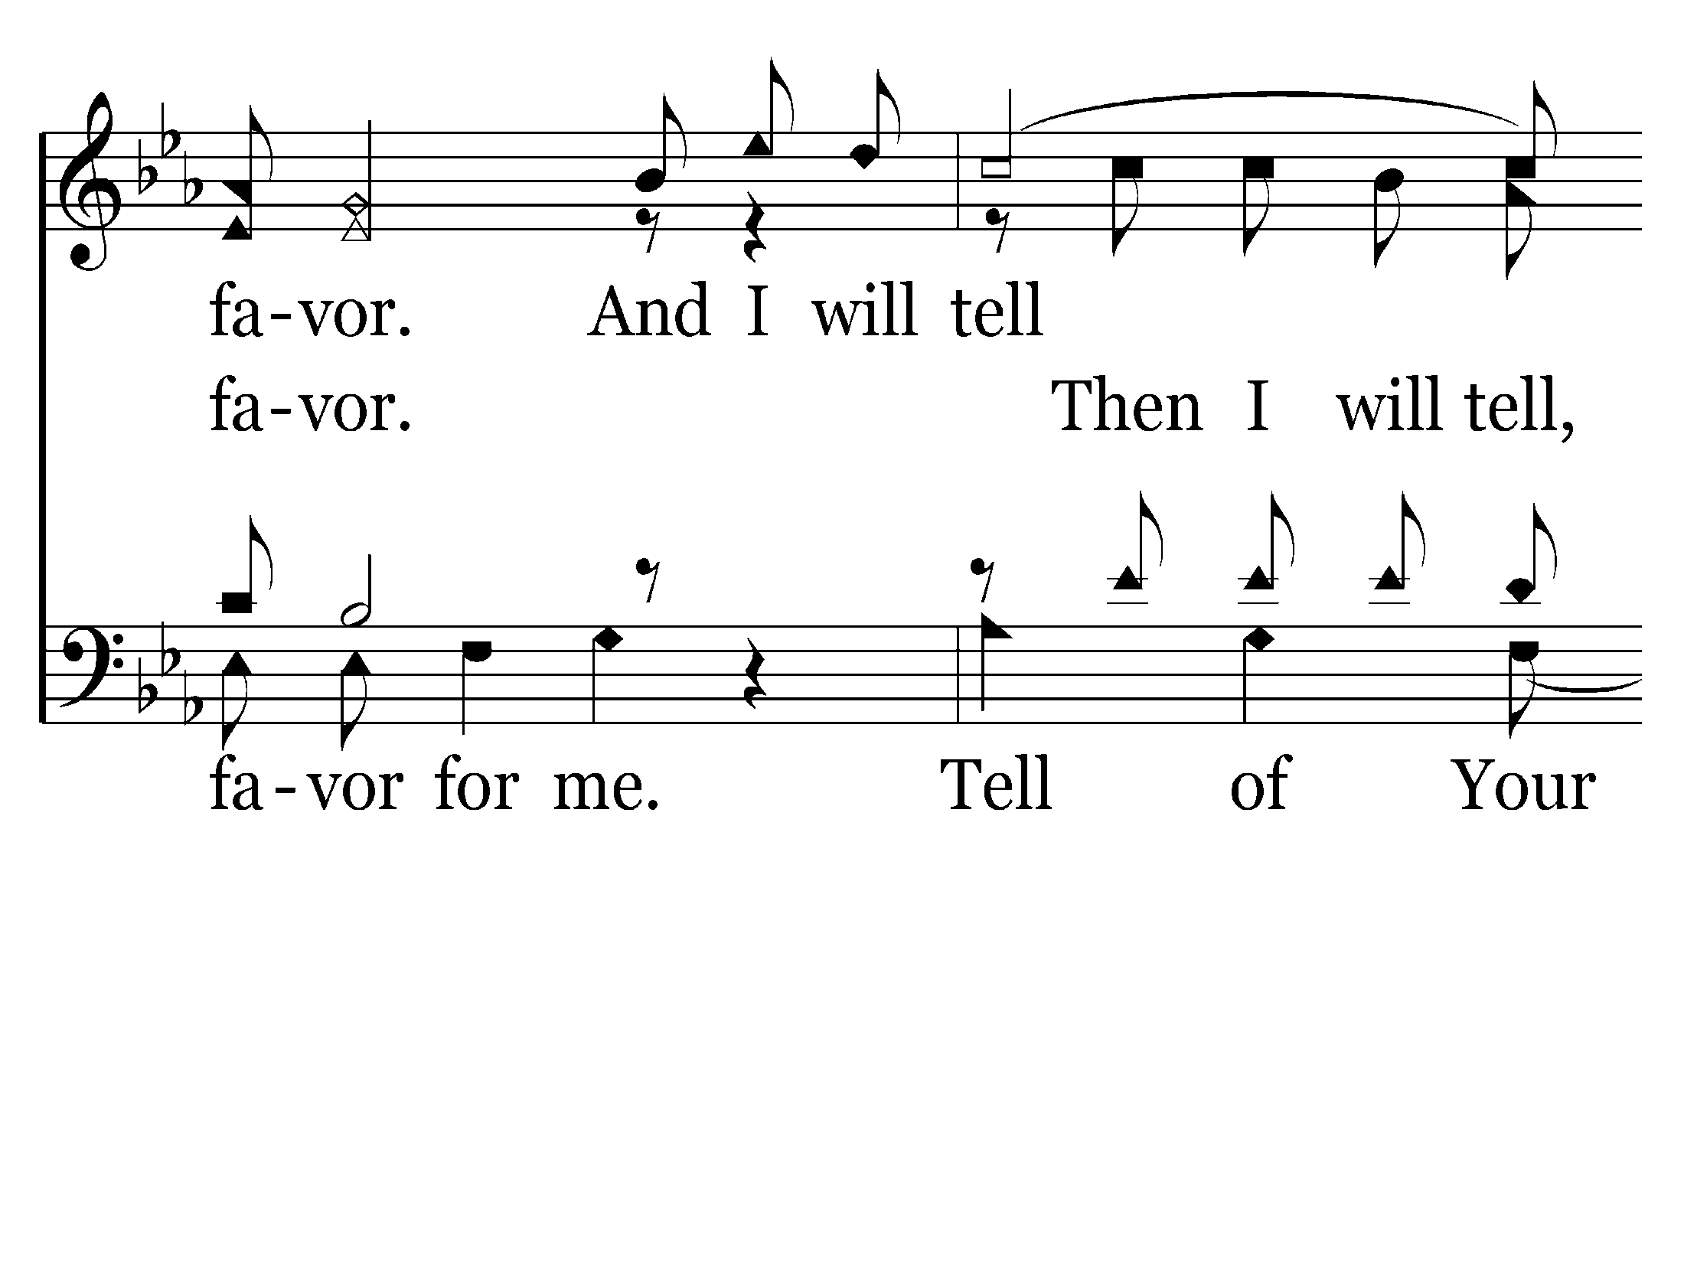
028 - For You Have Promised - C.4

Slide 9
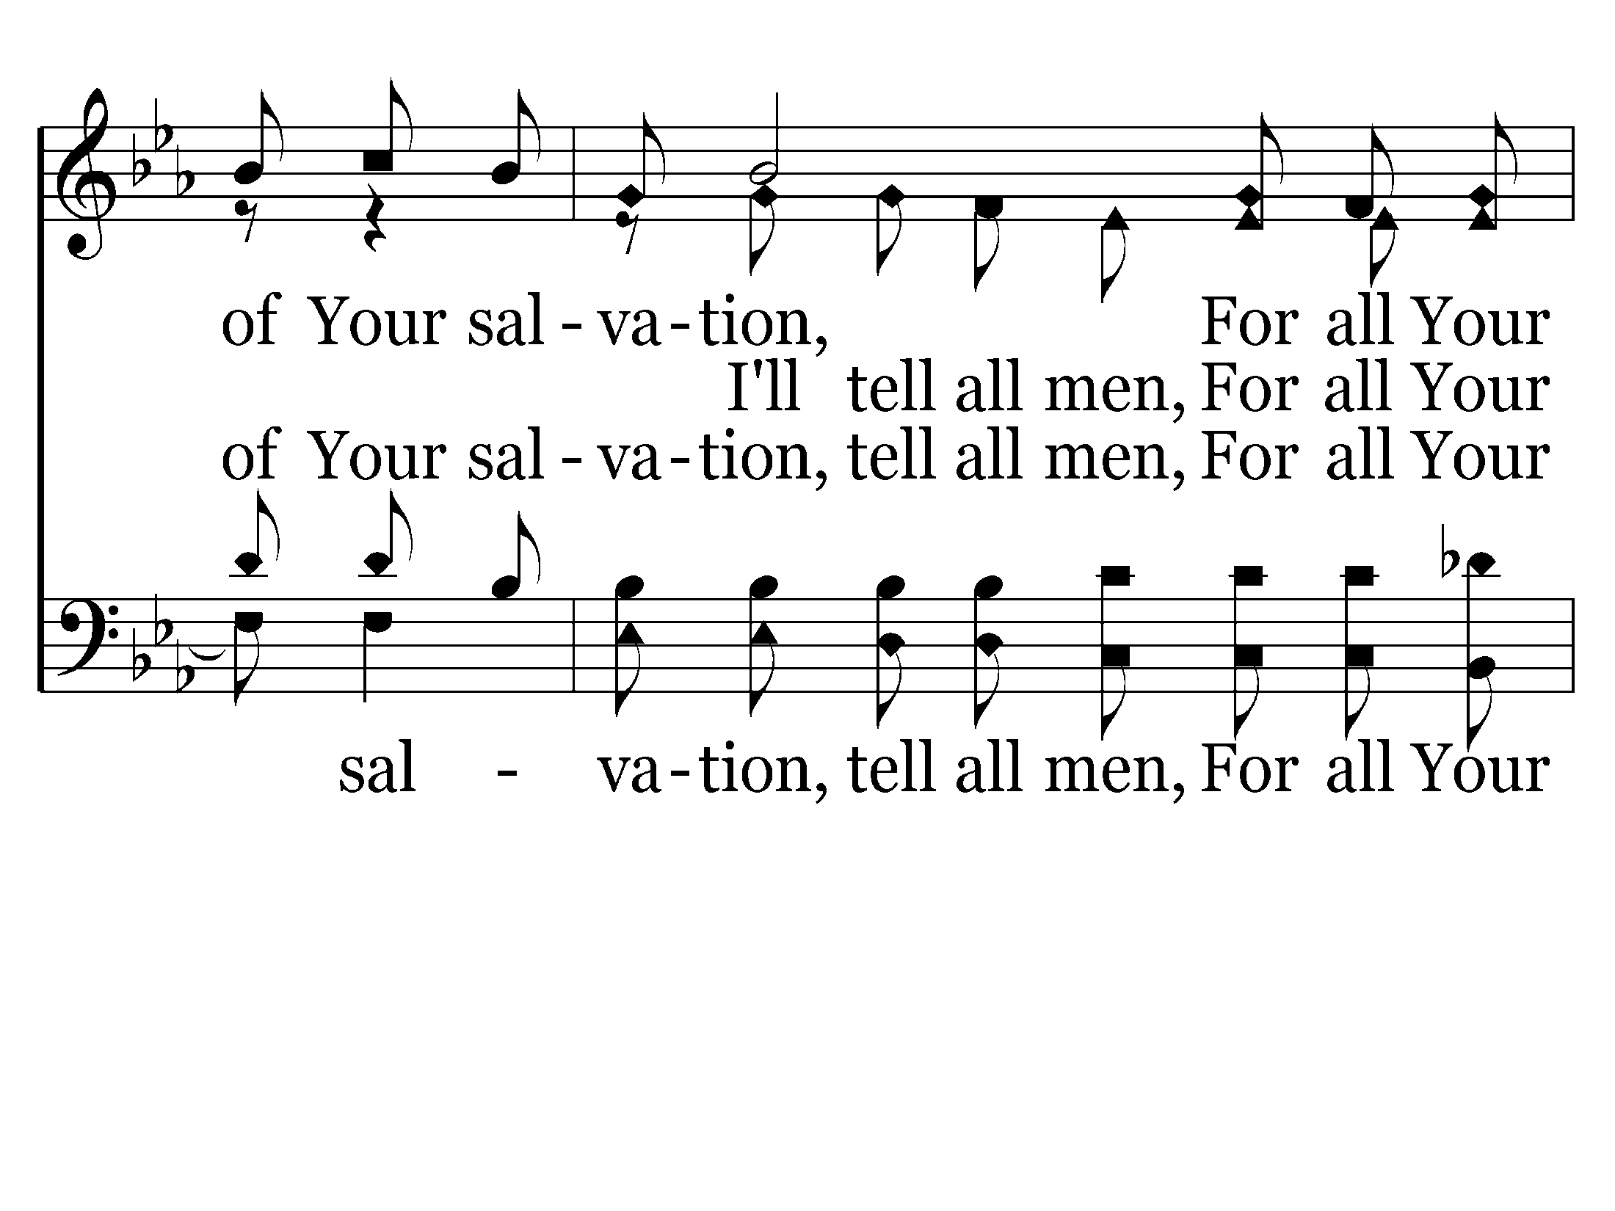
028 - For You Have Promised - C.5

Slide 10
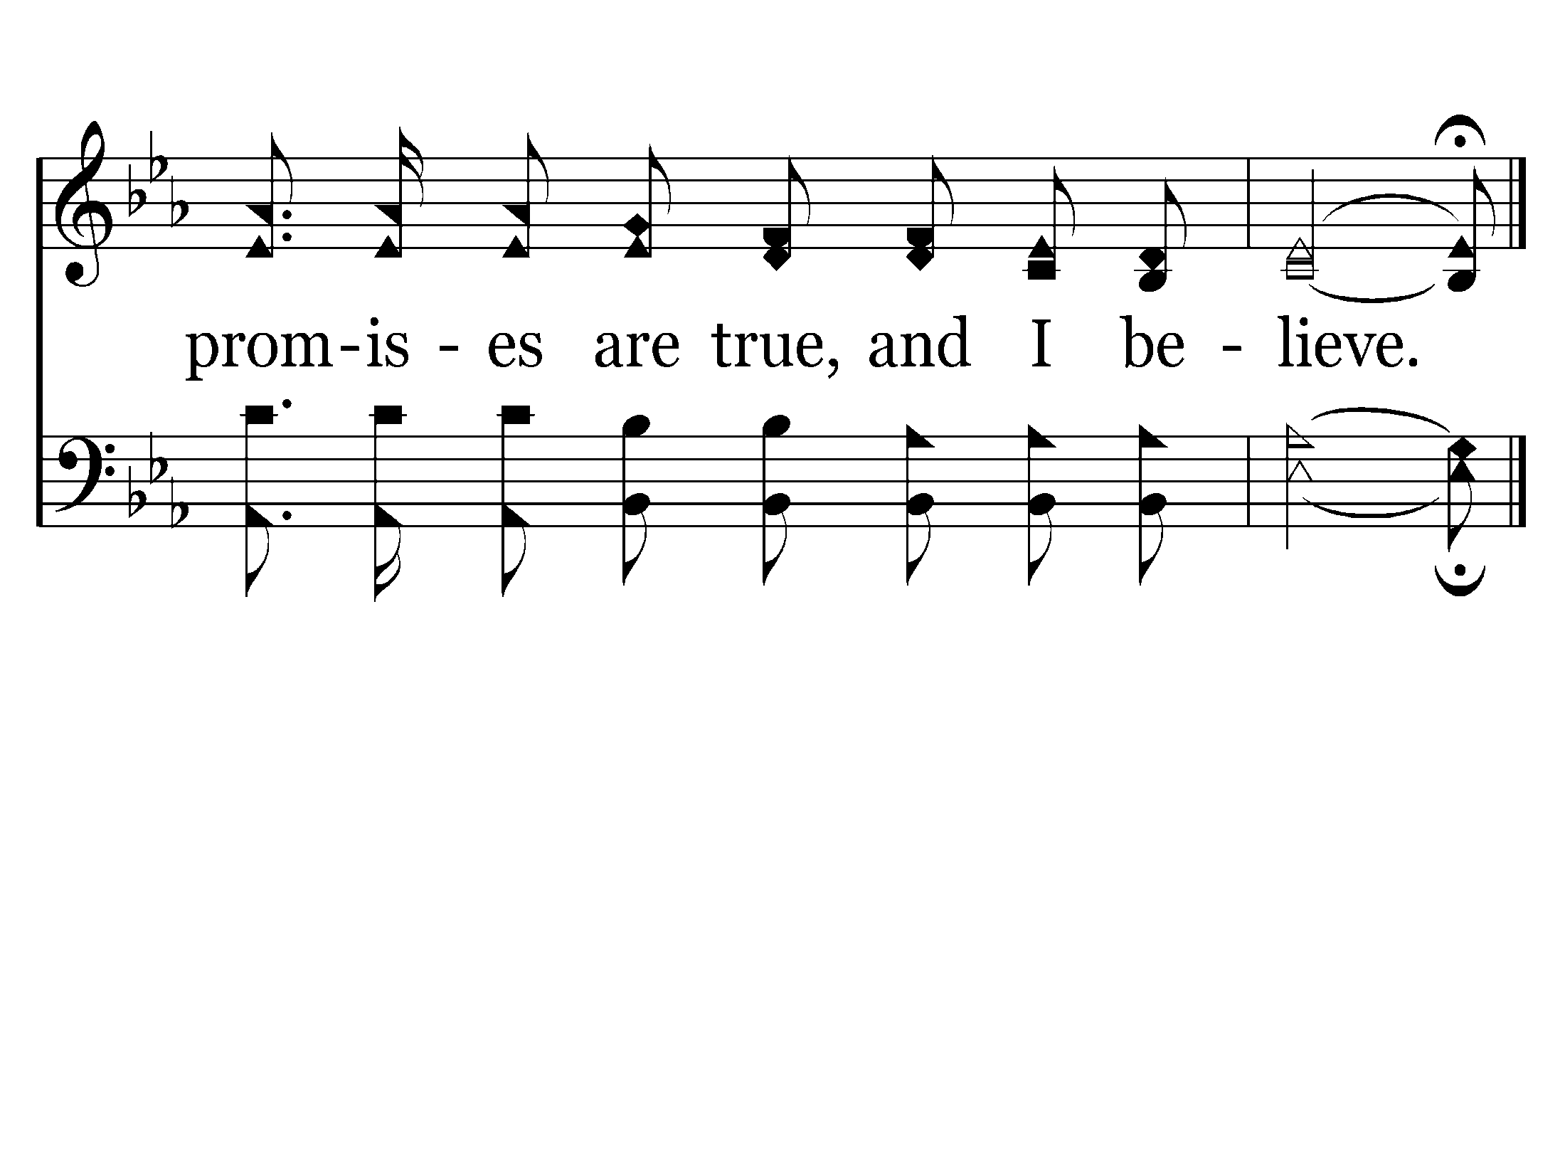
028 - For You Have Promised - C.6
End of Verse 1

Slide 11
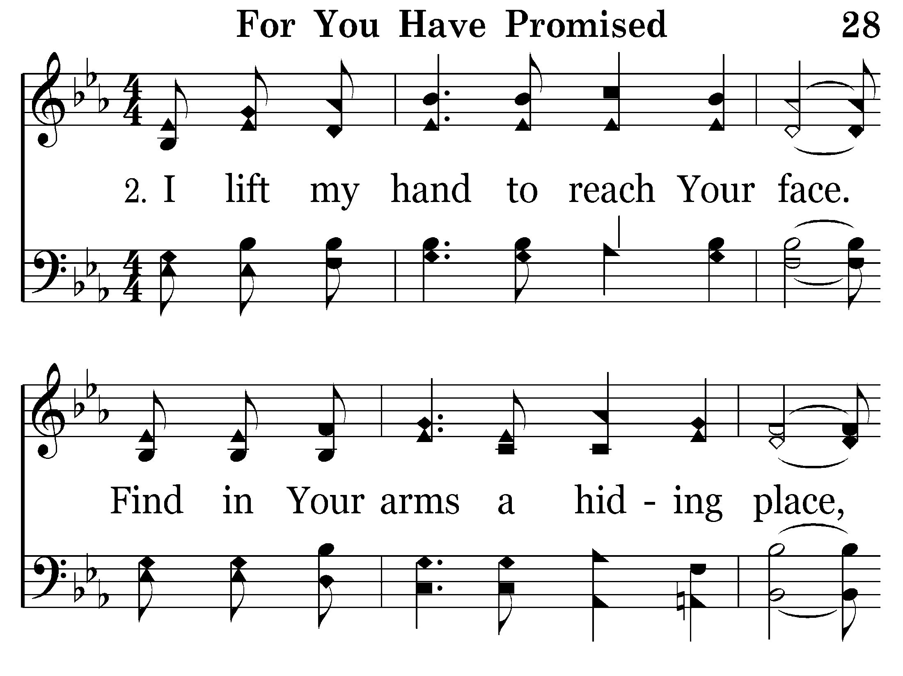
028 - For You Have Promised - 2.1

Slide 12
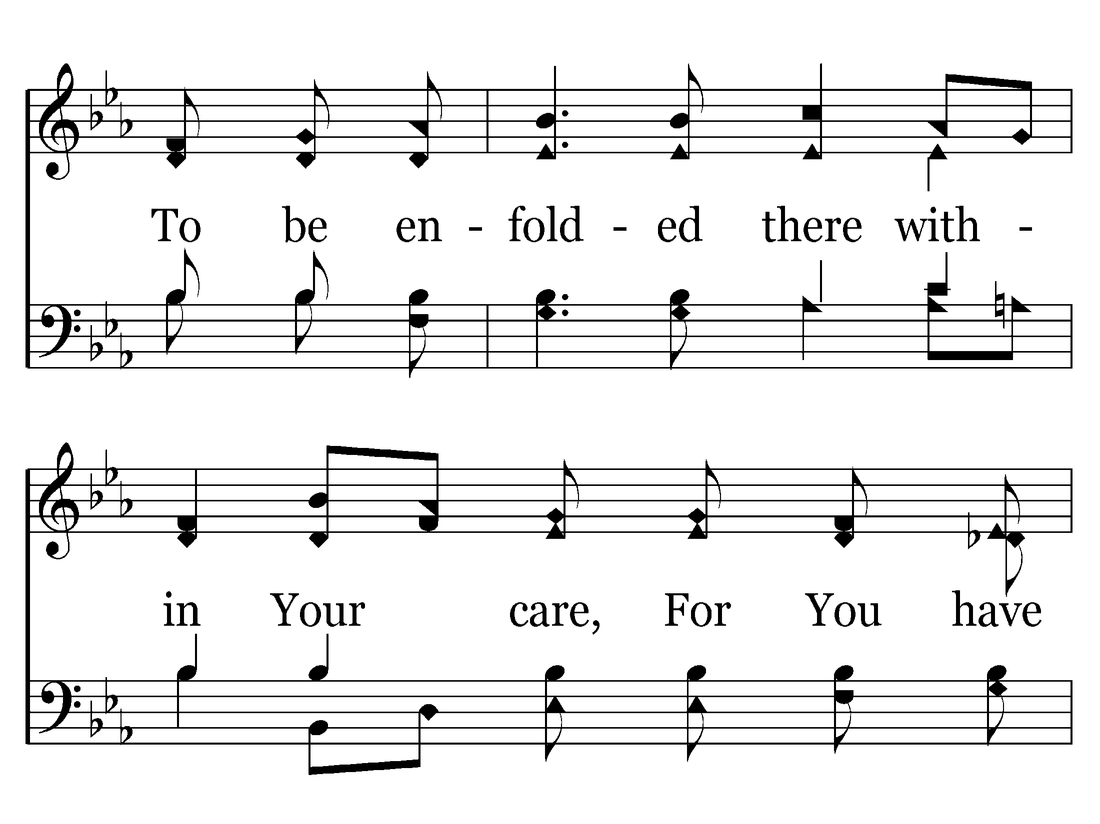
028 - For You Have Promised - 2.2

Slide 13
028 - For You Have Promised - 2.3

Slide 14
028 - For You Have Promised - C.1

Slide 15
028 - For You Have Promised - C.2

Slide 16
028 - For You Have Promised - C.3

Slide 17
028 - For You Have Promised - C.4

Slide 18
028 - For You Have Promised - C.5

Slide 19
028 - For You Have Promised - C.6
End of Verse 2

Slide 20
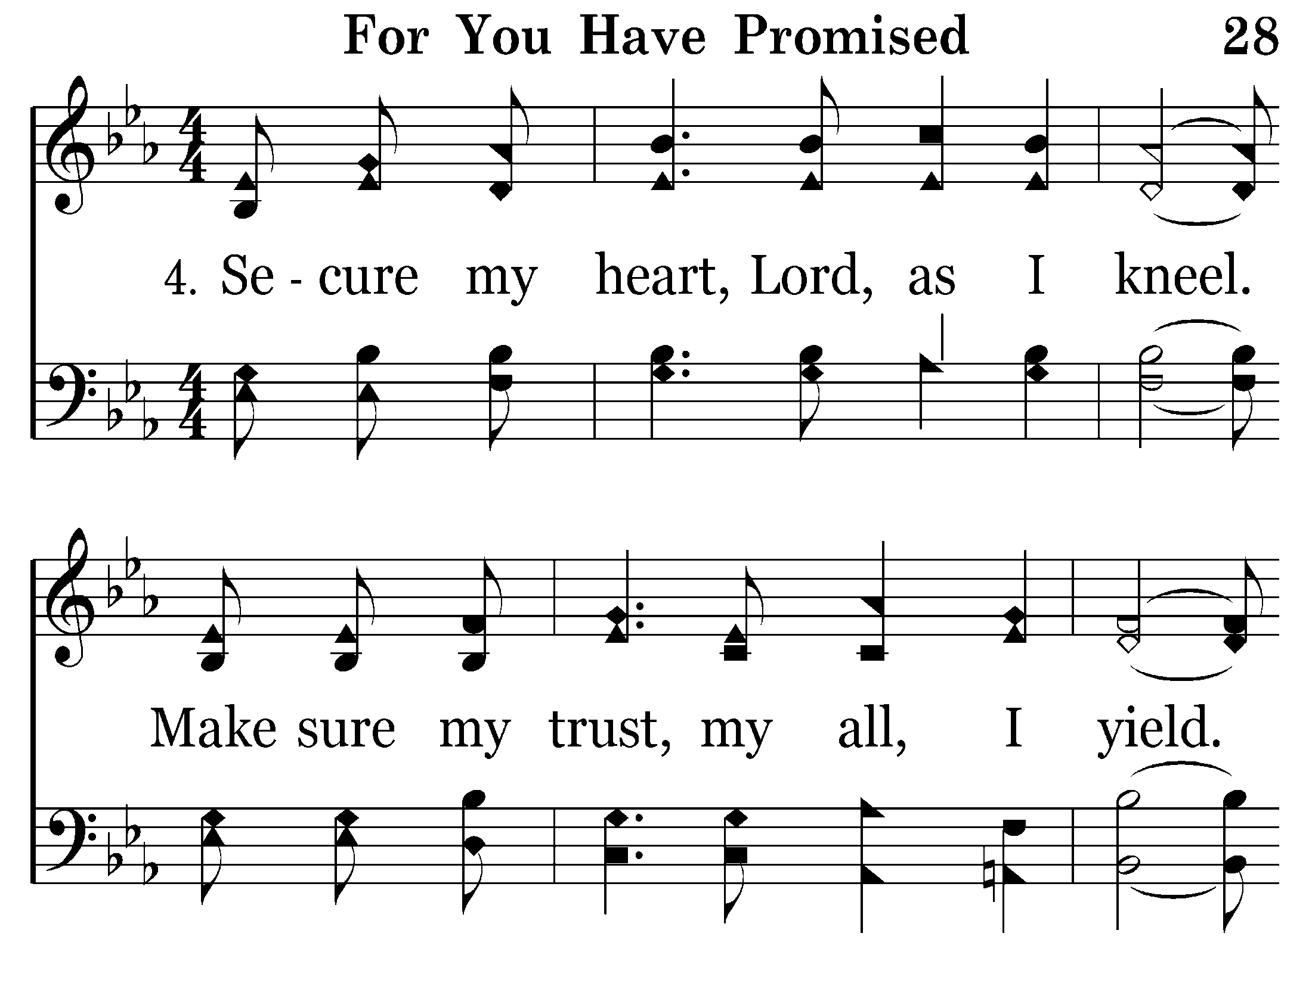
028 - For You Have Promised - 4.1

Slide 21
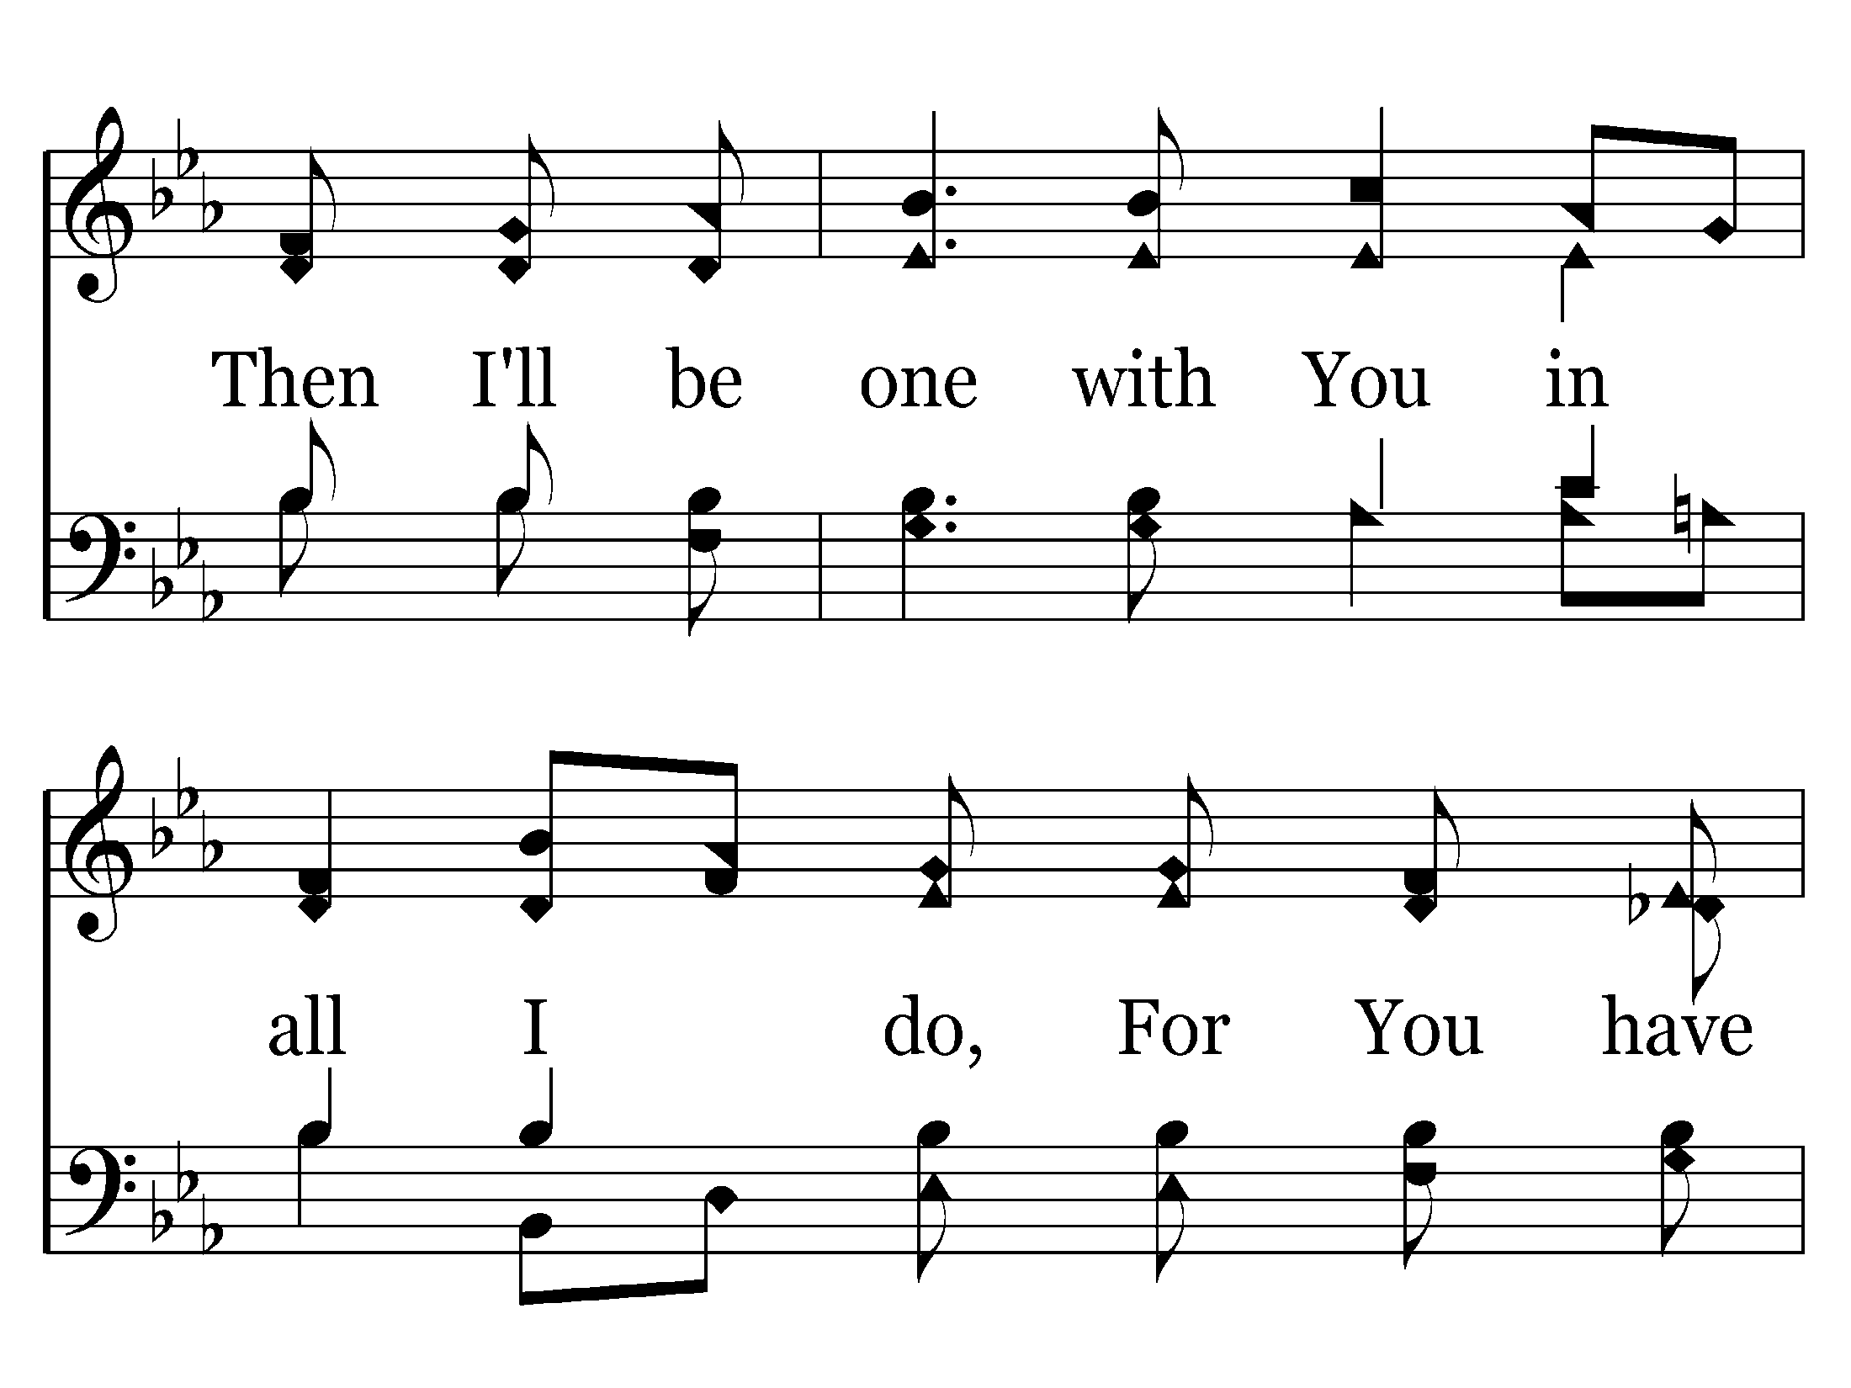
028 - For You Have Promised - 4.2

Slide 22
028 - For You Have Promised - 4.3

Slide 23
028 - For You Have Promised - C.1

Slide 24
028 - For You Have Promised - C.2

Slide 25
028 - For You Have Promised - C.3

Slide 26
028 - For You Have Promised - C.4

Slide 27
028 - For You Have Promised - C.5

Slide 28
028 - For You Have Promised - C.6
End of Song

Slide 30
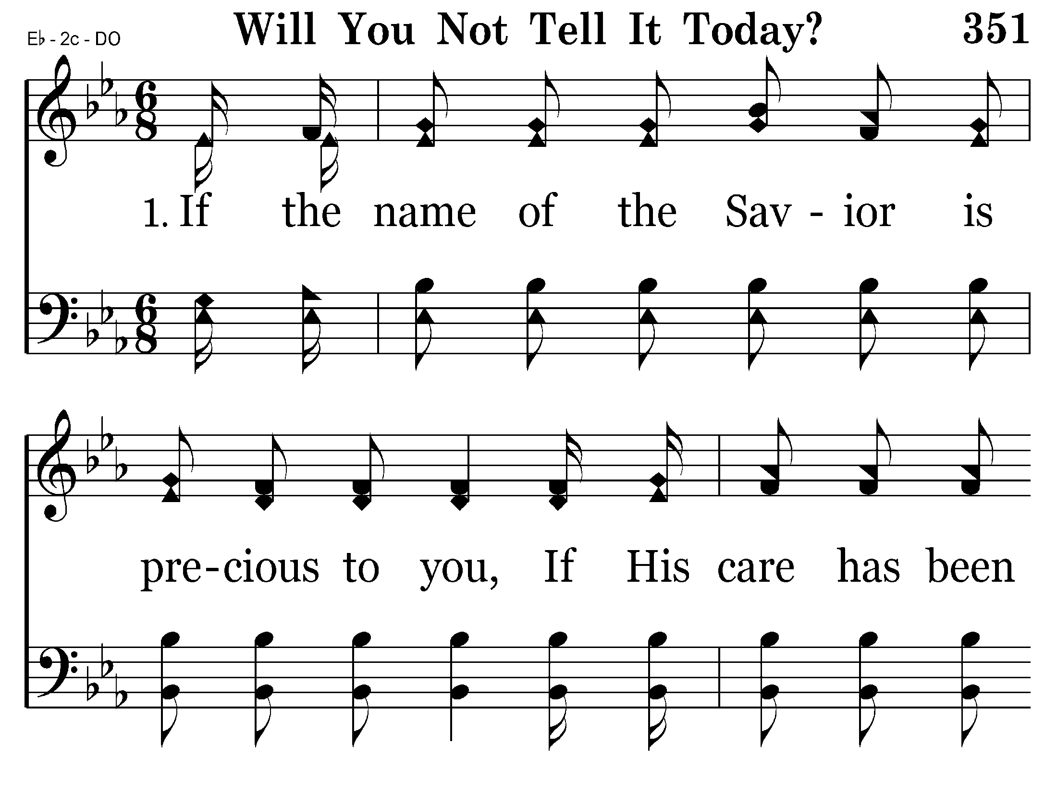
351 - Will You Not Tell It Today - 1.1

Slide 31
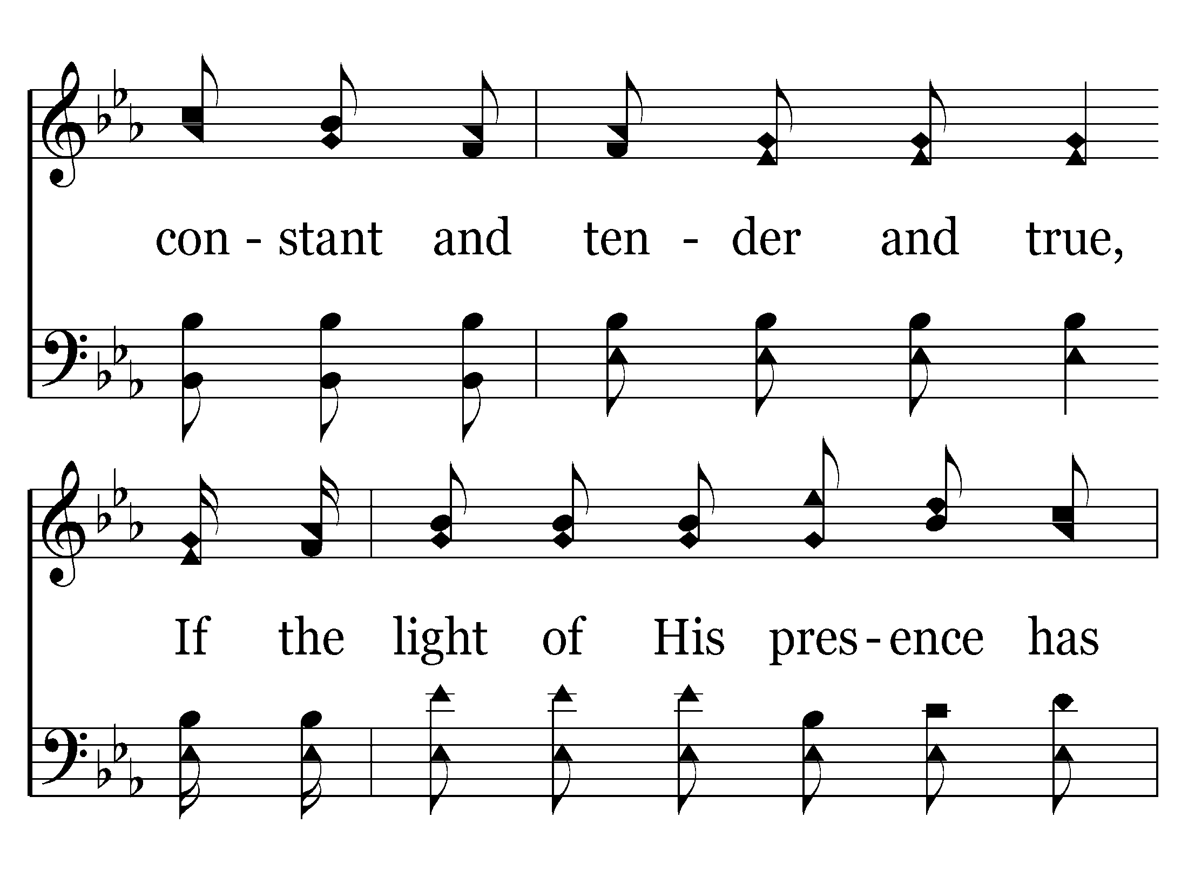
351 - Will You Not Tell It Today - 1.2

Slide 32
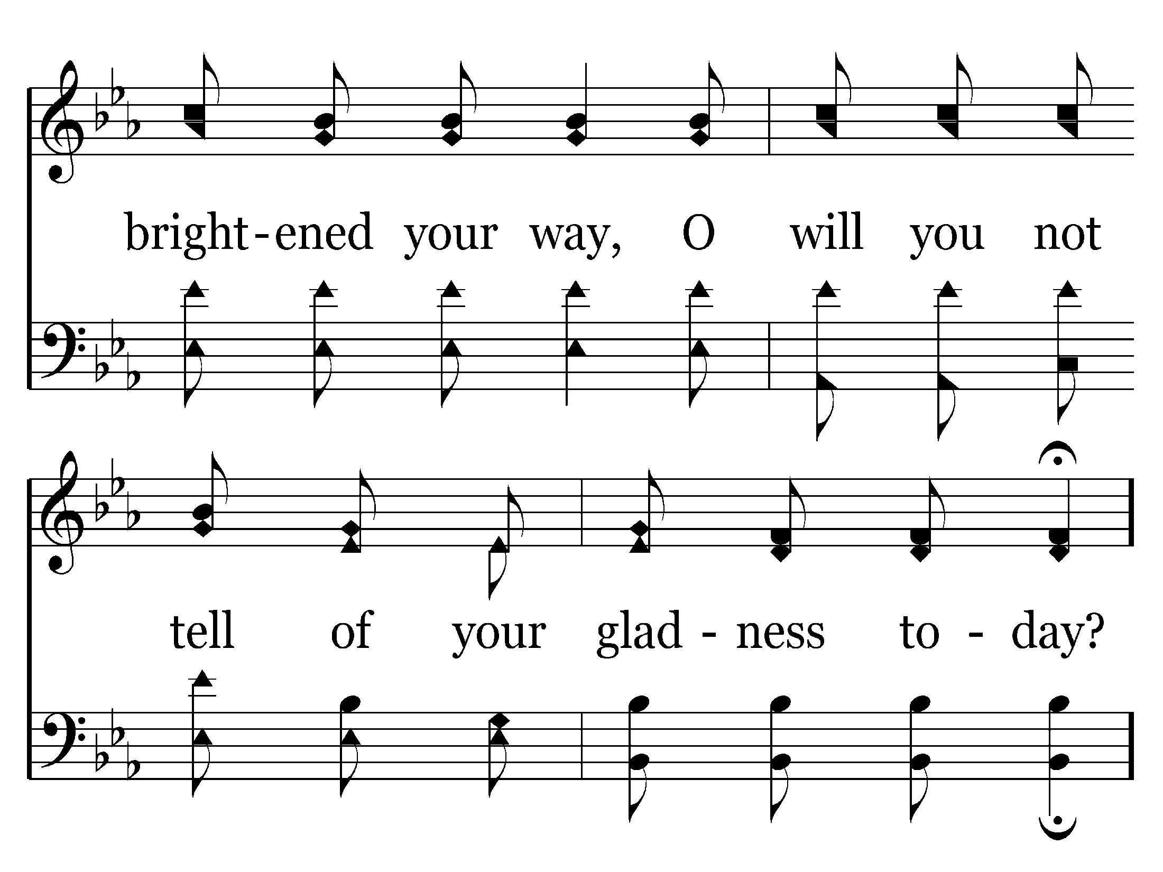
351 - Will You Not Tell It Today - 1.3

Slide 33
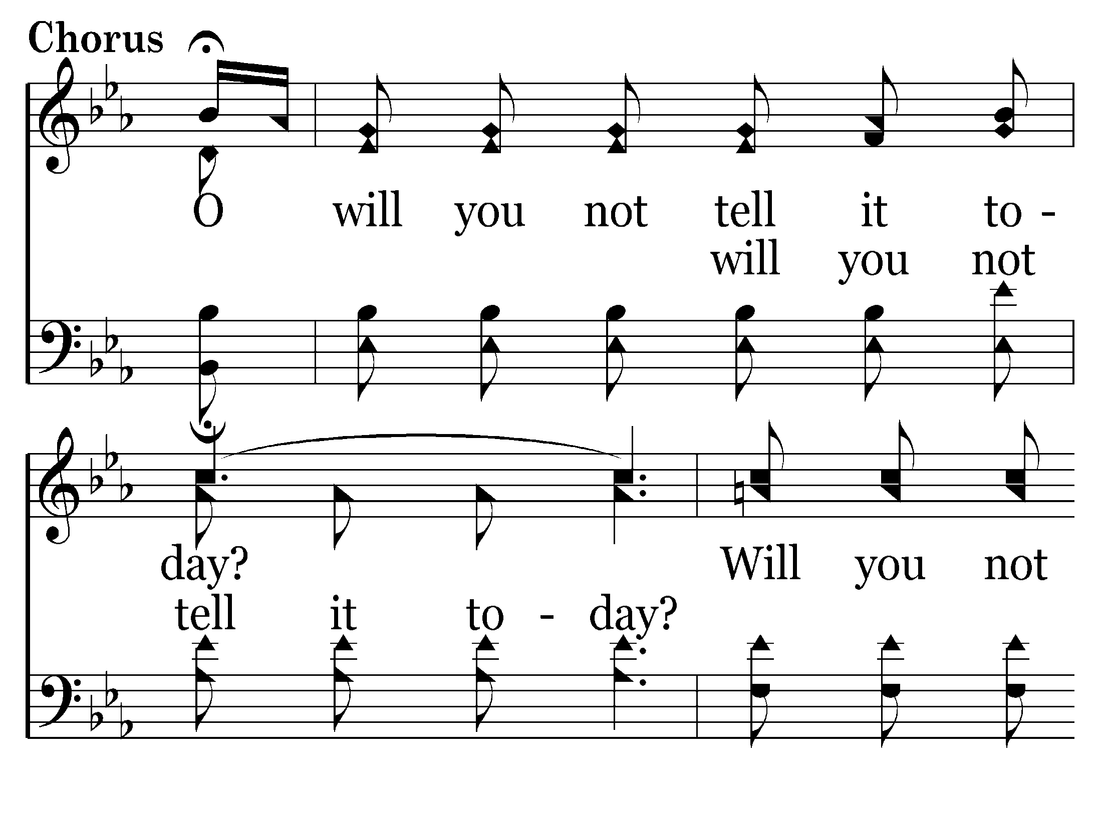
351 - Will You Not Tell It Today - C.1

Slide 34
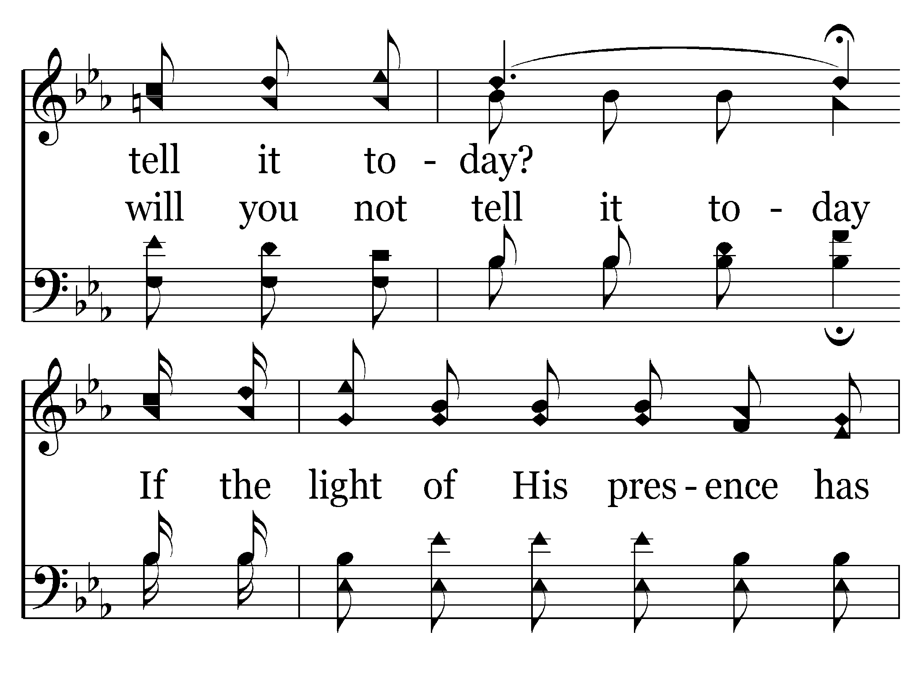
351 - Will You Not Tell It Today - C.2

Slide 35
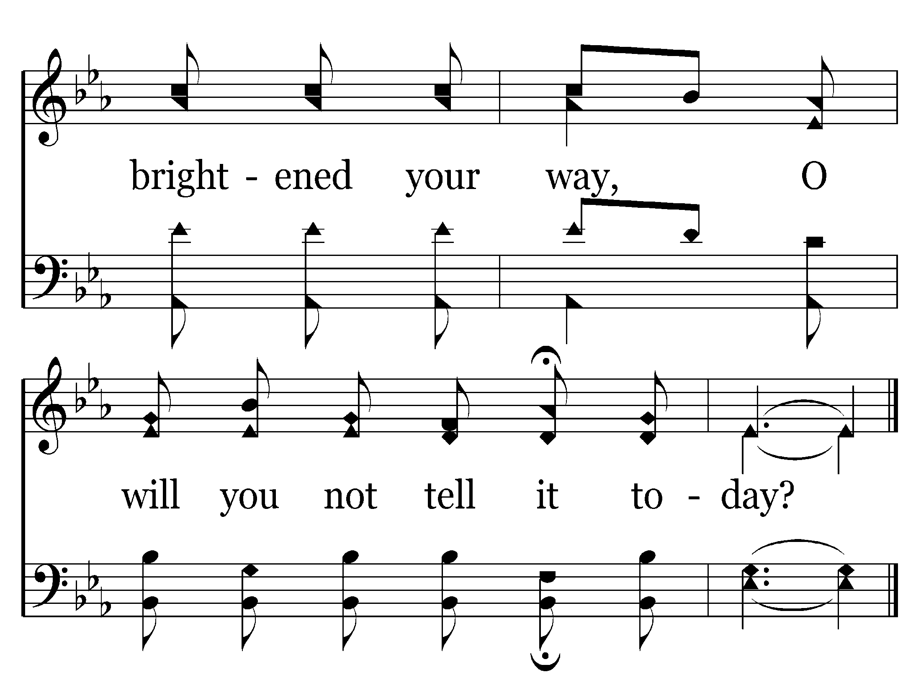
351 - Will You Not Tell It Today - C.3
End of Verse 1

Slide 36
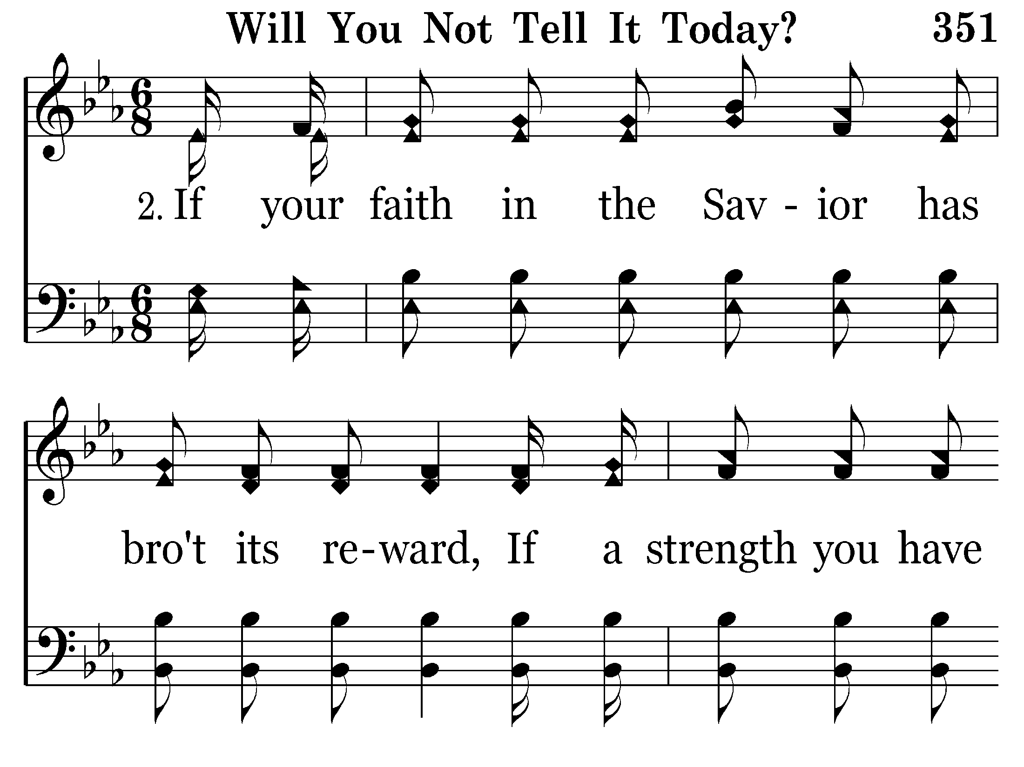
351 - Will You Not Tell It Today - 2.1

Slide 37
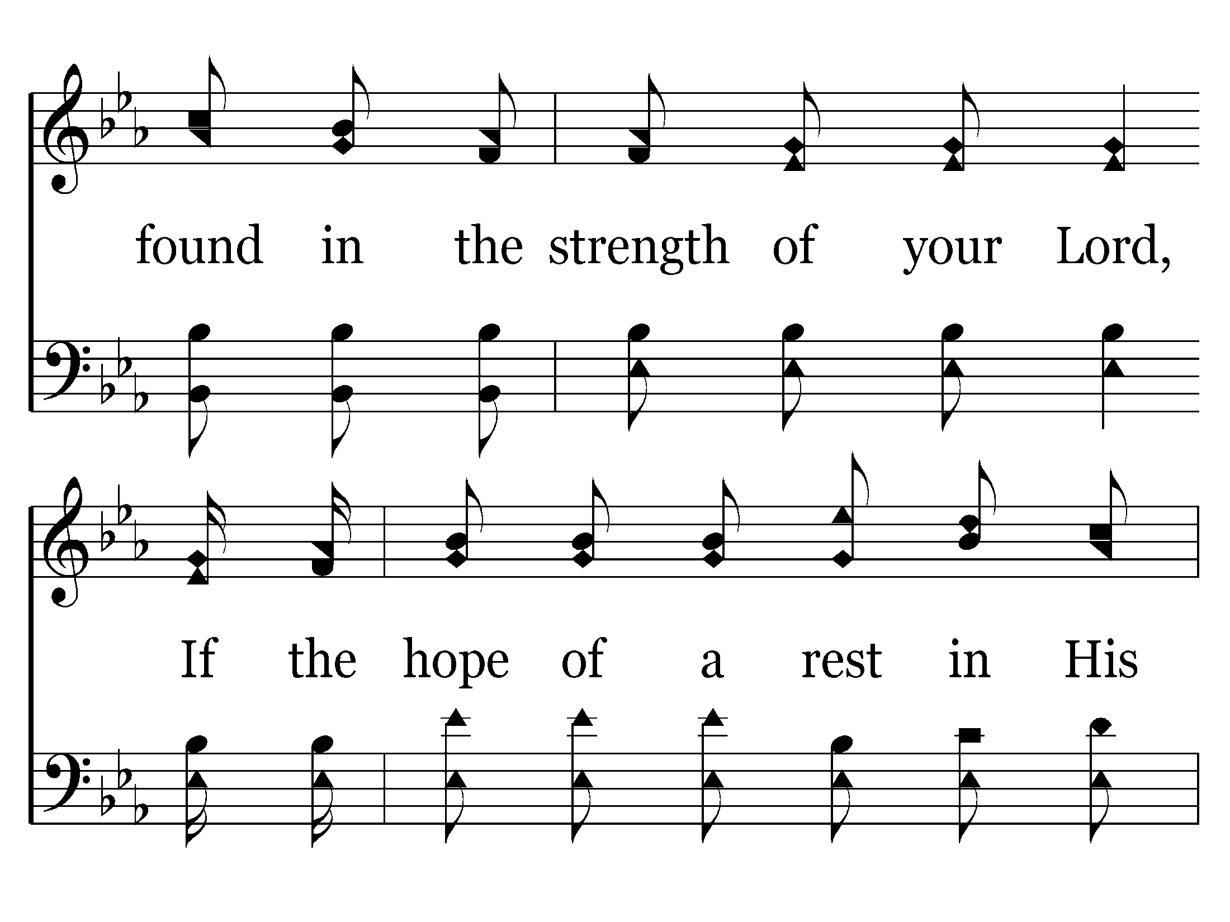
351 - Will You Not Tell It Today - 2.2

Slide 38
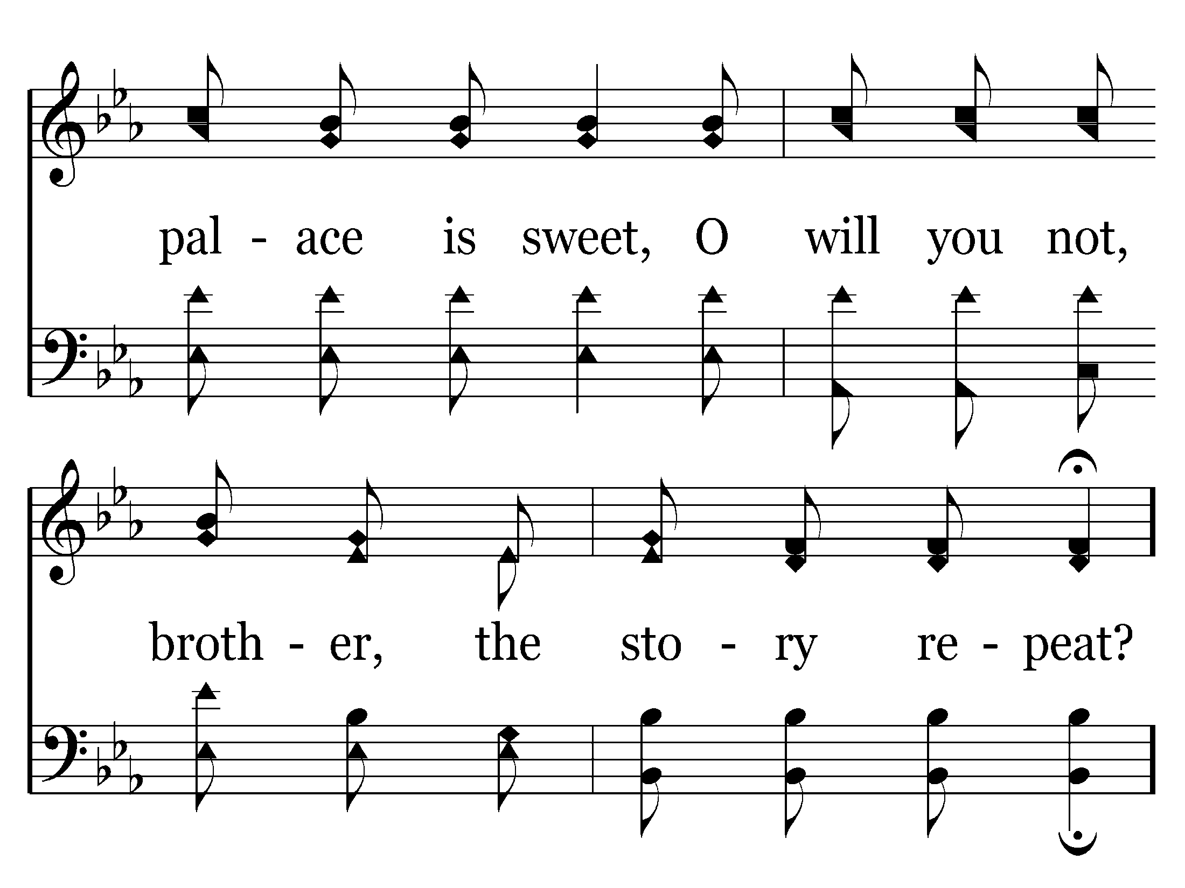
351 - Will You Not Tell It Today - 2.3

Slide 39
351 - Will You Not Tell It Today - C.1

Slide 40
351 - Will You Not Tell It Today - C.2

Slide 41
351 - Will You Not Tell It Today - C.3
End of Verse 2

Slide 42
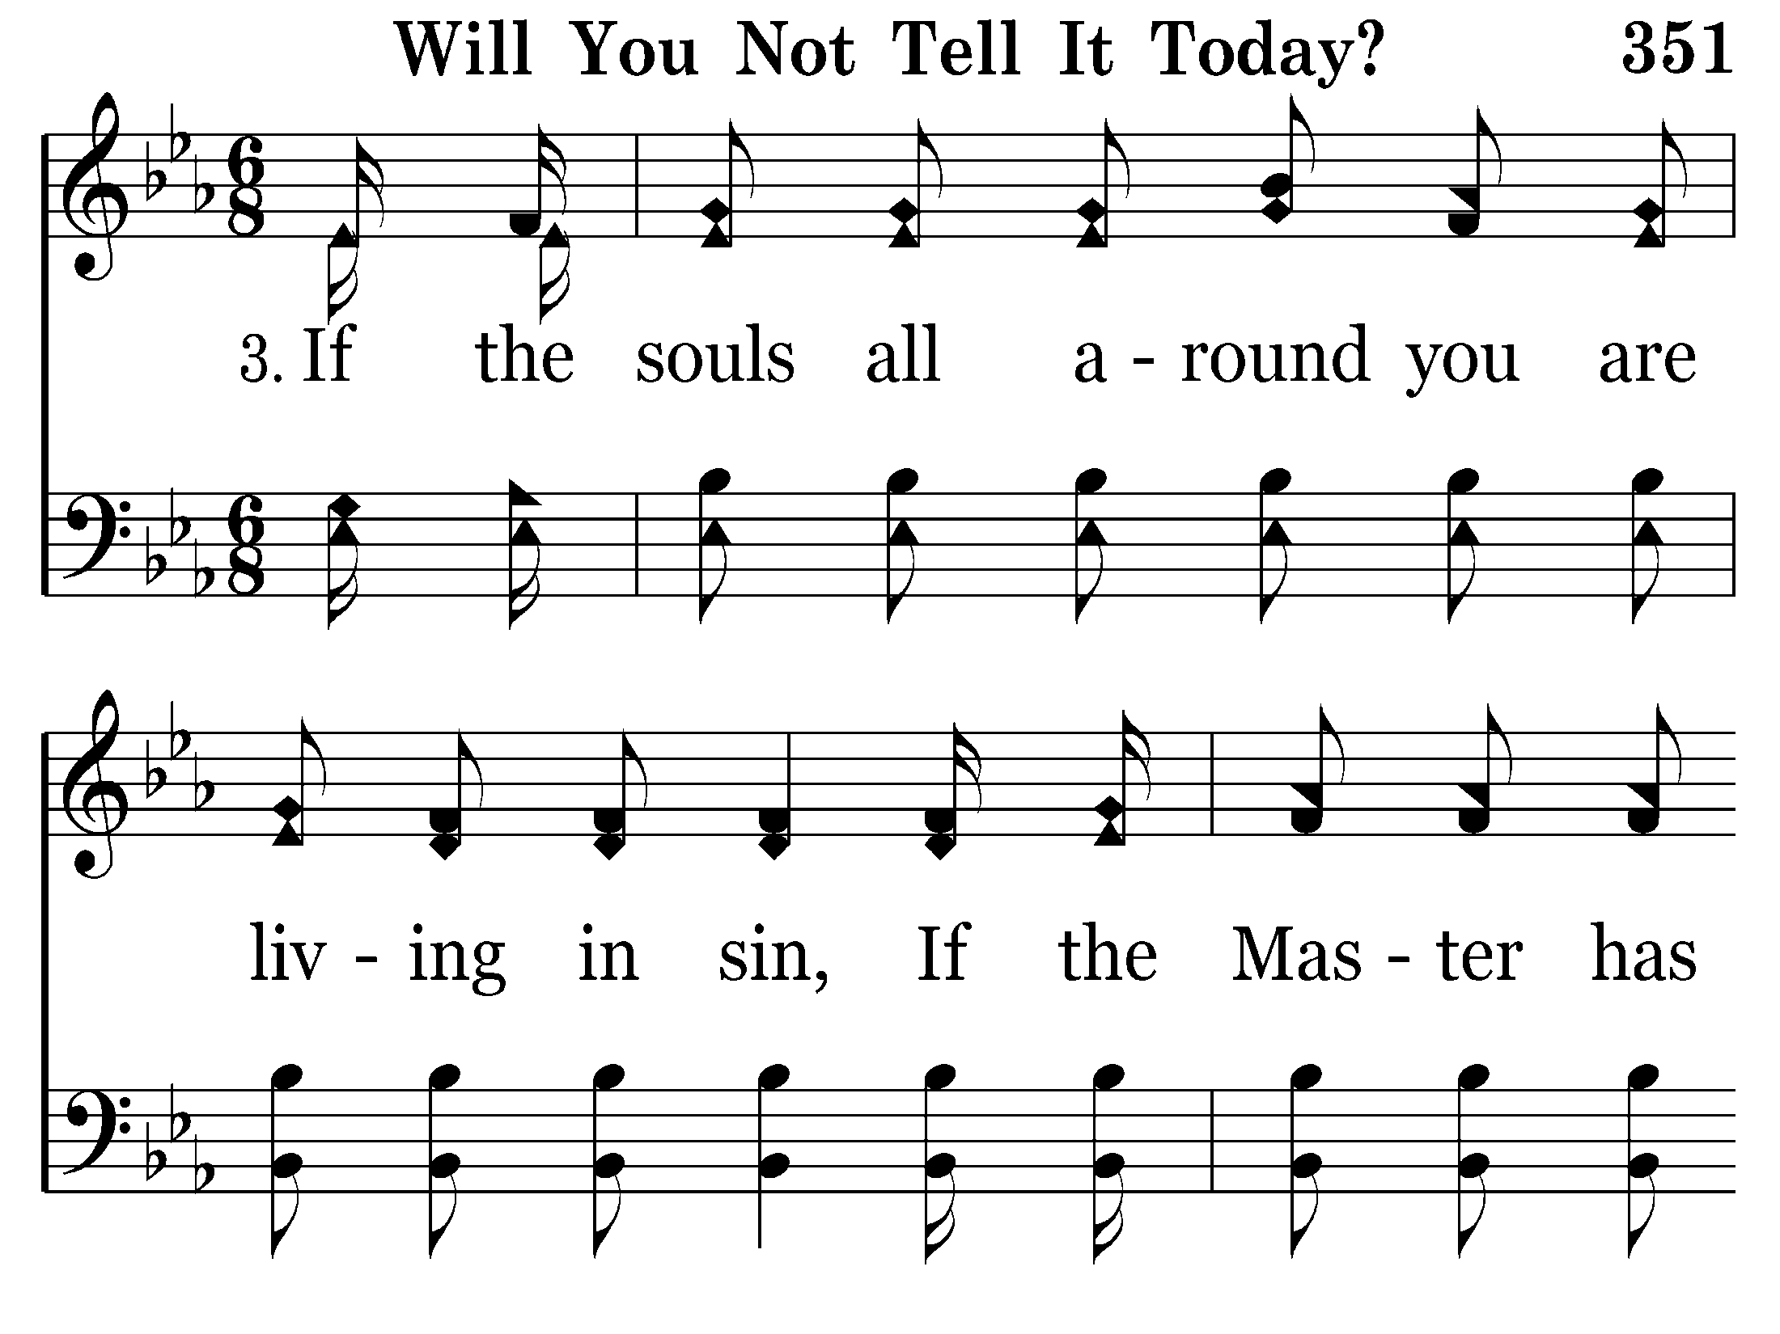
351 - Will You Not Tell It Today - 3.1

Slide 43
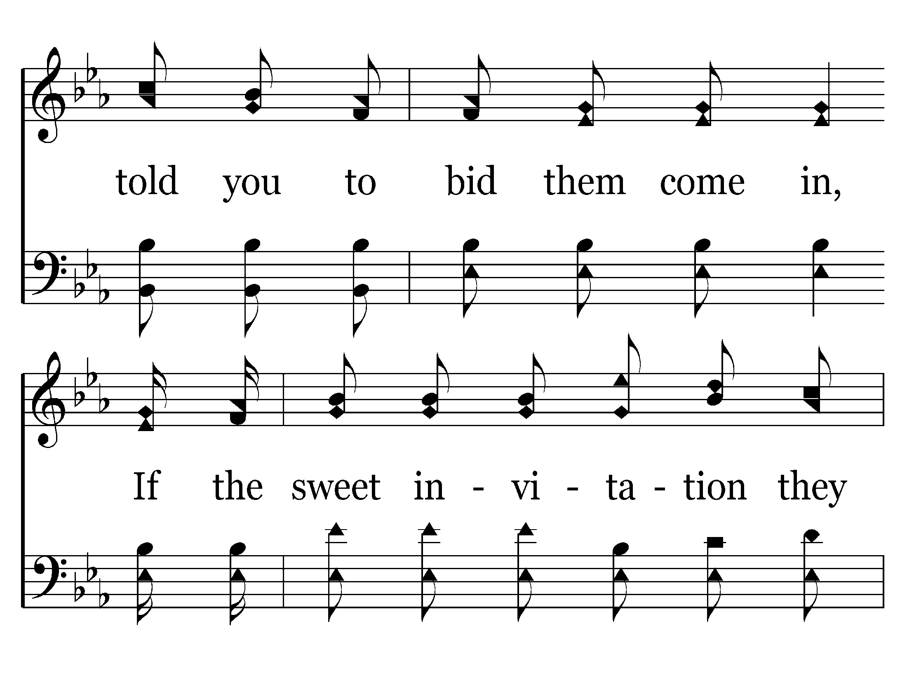
351 - Will You Not Tell It Today - 3.2

Slide 44
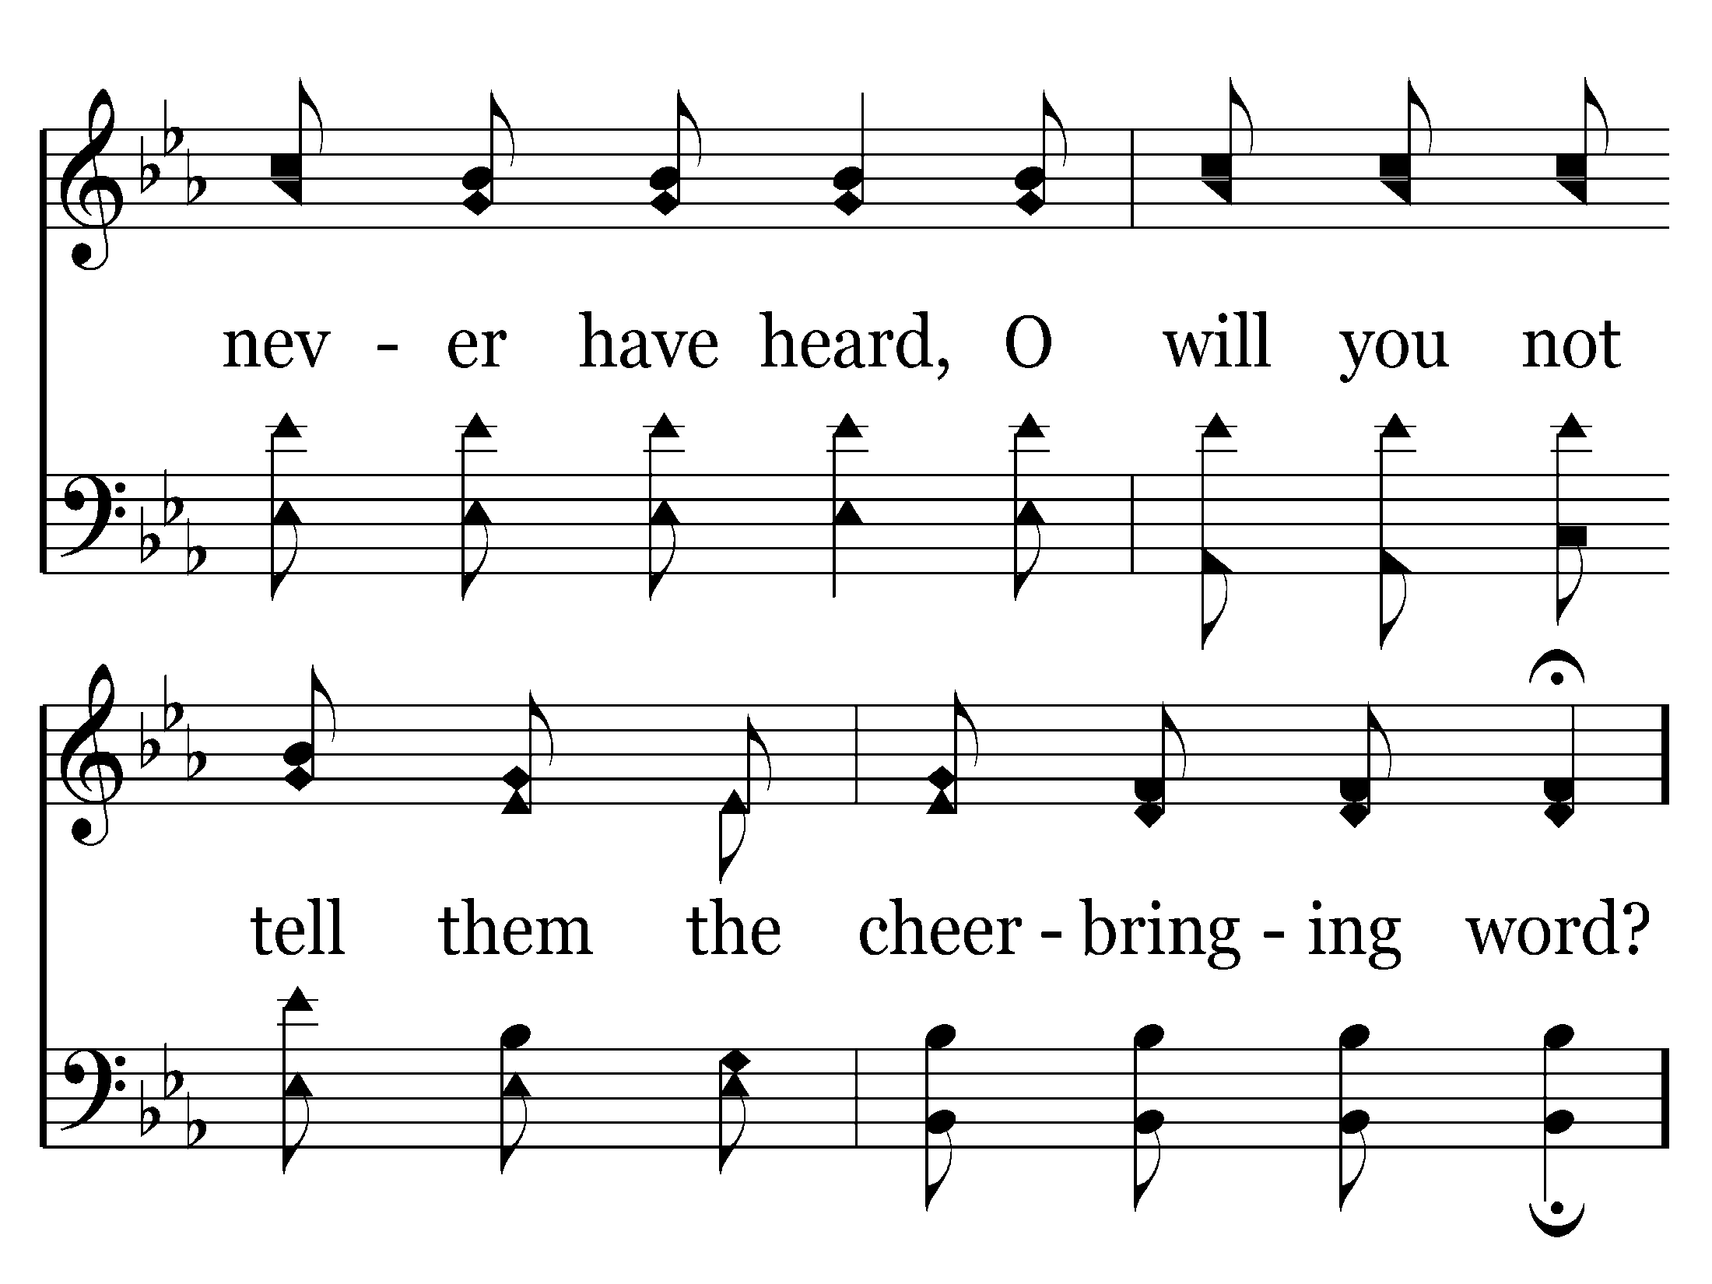
351 - Will You Not Tell It Today - 3.3

Slide 45
351 - Will You Not Tell It Today - C.1

Slide 46
351 - Will You Not Tell It Today - C.2

Slide 47
351 - Will You Not Tell It Today - C.3
End of Song

Slide 49
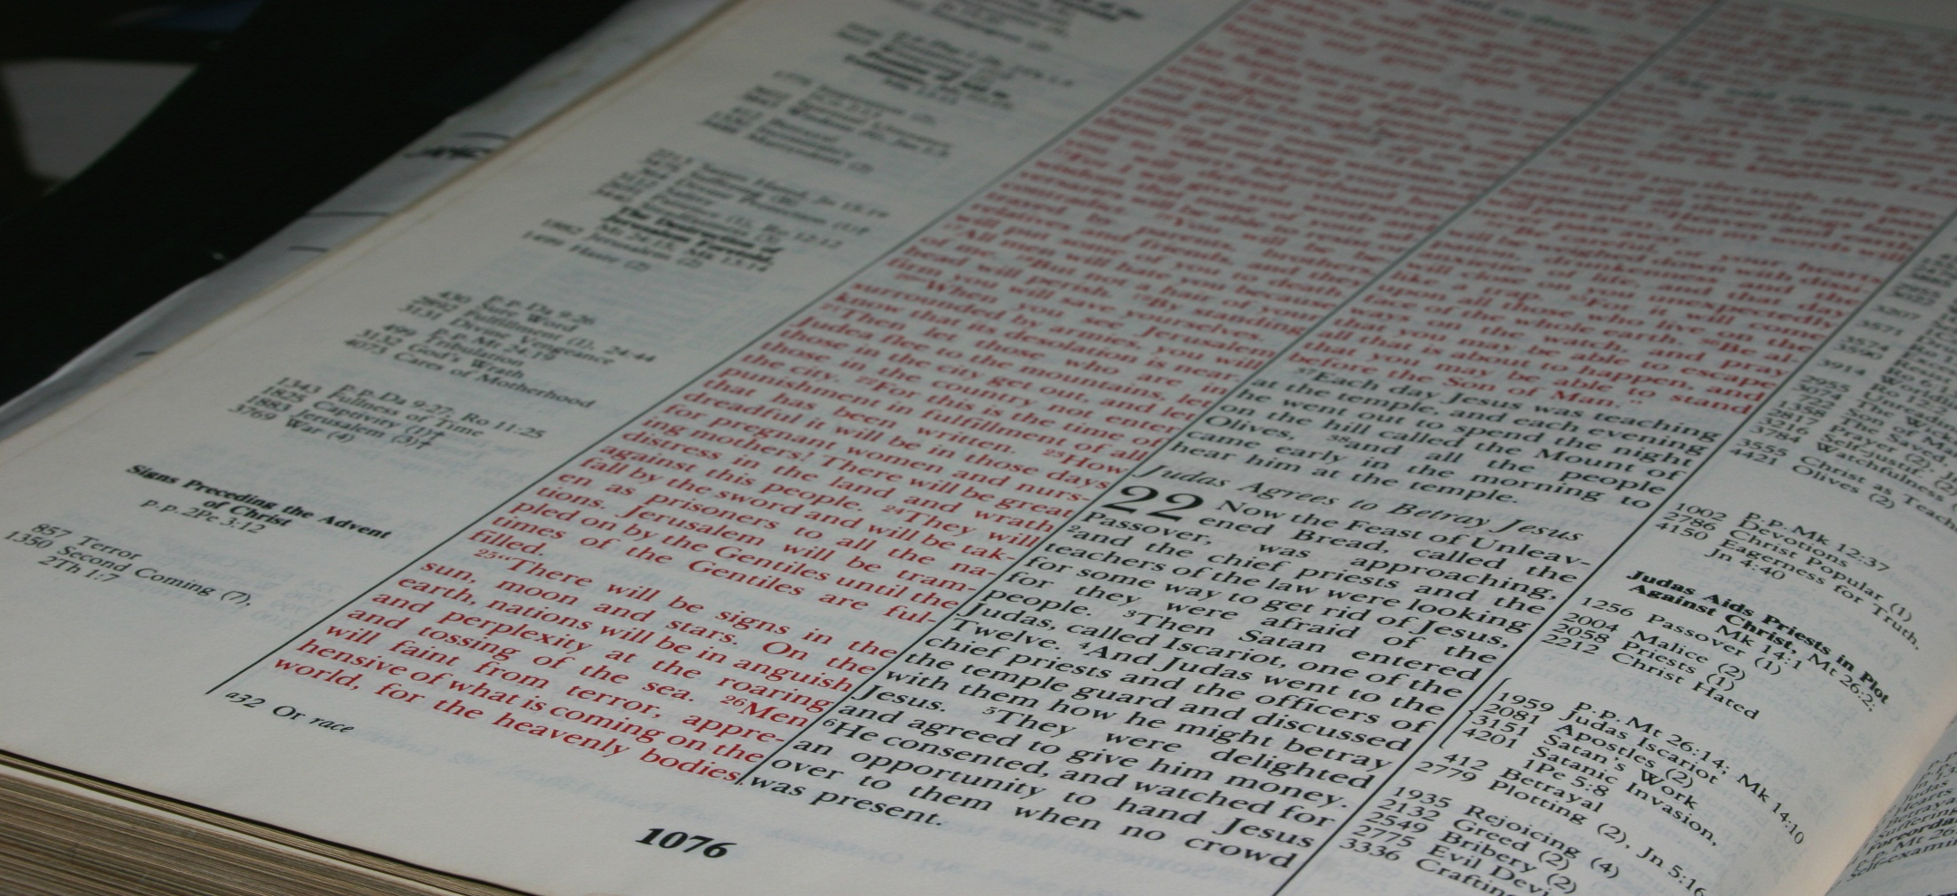
"Let your light so shine before men, that they may see your good works and glorify your Father in heaven."
Matthew 5:16
Real Life For Everyone!
Northwest Church of Christ April 20-25, 2014

Slide 50
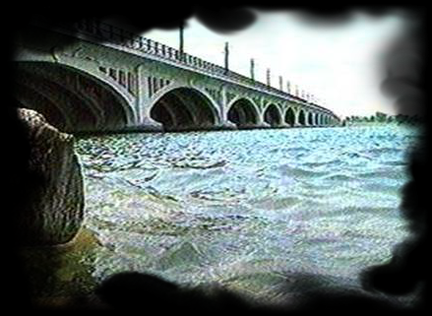
August 19, 1995…
…Detroit, Michigan

Slide 51

2 Indisputable Facts
Fact [1]
Countless people all around us are in grave danger.
Fact [2]
God commands us
to do something about it.

Slide 52
WHAT CAN I DO?

Slide 53
SHINE
Our daily lives must reflect the better way Jesus offers.
4
Simple Things
We All Can Do
To Reach The Lost

Slide 54
SHINE
SPEAK
Our daily lives must reflect the better way Jesus offers.
Spiritual things should naturally come out in our conversations with others.
4
Simple Things
We All Can Do
To Reach The Lost

Slide 55
What Should I Say?
Talk about God’s word
Give God glory for good things in our lives
Tell the lost we are praying for them
Point grieving people to God
Speak positively about the congregation
Say simple things

Slide 56
SHINE
SPEAK
Our daily lives must reflect the better way Jesus offers.
Spiritual things should naturally come out in our conversations with others.
4
Simple Things
We All Can Do
To Reach The Lost
INVITE
As we talk
positively about spiritual things, invite others to come and see for themselves.

Slide 57
Invite People To:
Bible Class
Worship Services
Specific Sermons
Teen Devotions
25%
of those who do not attend church services would come if invited
Special Events:
[a] Pray For Soldiers
[b] Show Videos
[c] Group Studies

Slide 58
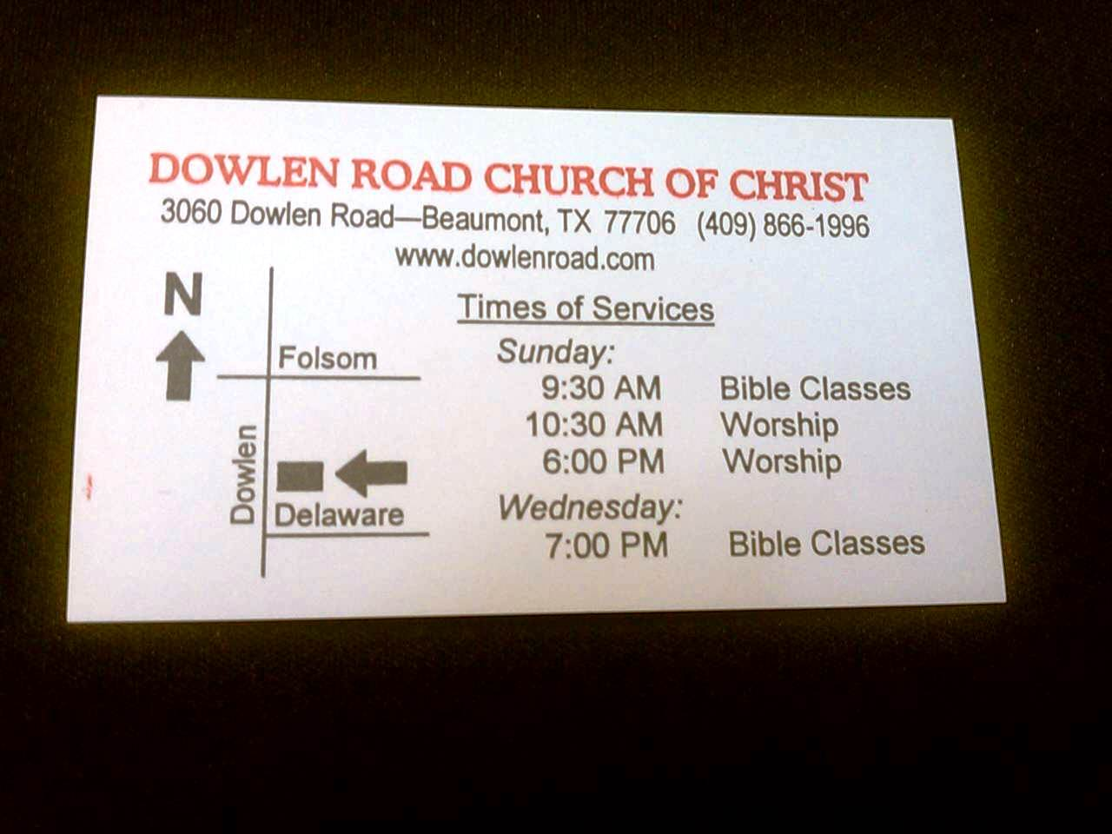

Slide 59
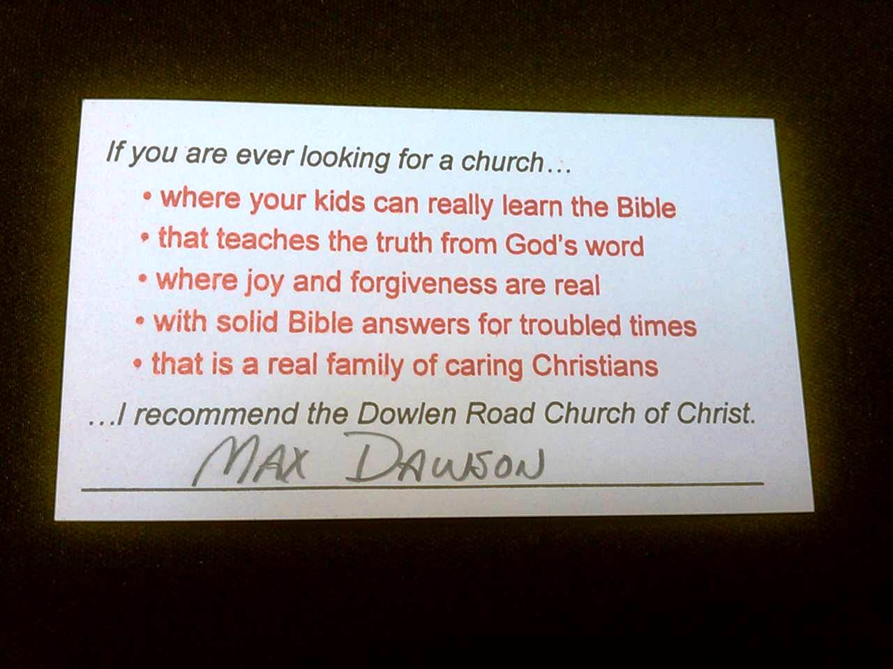

Slide 60
SHINE
SPEAK
Our daily lives must reflect the better way Jesus offers.
Spiritual things should naturally come out in our conversations with others.
4
Simple Things
We All Can Do
To Reach The Lost
INVITE
WELCOME
As we talk
positively about spiritual things, invite others to come and see for themselves.
We must
make sure that those who come to visit us are warmly welcomed as honored guests.

Slide 61
To Welcome Guests:
Be sure to greet them and introduce yourself.
Take a moment to find out why they have come and what needs they might have.
Show them every courtesy.
Adhere to the “10-Minute” Rule.

Slide 62
SHINE
SPEAK
Our daily lives must reflect the better way Jesus offers.
Spiritual things should naturally come out in our conversations with others.
4
Simple Things
We All Can Do
To Reach The Lost
INVITE
WELCOME
As we talk
positively about spiritual things, invite others to come and see for themselves.
We must
make sure that those who come to visit us are warmly welcomed as honored guests.

Slide 63
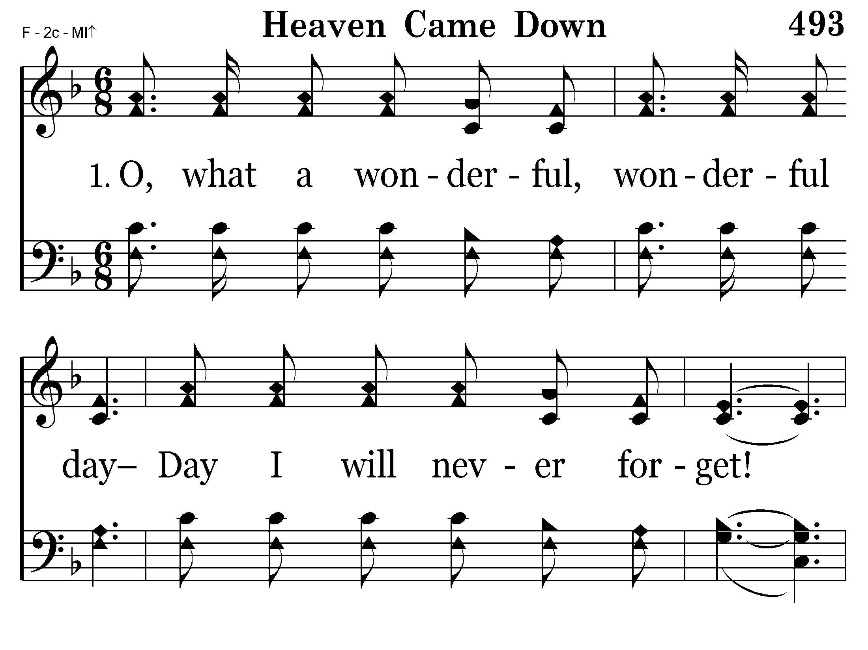
493 - Heaven Came Down - 1.1

Slide 64
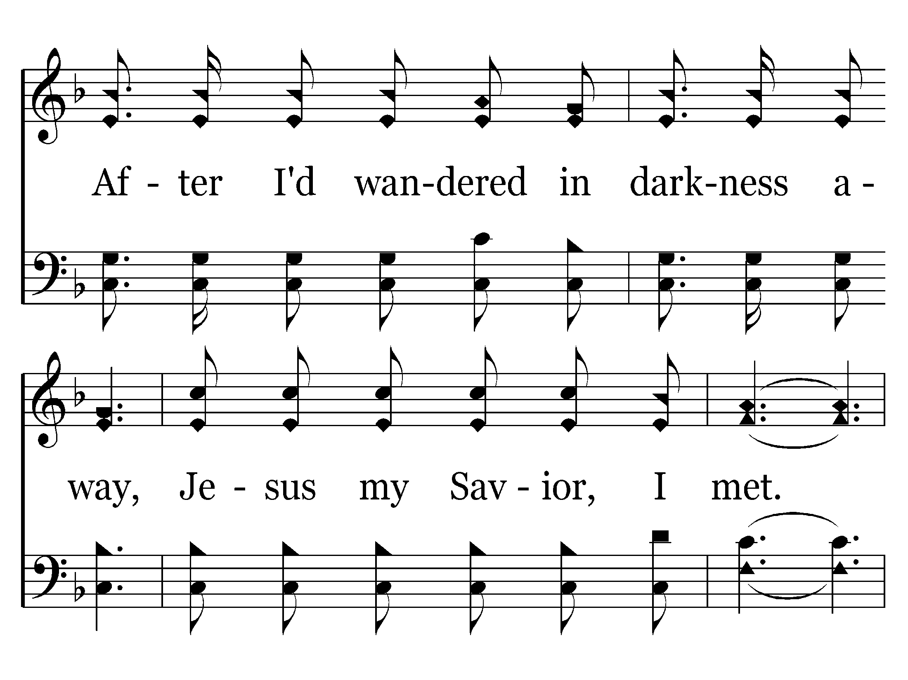
493 - Heaven Came Down - 1.2

Slide 65
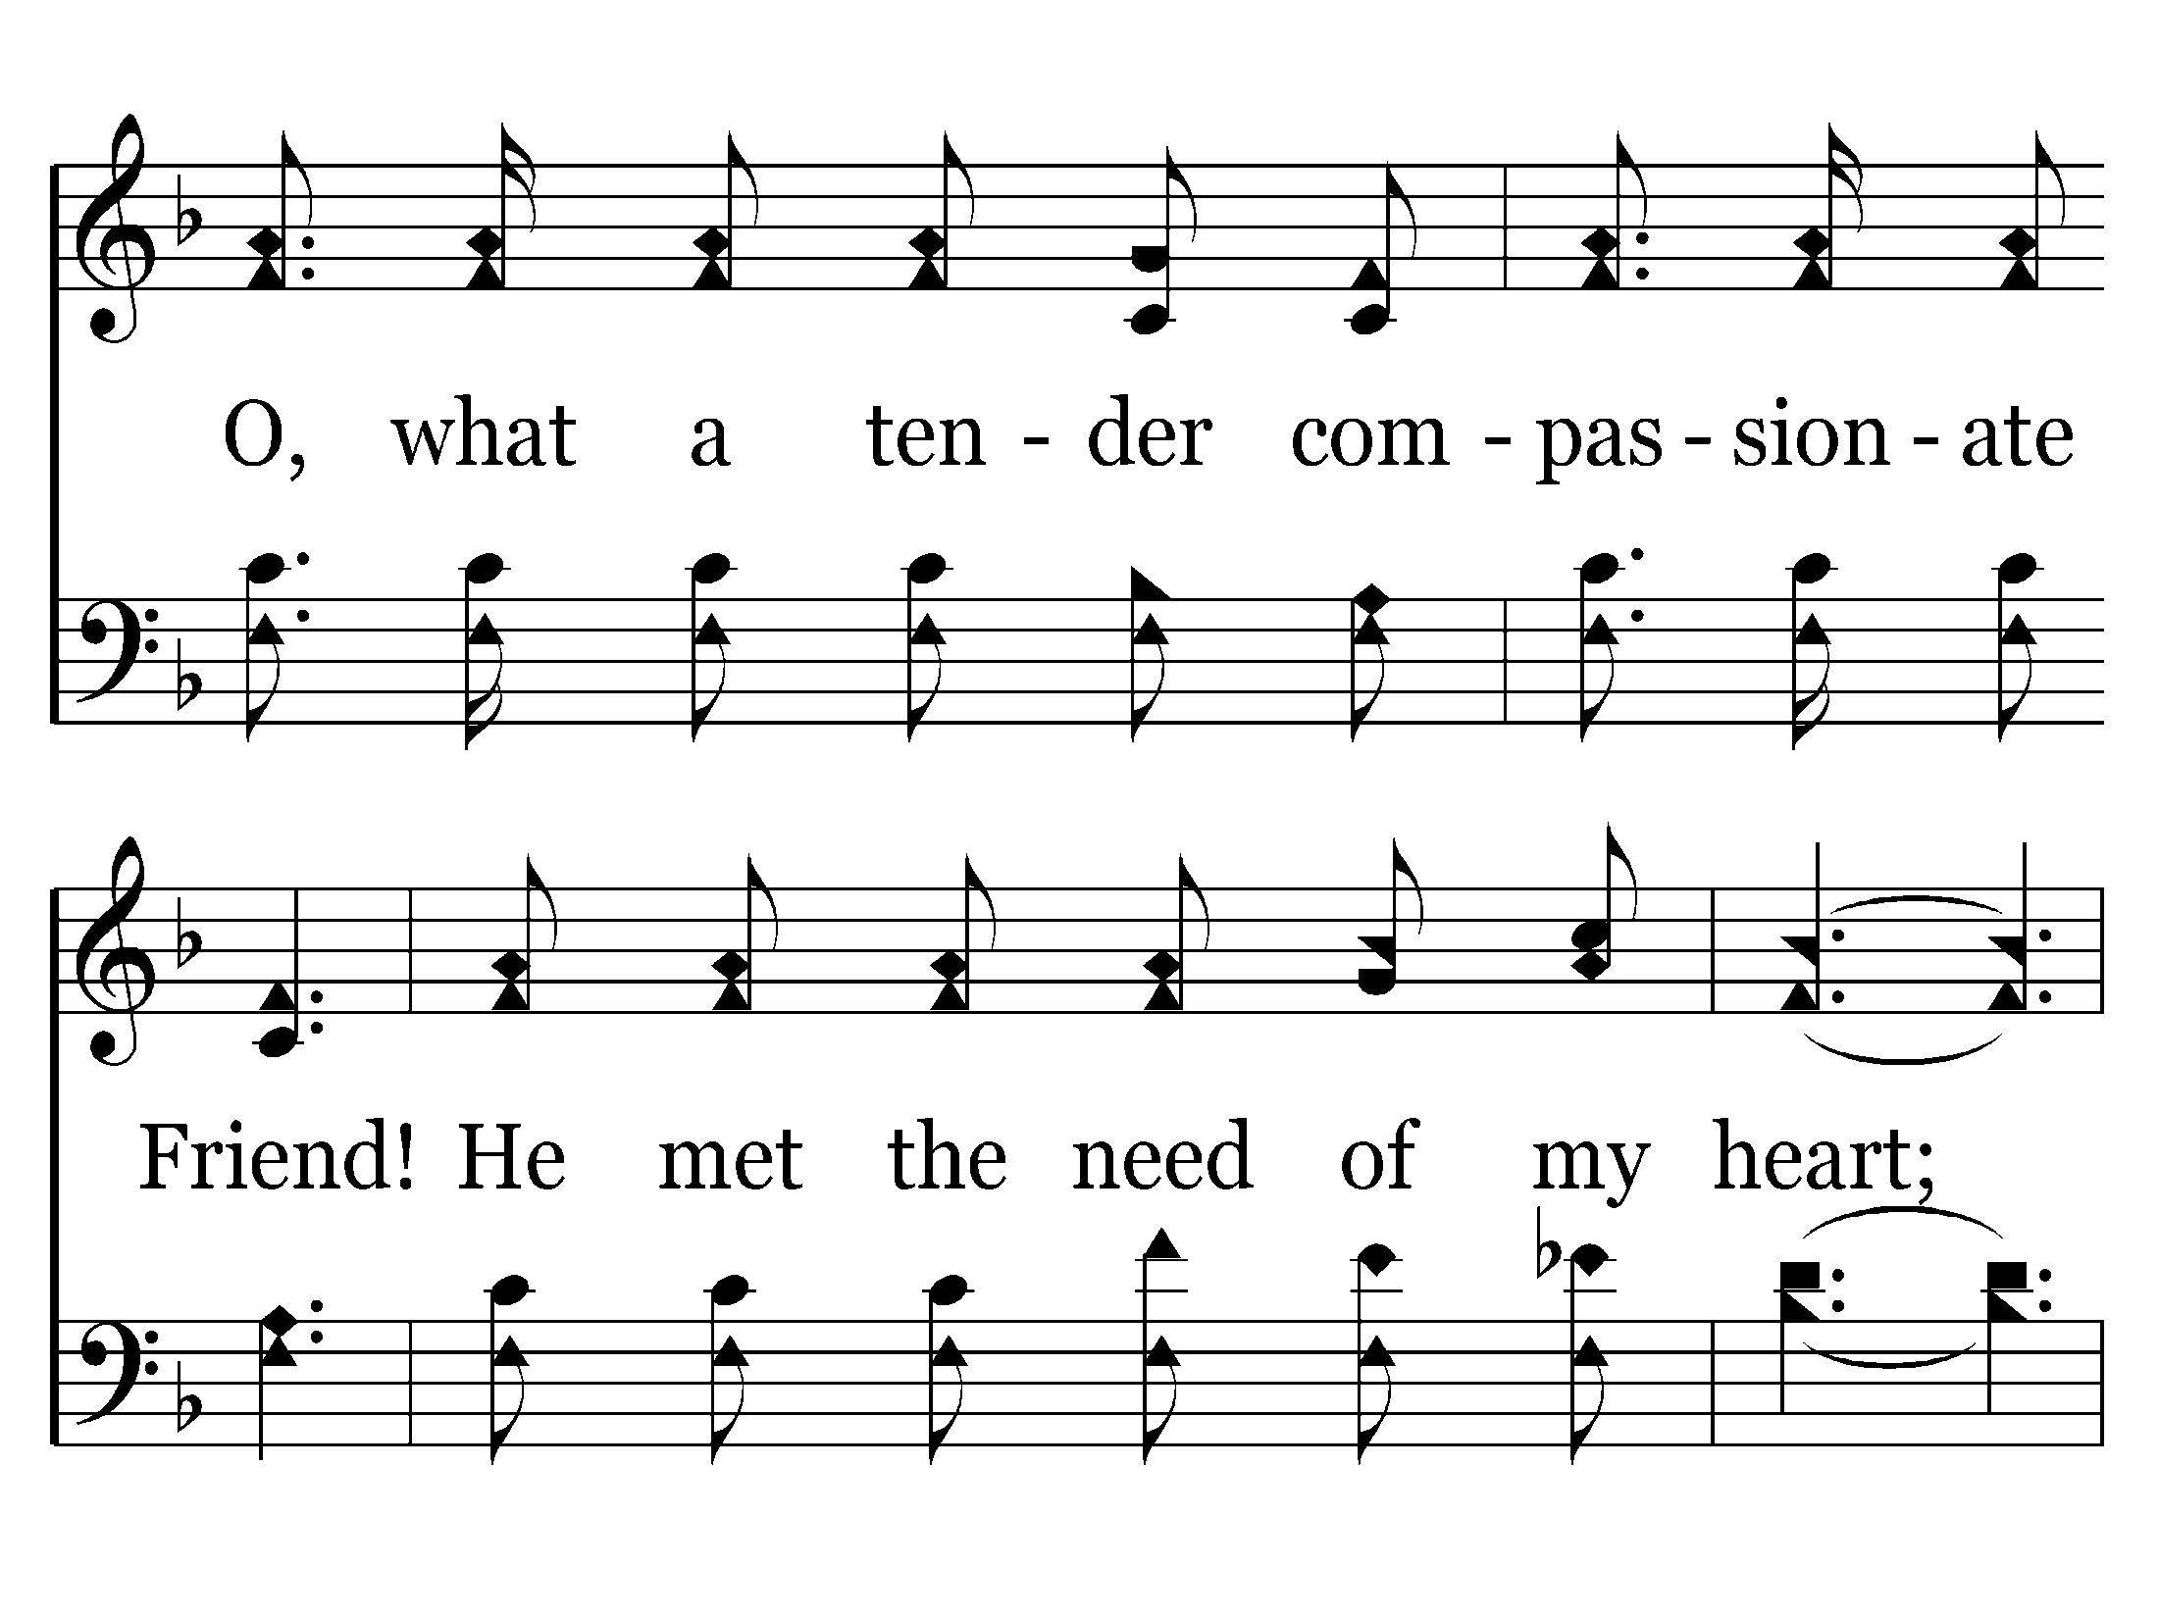
493 - Heaven Came Down - 1.3

Slide 66
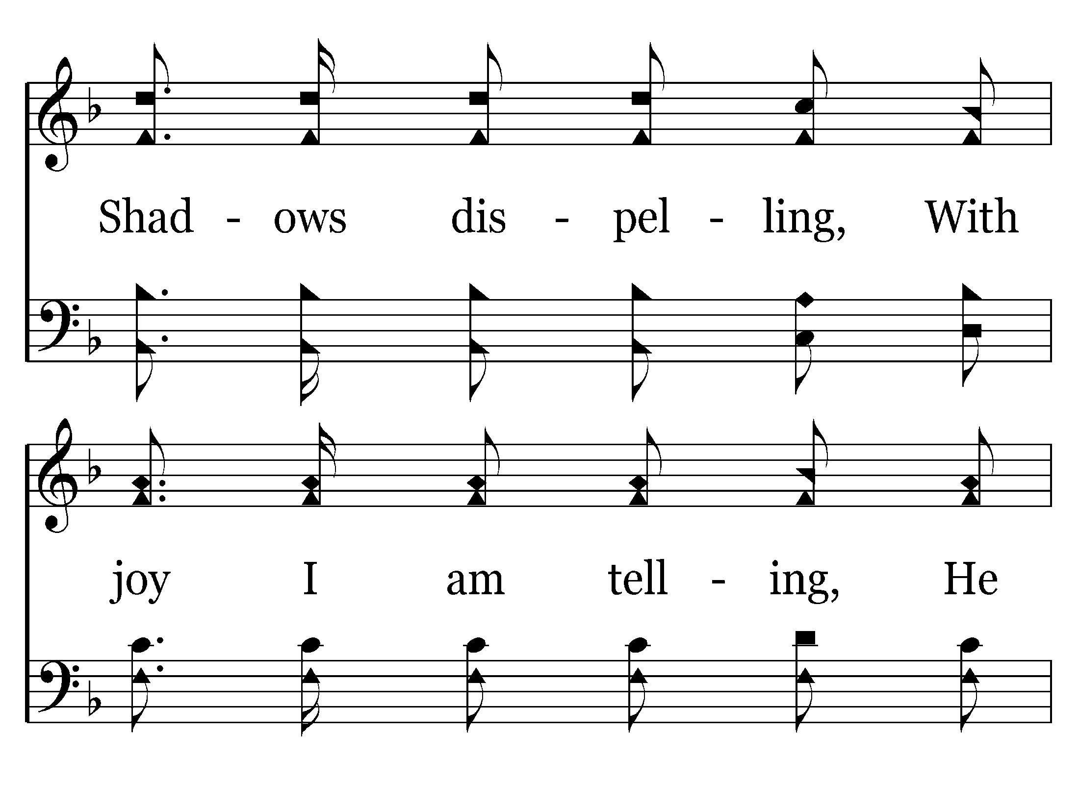
493 - Heaven Came Down - 1.4

Slide 67
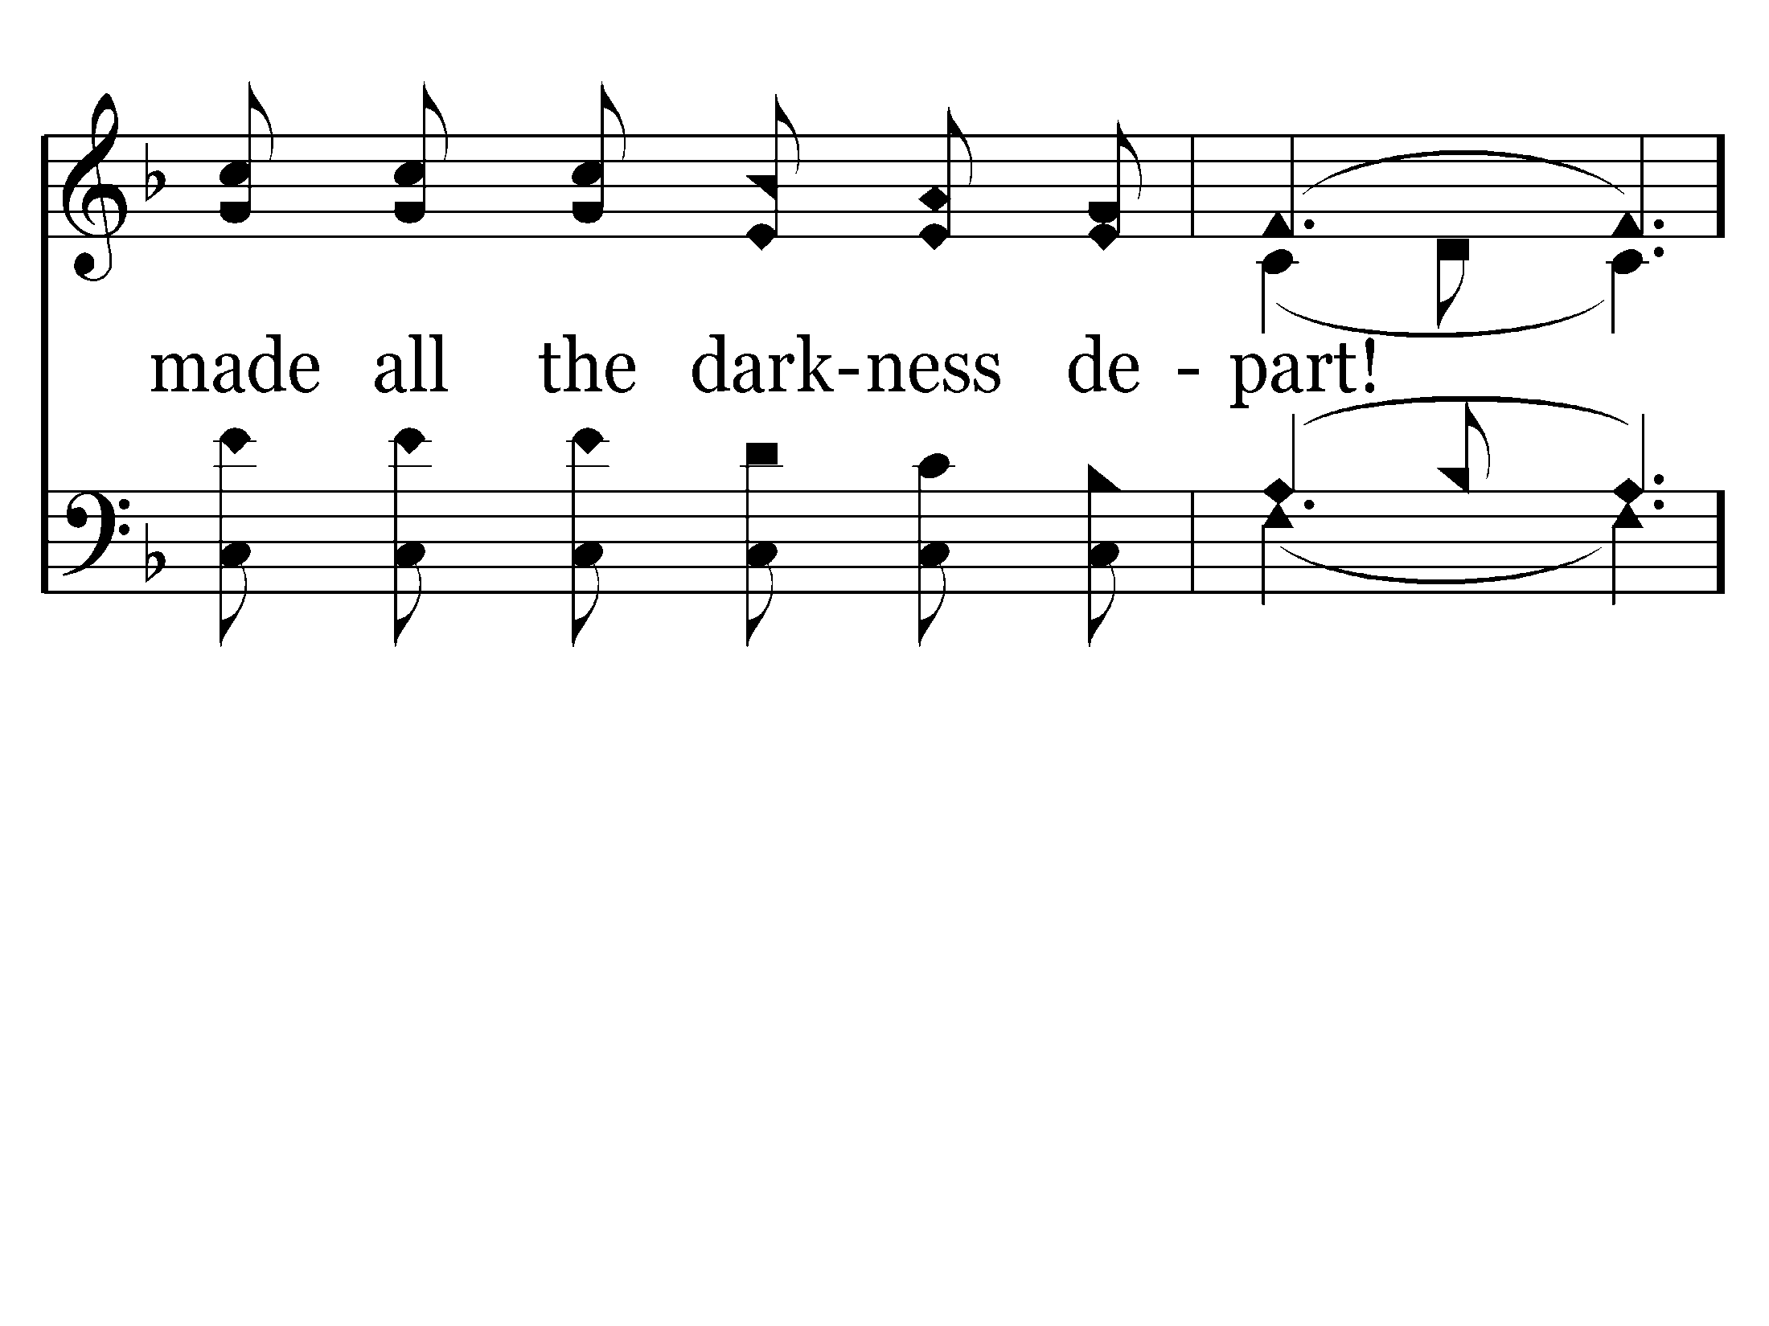
493 - Heaven Came Down - 1.5

Slide 68
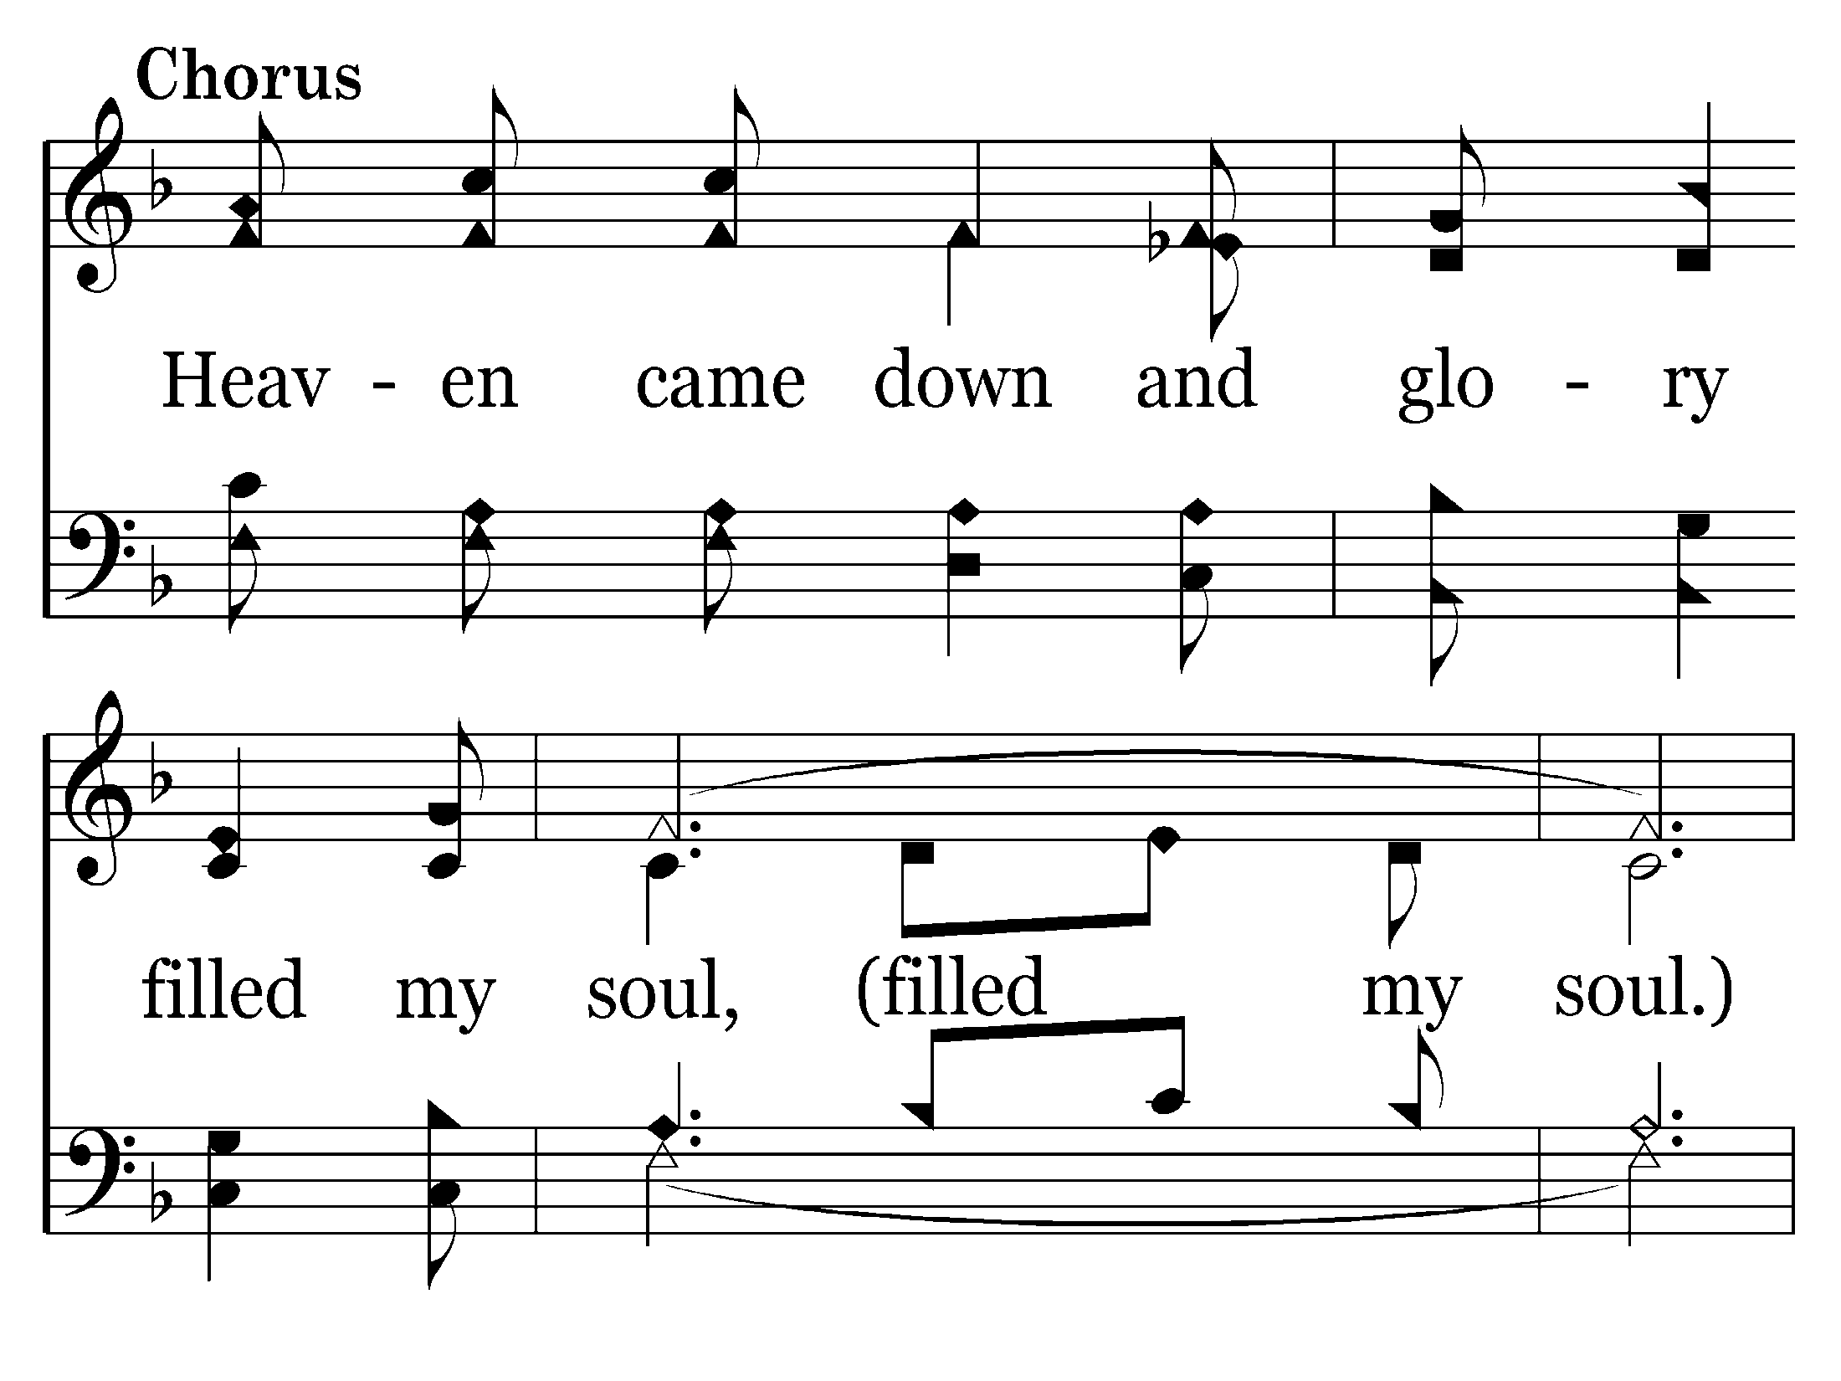
493 - Heaven Came Down - C.1

Slide 69
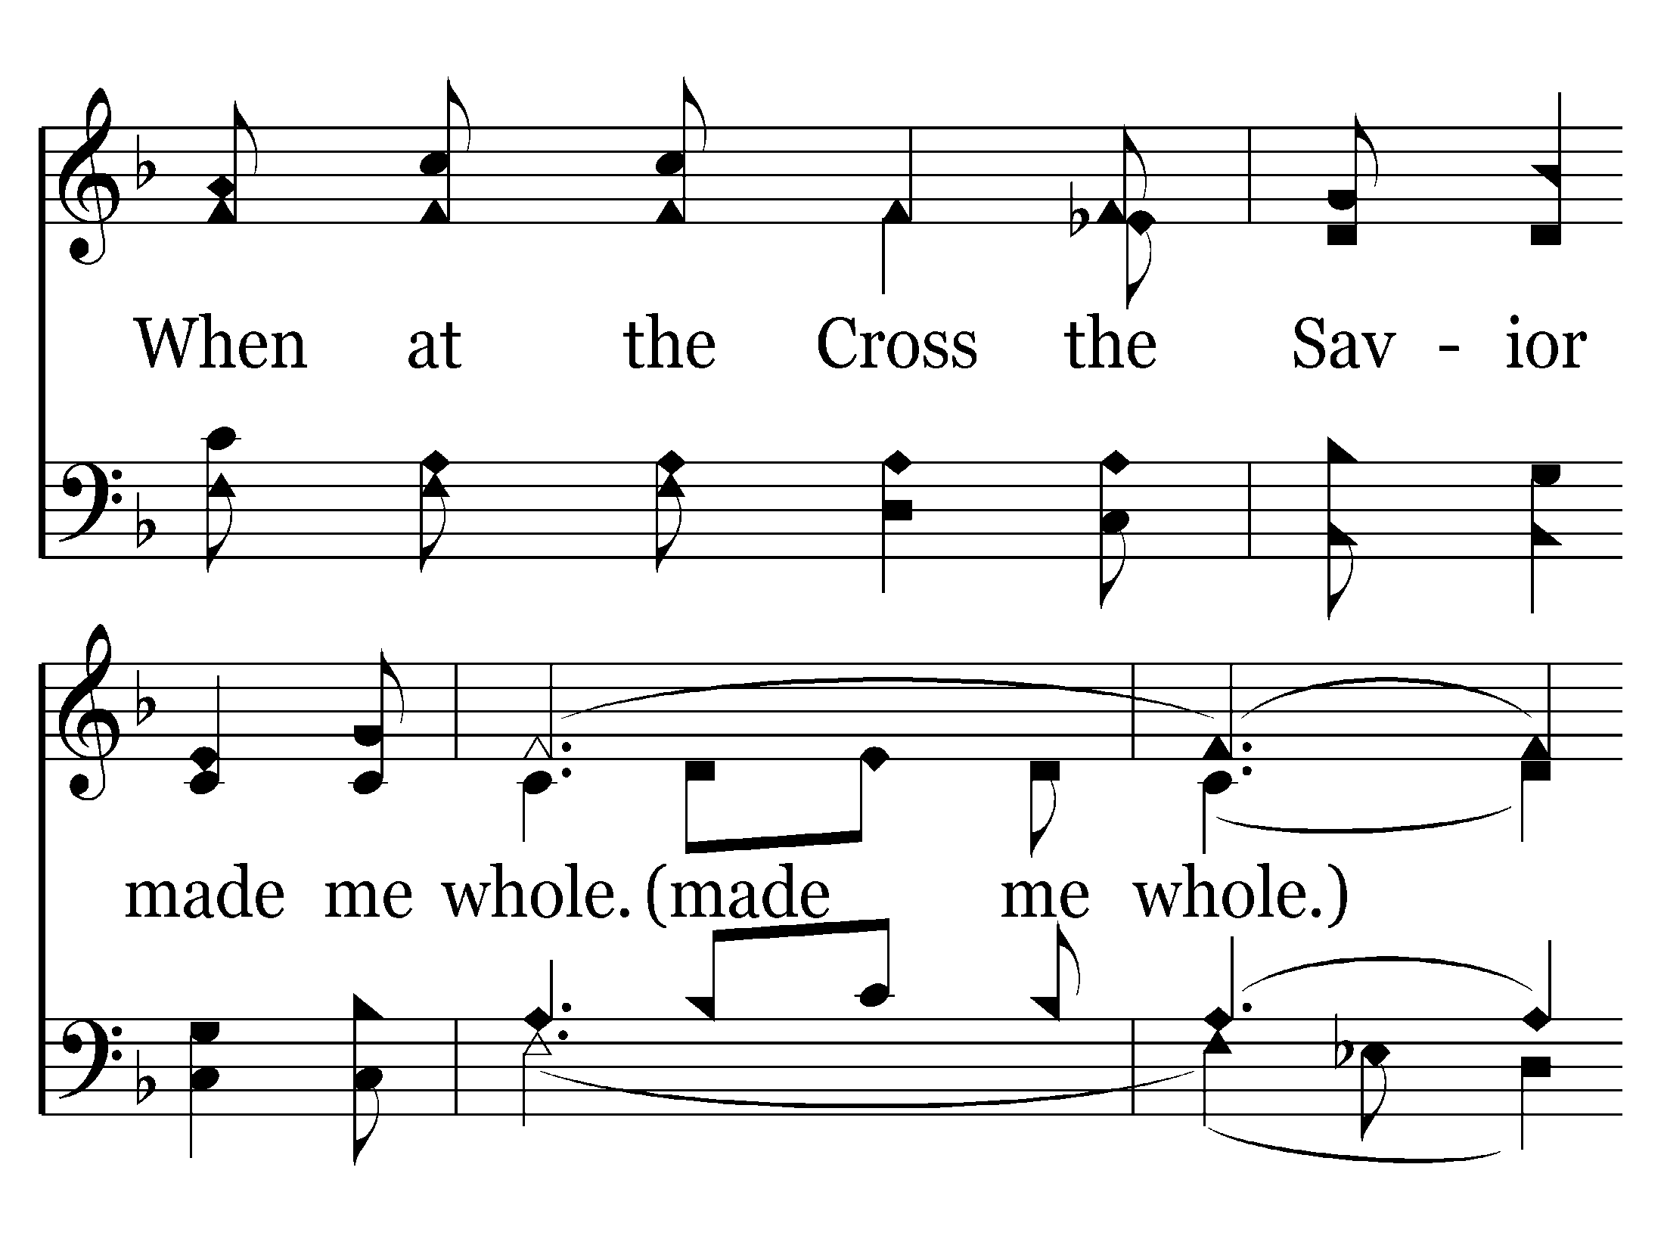
493 - Heaven Came Down - C.2

Slide 70
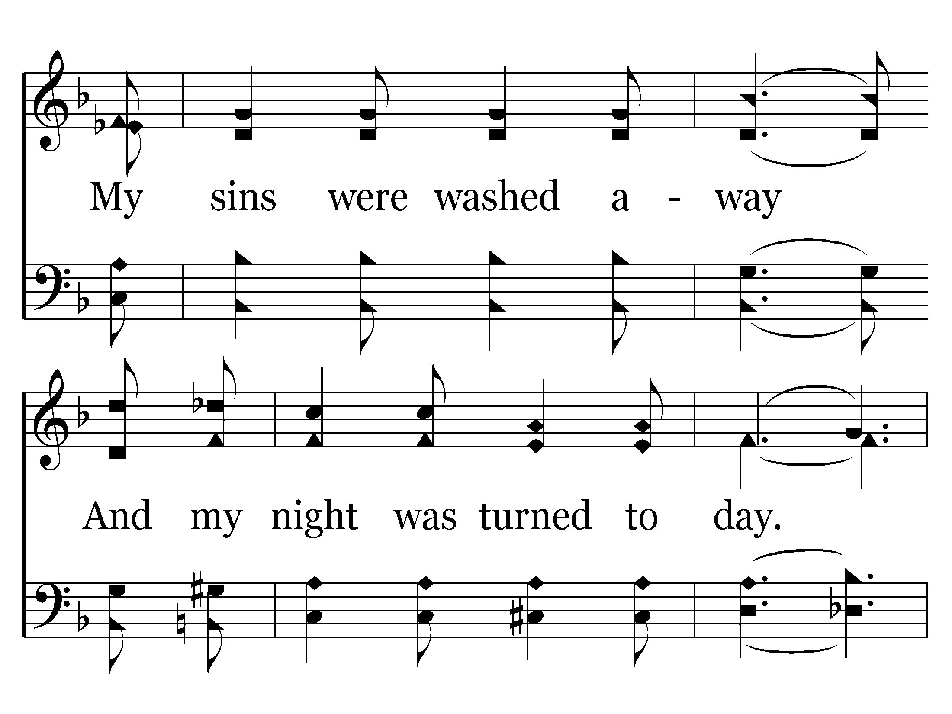
493 - Heaven Came Down - C.3

Slide 71
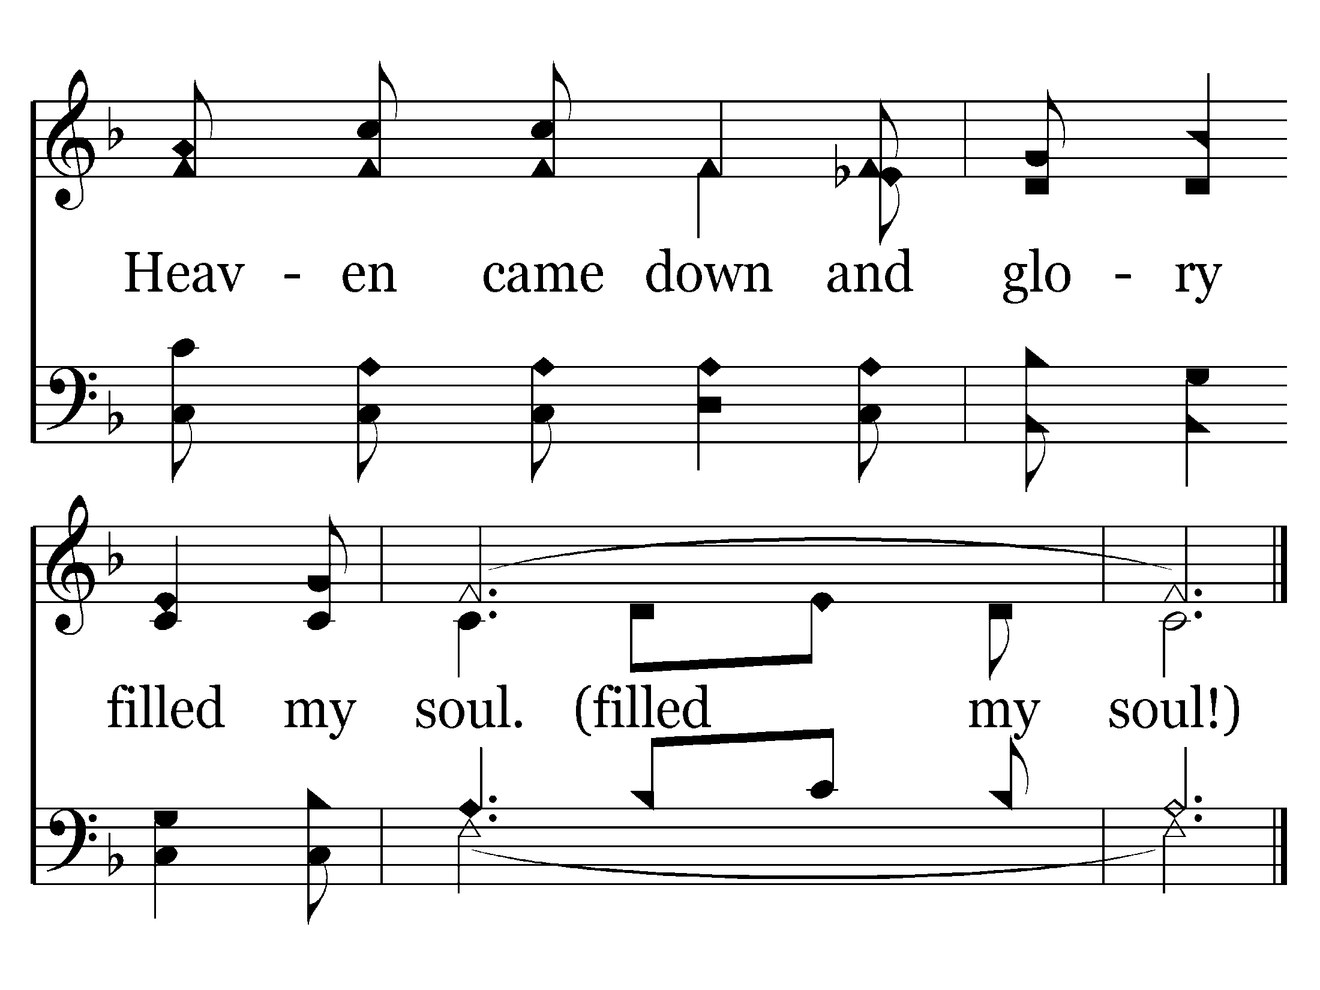
493 - Heaven Came Down - C.4
End of Verse 1

Slide 72
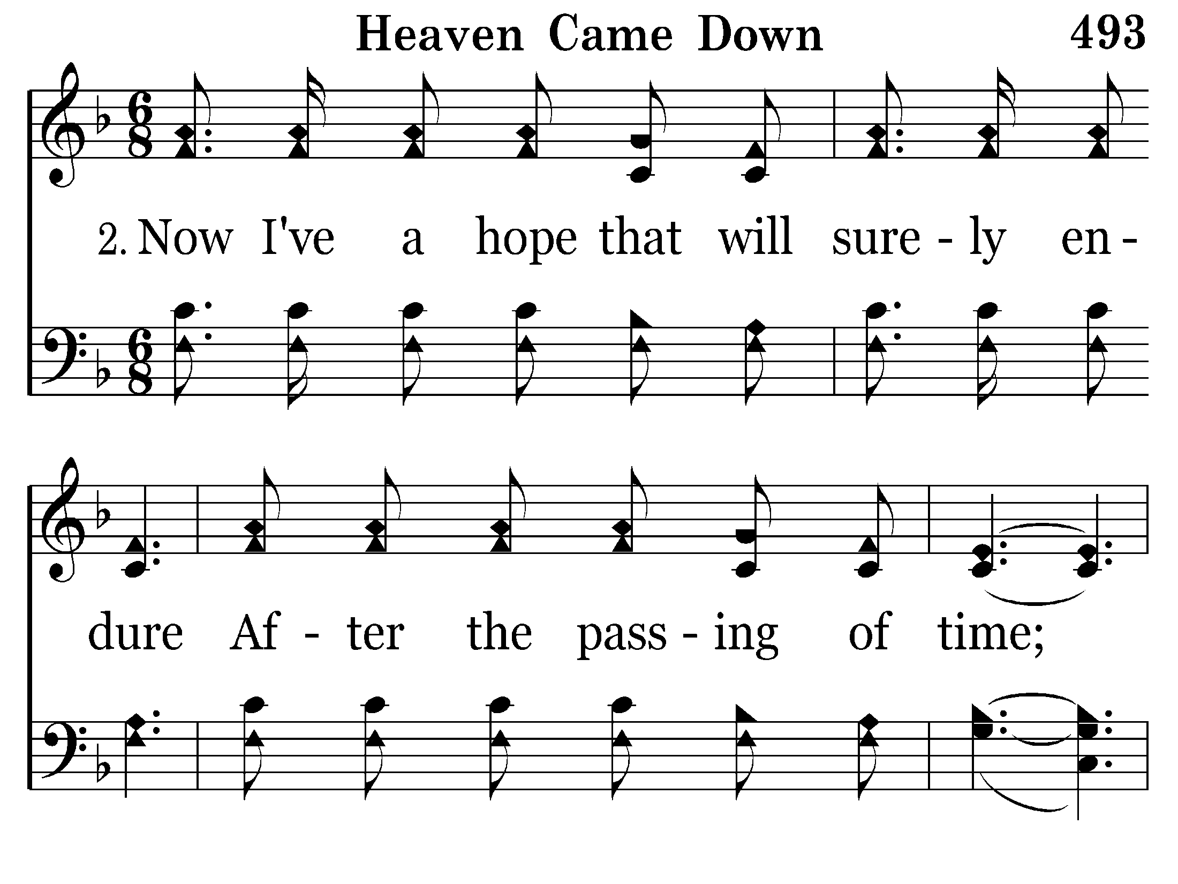
493 - Heaven Came Down - 2.1

Slide 73
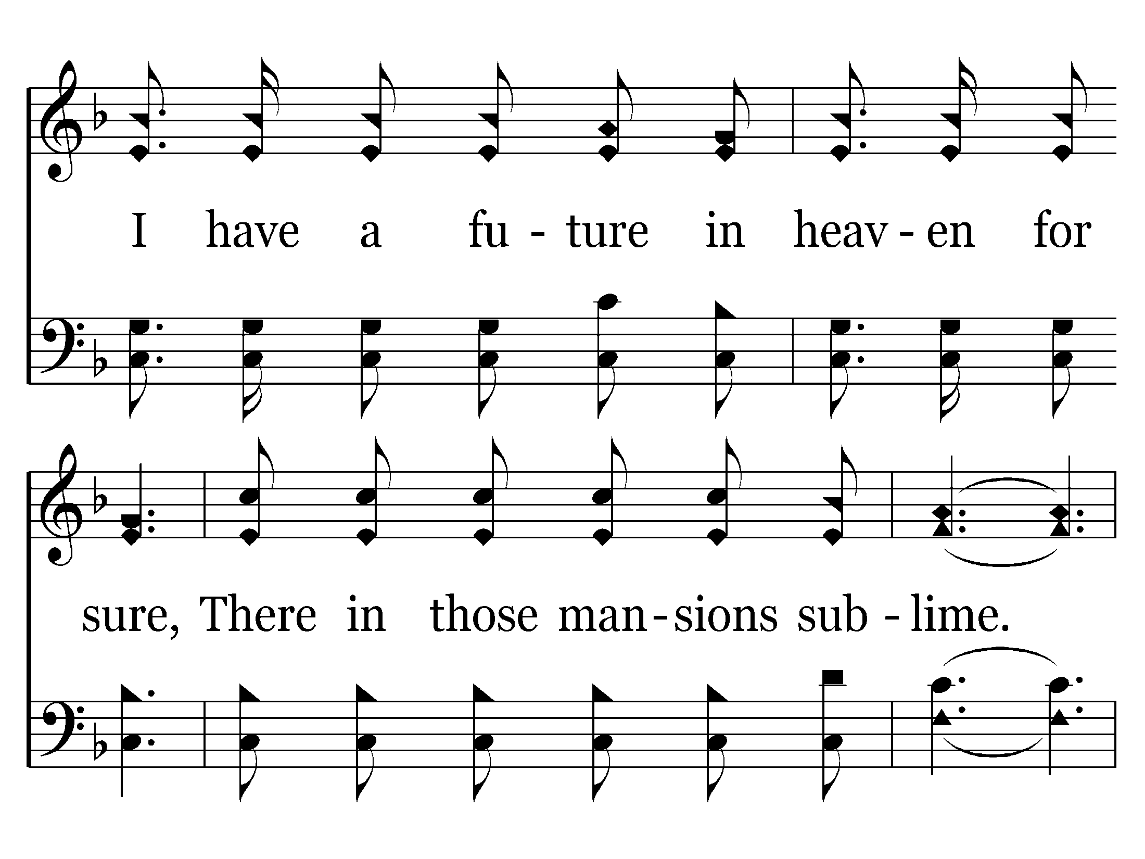
493 - Heaven Came Down - 2.2

Slide 74
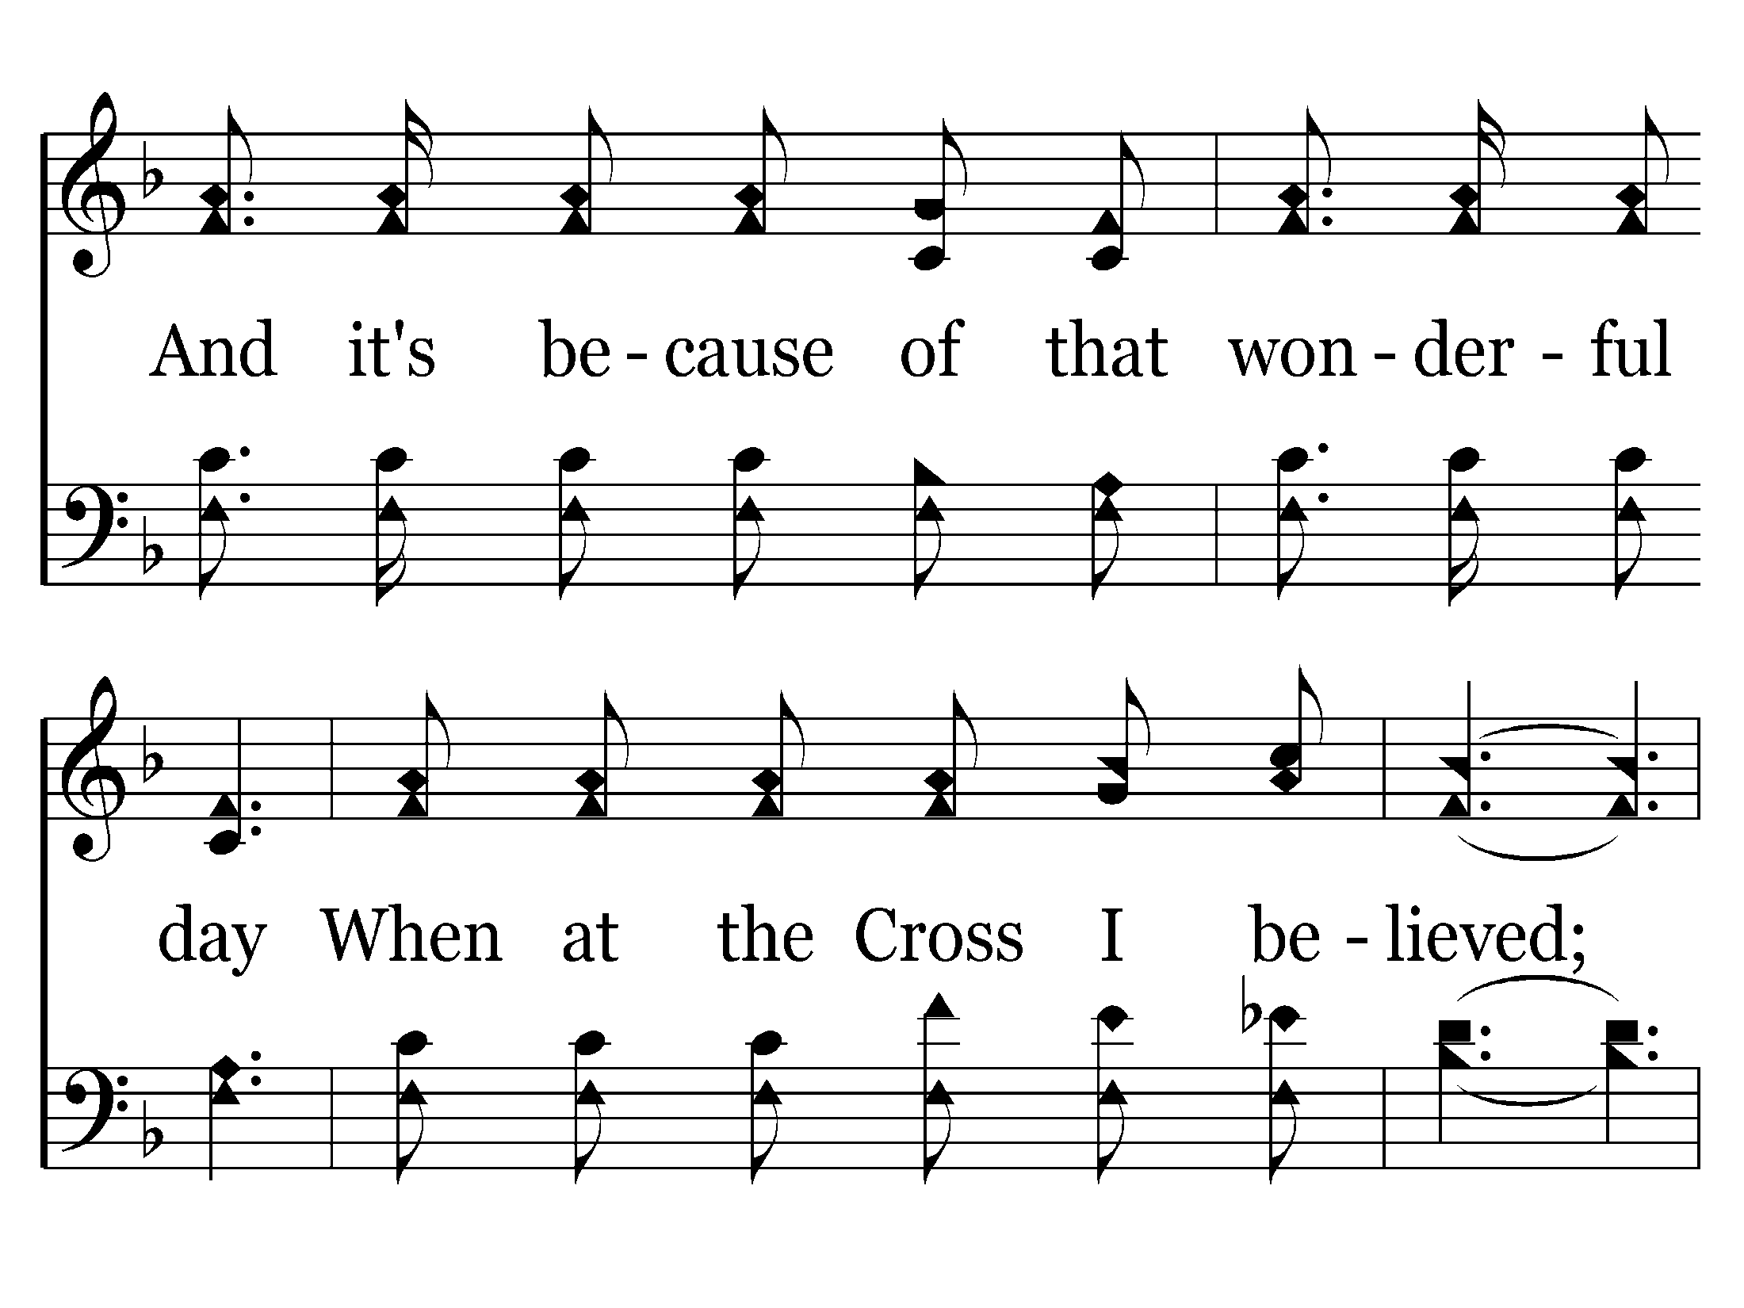
493 - Heaven Came Down - 2.3

Slide 75
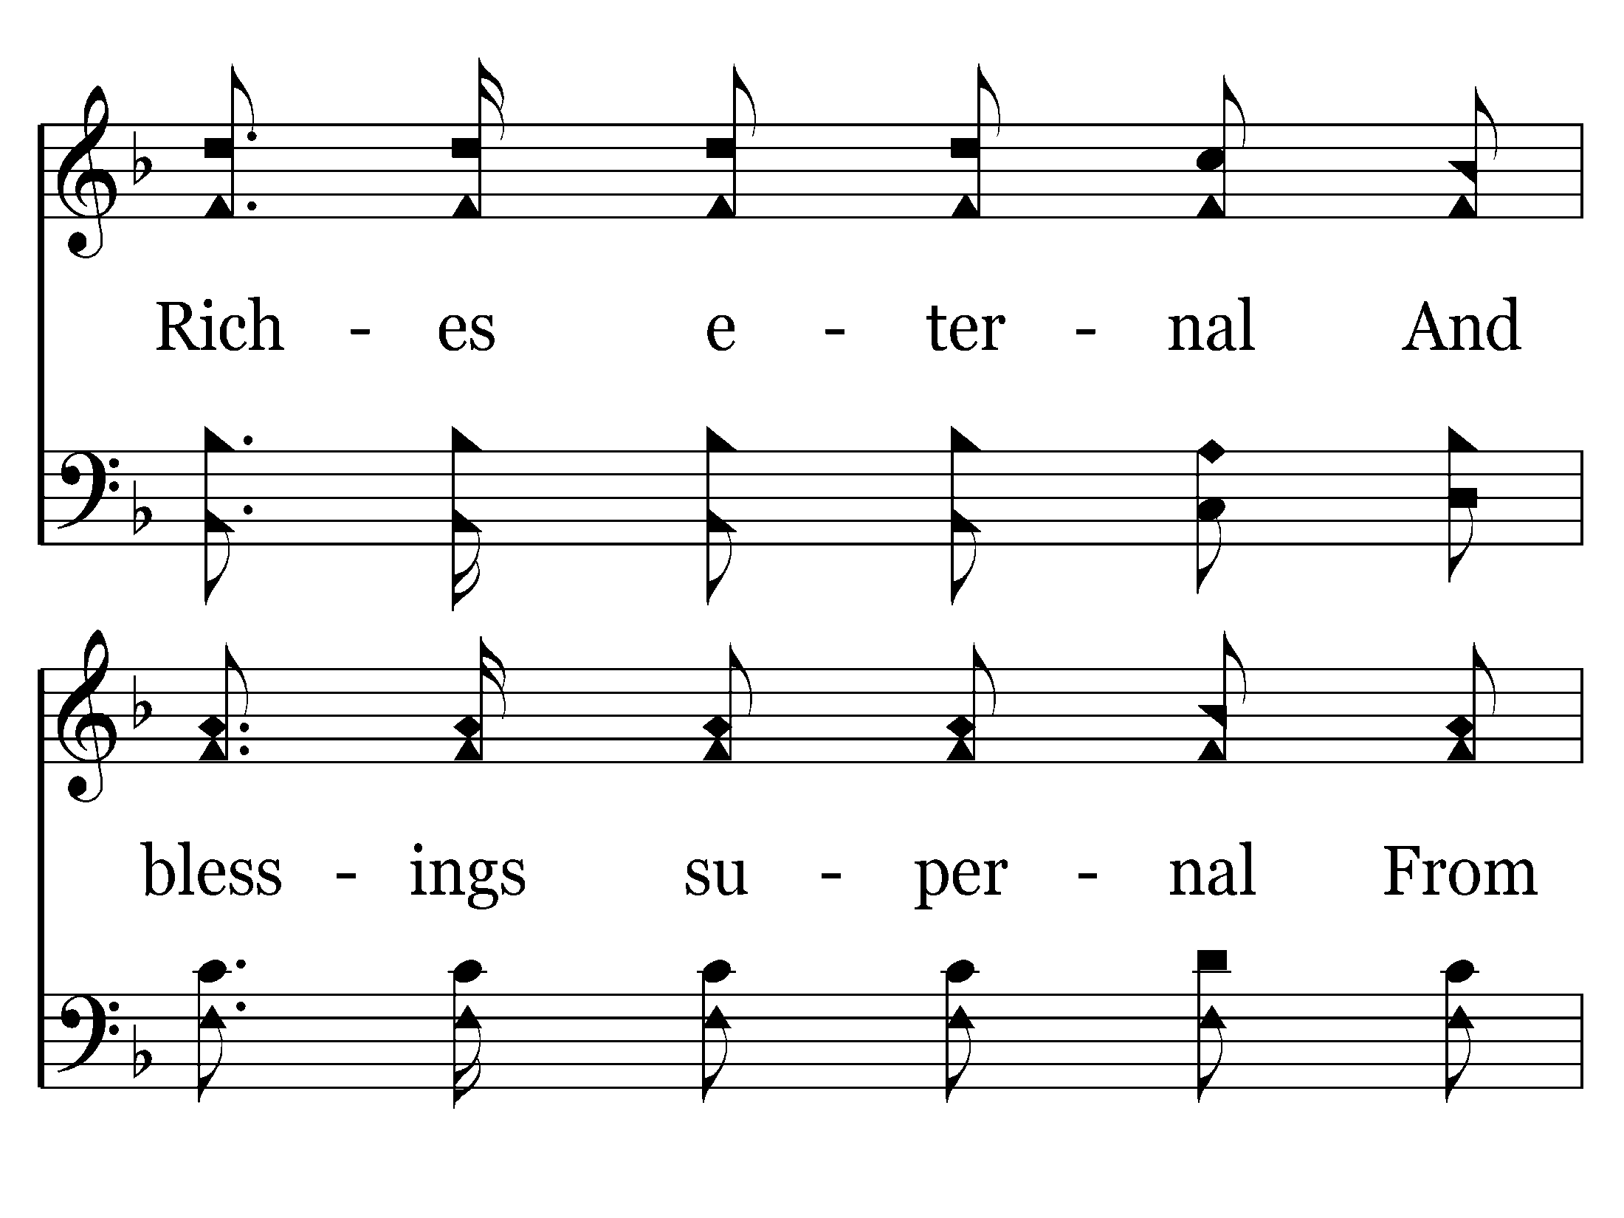
493 - Heaven Came Down - 2.4

Slide 76
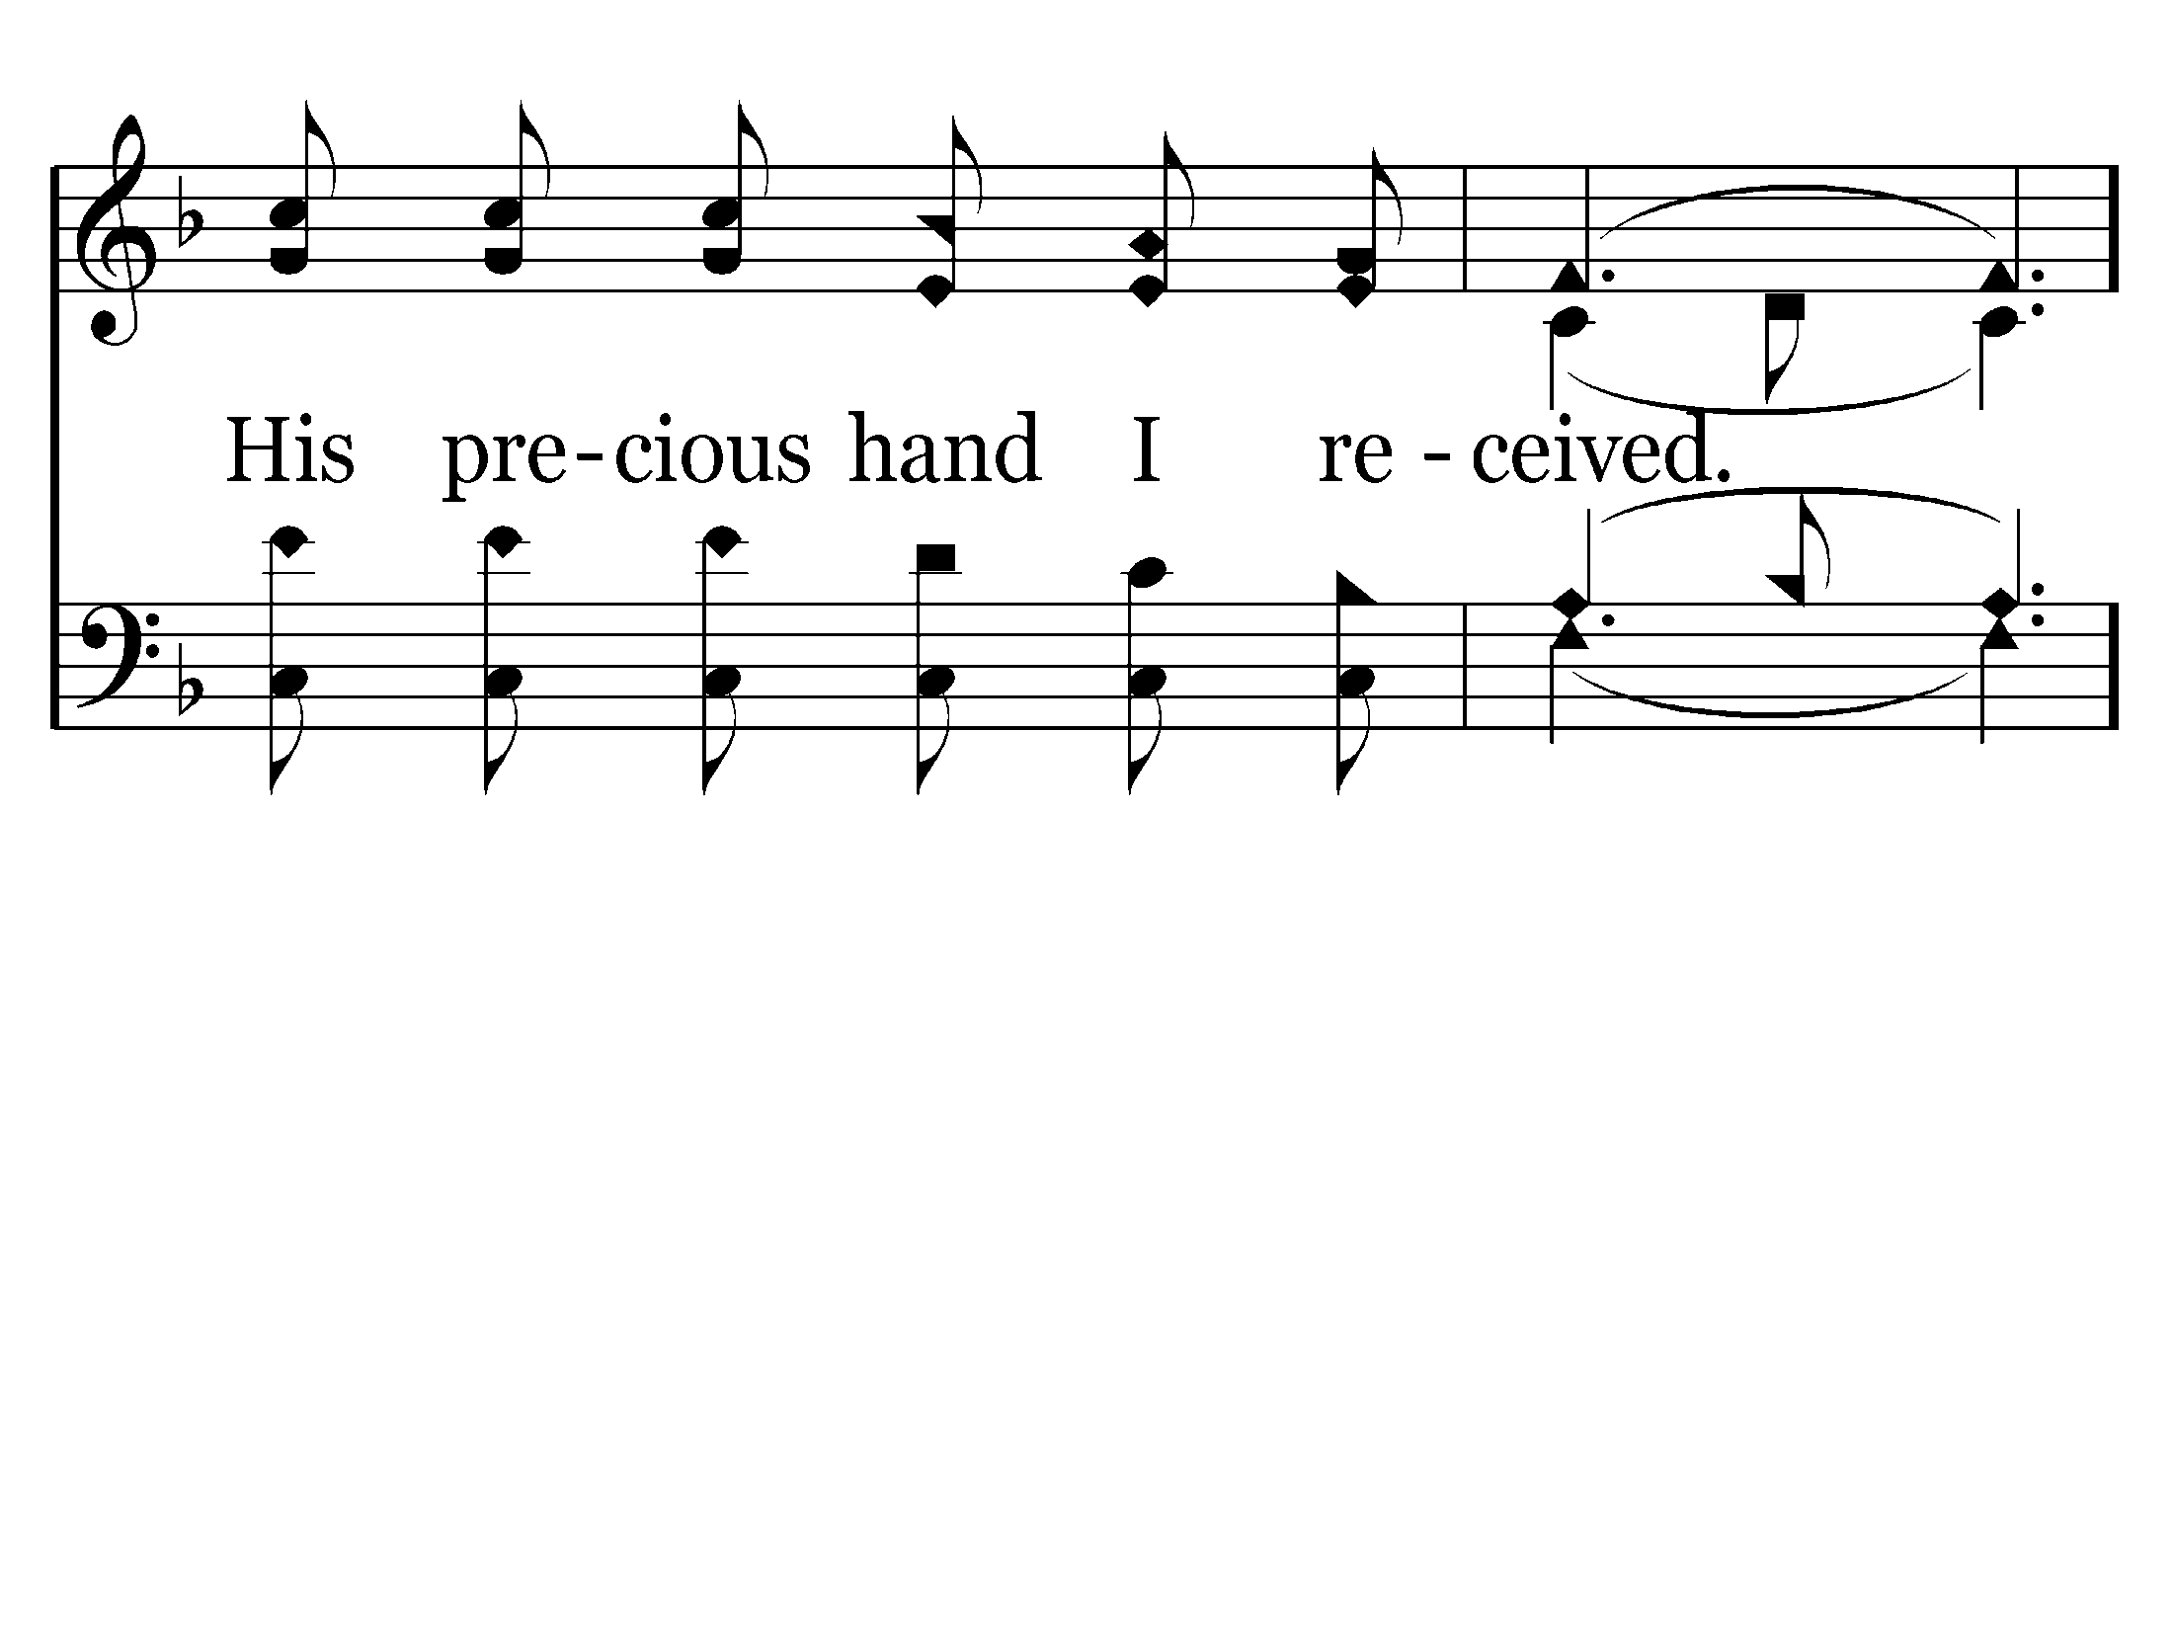
493 - Heaven Came Down - 2.5

Slide 77
493 - Heaven Came Down - C.1

Slide 78
493 - Heaven Came Down - C.2

Slide 79
493 - Heaven Came Down - C.3

Slide 80
493 - Heaven Came Down - C.4
End of Song

