Slide 2
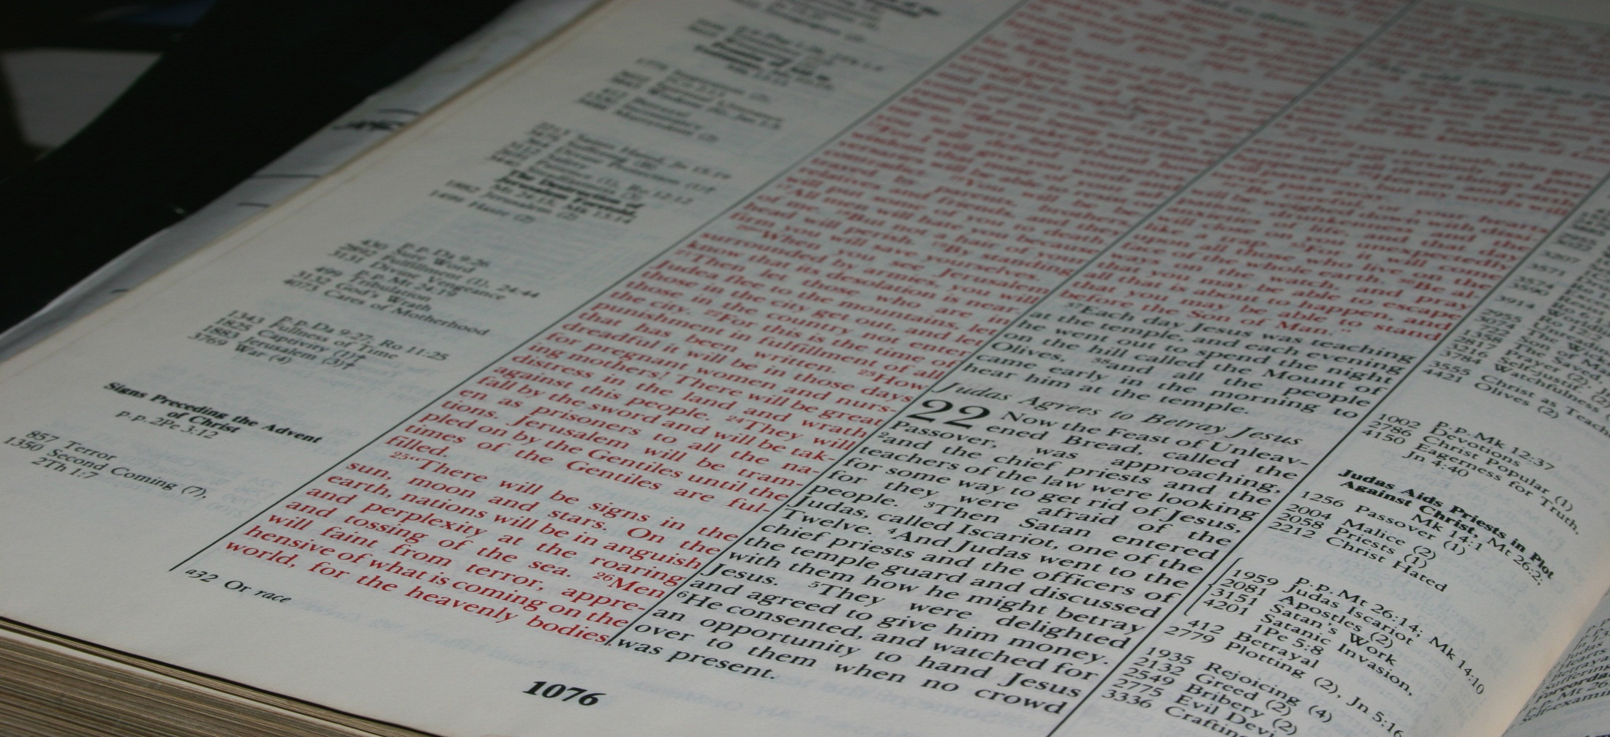
Then the churches throughout all Judea, Galilee, and Samaria had peace and were edified. And walking in the fear of the Lord and in the comfort of the Holy Spirit, they were multiplied.
Acts 9:31
Real Life For Everyone!
Northwest Church of Christ April 20-25, 2014

Slide 3

EDIFICATION
…the application of Bible truth to my life and circumstances so that I am more like Christ.
--Ephesians 4:11-13
Understand…
What it is
BUILDING UP

Slide 4
EDIFICATION
…the application of Bible truth to my life and circumstances so that I am more like Christ.
--Ephesians 4:11-13
Understand…
What it is
Its power
BUILDING UP

Slide 5
What You Can Do…
Demand quality worship services
Demand quality Bible classes
Demand something of yourself
Three Elements…
Truth
Motivation
Equipping
EDIFICATION
…the application of Bible truth to my life and circumstances so that I am more like Christ.
--Ephesians 4:11-13
Understand…
What it is
Its power
It is the solution
BUILDING UP

