Slide 1

The URGE
To Merge
Living In An
Ecumenical Age

Slide 2

ECUMENICAL
Interfaith
Alliance
worldwide or general in extent, influence or application
a : of, relating to, or representing the whole of a body of churches
b : promoting or tending toward worldwide Christian unity or cooperation
Greek: OIKOUMENE
“the entire inhabited world”

Slide 3

National Council of Churches
These 37 member communions come together in covenant community as the National Council of Churches to offer common witness to Jesus Christ and to share in a ministry of reconciliation to the world in his name. Together, they include more than 45 million people in over 100,000 congregations in the United States.
African Methodist Episcopal Church
The African Methodist Episcopal Zion Church
Alliance of Baptists
American Baptist Churches in the USA
Apostolic Catholic Church
Armenian Church of America, Eastern and Western Dioceses
Christian Church (Disciples of Christ) in the United States and Canada
Christian Methodist Episcopal Church
Church of the Brethren
Community of Christ
Coptic Orthodox Archdiocese of North America
The Episcopal Church (USA)
Evangelical Lutheran Church in America
Greek Orthodox Archdiocese of America
Hungarian Reformed Church in America
International Council of Community Churches
Korean Presbyterian Church Abroad
Malankara Orthodox Syrian Church, American Diocese

Slide 4
National Council of Churches
Mar Thoma Church
Moravian Church in America, Northern and Southern Provinces
National Baptist Convention of America, Inc.
National Baptist Convention, USA, Inc.
National Missionary Baptist Convention of America
Orthodox Church in America
Patriarchal Parishes of the Russian Orthodox Church in the USA
Polish National Catholic Church
Presbyterian Church (U.S.A.)
Progressive National Baptist Convention, Inc.
Reformed Church in America
Religious Society of Friends, Friends United Meeting
Religious Society of Friends, Philadelphia Yearly Meeting
Serbian Orthodox Church in North and South America
The Swedenborgian Church of North America
Syrian Orthodox Church of Antioch, Archdiocese of the Eastern Unitd States
Ukrainian Orthodox Church of the USA
United Church of Christ
The United Methodist Church

Slide 5
Denominationalism
Baptist
Method.
Nazarene
Lutheran
Unity in
Diversity
Presby.
Evang.
Free
Episcop.
Christ.
Science
Pent.
Discip.
Christ

Slide 6
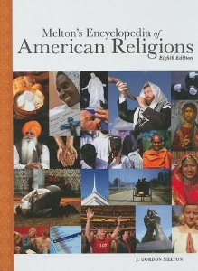
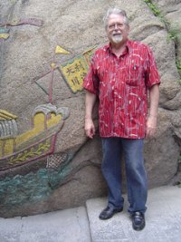
1,517
Denominations in the U.S.
J. Gordon Melton is the Distinguished Professor of American Religious History at the Institute for Studies of Religion, Baylor University
Church of the Mystery of Universal Wisdom
(talk to aliens and guided by flying saucers)
The Embassy of Heaven (Oregon)
(all govt’s illegitimate; issues own car plates)
The Nudist Christian Church of the Blessed
Virgin Mary
The Church of God Anonymous
88 Baptist sects
42 Methodist sects
22 Presbyterian sects, etc, etc.

Slide 7

Logic (?) for denominationalism
“All the disunity in the church is like a box of crayons with all their variety of colors, but in the end, they all go back into the same box!”

Slide 8
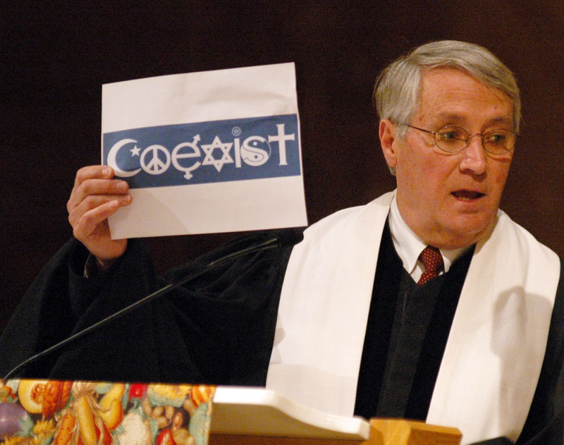
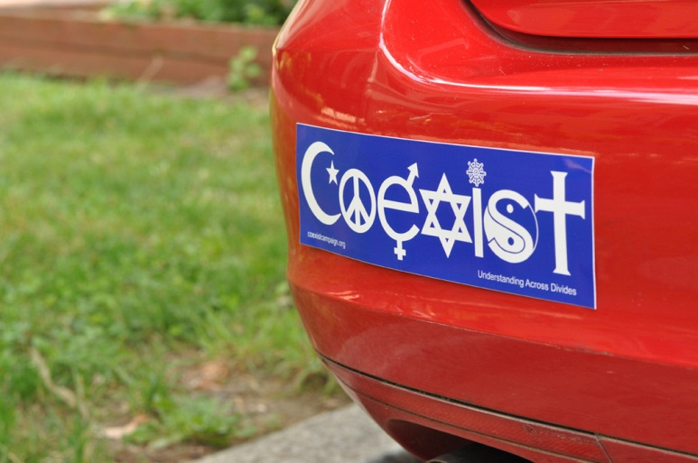
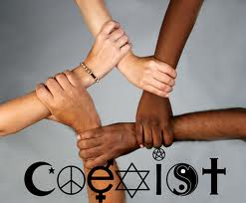
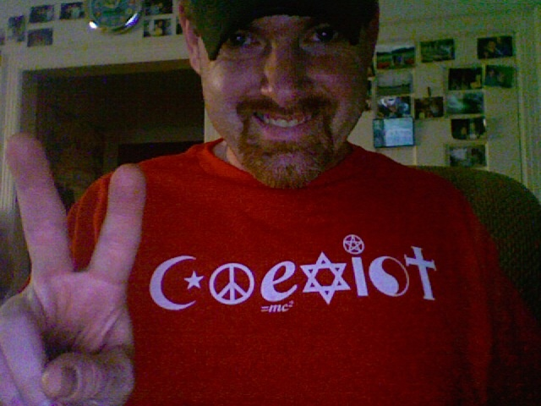

International
COEXIST MOVEMENT

Slide 9
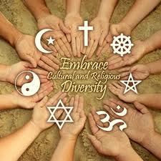
Interfaith
Ecumenical
Diversity

Slide 10
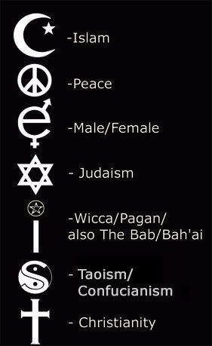
Appearance:
Peaceful
Application:
Impossible

Slide 11
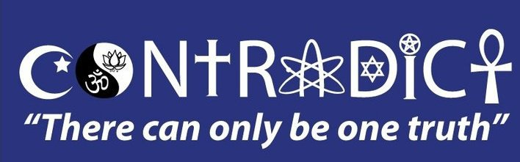
Nature: gravity (fall - die)
weather (-20 - die)
poison (eat – die)
lions (cage - die)
Religion: “whatever” ???
John 8:24 "Therefore I said to you that you will die in your sins; for if you do not believe that I am He, you will die in your sins."

Slide 12

Founded 1994
Goal: To protect faith and freedom by respecting individual rights and unite diverse voices to challenge extremism and build common ground
185,000 members from 75 faith traditions and systems (some who are non-religious)
“Interfaith Alliance works to ensure the sanctity of religion and the integrity of politics. The group also supports an end to discrimination based on sexual orientation”

Slide 13
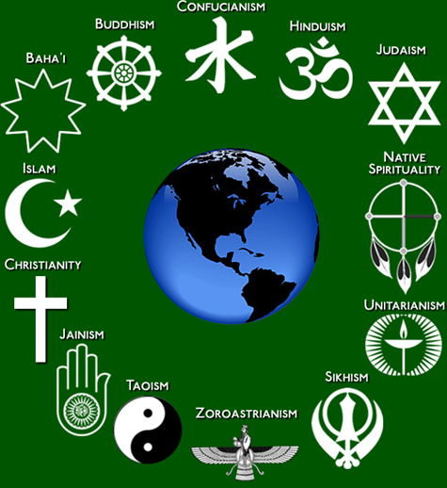
“We believe we have the truth!
But,
You have the truth too”
Interfaith
Alliance
?

Slide 14
Jesus
JOHN 14:6
“I Am the Way, the Truth, and the Life.
No one comes to the Father except through Me.”
Islam - Muhammad
Confucianism - Confucius
Interfaith
Alliance
Hinduism - Vashni
Buddhism - Gautama

Slide 15
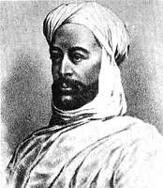
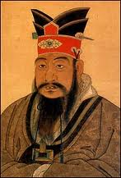
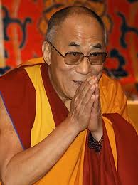
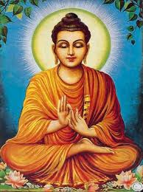
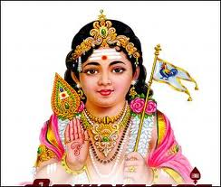
ACTS 4:12 “Jesus”
"Nor is there salvation in any other, for there is no other name under heaven given among men by which we must be saved."
Confucius
Islam
Muhammad
Hindu
Vashni
Buddha
Gautama
Buddha
Dalai Lama

Slide 16
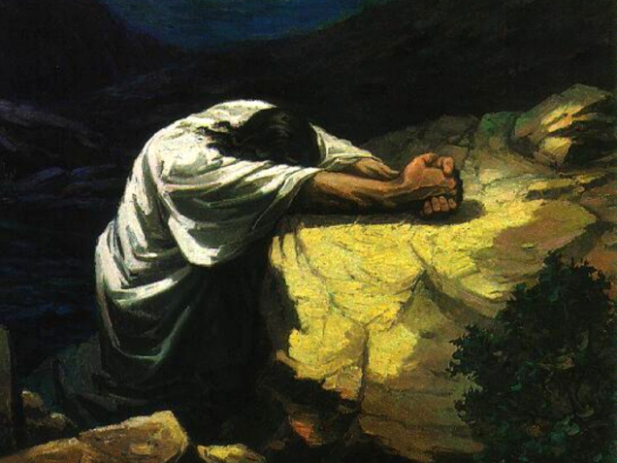
A Prayer, A Plea, A Plan
Jesus did not PREDICT religious unity.
Jesus did PRAY for religious unity
(John 17)
Jesus did PLEAD for religious unity
(I Corinthians 1:10)
Jesus did PLAN for religious unity
(Ephesians 4:3-6)

Slide 17

THE PRAYER John 17:1-5
(for Godhead)
1 Jesus spoke these words, lifted up His eyes to heaven, and said: "Father, the hour has come. Glorify Your Son, that Your Son also may glorify You,
2 "as You have given Him authority over all flesh, that He should give eternal life to as many as You have given Him.
3 "And this is eternal life, that they may know You, the only true God, and Jesus Christ whom You have sent.
4 "I have glorified You on the earth.
I have finished the work which You
have given Me to do.

Slide 18
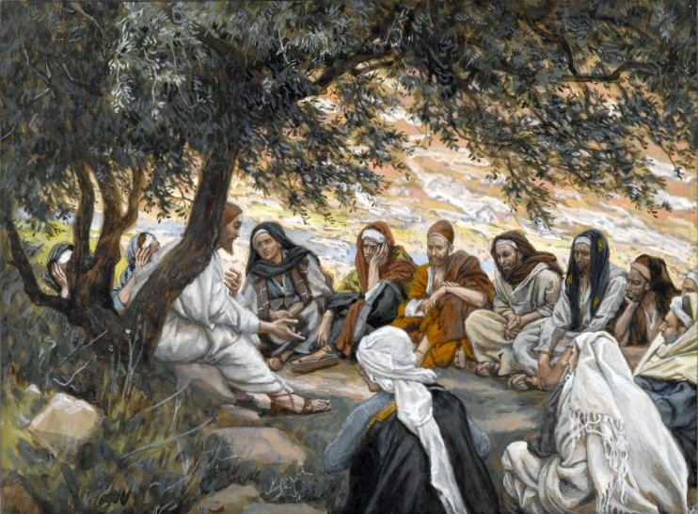
THE PRAYER John 17:6-19,24-26
(for the apostles)
11 that they may be one as We are.
17 "Sanctify them by Your truth.
Your word is truth.

Slide 19

THE PRAYER John 17:20-23
(for the world)
20 for those who will believe in Me
21 "that they all may be one,
that they also may be one in Us
22 that they may be one
just as We are one
23 that they may be made perfect in one

Slide 20
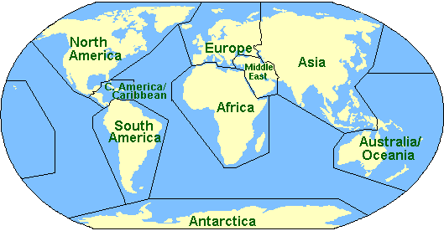
THE PLEA Philippians 1:27
Only let your conduct be worthy of the gospel of Christ, so that whether I come and see you or am absent, I may hear of your affairs, that you stand fast
in one spirit,
with one mind
striving together for the faith of the gospel

Slide 21
THE PLEA I Cor. 1:10-13
10 Now I plead with you, brethren, by the name of our Lord Jesus Christ, that you all speak the same thing, that there be no divisions among you, but you be perfectly joined together in
the same mind and in
the same judgment.

Slide 22
THE PLEA I Cor. 1:10-13
12 Now I say this, that each of you says,
"I am of Paul," or
"I am of Apollos," or
"I am of Cephas," or
"I am of Christ.“
13 Is Christ divided?
Was Paul crucified for you?
Or were you baptized in the name of Paul?

Slide 23

THE PLAN Eph. 4:3-6
There is:
one body and
one Spirit, just as you were called in
one hope of your calling;
one Lord,
one faith,
one baptism;
one God and Father of all

Slide 24
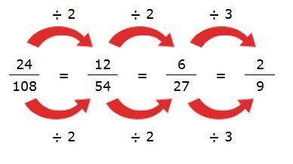
Lowest common denominator
Body
Spirit
Hope
Lord
Faith
Baptism
Spirit of
Ecumencalism
God

Slide 25
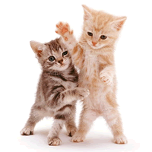
Spirit of Ecumencalism
Union without Unity
“You can tie two cats together and you have a union, but you do not have unity.”
- Mark Twain

Slide 26
Please Remember John 6
60 Therefore many of His disciples, when they heard this, said, "This is a hard saying; who can understand it?"
61 When Jesus knew in Himself that His disciples complained about this, He said to them, "Does this offend you?
66 From that time many of His disciples went back and walked with Him no more.

Slide 27
So What Can I Do For True Biblical Unity?
I can read Jesus’ prayer to everyone who will listen, and ask if they want this too
I can read Paul’s plea to everyone who will listen, and ask if they agree with the apostle
I can read the Holy Spirit’s plan to everyone, and ask if they will trust and obey all seven

