Slide 1
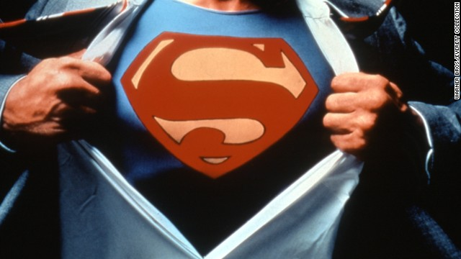
I AM
SUPERMAN

Slide 2
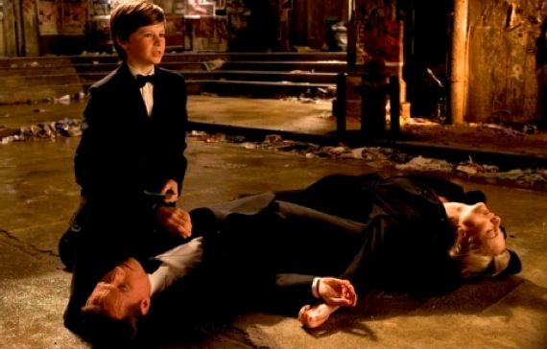
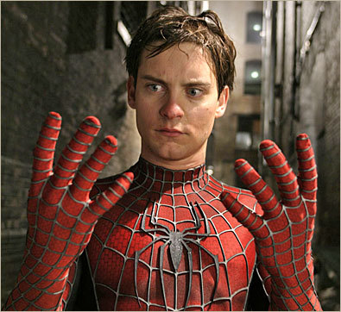
“Son, With Great Power
Comes Great Responsibility”
Peter Parker’s dad

Slide 3
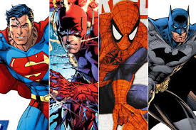
If I Had Super Powers

Slide 4
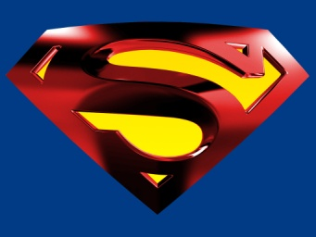
Tell the Government? Keep it a Secret? Fight crime…Daily? Natural disasters…Worldwide?
If I Had Super Powers…

Slide 5
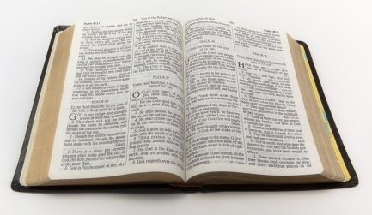
James 4:17
Therefore, to him who knows to do good and does not do it, to him it is sin.

Slide 6
Ever take a day off for: Marriage? Children? Job? Church?
If I Had Super Powers…

Slide 7
Soul > Body
Matt 10:28
"And do not fear those who kill the body but cannot kill the soul. But rather fear Him who is able to destroy both soul and body in hell.

Slide 8
Soul > Body
Matt. 16:26
For what profit is it to a man if he gains the whole world, and loses his own soul? Or what will a man give in exchange for his soul?

Slide 9
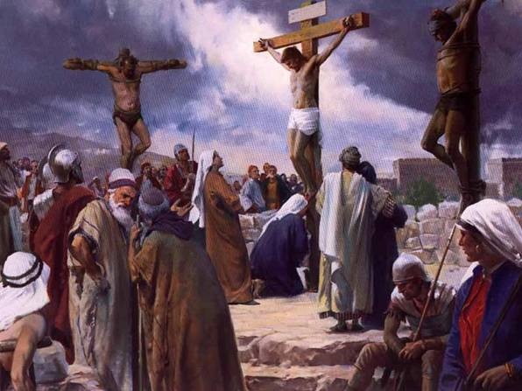
History’s Only Superman
Matt 27:42
"He saved others; Himself He cannot save. If He is the King of Israel, let Him now come down from the cross, and we will believe Him.

Slide 10
Paul’s Powers
Acts 20:26-27
"Therefore I testify to you this day that I am innocent of the blood of all men. For I have not shunned to declare to you the whole counsel of God.

Slide 11
My Present Powers
Matt. 25:34-40
37 "Then the righteous will answer Him, saying, 'Lord, when did we see You hungry and feed You, or thirsty and give You drink?
38 'When did we see You a stranger and take You in, or naked and clothe You?
39 'Or when did we see You sick, or in prison, and come to You?'

Slide 12
My Super Powers
Romans 1:16
For I am not ashamed of the gospel of Christ, for it is the power of God to salvation for everyone who believes, for the Jew first and also for the Greek.

Slide 13
My Super Powers
Matt. 16:18
"And I also say to you that you are Peter, and on this rock I will build My church, and the gates of Hades shall not prevail against it.

Slide 14
My Super Powers
Rom. 8:31-39
38 For I am persuaded that neither death nor life, nor angels nor principalities nor powers, nor things present nor things to come,
39 nor height nor depth, nor any other created thing, shall be able to separate us from the love of God which is in Christ Jesus our Lord.

Slide 15
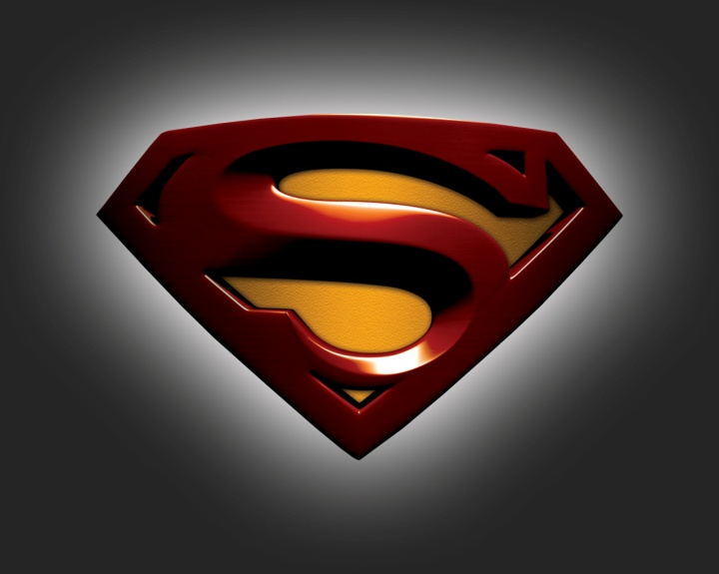
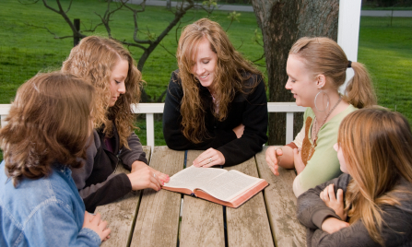
“Son, With Great Power
Comes Great Responsibility”
The Real Superman !

