Slide 1
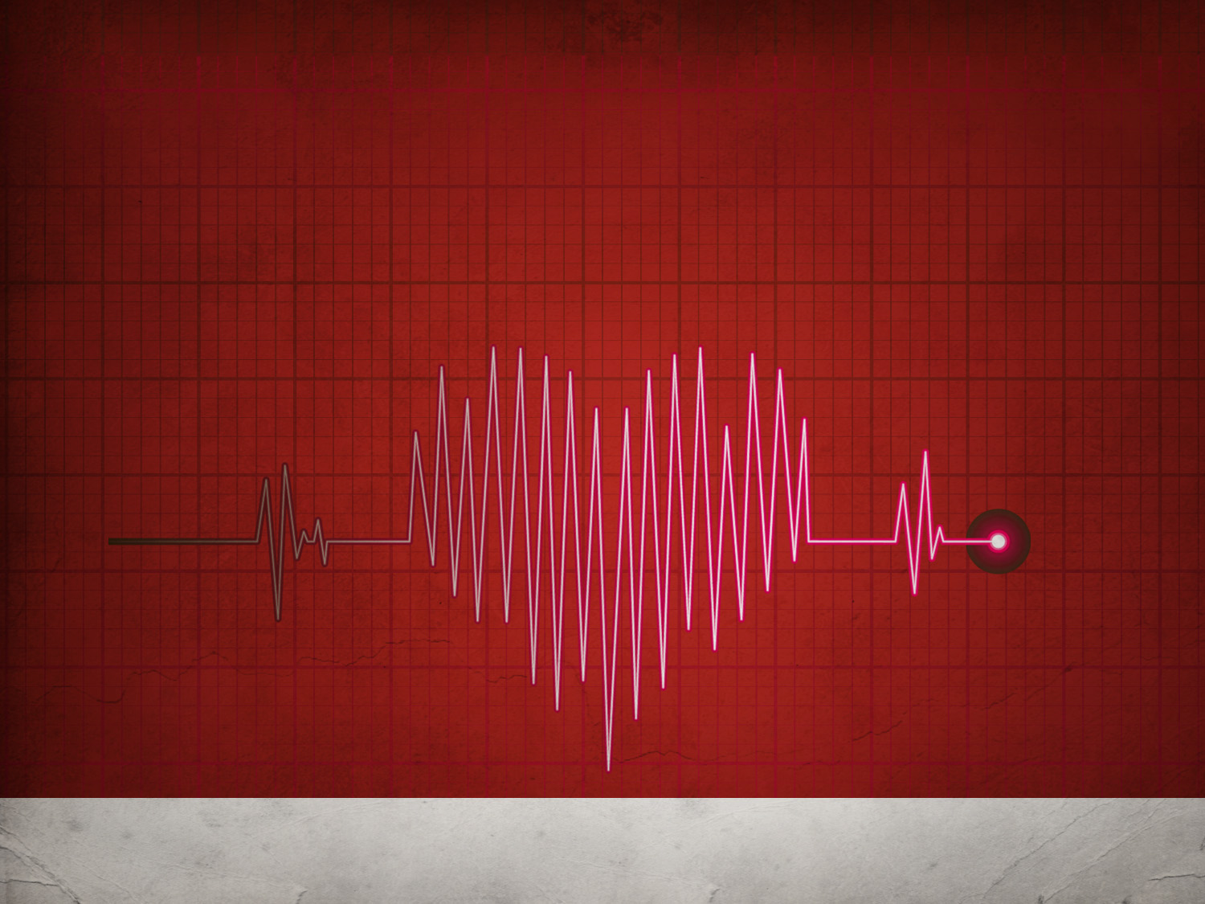
Be Anxious For…
Greek:
Merimnao / Merimna
Nothing?
Something?
Philippians 4:6
1 Corinthians 12:25
Matthew 6:25,27,28,31,34
2 Corinthians 11:28
Matthew 13:22
Philippians 2:20
Luke 10:41
Luke 21:34
1 Peter 5:7
1 Peter 1:22

