Slide 2
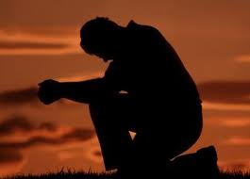
“Repent or Perish!”
Philip Henry (old pioneer preacher):
"Some people do not like to hear much of repentance; but I think it so necessary that if I were to die in the pulpit, I should desire to die preaching repentance, and if I should die out of the pulpit I hope to die practicing it."

Slide 3
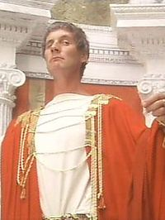
Luke 13:1-9
1 There were present at that season some who told Him about the Galileans whose blood Pilate had mingled with their sacrifices.
2 And Jesus answered and said to them, "Do you suppose that these Galileans were worse sinners than all other Galileans, because they suffered such things?
3 "I tell you, no; but unless you repent you will all likewise perish.

Slide 4
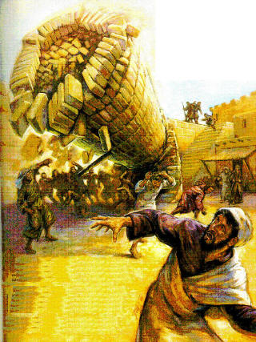
Luke 13:1-9
4 "Or those eighteen on whom the tower in Siloam fell and killed them, do you think that they were worse sinners than all other men who dwelt in Jerusalem?
5 "I tell you, no; but unless you repent you will all likewise perish.”

Slide 5
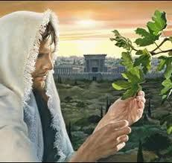
Luke 13:1-9
6 He also spoke this parable: "A certain man had a fig tree planted in his vineyard, and he came seeking fruit on it and found none.
7 "Then he said to the keeper of his vineyard, 'Look, for three years I have come seeking fruit on this fig tree and find none. Cut it down; why does it use up the ground?'
8 "But he answered and said to him, 'Sir, let it alone this year also, until I dig around it and fertilize it.
9 'And if it bears fruit, well. But if not, after that you can cut it down.'"

Slide 6
The Pilate Incident
No known secular historical recordings
Possible Scenarios: 1) Pilate’s appropriation of temple treasury for aqueduct
Bloody incident with plain-clothes soldiers
2) Acts 5:37 Judas of Galilee anti-tax insurrection
Interpretation: “greatest sinners = greatest sufferers”
Correction: Eccl 9:11 “time and chance” Rom. 5:12 “death to all men” Personal Warning

Slide 7
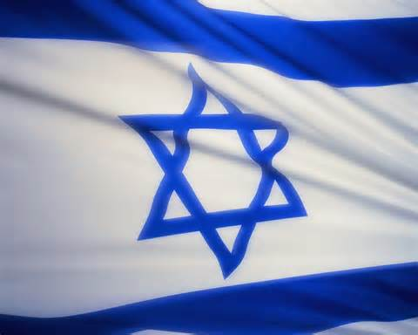
Jesus Main Point
Not the sins of Pilate
But the sins of the nation of Israel
“… unless YOU repent … YOU will perish!”
Greek: “Ean me metanoete” – present, active, linear action (“unless you change your mind about sin now and keep on changing in the future…”)Except You Repent

Slide 8
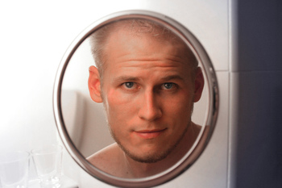
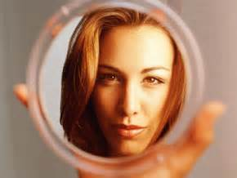
Jesus Application To Us
Not the sins of notable sinners (“look how bad…”)
But the sins of myself (“look in the mirror…”)
“… unless YOU repent … YOU will perish!”
Others deaths = My warning (Eccl. 7:2-4)

Slide 9
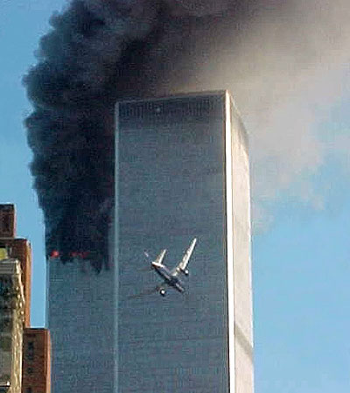
The Tower Incident
The 18 deaths at Tower of Siloam
Historical event well known to listeners
Speculations by Jews: “great sinner = great sufferer”
Jesus’ conclusion: “YOU repent…or perish!”
Greek: “ean me metanoesete” (immediately change now! – contrast vs. 3 – continuous action)

Slide 10
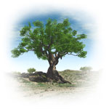
The Fig Tree Incident
And if it bears fruit, well. But if not, after that you can cut it down. Life and Death hangs on those 2 “if’s”
Fig Tree in Jew’s mindset (Hosea 9:10 = “Israel nation”)
3 years – fruitless! (wasting soil, space, time)
Gardner’s intercession: Patience…one more year
No explanation – necessary inference

Slide 11
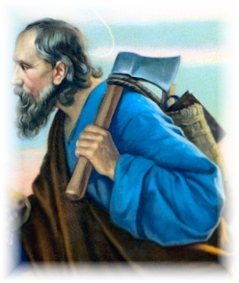
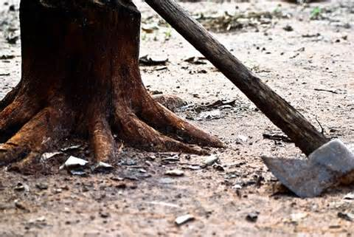
Israel Barren – Time Running Out!
Therefore: John & Jesus ministry (3+ yrs) vs. 3 “Unless you repent, you also will perish!” vs. 5 “Unless you repent, you also will perish!”
Slain just like Pilate’s Galileans Slain just like the Tower 18
Luke 3:9 “Even now the ax is lying at the root of the trees; every tree that does not bear good fruit is cut down and thrown into the fire”

Slide 12
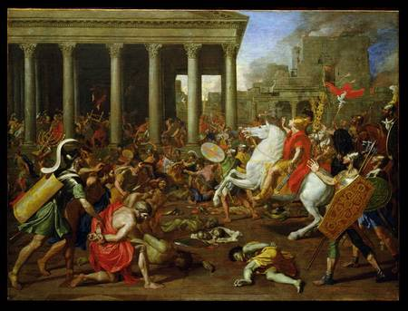
Israel Barren – Time Running Out!
Luke 21:20 "But when you see Jerusalem surrounded by armies, then know that its desolation is near.”
Luke 21:29-32 “Then He spoke to them a parable: "Look at the fig tree, and all the trees. … "Assuredly, I say to you, this generation will by no means pass away till all things take place.”

Slide 13
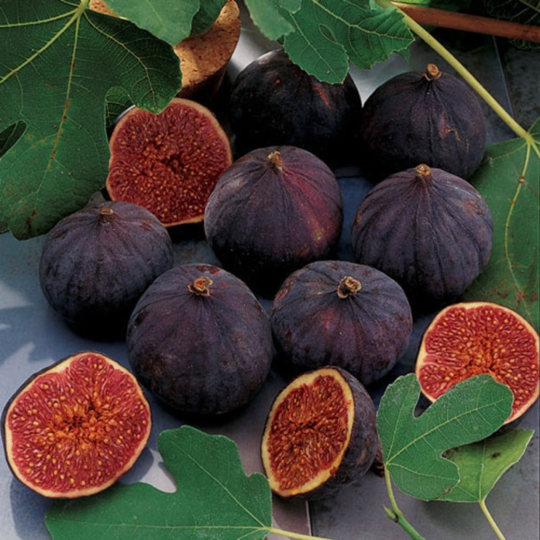
Israel – Forgot It’s Purpose
“Bear Fruit!”
When do not fulfill purpose – worthless to owner!

Slide 14
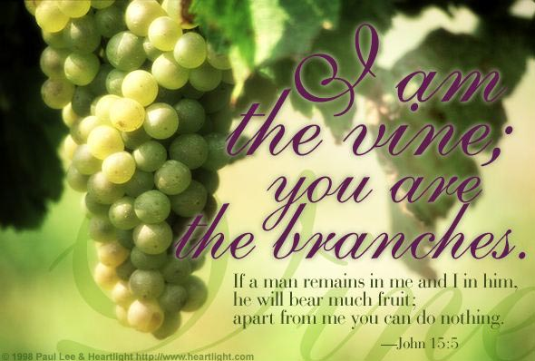
Do I Know My Purpose?
John 15:1-8 "By this My Father is glorified, that you bear much fruit; so you will be My disciples.”

Slide 15
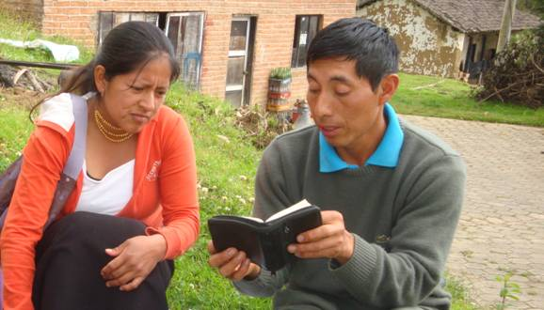
How Do I Bear Much Fruit?
John 15:1-8 "He who abides in Me, and I in him, bears much fruit; for without Me you can do nothing.”
But how do I abide in Christ? “If you abide in Me, and My words abide in you…”

Slide 16
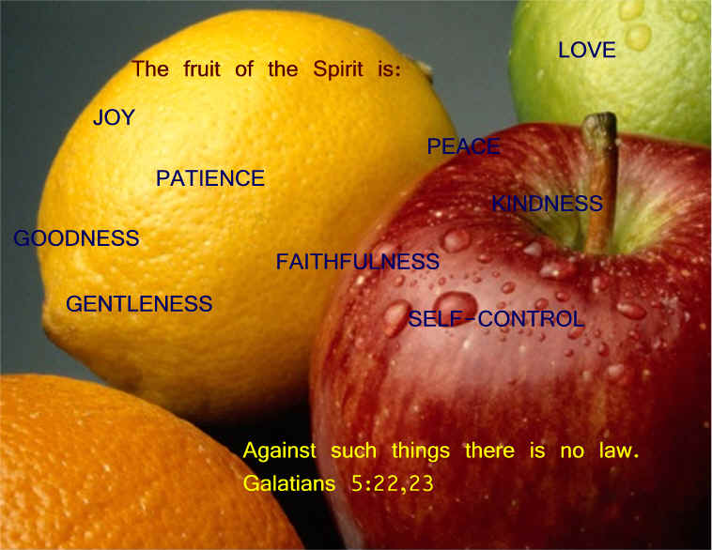
The Fruit of the Spirit
Galatians 5:22-23 “The fruit of the Spirit is… Love Joy Peace Longsuffering Kindness Goodness Faithfulness Gentleness Self-control

Slide 17
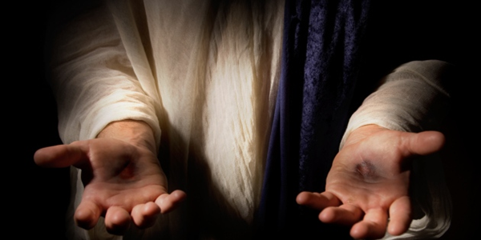
The Fruit Looks Like Jesus !
Rom 8:29 “For whom he did foreknow, he also did predestinate to be conformed to the image of his Son

Slide 18
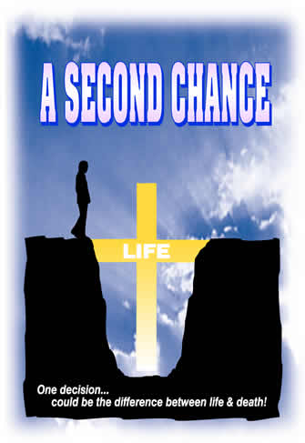
God Is Longsuffering
The Giver of Second Chances
2 Peter 3:8-10
8 “But, beloved, do not forget this one thing, that with the Lord one day is as a thousand years, and a thousand years as one day.
9 The Lord is not slack concerning His promise, as some count slackness, but is longsuffering toward us, not willing that any should perish but that all should come to repentance.
10 But the day of the Lord will come as a thief in the night…

Slide 19
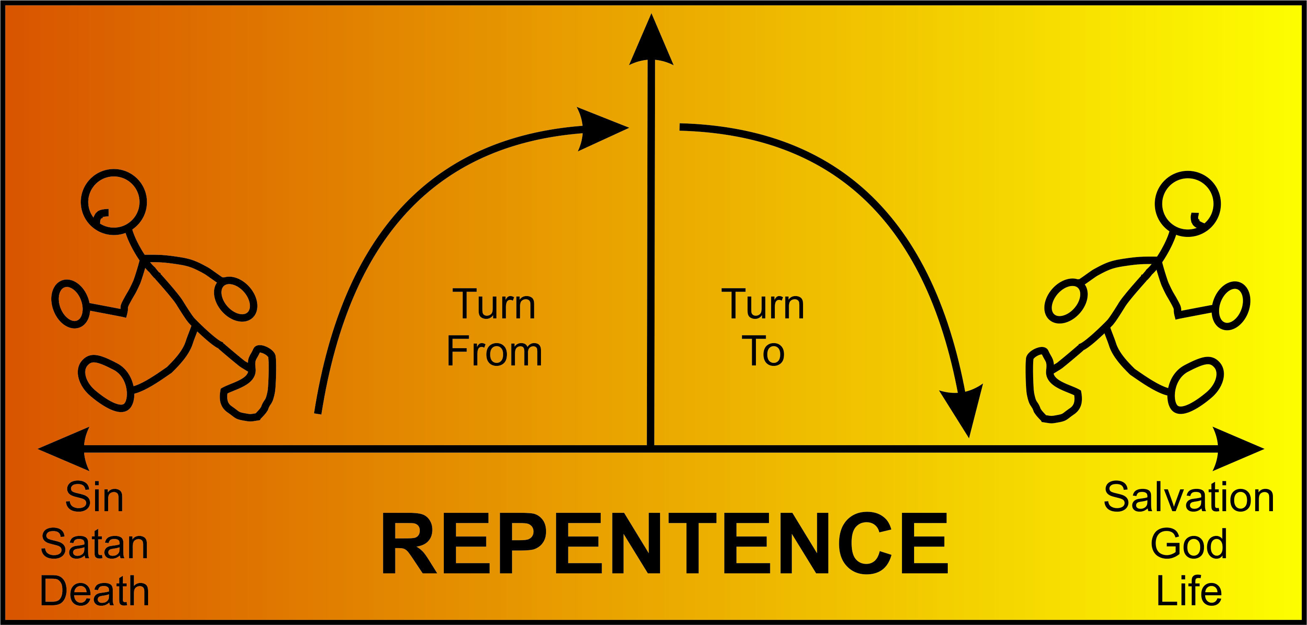
Repentance Defined By Jesus
Luke 13 Israel: Change your thinking = Change your actions
Terminus a quo (turning from) Terminus ad quem (turning to)

Slide 20
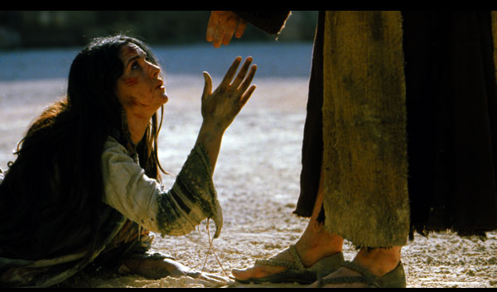
Repentance Defined By Paul
2 Corinthians 7:9 Now I rejoice, not that you were made sorry, but that your sorrow led to repentance. For you were made sorry in a godly manner, that you might suffer loss from us in nothing.
Luke 7:37 And behold, a woman in the city who was a sinner, when she knew that Jesus sat at the table in the Pharisee's house, brought an alabaster flask of fragrant oil, 38 and stood at His feet behind Him weeping; and she began to wash His feet with her tears, and wiped them with the hair of her head; and she kissed His feet and anointed them with the fragrant oil.

Slide 21
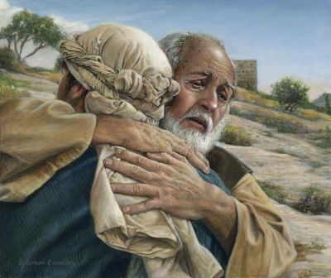
Repentance: Godly Sorrow “sorrow toward God, not man”
2 Corinthians 7:10
For godly sorrow produces repentance leading to salvation, not to be regretted; but the sorrow of the world produces death.
Psalm 51:4 Against You, You only, have I sinned, and done this evil in Your sight
Luke 15:21 "And the son said to him, 'Father, I have sinned against heaven and in your sight, and am no longer worthy to be called your son.'

Slide 22
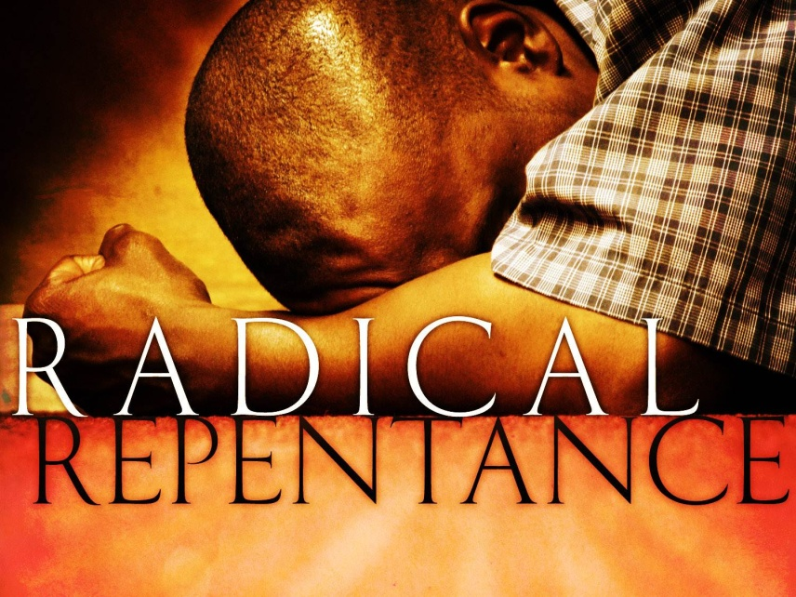
Radical Repentance
2 Corinthians 7:11 For observe this very thing, that you sorrowed in a godly manner:
What diligence it produced in you,
what clearing of yourselves,
what indignation,
what fear,
what vehement desire,
what zeal,
what vindication!
In all things you proved yourselves to be clear in this matter.

