Slide 1
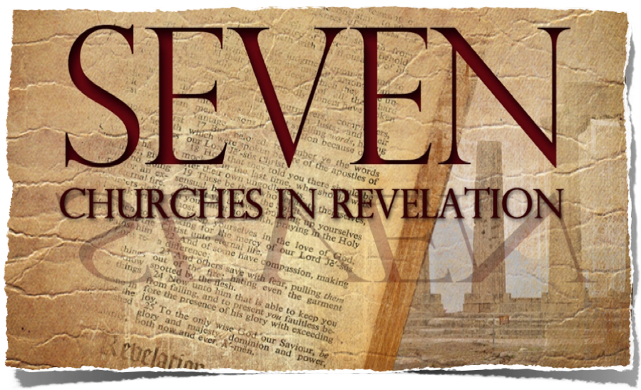
To The Church In
“I know your works, love, service, faith, and your patience; and as for your works, the last are more than the first.”
Revelation 2:18-29

Slide 2
The Seven
Churches of Asia

Slide 3
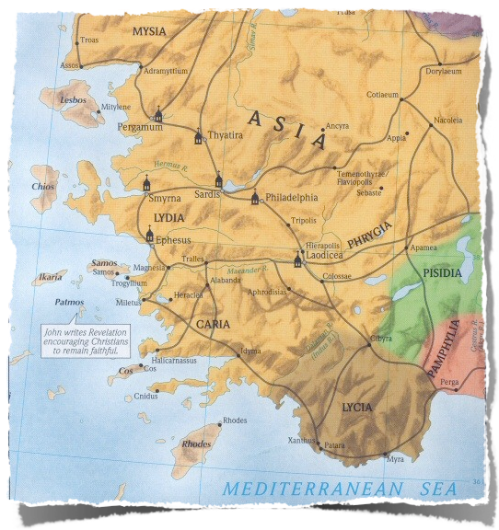
Revelation 1:11 ^{(NKJV)}
¹¹ saying, "I am the Alpha and the Omega, the First and the Last," and, "What you see, write in a book and send it to the seven churches which are in Asia: to Ephesus, to Smyrna, to Pergamos, to Thyatira, to Sardis, to Philadelphia, and to Laodicea."
3. Pergamos
4. Thyatira
Divided Church
5. Sardis
2. Smyrna
Poor Rich Church
6. Philadelphia
1. Ephesus
7. Laodicea
Loveless Church

Slide 4
The Fourth Church: Thyatira
“And to the angel of the church in Thyatira write, . . .Rev 2:18
The Compromising
Church
Revelation 2:18-29
“Nevertheless I have a few things against you, because you allow that woman Jezebel, who calls herself a prophetess, to teach and seduce My servants to commit sexual immorality and eat things sacrificed to idols.” Revelation 2:20

Slide 5
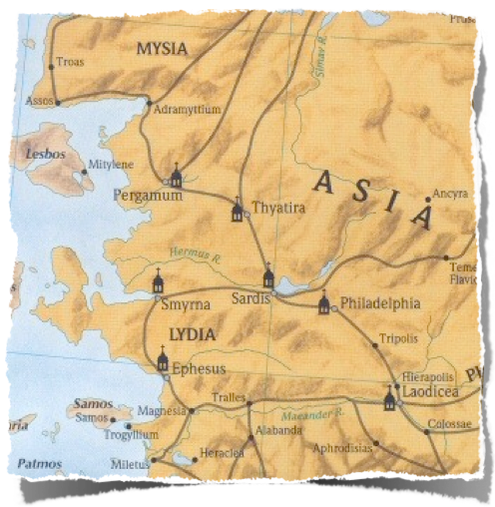
Thyatira
“And to the angel of the church in Thyatira write, . . .Rev 2:18
40 miles SE of Pergamum (capital of province)
Established as military outpost
Commercial route between Pergamos and Sardis
Notes:
Revelation 2:12 (NKJV)
12 "And to the angel of the church in Pergamos write, 'These things says He who has the sharp two-edged sword:
1. History:
Pergamos, to which the ancient writers also gave the neuter form of the name, was a city of Mysia of the ancient Roman province of Asia, in the Caicus valley, 3 miles from the river, and about 15 miles from the sea. The Caicus was navigable for small native craft. Two of the tributaries of the Caicus were the Selinus and the Kteios. The former of these rivers flowed through the city; the latter ran along its walls. On the hill between these two streams the first city stood, and there also stood the acropolis, the chief temples, and theaters of the later city. The early people of the town were descendants of Greek colonists, and as early as 420 BC they struck coins of their own. Lysimachus, who possessed the town, deposited there 9,000 talents of gold. Upon his death, Philetaerus (283-263 BC) used this wealth to found the independent Greek dynasty of the Attalid kings. The first of this dynasty to bear the title of king was Attalus I (241-197 BC), a nephew of Philetaerus, and not only did he adorn the city with beautiful buildings until it became the most wonderful city of the East, but he added to his kingdom the countries of Mysia, Lydia, Caria, Pamphylia and Phrygia. Eumenes II (197-159 BC) was the most illustrious king of the dynasty, and during his reign the city reached its greatest height. Art and literature were encouraged, and in the city was a library of 200,000 volumes which later Antony gave to Cleopatra. The books were of parchment which was here first used; hence, the word “parchment,” which is derived from the name of the town Pergamos. Of the structures which adorned the city, the most renowned was the altar of Zeus, which was 40 ft. in height, and also one of the wonders of the ancient world. When in 133 BC Attalus III, the last king of the dynasty, died, he gave his kingdom to the Roman government. His son, Aristonicus, however, attempted to seize it for himself, but in 129 he was defeated, and the Roman province of Asia was formed, and Pergamos was made its capital. The term Asia, as here employed, should not be confused with the continent of Asia, nor with Asia Minor. It applied simply to that part of Asia Minor which was then in the possession of the Romans, and formed into the province of which Pergamos was the capital. Upon the establishment of the province of Asia there began a new series of coins struck at Pergamos, which continued into the 3rd century AD. The magnificence of the city continued.
2. Religions:
There were beautiful temples to the four great gods Zeus, Dionysus, Athena and Asklepios. To the temple of the latter, invalids from all parts of Asia flocked, and there, while they were sleeping in the court, the god revealed to the priests and physicians by means of dreams the remedies which were necessary to heal their maladies. Thus opportunities of deception were numerous. There was a school of medicine in connection with the temple. Pergamos was chiefly a religious center of the province. A title which it bore was “Thrice Neokoros,” meaning that in the city 3 temples had been built to the Roman emperors, in which the emperors were worshipped as gods. Smyrna, a rival city, was a commercial center, and as it increased in wealth, it gradually became the political center. Later, when it became the capital, Pergamos remained the religious center. As in many of the towns of Asia Minor, there were at Pergamos many Jews, and in 130 BC the people of the city passed a decree in their favor. Many of the Jews were more or less assimilated with the Greeks, even to the extent of bearing Greek names.
3. Christianity:
Christianity reached Pergamos early, for there one of the Seven Churches of the Book of Rev stood, and there, according to Revelation 2:13, Antipas was marryred; he was the first Christian to be put to death by the Roman state. The same passage speaks of Pergamos as the place “where Satan's throne is,” probably referring to the temples in which the Roman emperors were worshipped. During the Byzantine times Pergamos still continued as a religious center, for there a bishop lived. However, the town fell into the hands of the Seljuks in 1304, and in 1336 it was taken by Suleiman, the son of Orkhan, and became Turkish.
The modern name of the town, which is of considerable size, possessing 15 mosques, is Bergama, the Turkish corruption of the ancient name. One of its mosques is the early Byzantine church of Sophia. The modern town is built among the ruins of the ancient city, but is far less in extent. From 1879 to 1886 excavations among the ruins were conducted by Herr Humann at the expense of the German government. Among them are still to be seen the base of the altar of Zeus, the friezes of which are now in the Pergamon Museum, Berlin; theater, the agora, the gymnasium and several temples. In ancient times the city was noted for its ointments, pottery and parchment; at present the chief articles of trade are cotton, wool, opium, valonia, and leather.
http://astheoracle.truepath.com/index-244.htm

Slide 6
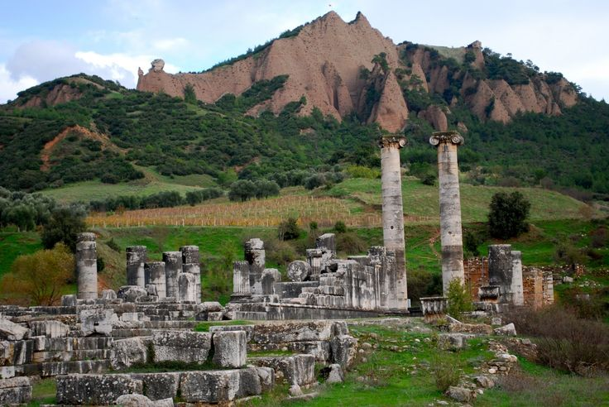
Thyatira
"“And to the angel of the church in Thyatira write, . . .Rev 2:18
Chief pagan deity was Apollo: “The Sun God”
Pagan temples everywhere
Notes:
Revelation 2:12 (NKJV)
12 "And to the angel of the church in Pergamos write, 'These things says He who has the sharp two-edged sword:
1. History:
Pergamos, to which the ancient writers also gave the neuter form of the name, was a city of Mysia of the ancient Roman province of Asia, in the Caicus valley, 3 miles from the river, and about 15 miles from the sea. The Caicus was navigable for small native craft. Two of the tributaries of the Caicus were the Selinus and the Kteios. The former of these rivers flowed through the city; the latter ran along its walls. On the hill between these two streams the first city stood, and there also stood the acropolis, the chief temples, and theaters of the later city. The early people of the town were descendants of Greek colonists, and as early as 420 BC they struck coins of their own. Lysimachus, who possessed the town, deposited there 9,000 talents of gold. Upon his death, Philetaerus (283-263 BC) used this wealth to found the independent Greek dynasty of the Attalid kings. The first of this dynasty to bear the title of king was Attalus I (241-197 BC), a nephew of Philetaerus, and not only did he adorn the city with beautiful buildings until it became the most wonderful city of the East, but he added to his kingdom the countries of Mysia, Lydia, Caria, Pamphylia and Phrygia. Eumenes II (197-159 BC) was the most illustrious king of the dynasty, and during his reign the city reached its greatest height. Art and literature were encouraged, and in the city was a library of 200,000 volumes which later Antony gave to Cleopatra. The books were of parchment which was here first used; hence, the word “parchment,” which is derived from the name of the town Pergamos. Of the structures which adorned the city, the most renowned was the altar of Zeus, which was 40 ft. in height, and also one of the wonders of the ancient world. When in 133 BC Attalus III, the last king of the dynasty, died, he gave his kingdom to the Roman government. His son, Aristonicus, however, attempted to seize it for himself, but in 129 he was defeated, and the Roman province of Asia was formed, and Pergamos was made its capital. The term Asia, as here employed, should not be confused with the continent of Asia, nor with Asia Minor. It applied simply to that part of Asia Minor which was then in the possession of the Romans, and formed into the province of which Pergamos was the capital. Upon the establishment of the province of Asia there began a new series of coins struck at Pergamos, which continued into the 3rd century AD. The magnificence of the city continued.
2. Religions:
There were beautiful temples to the four great gods Zeus, Dionysus, Athena and Asklepios. To the temple of the latter, invalids from all parts of Asia flocked, and there, while they were sleeping in the court, the god revealed to the priests and physicians by means of dreams the remedies which were necessary to heal their maladies. Thus opportunities of deception were numerous. There was a school of medicine in connection with the temple. Pergamos was chiefly a religious center of the province. A title which it bore was “Thrice Neokoros,” meaning that in the city 3 temples had been built to the Roman emperors, in which the emperors were worshipped as gods. Smyrna, a rival city, was a commercial center, and as it increased in wealth, it gradually became the political center. Later, when it became the capital, Pergamos remained the religious center. As in many of the towns of Asia Minor, there were at Pergamos many Jews, and in 130 BC the people of the city passed a decree in their favor. Many of the Jews were more or less assimilated with the Greeks, even to the extent of bearing Greek names.
3. Christianity:
Christianity reached Pergamos early, for there one of the Seven Churches of the Book of Rev stood, and there, according to Revelation 2:13, Antipas was marryred; he was the first Christian to be put to death by the Roman state. The same passage speaks of Pergamos as the place “where Satan's throne is,” probably referring to the temples in which the Roman emperors were worshipped. During the Byzantine times Pergamos still continued as a religious center, for there a bishop lived. However, the town fell into the hands of the Seljuks in 1304, and in 1336 it was taken by Suleiman, the son of Orkhan, and became Turkish.
The modern name of the town, which is of considerable size, possessing 15 mosques, is Bergama, the Turkish corruption of the ancient name. One of its mosques is the early Byzantine church of Sophia. The modern town is built among the ruins of the ancient city, but is far less in extent. From 1879 to 1886 excavations among the ruins were conducted by Herr Humann at the expense of the German government. Among them are still to be seen the base of the altar of Zeus, the friezes of which are now in the Pergamon Museum, Berlin; theater, the agora, the gymnasium and several temples. In ancient times the city was noted for its ointments, pottery and parchment; at present the chief articles of trade are cotton, wool, opium, valonia, and leather.
http://astheoracle.truepath.com/index-244.htm

Slide 7
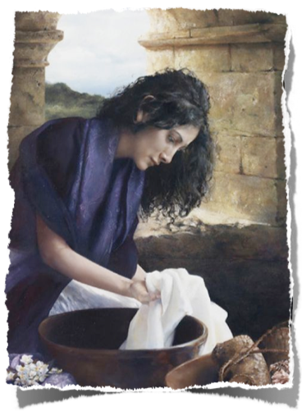
Thyatira
"“And to the angel of the church in Thyatira write, . . .Rev 2:18
Possible beginning of the church Paul’s conversion of Lydia and family (Acts 16)
Acts 16:15 And when she and her household were baptized, she begged us, saying, "If you have judged me to be faithful to the Lord, come to my house and stay."
“Lydia, a seller of purple , of the city of Thyatira”
(Acts 16:14-15)
Notes:
Revelation 2:12 (NKJV)
12 "And to the angel of the church in Pergamos write, 'These things says He who has the sharp two-edged sword:
1. History:
Pergamos, to which the ancient writers also gave the neuter form of the name, was a city of Mysia of the ancient Roman province of Asia, in the Caicus valley, 3 miles from the river, and about 15 miles from the sea. The Caicus was navigable for small native craft. Two of the tributaries of the Caicus were the Selinus and the Kteios. The former of these rivers flowed through the city; the latter ran along its walls. On the hill between these two streams the first city stood, and there also stood the acropolis, the chief temples, and theaters of the later city. The early people of the town were descendants of Greek colonists, and as early as 420 BC they struck coins of their own. Lysimachus, who possessed the town, deposited there 9,000 talents of gold. Upon his death, Philetaerus (283-263 BC) used this wealth to found the independent Greek dynasty of the Attalid kings. The first of this dynasty to bear the title of king was Attalus I (241-197 BC), a nephew of Philetaerus, and not only did he adorn the city with beautiful buildings until it became the most wonderful city of the East, but he added to his kingdom the countries of Mysia, Lydia, Caria, Pamphylia and Phrygia. Eumenes II (197-159 BC) was the most illustrious king of the dynasty, and during his reign the city reached its greatest height. Art and literature were encouraged, and in the city was a library of 200,000 volumes which later Antony gave to Cleopatra. The books were of parchment which was here first used; hence, the word “parchment,” which is derived from the name of the town Pergamos. Of the structures which adorned the city, the most renowned was the altar of Zeus, which was 40 ft. in height, and also one of the wonders of the ancient world. When in 133 BC Attalus III, the last king of the dynasty, died, he gave his kingdom to the Roman government. His son, Aristonicus, however, attempted to seize it for himself, but in 129 he was defeated, and the Roman province of Asia was formed, and Pergamos was made its capital. The term Asia, as here employed, should not be confused with the continent of Asia, nor with Asia Minor. It applied simply to that part of Asia Minor which was then in the possession of the Romans, and formed into the province of which Pergamos was the capital. Upon the establishment of the province of Asia there began a new series of coins struck at Pergamos, which continued into the 3rd century AD. The magnificence of the city continued.
2. Religions:
There were beautiful temples to the four great gods Zeus, Dionysus, Athena and Asklepios. To the temple of the latter, invalids from all parts of Asia flocked, and there, while they were sleeping in the court, the god revealed to the priests and physicians by means of dreams the remedies which were necessary to heal their maladies. Thus opportunities of deception were numerous. There was a school of medicine in connection with the temple. Pergamos was chiefly a religious center of the province. A title which it bore was “Thrice Neokoros,” meaning that in the city 3 temples had been built to the Roman emperors, in which the emperors were worshipped as gods. Smyrna, a rival city, was a commercial center, and as it increased in wealth, it gradually became the political center. Later, when it became the capital, Pergamos remained the religious center. As in many of the towns of Asia Minor, there were at Pergamos many Jews, and in 130 BC the people of the city passed a decree in their favor. Many of the Jews were more or less assimilated with the Greeks, even to the extent of bearing Greek names.
3. Christianity:
Christianity reached Pergamos early, for there one of the Seven Churches of the Book of Rev stood, and there, according to Revelation 2:13, Antipas was marryred; he was the first Christian to be put to death by the Roman state. The same passage speaks of Pergamos as the place “where Satan's throne is,” probably referring to the temples in which the Roman emperors were worshipped. During the Byzantine times Pergamos still continued as a religious center, for there a bishop lived. However, the town fell into the hands of the Seljuks in 1304, and in 1336 it was taken by Suleiman, the son of Orkhan, and became Turkish.
The modern name of the town, which is of considerable size, possessing 15 mosques, is Bergama, the Turkish corruption of the ancient name. One of its mosques is the early Byzantine church of Sophia. The modern town is built among the ruins of the ancient city, but is far less in extent. From 1879 to 1886 excavations among the ruins were conducted by Herr Humann at the expense of the German government. Among them are still to be seen the base of the altar of Zeus, the friezes of which are now in the Pergamon Museum, Berlin; theater, the agora, the gymnasium and several temples. In ancient times the city was noted for its ointments, pottery and parchment; at present the chief articles of trade are cotton, wool, opium, valonia, and leather.
http://astheoracle.truepath.com/index-244.htm

Slide 8
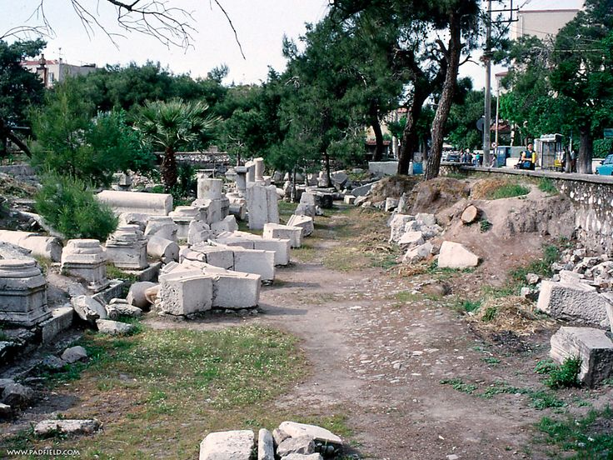
Thyatira
"“And to the angel of the church in Thyatira write, . . .Rev 2:18
Small, wealthy city of commerce
Famous: Purple dye (cf. Lydia - Acts 16:14).
Many Trade guilds: wool, leather, linen, bronze, garments, dyers, potters, bakers, slaves
Pagan religion - Immoral practices
Christians: employed or ostracized depending on membership and participation in trade guilds
Notes:
Revelation 2:12 (NKJV)
12 "And to the angel of the church in Pergamos write, 'These things says He who has the sharp two-edged sword:
1. History:
Pergamos, to which the ancient writers also gave the neuter form of the name, was a city of Mysia of the ancient Roman province of Asia, in the Caicus valley, 3 miles from the river, and about 15 miles from the sea. The Caicus was navigable for small native craft. Two of the tributaries of the Caicus were the Selinus and the Kteios. The former of these rivers flowed through the city; the latter ran along its walls. On the hill between these two streams the first city stood, and there also stood the acropolis, the chief temples, and theaters of the later city. The early people of the town were descendants of Greek colonists, and as early as 420 BC they struck coins of their own. Lysimachus, who possessed the town, deposited there 9,000 talents of gold. Upon his death, Philetaerus (283-263 BC) used this wealth to found the independent Greek dynasty of the Attalid kings. The first of this dynasty to bear the title of king was Attalus I (241-197 BC), a nephew of Philetaerus, and not only did he adorn the city with beautiful buildings until it became the most wonderful city of the East, but he added to his kingdom the countries of Mysia, Lydia, Caria, Pamphylia and Phrygia. Eumenes II (197-159 BC) was the most illustrious king of the dynasty, and during his reign the city reached its greatest height. Art and literature were encouraged, and in the city was a library of 200,000 volumes which later Antony gave to Cleopatra. The books were of parchment which was here first used; hence, the word “parchment,” which is derived from the name of the town Pergamos. Of the structures which adorned the city, the most renowned was the altar of Zeus, which was 40 ft. in height, and also one of the wonders of the ancient world. When in 133 BC Attalus III, the last king of the dynasty, died, he gave his kingdom to the Roman government. His son, Aristonicus, however, attempted to seize it for himself, but in 129 he was defeated, and the Roman province of Asia was formed, and Pergamos was made its capital. The term Asia, as here employed, should not be confused with the continent of Asia, nor with Asia Minor. It applied simply to that part of Asia Minor which was then in the possession of the Romans, and formed into the province of which Pergamos was the capital. Upon the establishment of the province of Asia there began a new series of coins struck at Pergamos, which continued into the 3rd century AD. The magnificence of the city continued.
2. Religions:
There were beautiful temples to the four great gods Zeus, Dionysus, Athena and Asklepios. To the temple of the latter, invalids from all parts of Asia flocked, and there, while they were sleeping in the court, the god revealed to the priests and physicians by means of dreams the remedies which were necessary to heal their maladies. Thus opportunities of deception were numerous. There was a school of medicine in connection with the temple. Pergamos was chiefly a religious center of the province. A title which it bore was “Thrice Neokoros,” meaning that in the city 3 temples had been built to the Roman emperors, in which the emperors were worshipped as gods. Smyrna, a rival city, was a commercial center, and as it increased in wealth, it gradually became the political center. Later, when it became the capital, Pergamos remained the religious center. As in many of the towns of Asia Minor, there were at Pergamos many Jews, and in 130 BC the people of the city passed a decree in their favor. Many of the Jews were more or less assimilated with the Greeks, even to the extent of bearing Greek names.
3. Christianity:
Christianity reached Pergamos early, for there one of the Seven Churches of the Book of Rev stood, and there, according to Revelation 2:13, Antipas was marryred; he was the first Christian to be put to death by the Roman state. The same passage speaks of Pergamos as the place “where Satan's throne is,” probably referring to the temples in which the Roman emperors were worshipped. During the Byzantine times Pergamos still continued as a religious center, for there a bishop lived. However, the town fell into the hands of the Seljuks in 1304, and in 1336 it was taken by Suleiman, the son of Orkhan, and became Turkish.
The modern name of the town, which is of considerable size, possessing 15 mosques, is Bergama, the Turkish corruption of the ancient name. One of its mosques is the early Byzantine church of Sophia. The modern town is built among the ruins of the ancient city, but is far less in extent. From 1879 to 1886 excavations among the ruins were conducted by Herr Humann at the expense of the German government. Among them are still to be seen the base of the altar of Zeus, the friezes of which are now in the Pergamon Museum, Berlin; theater, the agora, the gymnasium and several temples. In ancient times the city was noted for its ointments, pottery and parchment; at present the chief articles of trade are cotton, wool, opium, valonia, and leather.
http://astheoracle.truepath.com/index-244.htm

Slide 9
Thyatira
“And to the angel of the church in Thyatira write, . . .
Revelation 2:18 ^{(NKJV)}
¹⁸ ". . . 'These things says the Son of God, who has eyes like a flame of fire, and His feet like fine brass:
Christ’s Self Designation
“The Son of God” – claim to Deity
Not “A” son of God but “THE” Son of God (vs. Apollo)
Immanuel (“God with us”):
Notes:
The “Son of God” – A Direct claim to Deity (John 5:17,18)
John 5:17-18 (NKJV) But Jesus answered them, "My Father has been working until now, and I have been working." [18] Therefore the Jews sought all the more to kill Him, because He not only broke the Sabbath, but also said that God was His Father, making Himself equal with God.
Psalm 2:7 (NKJV) "I will declare the decree: The Lord has said to Me, 'You are My Son, Today I have begotten You.
Matthew 26:63-64 (NKJV) But Jesus kept silent. And the high priest answered and said to Him, "I put You under oath by the living God: Tell us if You are the Christ, the Son of God!" [64] Jesus said to him, "It is as you said. Nevertheless, I say to you, hereafter you will see the Son of Man sitting at the right hand of the Power, and coming on the clouds of heaven."
John 11:4 (NKJV) When Jesus heard that, He said, "This sickness is not unto death, but for the glory of God, that the Son of God may be glorified through it."
Eyes like a flame of fire– Penetrating vision – (Heb 4:13)
Fire, in Scripture, is the expression of divine anger. The figure may include the thought of the clear and penetrating insight of the Son of Man; but it also expresses His indignation at the sin which His divine insight detects.
Hebrews 4:13 (NKJV) And there is no creature hidden from His sight, but all things are naked and open to the eyes of Him to whom we must give account.
Feet like fine brass – Strength & durability – (Heb 13:8)
Denoting his immense strength. Able to tread down all opposition and turn to ashes His enemies.
Perhaps indicative of majesty and glory as he walked in the midst of the churches.
Hebrews 13:8 (NKJV) Jesus Christ is the same yesterday, today, and forever.

Slide 10
Thyatira
"“And to the angel of the church in Thyatira write, . . .Rev 2:18
Revelation 2:18 ^{(NKJV)}
¹⁸ ". . . 'These things says the Son of God, who has eyes like a flame of fire, and His feet like fine brass:
Christ’s Self Designation
“Eyes like a flame of fire” –
Penetrating vision / omniscient
He knows all we do, say, think
Notes:
The “Son of God” – A Direct claim to Deity (John 5:17,18)
John 5:17-18 (NKJV) But Jesus answered them, "My Father has been working until now, and I have been working." [18] Therefore the Jews sought all the more to kill Him, because He not only broke the Sabbath, but also said that God was His Father, making Himself equal with God.
Psalm 2:7 (NKJV) "I will declare the decree: The Lord has said to Me, 'You are My Son, Today I have begotten You.
Matthew 26:63-64 (NKJV) But Jesus kept silent. And the high priest answered and said to Him, "I put You under oath by the living God: Tell us if You are the Christ, the Son of God!" [64] Jesus said to him, "It is as you said. Nevertheless, I say to you, hereafter you will see the Son of Man sitting at the right hand of the Power, and coming on the clouds of heaven."
John 11:4 (NKJV) When Jesus heard that, He said, "This sickness is not unto death, but for the glory of God, that the Son of God may be glorified through it."
Eyes like a flame of fire– Penetrating vision – (Heb 4:13)
Fire, in Scripture, is the expression of divine anger. The figure may include the thought of the clear and penetrating insight of the Son of Man; but it also expresses His indignation at the sin which His divine insight detects.
Hebrews 4:13 (NKJV) And there is no creature hidden from His sight, but all things are naked and open to the eyes of Him to whom we must give account.
Feet like fine brass – Strength & durability – (Heb 13:8)
Denoting his immense strength. Able to tread down all opposition and turn to ashes His enemies.
Perhaps indicative of majesty and glory as he walked in the midst of the churches.
Hebrews 13:8 (NKJV) Jesus Christ is the same yesterday, today, and forever.

Slide 11
Thyatira
"“And to the angel of the church in Thyatira write, . . .Rev 2:18
Revelation 2:18 ^{(NKJV)}
¹⁸ ". . . 'These things says the Son of God, who has eyes like a flame of fire, and His feet like fine brass:
Christ’s Self Designation
“Feet like fine brass” (cf. 1:15)
Firmness, strength & purity
Power to vanquish all enemies in fiery judgment - (2 Thess 1:7-9).
Notes:
The “Son of God” – A Direct claim to Deity (John 5:17,18)
John 5:17-18 (NKJV) But Jesus answered them, "My Father has been working until now, and I have been working." [18] Therefore the Jews sought all the more to kill Him, because He not only broke the Sabbath, but also said that God was His Father, making Himself equal with God.
Psalm 2:7 (NKJV) "I will declare the decree: The Lord has said to Me, 'You are My Son, Today I have begotten You.
Matthew 26:63-64 (NKJV) But Jesus kept silent. And the high priest answered and said to Him, "I put You under oath by the living God: Tell us if You are the Christ, the Son of God!" [64] Jesus said to him, "It is as you said. Nevertheless, I say to you, hereafter you will see the Son of Man sitting at the right hand of the Power, and coming on the clouds of heaven."
John 11:4 (NKJV) When Jesus heard that, He said, "This sickness is not unto death, but for the glory of God, that the Son of God may be glorified through it."
Eyes like a flame of fire– Penetrating vision – (Heb 4:13)
Fire, in Scripture, is the expression of divine anger. The figure may include the thought of the clear and penetrating insight of the Son of Man; but it also expresses His indignation at the sin which His divine insight detects.
Hebrews 4:13 (NKJV) And there is no creature hidden from His sight, but all things are naked and open to the eyes of Him to whom we must give account.
Feet like fine brass – Strength & durability – (Heb 13:8)
Denoting his immense strength. Able to tread down all opposition and turn to ashes His enemies.
Perhaps indicative of majesty and glory as he walked in the midst of the churches.
Hebrews 13:8 (NKJV) Jesus Christ is the same yesterday, today, and forever.

Slide 12
Thyatira
"“And to the angel of the church in Thyatira write, . . .Rev 2:18
Commendations (# 1)
“I know Your works” Knows everything church is doing
Good qualities like Thessalonians: “your work of faith and labor of love and patience of hope” (1 Thess. 1:3)
Revelation 2:19 ^{(NKJV)}
¹⁹ I know your works, love, service, faith, and your patience; and as for your works, the last are more than the first.
Notes:
I know thy works. Revelation 2:2. He knew all they had done, good and bad.
And charity. Love: love to God, and love to man. The Essence of Christianity – (Mk 12:29-31; John 14:15; 15:14; 1 John 5:3)
Mark 12:29-31 (NKJV) Jesus answered him, "The first of all the commandments is: 'Hear, O Israel, the Lord our God, the Lord is one. [30] And you shall love the Lord your God with all your heart, with all your soul, with all your mind, and with all your strength.' This is the first commandment. [31] And the second, like it, is this: 'You shall love your neighbor as yourself.' There is no other commandment greater than these."
John 14:15 (NKJV) "If you love Me, keep My commandments.
1 John 5:3 (NKJV) For this is the love of God, that we keep His commandments. And His commandments are not burdensome.
And service. , ministry- The word would seem to include all the service which the church had rendered in the cause of religion; all which was the proper fruit of love, or which would be a carrying out of the principles of love to God and man.
2 Corinthians 9:1 For as touching the ministering to the saints, it is superfluous for me to write to you:
Hebrews 6:9-10 (NKJV) But, beloved, we are confident of better things concerning you, yes, things that accompany salvation, though we speak in this manner. [10] For God is not unjust to forget your work and labor of love which you have shown toward His name, in that you have ministered to the saints, and do minister.
And faith. Or, fidelity in the cause of the Redeemer. The word here would include not only trust in Christ for salvation, but that which is the proper result of such trust-fidelity in his service.
Hebrews 11:1 (NKJV) Now faith is the substance of things hoped for, the evidence of things not seen. . . . . [6] But without faith it is impossible to please Him, for he who comes to God must believe that He is, and that He is a rewarder of those who diligently seek Him.
And thy patience. Patient endurance of the sorrows of life-of all that God brought upon them in any way, to test the reality of their religion.
James 5:10,11 My brethren, take the prophets, who spoke in the name of the Lord, as an example of suffering and patience. [11] Indeed we count them blessed who endure. You have heard of the perseverance of Job and seen the end intended by the Lord——that the Lord is very compassionate and merciful.
And thy works. Thy works as the fruit of the virtues just mentioned.
And the last to be more than the first.- That is, they were making progress; they had been acting more and more in accordance with the nature and claims of the Christian profession. Making advances in knowledge and holiness; as we grow in years and experience is required of us, (Heb 5:12-14)
1 Timothy 4:15 Meditate on these things; give yourself entirely to them, that your progress may be evident to all.
Philippians 1:25 And being confident of this, I know that I shall remain and continue with you all for your progress and joy of faith,
2 Thes. 1:3 (NKJV)
We are bound to thank God always for you, brethren, as it is fitting, because your faith grows exceedingly, and the love of every one of you all abounds toward each other,

Slide 13
Thyatira
"“And to the angel of the church in Thyatira write, . . .Rev 2:18
Revelation 2:19 ^{(NKJV)}
¹⁹ I know your works, love, service, faith, and your patience; and as for your works, the last are more than the first.
Commendations (#2-3)
Love – (unlike Ephesus) Toward God and man
Service – Followed Jesus by serving God and others
Notes:
I know thy works. Revelation 2:2. He knew all they had done, good and bad.
And charity. Love: love to God, and love to man. The Essence of Christianity – (Mk 12:29-31; John 14:15; 15:14; 1 John 5:3)
Mark 12:29-31 (NKJV) Jesus answered him, "The first of all the commandments is: 'Hear, O Israel, the Lord our God, the Lord is one. [30] And you shall love the Lord your God with all your heart, with all your soul, with all your mind, and with all your strength.' This is the first commandment. [31] And the second, like it, is this: 'You shall love your neighbor as yourself.' There is no other commandment greater than these."
John 14:15 (NKJV) "If you love Me, keep My commandments.
1 John 5:3 (NKJV) For this is the love of God, that we keep His commandments. And His commandments are not burdensome.
And service. , ministry- The word would seem to include all the service which the church had rendered in the cause of religion; all which was the proper fruit of love, or which would be a carrying out of the principles of love to God and man.
2 Corinthians 9:1 For as touching the ministering to the saints, it is superfluous for me to write to you:
Hebrews 6:9-10 (NKJV) But, beloved, we are confident of better things concerning you, yes, things that accompany salvation, though we speak in this manner. [10] For God is not unjust to forget your work and labor of love which you have shown toward His name, in that you have ministered to the saints, and do minister.
And faith. Or, fidelity in the cause of the Redeemer. The word here would include not only trust in Christ for salvation, but that which is the proper result of such trust-fidelity in his service.
Hebrews 11:1 (NKJV) Now faith is the substance of things hoped for, the evidence of things not seen. . . . . [6] But without faith it is impossible to please Him, for he who comes to God must believe that He is, and that He is a rewarder of those who diligently seek Him.
And thy patience. Patient endurance of the sorrows of life-of all that God brought upon them in any way, to test the reality of their religion.
James 5:10,11 My brethren, take the prophets, who spoke in the name of the Lord, as an example of suffering and patience. [11] Indeed we count them blessed who endure. You have heard of the perseverance of Job and seen the end intended by the Lord——that the Lord is very compassionate and merciful.
And thy works. Thy works as the fruit of the virtues just mentioned.
And the last to be more than the first.- That is, they were making progress; they had been acting more and more in accordance with the nature and claims of the Christian profession. Making advances in knowledge and holiness; as we grow in years and experience is required of us, (Heb 5:12-14)
1 Timothy 4:15 Meditate on these things; give yourself entirely to them, that your progress may be evident to all.
Philippians 1:25 And being confident of this, I know that I shall remain and continue with you all for your progress and joy of faith,
2 Thes. 1:3 (NKJV)
We are bound to thank God always for you, brethren, as it is fitting, because your faith grows exceedingly, and the love of every one of you all abounds toward each other,

Slide 14
Thyatira
"“And to the angel of the church in Thyatira write, . . .Rev 2:18
Revelation 2:19 ^{(NKJV)}
¹⁹ I know your works, love, service, faith, and your patience; and as for your works, the last are more than the first.
Commendations (#4-6)
Faith – reliable / trustworthy to the Lord
Patience – steadfast, enduring
Progress – increasingly zealous
Notes:
I know thy works. Revelation 2:2. He knew all they had done, good and bad.
And charity. Love: love to God, and love to man. The Essence of Christianity – (Mk 12:29-31; John 14:15; 15:14; 1 John 5:3)
Mark 12:29-31 (NKJV) Jesus answered him, "The first of all the commandments is: 'Hear, O Israel, the Lord our God, the Lord is one. [30] And you shall love the Lord your God with all your heart, with all your soul, with all your mind, and with all your strength.' This is the first commandment. [31] And the second, like it, is this: 'You shall love your neighbor as yourself.' There is no other commandment greater than these."
John 14:15 (NKJV) "If you love Me, keep My commandments.
1 John 5:3 (NKJV) For this is the love of God, that we keep His commandments. And His commandments are not burdensome.
And service. , ministry- The word would seem to include all the service which the church had rendered in the cause of religion; all which was the proper fruit of love, or which would be a carrying out of the principles of love to God and man.
2 Corinthians 9:1 For as touching the ministering to the saints, it is superfluous for me to write to you:
Hebrews 6:9-10 (NKJV) But, beloved, we are confident of better things concerning you, yes, things that accompany salvation, though we speak in this manner. [10] For God is not unjust to forget your work and labor of love which you have shown toward His name, in that you have ministered to the saints, and do minister.
And faith. Or, fidelity in the cause of the Redeemer. The word here would include not only trust in Christ for salvation, but that which is the proper result of such trust-fidelity in his service.
Hebrews 11:1 (NKJV) Now faith is the substance of things hoped for, the evidence of things not seen. . . . . [6] But without faith it is impossible to please Him, for he who comes to God must believe that He is, and that He is a rewarder of those who diligently seek Him.
And thy patience. Patient endurance of the sorrows of life-of all that God brought upon them in any way, to test the reality of their religion.
James 5:10,11 My brethren, take the prophets, who spoke in the name of the Lord, as an example of suffering and patience. [11] Indeed we count them blessed who endure. You have heard of the perseverance of Job and seen the end intended by the Lord——that the Lord is very compassionate and merciful.
And thy works. Thy works as the fruit of the virtues just mentioned.
And the last to be more than the first.- That is, they were making progress; they had been acting more and more in accordance with the nature and claims of the Christian profession. Making advances in knowledge and holiness; as we grow in years and experience is required of us, (Heb 5:12-14)
1 Timothy 4:15 Meditate on these things; give yourself entirely to them, that your progress may be evident to all.
Philippians 1:25 And being confident of this, I know that I shall remain and continue with you all for your progress and joy of faith,
2 Thes. 1:3 (NKJV)
We are bound to thank God always for you, brethren, as it is fitting, because your faith grows exceedingly, and the love of every one of you all abounds toward each other,

Slide 15
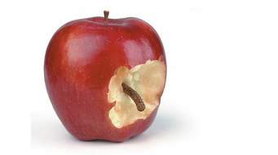
Thyatira
"“And to the angel of the church in Thyatira write, . . .Rev 2:18
Revelation 2:20 ^{(NKJV)}
Nevertheless I have a few things against you, because you allow that woman Jezebel …
Condemnation (#1)
Toleration of Error (Compromise)
serious defect
tolerated a woman called "Jezebel"
Notes:
II. THE PROBLEM (2:20-21). A. 2:20-21 "Nevertheless I have a few things against you, because you allow that woman Jezebel, who calls herself a prophetess, to teach and seduce My servants to commit sexual immorality and eat things sacrificed to idols. 21 "And I gave her time to repent of her sexual immorality, and she did not repent.”
B. Notice the name that stands out: “Jezebel.”
This name was apparently given because this individual was like the character of old.
1) The original Jezebel was the daughter of Ethbaal; king of the Sidonians, also known as the Phoenicians.
2) We read of her record in 1 Kings 16-21 and 2 Kings 9.
3) She was the wife of king Ahab, and helped to lead her husband into Baal worship (1 Kings 16:31).
4) She was a vicious lady, having destroyed the prophets of God (1 Kings 18:4).
5) Even Naboth’s death is laid to her charge, as she had him killed that Ahab could have his vineyard (1 Kings 21).
6) She encouraged idolatry: evening feeding at her table the prophets of Baal and Asherah (1 Kings 18:19).
7) Jehu described her practices as harlotry and witchcraft (2 Kings 9:22).
8) Her name is virtually synonymous with evil.
9) We read of her death in 2 Kings 9:30-37, and it was a very violent death.
The woman teaching in Thyatira was a proverbial Jezebel, in that she was a false prophetess.
1) She was teaching the people to commit sexual immorality.
2) Teaching them to eat things sacrificed to idols.
3) It is of little doubt that she was trying to bring pagan worship into the church, the holding again of the doctrine of Balaam.
4. Again with reference to the guilds, it is evident from the background information that compromise would have been a danger.
1) Membership in the guilds would have been difficult for a member of the Lord’s church, especially since the guilds were tied in with idolatrous worship.
2) With pressure even coming within the church, it is possible that members may have succumbed to the pressure and temptation.
3) Compromise has long been a tool of satan.
C. 21 "And I gave her time to repent of her sexual immorality, and she did not repent.”
Even in the face of evil within the church, we see the longsuffering and patience of God (2 Pet. 3:9).
God’s patience was tremendous in the days of Noah while the ark was being prepared for 120 yrs.
His patience is also evident today, giving men time to repent.
Repentance signifies a change; and there are too many Jezebel’s today preventing people from repenting of their sins.

Slide 16
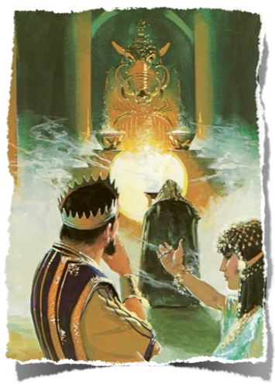
Thyatira
"“And to the angel of the church in Thyatira write, . . .Rev 2:18
1 Kings 21:25 (NKJV) But there was no one like Ahab who sold himself to do wickedness in the sight of the LORD, because Jezebel his wife stirred him up.
The literal Jezebel – perfect ex. of wicked / deceitful woman gentile / pagan queen married Ahab supported Baal prophets (killed God’s) guilty of harlotries and witchcraft
The spiritual Jezebel leading church into error / compromise
Notes:
This false teacher was corrupting the Thyatira church much like Ahab’s wife Jezebel corrupted Israel, an impious and cruel queen who protected idolatry and persecuted the prophets of God. (1 Kings 16:31-33).
She was a daughter of Ethbaal, king of Tyre and Sidon, and lived about 918 years before Christ.
She was highly gifted, persuasive, and artful; was resolute in the accomplishment of her purposes; ambitious of extending and perpetuating her power, and unscrupulous in the means which she employed to execute her designs. See 1 Kings 16:31.
The kind of character, therefore, which would be designated by the term as used here, would be that of a woman who was artful and persuasive in her manner; who was capable of exerting a wide influence over others; who had talents of a high order; who was a thorough advocate of error; who was unscrupulous in the means which she employed for accomplishing her ends, and the tendency of whose influence was to lead the people into the abominable practices of idolatry.
1 Kings 21:25 (NKJV) But there was no one like Ahab who sold himself to do wickedness in the sight of the Lord, because Jezebel his wife stirred him up.
Her spiritual counterpart at Thyatira lured God's "servants" by pretended utterances of inspiration to the same libertinism, as though things done in the flesh were outside the true man, and were, therefore, indifferent, (A touch of Calvinism).
I found the definition given by Thayer concerning this “Jezebel” as found in our text interesting: “The symbolic name of a woman who pretended to be a prophetess, and who, addicted to antinomianism, [the doctrine of faith only], claimed Christian liberty of eating things sacrificed to idols.

Slide 17
Thyatira
"“And to the angel of the church in Thyatira write, . . .Rev 2:18
CONDEMNATION
Toleration of Error
Compromise (“you allow” – permit by your silence or refusing to stop her)
To commit adultery & join trade guilds (with its sacrifices to idols & drunken revelry)
Go along to get along
Revelation 2:20 ^{(NKJV)}
…you allow that woman Jezebel, who calls herself a prophetess, to teach and seduce My servants to commit sexual immorality and eat things sacrificed to idols.
Notes:
This false teacher was corrupting the Thyatira church much like Ahab’s wife Jezebel corrupted Israel, an impious and cruel queen who protected idolatry and persecuted the prophets of God. (1 Kings 16:31-33).
She was a daughter of Ethbaal, king of Tyre and Sidon, and lived about 918 years before Christ.
She was highly gifted, persuasive, and artful; was resolute in the accomplishment of her purposes; ambitious of extending and perpetuating her power, and unscrupulous in the means which she employed to execute her designs. See 1 Kings 16:31.
The kind of character, therefore, which would be designated by the term as used here, would be that of a woman who was artful and persuasive in her manner; who was capable of exerting a wide influence over others; who had talents of a high order; who was a thorough advocate of error; who was unscrupulous in the means which she employed for accomplishing her ends, and the tendency of whose influence was to lead the people into the abominable practices of idolatry.
1 Kings 21:25 (NKJV) But there was no one like Ahab who sold himself to do wickedness in the sight of the Lord, because Jezebel his wife stirred him up.
Her spiritual counterpart at Thyatira lured God's "servants" by pretended utterances of inspiration to the same libertinism, as though things done in the flesh were outside the true man, and were, therefore, indifferent, (A touch of Calvinism).
I found the definition given by Thayer concerning this “Jezebel” as found in our text interesting: “The symbolic name of a woman who pretended to be a prophetess, and who, addicted to antinomianism, [the doctrine of faith only], claimed Christian liberty of eating things sacrificed to idols.

Slide 18
Thyatira
"“And to the angel of the church in Thyatira write, . . .Rev 2:18
Revelation 2:20 ^{(NKJV)}
Nevertheless I have a few things against you, because you allow that woman Jezebel, who calls herself a prophetess, to teach and seduce My servants to commit sexual immorality and eat things sacrificed to idols.
CONDEMNATION
Toleration / Compromise Error
When we tolerate error, we endorse it Silence is an endorsement of error !!
2 John 9 Whoever transgresses and does not abide in the doctrine of Christ does not have God. He who abides in the doctrine of Christ has both the Father and the Son.
10 If anyone comes to you and does not bring this doctrine, do not receive him into your house nor greet him; 11 for he who greets him shares in his evil deeds.
Notes:
This false teacher was corrupting the Thyatira church much like Ahab’s wife Jezebel corrupted Israel, an impious and cruel queen who protected idolatry and persecuted the prophets of God. (1 Kings 16:31-33).
She was a daughter of Ethbaal, king of Tyre and Sidon, and lived about 918 years before Christ.
She was highly gifted, persuasive, and artful; was resolute in the accomplishment of her purposes; ambitious of extending and perpetuating her power, and unscrupulous in the means which she employed to execute her designs. See 1 Kings 16:31.
The kind of character, therefore, which would be designated by the term as used here, would be that of a woman who was artful and persuasive in her manner; who was capable of exerting a wide influence over others; who had talents of a high order; who was a thorough advocate of error; who was unscrupulous in the means which she employed for accomplishing her ends, and the tendency of whose influence was to lead the people into the abominable practices of idolatry.
1 Kings 21:25 (NKJV) But there was no one like Ahab who sold himself to do wickedness in the sight of the Lord, because Jezebel his wife stirred him up.
Her spiritual counterpart at Thyatira lured God's "servants" by pretended utterances of inspiration to the same libertinism, as though things done in the flesh were outside the true man, and were, therefore, indifferent, (A touch of Calvinism).
I found the definition given by Thayer concerning this “Jezebel” as found in our text interesting: “The symbolic name of a woman who pretended to be a prophetess, and who, addicted to antinomianism, [the doctrine of faith only], claimed Christian liberty of eating things sacrificed to idols.

Slide 19
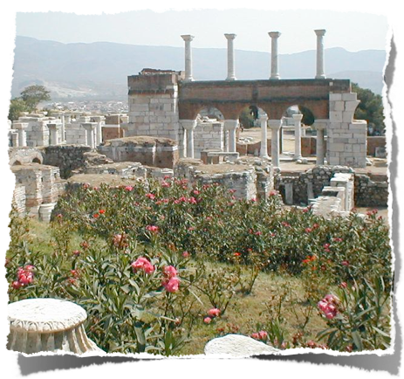
Thyatira
"“And to the angel of the church in Thyatira write, . . .Rev 2:18
Contrast Ephesus and Thyatira:
Ephesus: weakening in its love, but intolerant of false teachers
Thyatira: growing in their love / works, but tolerant of false teachers
Must speak the TRUTH – in LOVE. Fellowship with God: a fine line we walk
Notes:
Revelation 2:12 (NKJV)
12 "And to the angel of the church in Pergamos write, 'These things says He who has the sharp two-edged sword:
1. History:
Pergamos, to which the ancient writers also gave the neuter form of the name, was a city of Mysia of the ancient Roman province of Asia, in the Caicus valley, 3 miles from the river, and about 15 miles from the sea. The Caicus was navigable for small native craft. Two of the tributaries of the Caicus were the Selinus and the Kteios. The former of these rivers flowed through the city; the latter ran along its walls. On the hill between these two streams the first city stood, and there also stood the acropolis, the chief temples, and theaters of the later city. The early people of the town were descendants of Greek colonists, and as early as 420 BC they struck coins of their own. Lysimachus, who possessed the town, deposited there 9,000 talents of gold. Upon his death, Philetaerus (283-263 BC) used this wealth to found the independent Greek dynasty of the Attalid kings. The first of this dynasty to bear the title of king was Attalus I (241-197 BC), a nephew of Philetaerus, and not only did he adorn the city with beautiful buildings until it became the most wonderful city of the East, but he added to his kingdom the countries of Mysia, Lydia, Caria, Pamphylia and Phrygia. Eumenes II (197-159 BC) was the most illustrious king of the dynasty, and during his reign the city reached its greatest height. Art and literature were encouraged, and in the city was a library of 200,000 volumes which later Antony gave to Cleopatra. The books were of parchment which was here first used; hence, the word “parchment,” which is derived from the name of the town Pergamos. Of the structures which adorned the city, the most renowned was the altar of Zeus, which was 40 ft. in height, and also one of the wonders of the ancient world. When in 133 BC Attalus III, the last king of the dynasty, died, he gave his kingdom to the Roman government. His son, Aristonicus, however, attempted to seize it for himself, but in 129 he was defeated, and the Roman province of Asia was formed, and Pergamos was made its capital. The term Asia, as here employed, should not be confused with the continent of Asia, nor with Asia Minor. It applied simply to that part of Asia Minor which was then in the possession of the Romans, and formed into the province of which Pergamos was the capital. Upon the establishment of the province of Asia there began a new series of coins struck at Pergamos, which continued into the 3rd century AD. The magnificence of the city continued.
2. Religions:
There were beautiful temples to the four great gods Zeus, Dionysus, Athena and Asklepios. To the temple of the latter, invalids from all parts of Asia flocked, and there, while they were sleeping in the court, the god revealed to the priests and physicians by means of dreams the remedies which were necessary to heal their maladies. Thus opportunities of deception were numerous. There was a school of medicine in connection with the temple. Pergamos was chiefly a religious center of the province. A title which it bore was “Thrice Neokoros,” meaning that in the city 3 temples had been built to the Roman emperors, in which the emperors were worshipped as gods. Smyrna, a rival city, was a commercial center, and as it increased in wealth, it gradually became the political center. Later, when it became the capital, Pergamos remained the religious center. As in many of the towns of Asia Minor, there were at Pergamos many Jews, and in 130 BC the people of the city passed a decree in their favor. Many of the Jews were more or less assimilated with the Greeks, even to the extent of bearing Greek names.
3. Christianity:
Christianity reached Pergamos early, for there one of the Seven Churches of the Book of Rev stood, and there, according to Revelation 2:13, Antipas was marryred; he was the first Christian to be put to death by the Roman state. The same passage speaks of Pergamos as the place “where Satan's throne is,” probably referring to the temples in which the Roman emperors were worshipped. During the Byzantine times Pergamos still continued as a religious center, for there a bishop lived. However, the town fell into the hands of the Seljuks in 1304, and in 1336 it was taken by Suleiman, the son of Orkhan, and became Turkish.
The modern name of the town, which is of considerable size, possessing 15 mosques, is Bergama, the Turkish corruption of the ancient name. One of its mosques is the early Byzantine church of Sophia. The modern town is built among the ruins of the ancient city, but is far less in extent. From 1879 to 1886 excavations among the ruins were conducted by Herr Humann at the expense of the German government. Among them are still to be seen the base of the altar of Zeus, the friezes of which are now in the Pergamon Museum, Berlin; theater, the agora, the gymnasium and several temples. In ancient times the city was noted for its ointments, pottery and parchment; at present the chief articles of trade are cotton, wool, opium, valonia, and leather.
http://astheoracle.truepath.com/index-244.htm

Slide 20
Thyatira
"“And to the angel of the church in Thyatira write, . . .Rev 2:18
Exhortation:
Jezebel given "time to repent," but she refused
Lord longs for even Jez. salvation - (2 Peter 3:9; Romans 2:4-5)
Revelation 2:21,22 ^{(NKJV)}
²¹ I gave her time to repent of her sexual immorality, and she did not repent. ²² Indeed I will cast her into a sickbed, and those who commit adultery with her into great tribulation, unless they repent of their deeds.
Rom. 2 4 Or do you despise the riches of His goodness, forbearance, and longsuffering, not knowing that the goodness of God leads you to repentance?
5 But in accordance with your hardness and your impenitent heart you are treasuring up for yourself wrath in the day of wrath and revelation of the righteous judgment of God
Notes:
Longsuffering -
God’s longsuffering is not eternal! - 2 Peter 3:9
2 Peter 3:9 (NKJV) The Lord is not slack concerning His promise, as some count slackness, but is longsuffering toward us, not willing that any should perish but that all should come to repentance.
Intended to bring repentance – Rom 2:4
Romans 2:4-5 (NKJV) Or do you despise the riches of His goodness, forbearance, and longsuffering, not knowing that the goodness of God leads you to repentance? [5] But in accordance with your hardness and your impenitent heart you are treasuring up for yourself wrath in the day of wrath and revelation of the righteous judgment of God,
Longsuffering not to be confused with indifference! – Ecc. 8:11; 1 Cor. 5:5
Eccles. 8:11 (NKJV) Because the sentence against an evil work is not executed speedily, therefore the heart of the sons of men is fully set in them to do evil.
1 Cor. 5:5 (NKJV) deliver such a one to Satan for the destruction of the flesh, that his spirit may be saved in the day of the Lord Jesus.
She refused - . . .
Each receives according to works – Gal 6:7-8

Slide 21
Thyatira
"“And to the angel of the church in Thyatira write, . . .Rev 2:18
Exhortation:
Each one held accountable
The False teacher The Followers The Tolerant
Revelation 2:23 ^{(NKJV)}
²³ And I will give to each one of you according to your works.
Notes:
Consequences of sin –
Causes suffering to the one guilty – Gal 6:7-9
Causes suffering to others who are influenced to partake – Matthew 15:14
Matthew 15:14 (NKJV) Let them alone. They are blind leaders of the blind. And if the blind leads the blind, both will fall into a ditch."
The rest must repent of following or tolerating her error -Ezekiel 18:30-32
Ezekiel 18:30-32 (NKJV) "Therefore I will judge you, O house of Israel, every one according to his ways," says the Lord God. "Repent, and turn from all your transgressions, so that iniquity will not be your ruin. [31] Cast away from you all the transgressions which you have committed, and get yourselves a new heart and a new spirit. For why should you die, O house of Israel? [32] For I have no pleasure in the death of one who dies," says the Lord God. "Therefore turn and live!
Ezekiel 33:11 (NKJV) Say to them: 'As I live,' says the Lord God, 'I have no pleasure in the death of the wicked, but that the wicked turn from his way and live. Turn, turn from your evil ways! For why should you die, O house of Israel?'
2 Tim. 2:25-26 (NKJV) in humility correcting those who are in opposition, if God perhaps will grant them repentance, so that they may know the truth, [26] and that they may come to their senses and escape the snare of the devil, having been taken captive by him to do his will.
kill . . . with death— Compare the disaster that overtook the literal Jezebel's votaries of Baal, and Ahab's sons, 1 Kings 18:40; 2 Kings 10:6-7, 24-25. Kill with death is a Hebraism for slay with most sure and awful death; so "dying thou shalt die" (Genesis 2:17). Not "die the common death of men" (Numbers 16:29).
Genesis 2:17 (NKJV) but of the tree of the knowledge of good and evil you shall not eat, for in the day that you eat of it you shall surely die."
Romans 6:23 (NKJV) For the wages of sin is death, but the gift of God is eternal life in Christ Jesus our Lord.
Punishment to be visible - Deut. 21:21
Deut. 17:13 (NKJV) And all the people shall hear and fear, and no longer act presumptuously.
Deut. 19:20 (NKJV) And those who remain shall hear and fear, and hereafter they shall not again commit such evil among you.
Deut. 21:21 (NKJV) Then all the men of his city shall stone him to death with stones; so you shall put away the evil from among you, and all Israel shall hear and fear.
Jesus knows our motives –2 Cor. 5:10; Rom 2:6
2 Cor. 5:10 (NKJV) For we must all appear before the judgment seat of Christ, that each one may receive the things done in the body, according to what he has done, whether good or bad.
Romans 2:6 (NKJV) who "will render to each one according to his deeds":
Romans 14:10-12 (NKJV) But why do you judge your brother? Or why do you show contempt for your brother? For we shall all stand before the judgment seat of Christ. [11] For it is written: "As I live, says the Lord, Every knee shall bow to Me, And every tongue shall confess to God." [12] So then each of us shall give account of himself to God.

Slide 22
Thyatira
"“And to the angel of the church in Thyatira write, . . .Rev 2:18
Exhortation:
To the Faithful: “hold fast”
Not embraced Jezebels doctrine
“Everybody’s doing it” is not true!
Revelation 2:24,25 ^{(NKJV)}
²⁴ Now to you I say, and to the rest in Thyatira, as many as do not have this doctrine, who have not known the depths of Satan, as they say, I will put on you no other burden. ²⁵ But hold fast what you have till I come.
Notes:
As many as have not this doctrine.
To all who have not embraced it, or been contaminated with it. It may be presumed that there was a considerable portion of the church which had not.
And which have not known the depths of Satan. As they speak.
Gnostics (Cainites, Carpocratians, Naassenes) boasted of their knowledge of “the deep things,”
There seems to be some doubt about what, exactly, is meant here. The problem was stated thus by Plummer:
Did they call their doctrine "deep things," which the Lord here enlarges to "deep things of Satan," in order to declare its true nature? Or did they themselves call their knowledge "the deep things of Satan," which they fathomed in order to prove their mastery over them? F88 Plummer thought it was the former, but Lenski believed it was the latter. It could have been either. If the former, the Lord here exposed their "deep things" as really being of the devil; and, if the latter, the deviates were reasoning as some do even today, who say that in order to triumph over evil one must practice evil. "To probe the depths of Satan, one must go down into these depths ... the folly and fallacy of such reasoning are obvious." F89
I will put upon you none other burden. –
Barnes: “He was not disposed to bring upon them any other expression of his displeasure than that which grew naturally and necessarily out of the fact that they had been tolerated among them, and those troubles and toils which must attend the effort to deliver the church from these errors. . . .”
BUT - These false prophets rejected the law as a rule of life, as though it were an intolerable "burden." But it is a "light" burden. In Acts 15:28-29, the very term "burden," as here, is used of abstinence from fornication and idol-meats; to this the Lord here refers.
Acts 15:28 (NKJV) For it seemed good to the Holy Spirit, and to us, to lay upon you no greater burden than these necessary things: [29] that you abstain from things offered to idols, from blood, from things strangled, and from sexual immorality. If you keep yourselves from these, you will do well.
Galatians 6:5 (NKJV) For each one shall bear his own load.
1 John 5:3 (NKJV) For this is the love of God, that we keep His commandments. And His commandments are not burdensome.
Nevertheless that which ye have, hold fast until I come.
The coming here is not the Second Advent. "It was necessary to hold fast to the Christian profession until Christ came in visitation through the trials soon to confront the churches." F93

Slide 23
Thyatira
"“And to the angel of the church in Thyatira write, . . .Rev 2:18
Promise & Reward:
Conditions: 1. Overcomes (finishes) 2. Keeps works till the end
Christ’s power (over the nations)
Christ Himself (“the morning star”)
Revelation 2:26-28 ^{(NKJV)}
²⁶ And he who overcomes, and keeps My works until the end, to him I will give power over the nations-- ²⁷ 'He shall rule them with a rod of iron; They shall be dashed to pieces like the potter's vessels'-- as I also have received from My Father; ²⁸ and I will give him the morning star.
Notes:
Must overcome – 2 Cor. 4:16-18; Rom. 8:18, 31-39
Must keep His works -
Romans 2:7 (NKJV) eternal life to those who by patient continuance in doing good seek for glory, honor, and immortality;
James 2:20 (NKJV) But do you want to know, O foolish man, that faith without works is dead?
Until the end –
Matthew 24:13 (NKJV) But he who endures to the end shall be saved.

Slide 24
Thyatira
"“And to the angel of the church in Thyatira write, . . .Rev 2:18
There is GREAT DANGER in looking the other way
Notes:
Revelation 2:12 (NKJV)
12 "And to the angel of the church in Pergamos write, 'These things says He who has the sharp two-edged sword:
1. History:
Pergamos, to which the ancient writers also gave the neuter form of the name, was a city of Mysia of the ancient Roman province of Asia, in the Caicus valley, 3 miles from the river, and about 15 miles from the sea. The Caicus was navigable for small native craft. Two of the tributaries of the Caicus were the Selinus and the Kteios. The former of these rivers flowed through the city; the latter ran along its walls. On the hill between these two streams the first city stood, and there also stood the acropolis, the chief temples, and theaters of the later city. The early people of the town were descendants of Greek colonists, and as early as 420 BC they struck coins of their own. Lysimachus, who possessed the town, deposited there 9,000 talents of gold. Upon his death, Philetaerus (283-263 BC) used this wealth to found the independent Greek dynasty of the Attalid kings. The first of this dynasty to bear the title of king was Attalus I (241-197 BC), a nephew of Philetaerus, and not only did he adorn the city with beautiful buildings until it became the most wonderful city of the East, but he added to his kingdom the countries of Mysia, Lydia, Caria, Pamphylia and Phrygia. Eumenes II (197-159 BC) was the most illustrious king of the dynasty, and during his reign the city reached its greatest height. Art and literature were encouraged, and in the city was a library of 200,000 volumes which later Antony gave to Cleopatra. The books were of parchment which was here first used; hence, the word “parchment,” which is derived from the name of the town Pergamos. Of the structures which adorned the city, the most renowned was the altar of Zeus, which was 40 ft. in height, and also one of the wonders of the ancient world. When in 133 BC Attalus III, the last king of the dynasty, died, he gave his kingdom to the Roman government. His son, Aristonicus, however, attempted to seize it for himself, but in 129 he was defeated, and the Roman province of Asia was formed, and Pergamos was made its capital. The term Asia, as here employed, should not be confused with the continent of Asia, nor with Asia Minor. It applied simply to that part of Asia Minor which was then in the possession of the Romans, and formed into the province of which Pergamos was the capital. Upon the establishment of the province of Asia there began a new series of coins struck at Pergamos, which continued into the 3rd century AD. The magnificence of the city continued.
2. Religions:
There were beautiful temples to the four great gods Zeus, Dionysus, Athena and Asklepios. To the temple of the latter, invalids from all parts of Asia flocked, and there, while they were sleeping in the court, the god revealed to the priests and physicians by means of dreams the remedies which were necessary to heal their maladies. Thus opportunities of deception were numerous. There was a school of medicine in connection with the temple. Pergamos was chiefly a religious center of the province. A title which it bore was “Thrice Neokoros,” meaning that in the city 3 temples had been built to the Roman emperors, in which the emperors were worshipped as gods. Smyrna, a rival city, was a commercial center, and as it increased in wealth, it gradually became the political center. Later, when it became the capital, Pergamos remained the religious center. As in many of the towns of Asia Minor, there were at Pergamos many Jews, and in 130 BC the people of the city passed a decree in their favor. Many of the Jews were more or less assimilated with the Greeks, even to the extent of bearing Greek names.
3. Christianity:
Christianity reached Pergamos early, for there one of the Seven Churches of the Book of Rev stood, and there, according to Revelation 2:13, Antipas was marryred; he was the first Christian to be put to death by the Roman state. The same passage speaks of Pergamos as the place “where Satan's throne is,” probably referring to the temples in which the Roman emperors were worshipped. During the Byzantine times Pergamos still continued as a religious center, for there a bishop lived. However, the town fell into the hands of the Seljuks in 1304, and in 1336 it was taken by Suleiman, the son of Orkhan, and became Turkish.
The modern name of the town, which is of considerable size, possessing 15 mosques, is Bergama, the Turkish corruption of the ancient name. One of its mosques is the early Byzantine church of Sophia. The modern town is built among the ruins of the ancient city, but is far less in extent. From 1879 to 1886 excavations among the ruins were conducted by Herr Humann at the expense of the German government. Among them are still to be seen the base of the altar of Zeus, the friezes of which are now in the Pergamon Museum, Berlin; theater, the agora, the gymnasium and several temples. In ancient times the city was noted for its ointments, pottery and parchment; at present the chief articles of trade are cotton, wool, opium, valonia, and leather.
http://astheoracle.truepath.com/index-244.htm

Slide 25
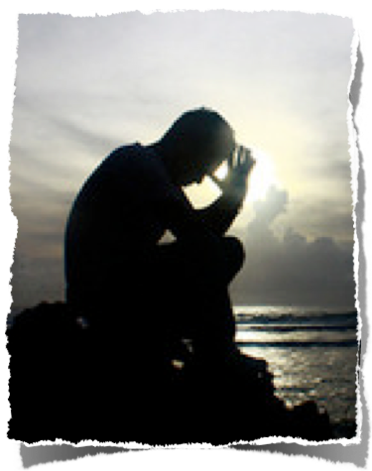
Thyatira
NO COMPROMISE - 2 Cor 6:14-7:1
Do not be unequally yoked together with unbelievers. For what fellowship has righteousness with lawlessness?
light with darkness? Christ with Belial? believer with an unbeliever? temple of God with idols?
… Therefore "Come out from among them and be separate, says the Lord. Do not touch what is unclean, And I will receive you."
Notes:
Revelation 2:12 (NKJV)
12 "And to the angel of the church in Pergamos write, 'These things says He who has the sharp two-edged sword:
1. History:
Pergamos, to which the ancient writers also gave the neuter form of the name, was a city of Mysia of the ancient Roman province of Asia, in the Caicus valley, 3 miles from the river, and about 15 miles from the sea. The Caicus was navigable for small native craft. Two of the tributaries of the Caicus were the Selinus and the Kteios. The former of these rivers flowed through the city; the latter ran along its walls. On the hill between these two streams the first city stood, and there also stood the acropolis, the chief temples, and theaters of the later city. The early people of the town were descendants of Greek colonists, and as early as 420 BC they struck coins of their own. Lysimachus, who possessed the town, deposited there 9,000 talents of gold. Upon his death, Philetaerus (283-263 BC) used this wealth to found the independent Greek dynasty of the Attalid kings. The first of this dynasty to bear the title of king was Attalus I (241-197 BC), a nephew of Philetaerus, and not only did he adorn the city with beautiful buildings until it became the most wonderful city of the East, but he added to his kingdom the countries of Mysia, Lydia, Caria, Pamphylia and Phrygia. Eumenes II (197-159 BC) was the most illustrious king of the dynasty, and during his reign the city reached its greatest height. Art and literature were encouraged, and in the city was a library of 200,000 volumes which later Antony gave to Cleopatra. The books were of parchment which was here first used; hence, the word “parchment,” which is derived from the name of the town Pergamos. Of the structures which adorned the city, the most renowned was the altar of Zeus, which was 40 ft. in height, and also one of the wonders of the ancient world. When in 133 BC Attalus III, the last king of the dynasty, died, he gave his kingdom to the Roman government. His son, Aristonicus, however, attempted to seize it for himself, but in 129 he was defeated, and the Roman province of Asia was formed, and Pergamos was made its capital. The term Asia, as here employed, should not be confused with the continent of Asia, nor with Asia Minor. It applied simply to that part of Asia Minor which was then in the possession of the Romans, and formed into the province of which Pergamos was the capital. Upon the establishment of the province of Asia there began a new series of coins struck at Pergamos, which continued into the 3rd century AD. The magnificence of the city continued.
2. Religions:
There were beautiful temples to the four great gods Zeus, Dionysus, Athena and Asklepios. To the temple of the latter, invalids from all parts of Asia flocked, and there, while they were sleeping in the court, the god revealed to the priests and physicians by means of dreams the remedies which were necessary to heal their maladies. Thus opportunities of deception were numerous. There was a school of medicine in connection with the temple. Pergamos was chiefly a religious center of the province. A title which it bore was “Thrice Neokoros,” meaning that in the city 3 temples had been built to the Roman emperors, in which the emperors were worshipped as gods. Smyrna, a rival city, was a commercial center, and as it increased in wealth, it gradually became the political center. Later, when it became the capital, Pergamos remained the religious center. As in many of the towns of Asia Minor, there were at Pergamos many Jews, and in 130 BC the people of the city passed a decree in their favor. Many of the Jews were more or less assimilated with the Greeks, even to the extent of bearing Greek names.
3. Christianity:
Christianity reached Pergamos early, for there one of the Seven Churches of the Book of Rev stood, and there, according to Revelation 2:13, Antipas was marryred; he was the first Christian to be put to death by the Roman state. The same passage speaks of Pergamos as the place “where Satan's throne is,” probably referring to the temples in which the Roman emperors were worshipped. During the Byzantine times Pergamos still continued as a religious center, for there a bishop lived. However, the town fell into the hands of the Seljuks in 1304, and in 1336 it was taken by Suleiman, the son of Orkhan, and became Turkish.
The modern name of the town, which is of considerable size, possessing 15 mosques, is Bergama, the Turkish corruption of the ancient name. One of its mosques is the early Byzantine church of Sophia. The modern town is built among the ruins of the ancient city, but is far less in extent. From 1879 to 1886 excavations among the ruins were conducted by Herr Humann at the expense of the German government. Among them are still to be seen the base of the altar of Zeus, the friezes of which are now in the Pergamon Museum, Berlin; theater, the agora, the gymnasium and several temples. In ancient times the city was noted for its ointments, pottery and parchment; at present the chief articles of trade are cotton, wool, opium, valonia, and leather.
http://astheoracle.truepath.com/index-244.htm

