Slide 1
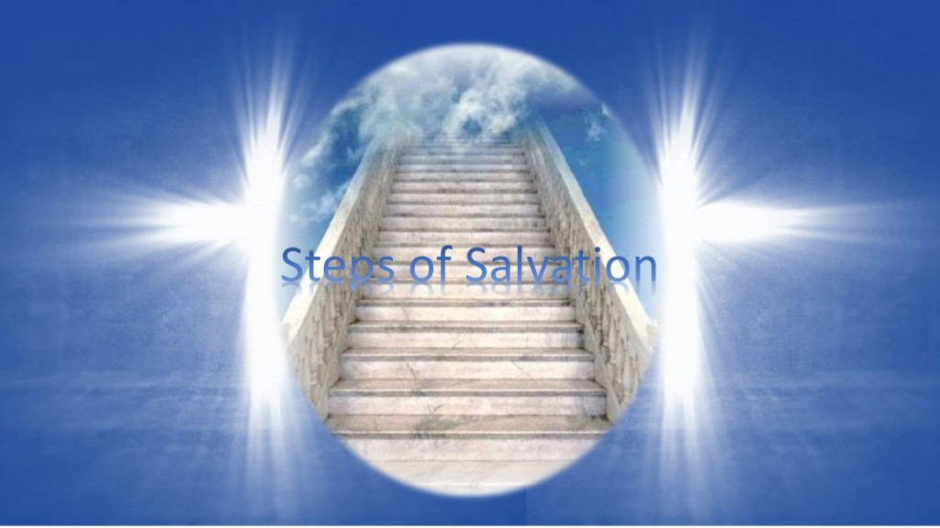
The Sure Steps of My Eternal Salvation
A Study of 2 Peter 1:5-11

Slide 2
Add to your faith
My Faith
7. Godly Love
6. Brotherly Love
5. Godliness
4. Patience
2 Peter 1:5
But also for this very reason, giving all diligence, add to your faith
3. Temperance
2. Knowledge
1. Virtue
Baptized: die to sin
Confess: Lord Jesus
Repent: godly sorrow
Admit: I am a Sinner
Believe: the Gospel
Hear: the Gospel

Slide 3
My Growing Faith
God’s Grace
2 Peter 3:17-18
You therefore, beloved, … but GROW in the grace and knowledge of our Lord and Savior Jesus Christ.
1 Peter 2:1-2
as newborn babes, desire the pure milk of the word, that you may GROW thereby.
Virtue
My Faith

Slide 4
VIRTUE
Greek - ARETE: “moral excellence; moral courage”
1. God’s Character
2 Peter 1:3
Philippians 4:8
as His divine power has given to us all things that pertain to life and godliness, through the knowledge of Him who called us by glory and virtue
whatever things are true, noble, just, pure, lovely, good report, if there is any virtue and if there is anything praiseworthy--meditate on these things.

Slide 5
VIRTUE
Greek - ARETE: “moral excellence; moral courage”
2. Man’s Character (raising my standard to God’s)
2 Peter 1:5
Matthew 5:43-48
But also for this very reason, giving all diligence, add to your faith virtue
that you may be sons of your Father in heaven… Therefore you shall be perfect, just as your Father in heaven is perfect.

Slide 6
My Growing Faith
God’s Grace
2 Peter 1:5-7
But also for this very reason, giving all diligence, add: to your faith virtue, to virtue knowledge,
to knowledge self-control, to self-control perseverance, to perseverance godliness,
to godliness brotherly kindness, to brotherly kindness love.
Knowledge
Virtue
My Faith

Slide 7
Knowledge
GNOSIS – “science; the deeper more perfect knowledge such as belongs to the more advanced”
RELIGIOUS KNOWLEDGE
Babes in Christ Knowledge (I Peter 2:2; Hebrews 5:12-13)
“as newborn babes, desire the pure milk of the word, that you may grow thereby, if indeed you have tasted that the Lord is gracious” I Peter 2:2-3

Slide 8
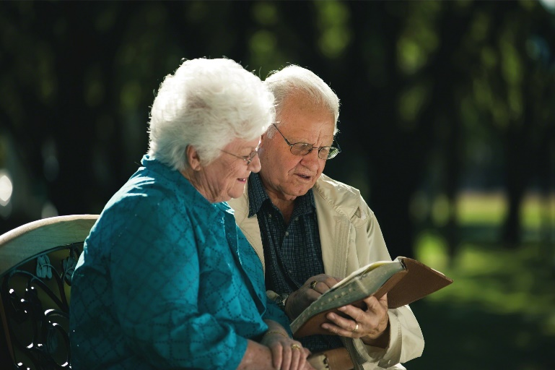
Knowledge
GNOSIS – “science; the deeper more perfect knowledge such as belongs to the more advanced”
RELIGIOUS KNOWLEDGE
Knowledge of the deeper things of Christianity
But solid food belongs to those who are of full age, that is, those who by reason of use have their senses exercised to discern both good and evil. - Hebrews 5:14
“Oh, the depth of the riches both of the wisdom and knowledge of God! How unsearchable are His judgments and His ways past finding out!” - Romans 11:33

Slide 9
My Growing Faith
God’s Grace
2 Peter 1:5-7
But also for this very reason, giving all diligence, add: to your faith virtue, to virtue knowledge,
to knowledge self-control, to self-control perseverance, to perseverance godliness,
to godliness brotherly kindness, to brotherly kindness love.
Temperance
Knowledge
Virtue
My Faith

Slide 10
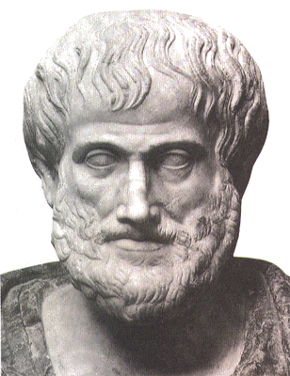
Temperance
EGKRATEIA – “the virtue of one who masters his desires and passions, esp. his sensual appetites;
continence; self-control”
SOPHROSUNE “passion controlled by reason – perfect temperance”
AKOLASIA “reason controlled by passion – unbridled lust”
AKRASIA “reason fights, but passion prevails – incontinence”
EGKRATEIA “reason fights passion, and reason prevails – self-control”
only 1 man ever
Aristotle

Slide 11
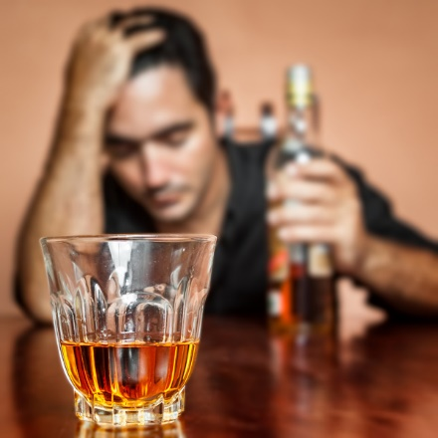
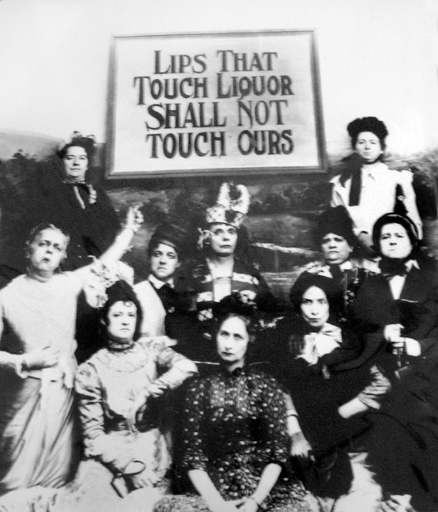
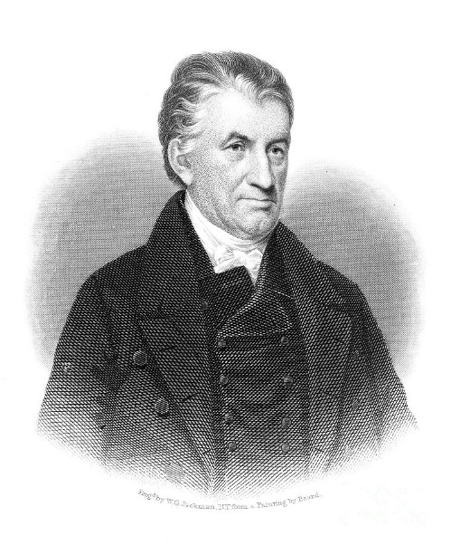
Temperance
EGKRATEIA – “the virtue of one who masters his desires and passions, esp his sensual appetites;
continence; self-control”
Incontinent = “out of control; lacks self-restraint; unbridled”
Alcoholics Anon.
Gamblers Anon.
Overeaters Anon.
Debtors Anon.
Sexaholics Anon.
Narcotics Anon.
American Temperance Society
Lyman Beecher

Slide 12
Temperance
EGKRATEIA – “the virtue of one who masters his desires and passions, esp his sensual appetites;
continence; self-control”
Galatians 5:22-23 “Now the works of the flesh are evident, which are: adultery, fornication, uncleanness, lewdness… But the fruit of the Spirit is love, joy, peace, longsuffering, kindness, goodness, faithfulness, gentleness, self-control. Against such there is no law.
Do you fully know your enemy? Define adultery____________
fornication ____________ uncleanness ____________ lewdness ____________ idolatry ____________ sorcery ____________ hatred ____________ contentions ____________ jealousies ____________ outbursts ____________ dissensions ____________
Do you fully know your antidote to sin? Define love _______________ joy _______________ peace _______________ longsuffering ______________ kindness _______________ goodness _______________ faithfulness ______________ gentleness ______________ self-control ______________

Slide 13
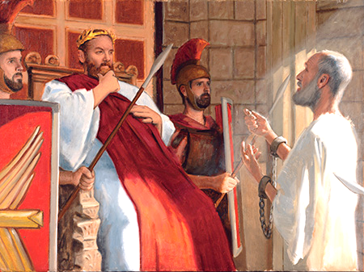
Temperance
EGKRATEIA – “the virtue of one who masters his desires and passions, esp his sensual appetites;
continence; self-control”
Acts 24:25 Now as he reasoned about righteousness, self-control, and the judgment to come, Felix was afraid and answered, "Go away for now; when I have a convenient time I will call for you."
Never be AFRAID of hearing a sermon on: RIGHTEOUSNESS
TEMPERANCE JUDGMENT
Procrastination kills !

Slide 14
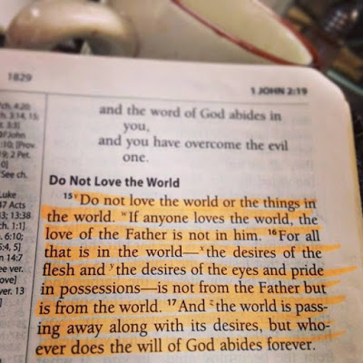
Temperance
EGKRATEIA – “the virtue of one who masters his desires and passions, esp. his sensual appetites;
continence; self-control”
Romans 8:13 “For if you live according to the flesh you will die; but if by the Spirit you put to death the deeds of the body, you will live.”
Disciple / Discipline
I John 2:15-17

Slide 15
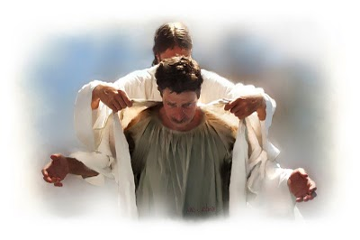
Temperance
EGKRATEIA – “the virtue of one who masters his desires and passions, esp. his sensual appetites;
continence; self-control”
Colossians 3:5-10
“But now you yourselves are to put off all these: anger, wrath, malice, blasphemy, filthy language out of your mouth. Do not lie to one another, since you have put off the old man with his deeds, and have put on the new man who is renewed in knowledge according to the image of Him who created him”
The New Me

Slide 16
Temperance
EGKRATEIA – “the virtue of one who masters his desires and passions, esp his sensual appetites;
continence; self-control”
The Devil’s Lies
I just can’t help my self
To err is human
Life is so hard – I need a release
Everyone else is doing it too
God wants me to be happy

Slide 17
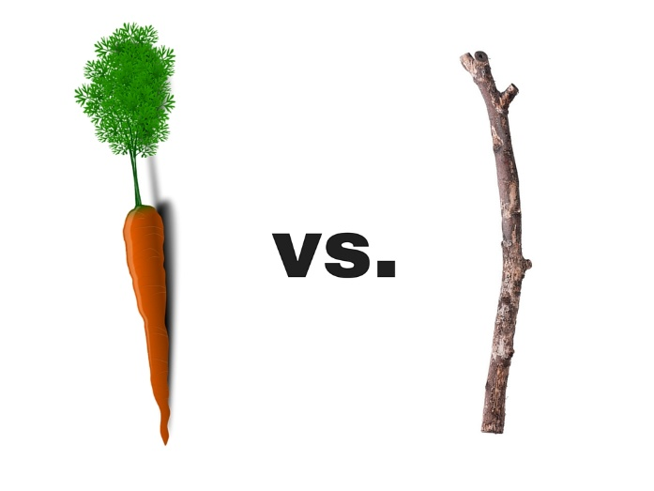
Temperance
James’ Three T’s of Temperance
Temptation
Temper
Tongue
James 1:12-17 Blessed is the man who endures temptation; for when he has been approved, he will receive the crown of life which the Lord has promised to those who love Him.
James 1:19-20 So then, my beloved brethren, let every man be swift to hear, slow to speak, slow to wrath; for the wrath of man does not produce the righteousness of God.
James 1:26 If anyone among you thinks he is religious, and does not bridle his tongue but deceives his own heart, this one's religion is useless. Pure religion and undefiled before God…keep self unspotted from the world.”

Slide 18
My Growing Faith
God’s Grace
2 Peter 1:5-7
But also for this very reason, giving all diligence, add: to your faith virtue, to virtue knowledge,
to knowledge self-control, to self-control perseverance, to perseverance godliness,
to godliness brotherly kindness, to brotherly kindness love.
Patience
Temperance
Knowledge
Virtue
My Faith

Slide 19
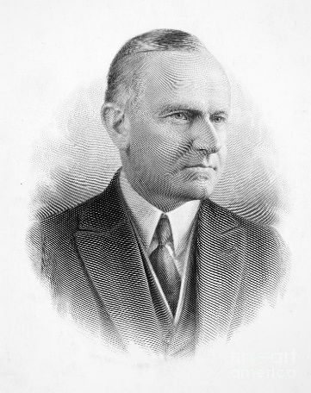
Patience
HYPOMONE – “steadfastness; constancy; endurance; sustaining perseverance”
“in the NT this is the characteristic of a person who is not swerved from his or her deliberate purpose and his or her loyalty to faith and piety by even the greatest trials and sufferings”
“Nothing in this world can take the place of Persistence. Talent will not, nothing is more common than unsuccessful people with talent. Genius will not, unrewarded genius is almost a proverb. Education will not, the world is full of educated derelicts. Persistence and Determination alone are omnipotent.
The slogan “Press On!” has solved and always will solve the problems of the human race” - Calvin Coolidge (30th President of US 1873-1933)

Slide 20
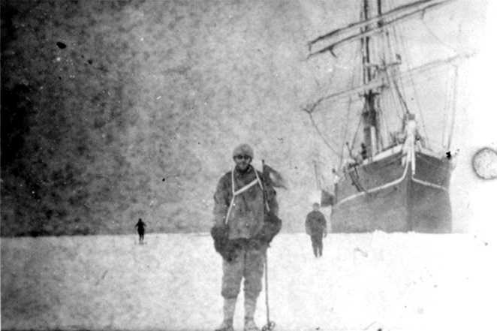
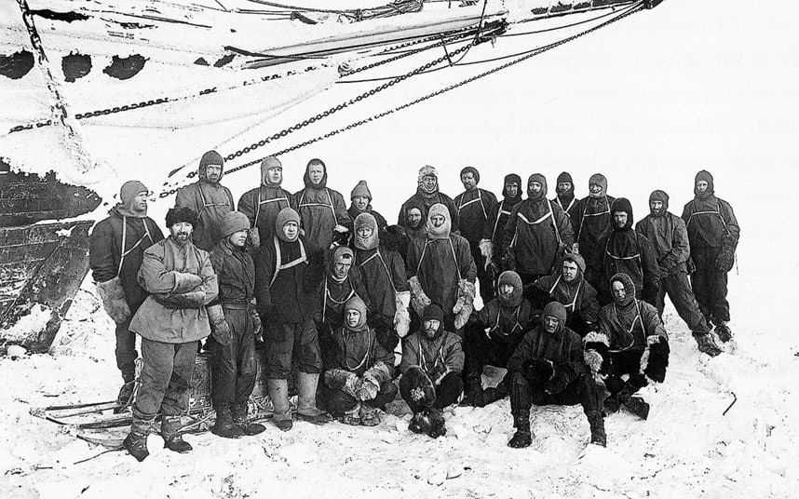

Slide 21
Patience
HYPOMONE – “steadfastness; constancy; endurance; sustaining perseverance”
Hebrews 10:35-39
35 Therefore do not cast away your confidence, which has great reward.
36 For you have need of endurance, so that after you have done the will of God, you may receive the promise:
37 "For yet a little while, And He who is coming will come and will not tarry.
38 Now the just shall live by faith; But if anyone draws back, My soul has no pleasure in him."
39 But we are not of those who draw back to perdition, but of those who believe to the saving of the soul.
What are you made of?

Slide 22
Patience
HYPOMONE – “steadfastness; constancy; endurance; sustaining perseverance”
Colossians 1:11-12
“…strengthened with all might, according to His glorious power, for all patience and longsuffering with joy; giving thanks to the Father who has qualified us to be partakers of the inheritance of the saints in the light.
Joyful & Thankful Endurance
Sees God’s hand in history
Forward View of Faith

Slide 23
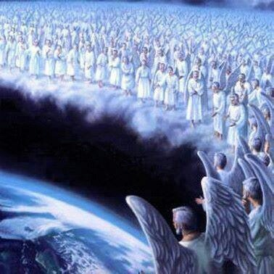
Patience
HYPOMONE – “steadfastness; constancy; endurance; sustaining perseverance”
Hebrews 12:1-2
Therefore we also, since we are surrounded by so great a cloud of witnesses, let us lay aside every weight, and the sin which so easily ensnares us, and let us run with endurance the race that is set before us, looking unto Jesus, the author and finisher of our faith, who for the joy that was set before Him endured the cross, despising the shame, and has sat down at the right hand of the throne of God.
I’ll never quit!

Slide 24
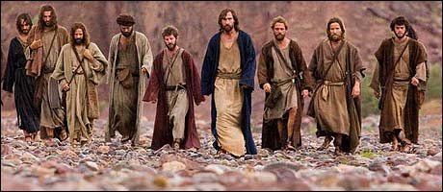
Patience
HYPOMONE – “steadfastness; constancy; endurance; sustaining perseverance”
Luke 21:12-19
“But before all these things (the destruction of Jerusalem) they will lay their hands on you and persecute you, delivering you up to the synagogues and prisons… You will be betrayed even by parents and brothers, relatives and friends; and they will put some of you to death. You will be hated by all for My name’s sake. … 19 BY YOUR PATIENCE POSSESS YOUR SOULS!”
Faith of our fathers

Slide 25
Patience & Hope
Romans 5:3-4
“And not only that, but we also glory in tribulations, knowing that tribulation produces perseverance; and perseverance, character; and character, hope.
Romans 8:25
“But if we hope for what we do not see, we eagerly wait for it with perseverance.
Romans 15:4
For whatever things were written before were written for our learning, that we through the patience and comfort of the Scriptures might have hope.

Slide 26
Six Certainties
God’s Grace
My Faith
But Richly Supplied to Heaven
Not Unsteady
Not Forgetful
Not Near-sighted or Blind
Not unfruitful
Not barren
Grand Entrance
Steady
Alert
20/20 Vision
Fruitful
Useful

