Slide 1
Brighten
the corner
where you are

Slide 2
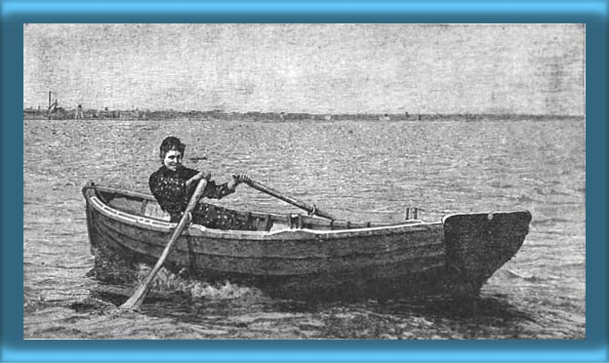
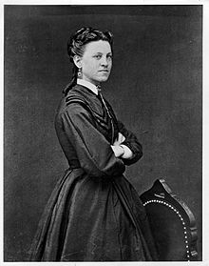
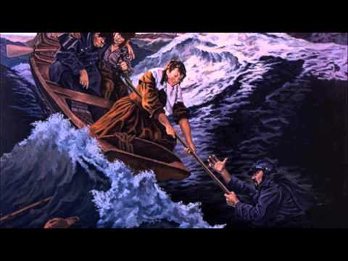
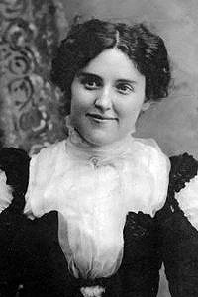
Ida Lewis
Ina Ogdon
Brighten
the corner
where you are

Slide 3
Do not wait until some deed of greatness you may do, Do not wait to shed your light afar; To the many duties ever near you now be true, Brighten the corner where you are.
Just above are clouded skies that you may help to clear, Let not narrow self your way debar; Though into one heart alone may fall your song of cheer, Brighten the corner where you are.
Here for all your talent you may surely find a need, Here reflect the bright and Morning Star; Even from your humble hand the Bread of Life may feed, Brighten the corner where you are.
Ina Ogdon
Refrain: Brighten the corner where you are! Brighten the corner where you are! Someone far from harbor you may guide across the bar; Brighten the corner where you are!
Brighten
the corner
where you are

Slide 4
Everyone Has A Sphere of Influence
Beware to Compare
Be Content While Striving For More
“He Who Boasts is to Boast In The Lord”
Brighten
the corner
where you are
2 Corinthians 10:12-17

