Slide 1
The Road Less Traveled
Matthew 7:13-14

Slide 2
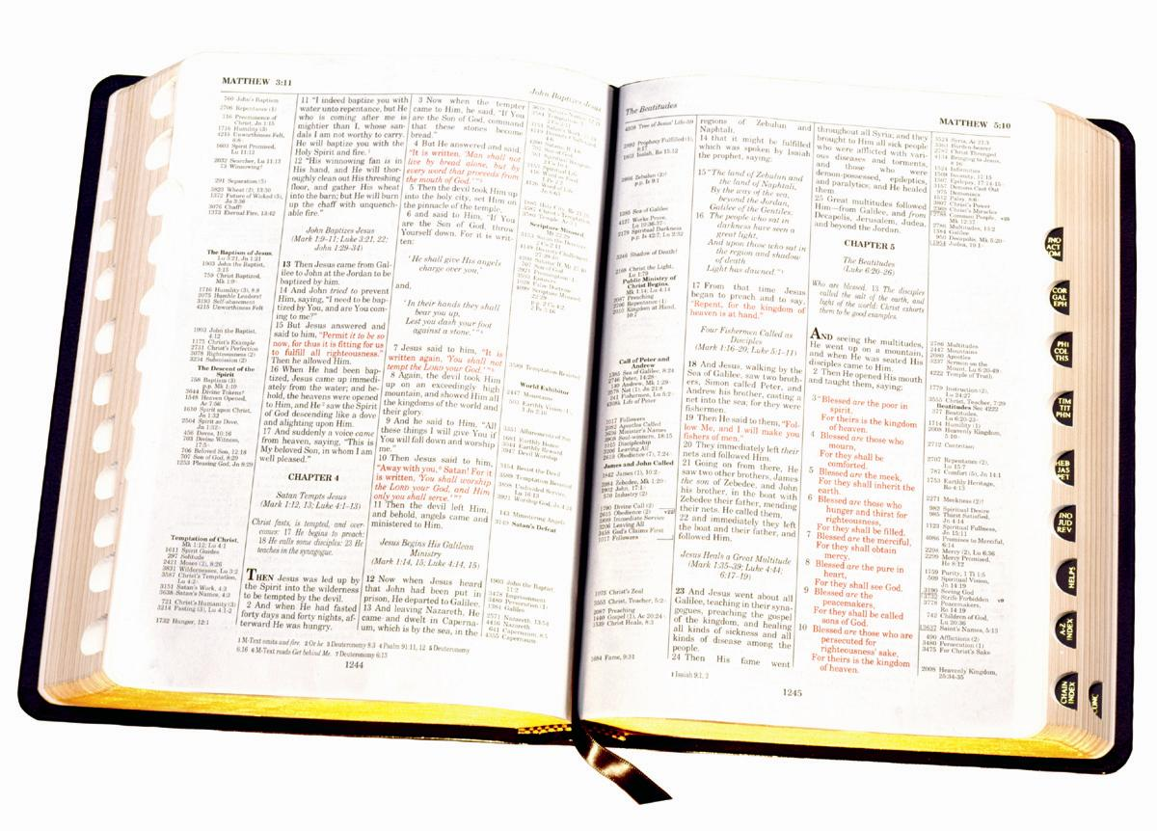
Matthew 7:13 "Enter by the narrow gate; for wide is the gate and broad is the way that leads to destruction, and there are many who go in by it.
14 "Because narrow is the gate and difficult is the way which leads to life, and there are few who find it.

Slide 3
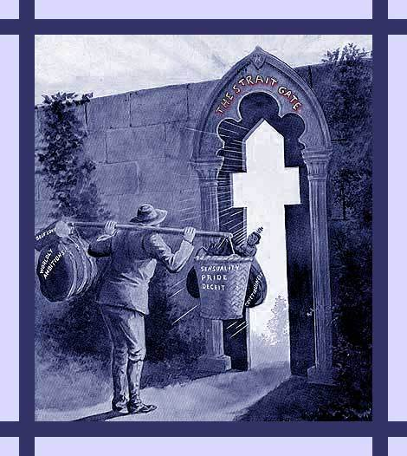
2 GATES
Narrow Gate
Wide Gate

Slide 4
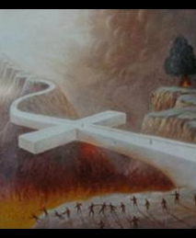
2 WAYS
Difficult
Broad

Slide 5
2 GROUPS
The Few
The Many

Slide 6
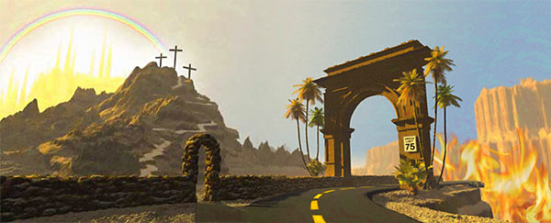
2
DESTINATIONS
Life
Destruction

Slide 8
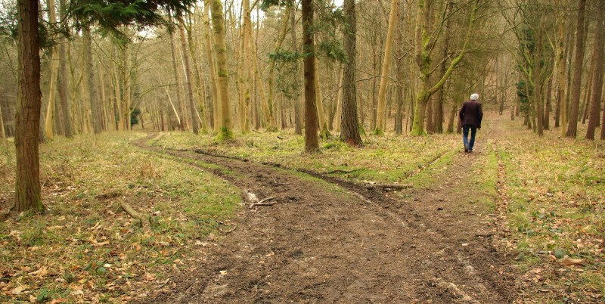
Chapter 1
“Life is difficult. This is a great truth, one of the greatest truths. Once we truly know that life is difficult – once we truly understand and accept it – then life is no longer difficult. Because once it is accepted, the fact that life is difficult no longer matters.”

Slide 9
2 GATES
Narrow Gate
Wide Gate

Slide 10
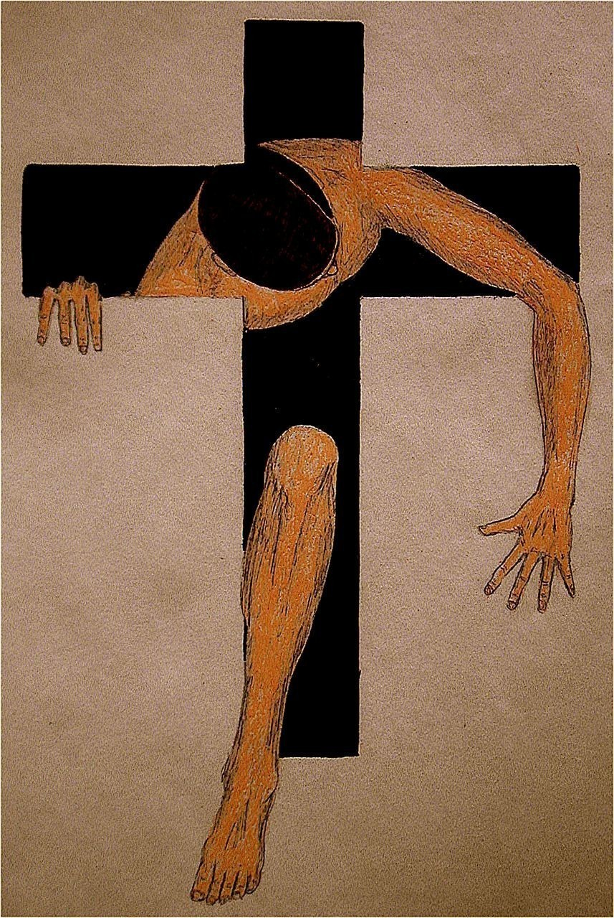
Narrow Gate
Where you start your journey
Restrictions
“The Strait Gate” (STENOS)
Demands A Decision: “New Birth” “Kingdom Citizenship”

Slide 11
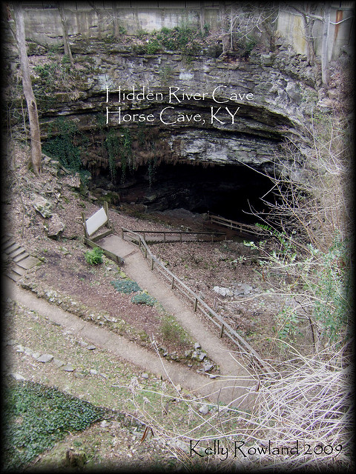
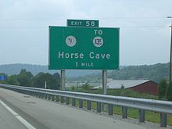
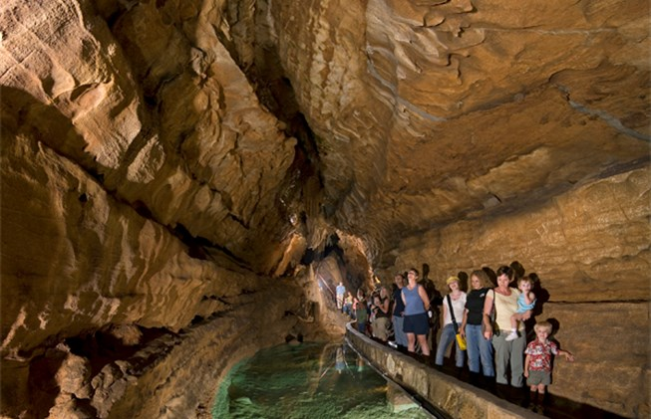
Rick’s Big Adventure

Slide 12
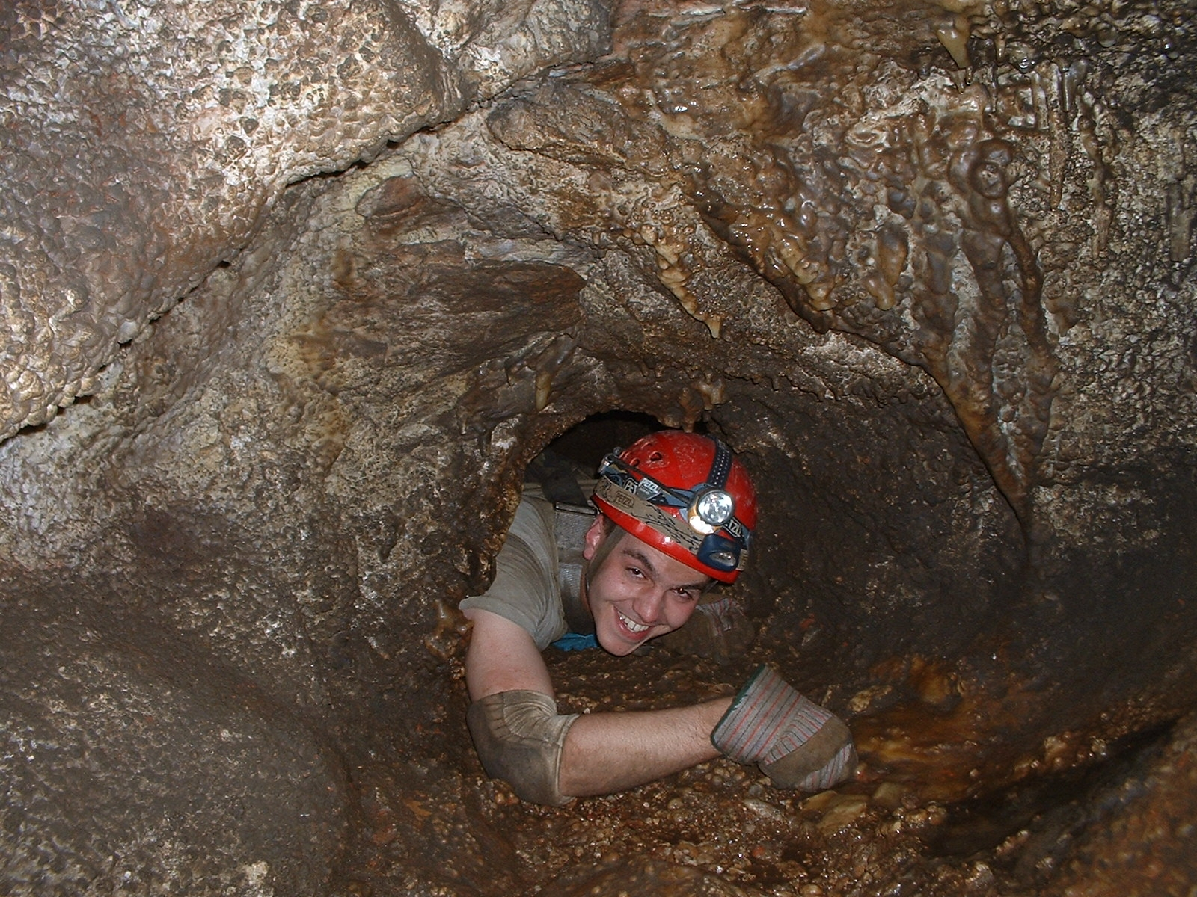
2 WAYS
Spelunking – Latin SPELUNCA – “cave, cavern” Greek SPELYNKS – “cave” Spelunker – one who explores caves
Cavers – experienced spelunkers
Difficult
Broad

Slide 13
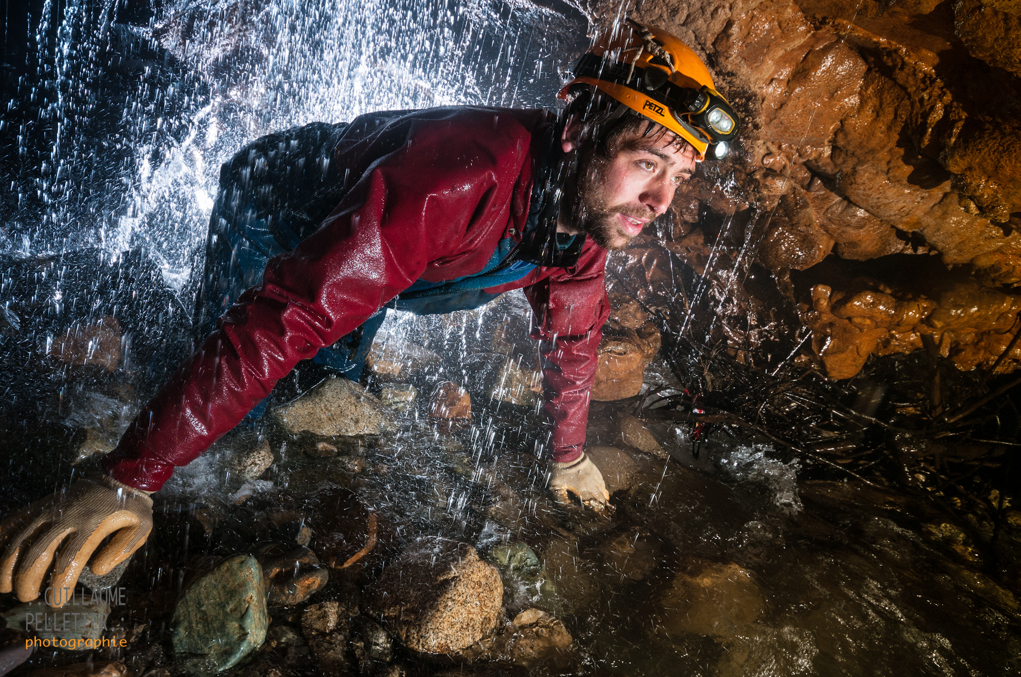
Spelunker or Tourist?

Slide 14
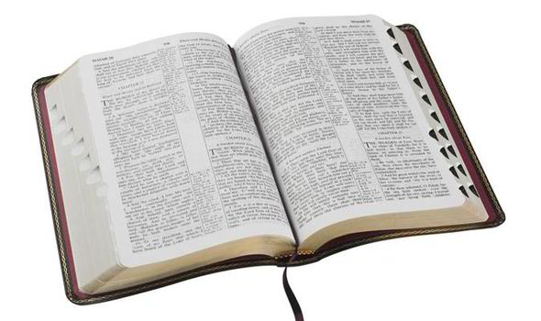
Starting Is Hard
Luke 14
26 "If anyone comes to Me and does not hate his father and mother, wife and children, brothers and sisters, yes, and his own life also, he cannot be My disciple.
27 "And whoever does not bear his cross and come after Me cannot be My disciple.
33 "So likewise, whoever of you does not forsake all that he has cannot be My disciple.

Slide 15
Starting Is Hard
FAITH IS HARD !
Romans 10
9 that if you confess with your mouth the Lord Jesus and believe in your heart that God has raised Him from the dead, you will be saved.
10 For with the heart one believes unto righteousness, and with the mouth confession is made unto salvation.
17 So then faith comes by hearing, and hearing by the word of God.

Slide 16
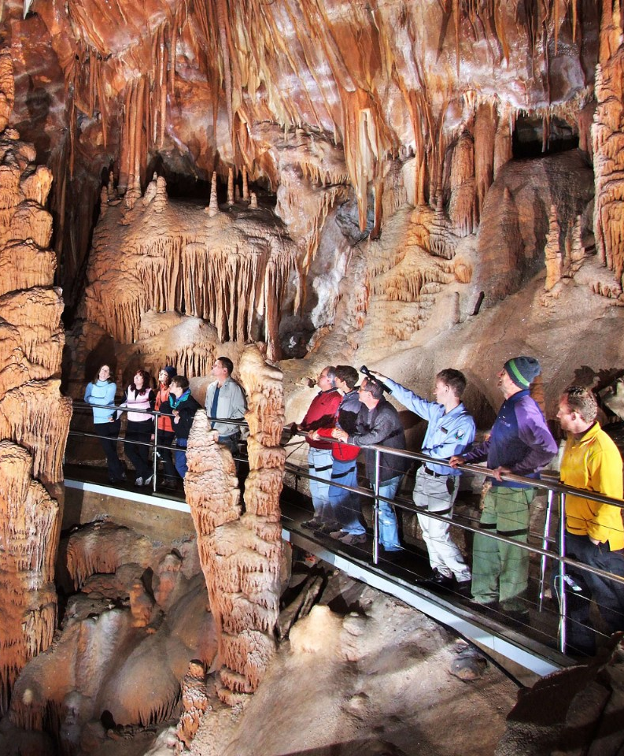
The Wide Gate
Spelunkers? No! Tourists!
Where You Start Your Journey
Few, if any, restrictions
Easy Entrance
Default Gate

Slide 17
Luke 10:25-37
And behold, a certain lawyer stood up and tested Him, saying, "Teacher, what shall I do to inherit eternal life?“ … But he, wanting to justify himself, said to Jesus, "And who is my neighbor?"

Slide 18
Luke 18:18-26
Now a certain ruler asked Him, saying, "Good Teacher, what shall I do to inherit eternal life?“
…
"How hard it is for those who have riches to enter the kingdom of God!

Slide 19
Deuteronomy 30:19-20
I have set before you life and death, blessing and cursing; therefore choose life, that both you and your descendants may live…

Slide 20
Joshua 24:13-15
"And if it seems evil to you to serve the LORD, choose for yourselves this day whom you will serve, … But as for me and my house, we will serve the LORD."

Slide 21
I Kings 18:21
And Elijah came to all the people, and said, "How long will you falter between two opinions? If the LORD is God, follow Him; but if Baal, follow him." But the people answered him not a word.

Slide 22
2 WAYS
Difficult
Broad

Slide 24
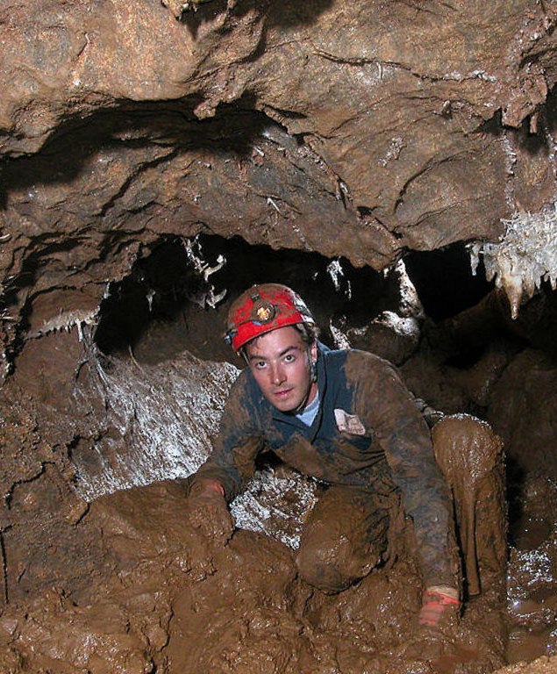
The Difficult Way
Spelunker or Tourist?
Narrow Way
Lifelong struggle of endurance
Hard Life of Righteousness

Slide 25
Why It Is Hard
Acts 14:21 And when they had preached the gospel to that city and made many disciples, they returned to Lystra, Iconium, and Antioch, strengthening the souls of the disciples, exhorting them to continue in the faith, and saying, "We must through many tribulations enter the kingdom of God."
1 Pet 4:12 Beloved, do not think it strange concerning the fiery trial which is to try you, as though some strange thing happened to you;… 14 If you are reproached for the name of Christ, blessed are you… 16 Yet if anyone suffers as a Christian, let him not be ashamed, but let him glorify God in this matter.
Acts 14:22
I Peter 4:12
2 Timothy 3:12
2 Tim 3:10 But you have carefully followed my doctrine, manner of life, purpose, faith, longsuffering, love, perseverance, 11 persecutions, afflictions, which happened to me at Antioch, at Iconium, at Lystra--what persecutions I endured. And out of them all the Lord delivered me. 12 Yes, and all who desire to live godly in Christ Jesus will suffer persecution.

Slide 26
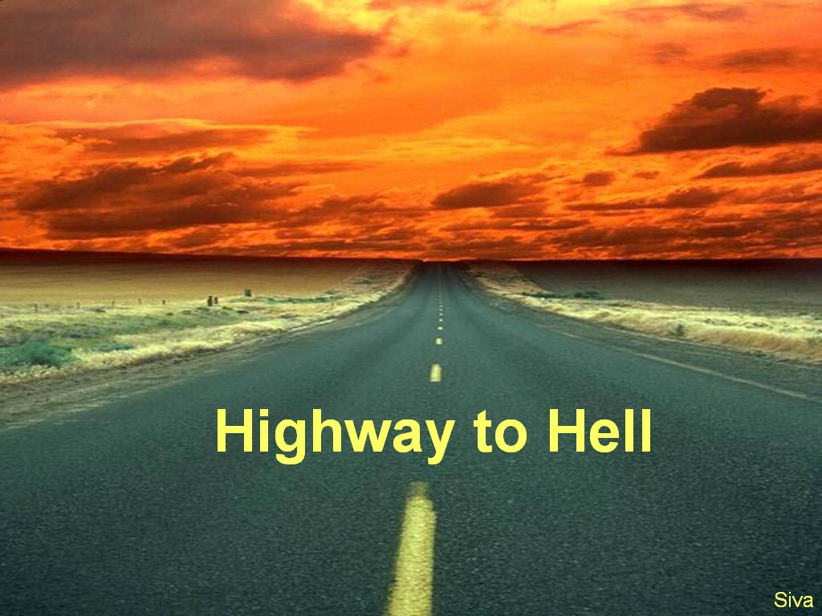
The Easy Way
Broad, Wide
Free Thinkers Broad Minded Tolerant Attitude
Majority Rule
Good Intentions Bad Destination

Slide 27
DESTRUCTION !
2 Thessalonians 1:5-9
5 which is manifest evidence of the righteous judgment of God, that you may be counted worthy of the kingdom of God, for which you also suffer; 6 since it is a righteous thing with God to repay with tribulation those who trouble you, 7 and to give you who are troubled rest with us when the Lord Jesus is revealed from heaven with His mighty angels, 8 in flaming fire taking vengeance on those who do not know God, and on those who do not obey the gospel of our Lord Jesus Christ. 9 These shall be punished with everlasting destruction from the presence of the Lord and from the glory of His power”

Slide 28
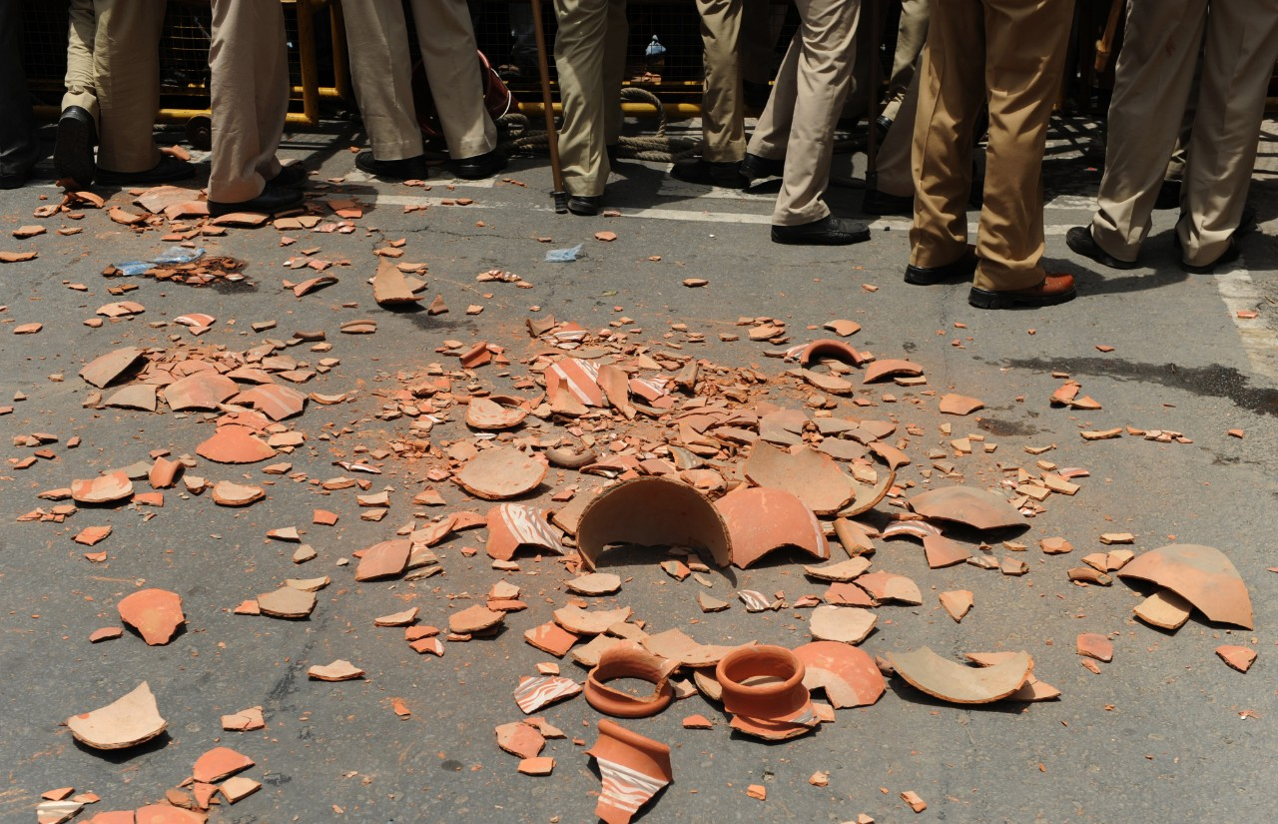
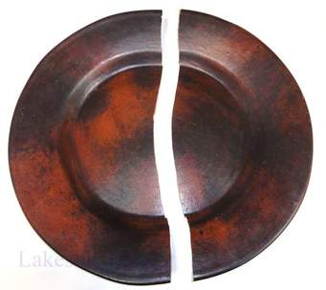
“Destruction” Grk. Olethros
Satan & Sin --- uses you until nothing left worth using, then breaks you in pieces and discards you

Slide 29
DEATH !
Proverbs 14:12
There is a way that seems right to a man, But its end is the way of death.

Slide 30
DEPART !
Matthew 7:21-23
Mt 7:22 "Many will say to Me in that day, 'Lord, Lord …
23 "And then I will declare to them, 'I never knew you; depart from Me, you who practice lawlessness!'

Slide 31
2 GROUPS
The Few
The Many

Slide 32
The Few
The 8 of Noah’s Family (I Pet 3:20)
The 2 of Israel from Egypt (Num. 14:30)
The Remnant from Exile (2 Kgs 19:30-31)
The 120 of Jesus’ Ministry (Acts 1:15)
The Noble Bereans (Acts 17:11)

Slide 33
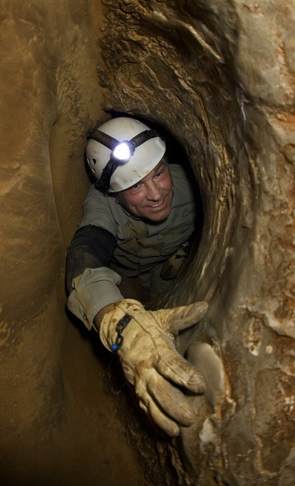
Few Strive To Enter
Strive: AGONIZOMAI “to endeavor with strenuous zeal to obtain something”
Luke 13:23-24
Then one said to Him, "Lord, are there few who are saved?" And He said to them,
"Strive to enter through the narrow gate, for many, I say to you, will seek to enter and will not be able.

Slide 34
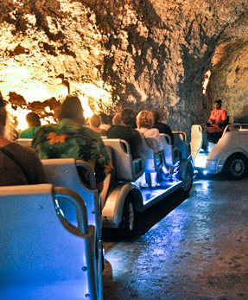
The Many
Spelunkers or Tourists?
Default: Line of least resistence
Majority Rule: No thought, or decision to make
Carry all baggage (Southwest vs Spirit Air)
Safety in Numbers?

Slide 35
Many
Matthew 20:16 "So the last will be first, and the first last. For many are called, but few chosen."
Matthew 22:9 'Therefore go into the highways, and as many as you find, invite to the wedding.‘ … 14 "For many are called, but few are chosen."

Slide 36
2
DESTINATIONS
Life
Destruction

Slide 37
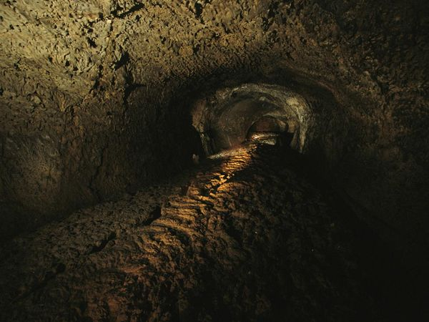
Choose Life
Matt. 13:44
"Again, the kingdom of heaven is like treasure hidden in a field, which a man found and hid; and for joy over it he goes and sells all that he has and buys that field.”

Slide 38
Matthew 13:45-46 "Again, the kingdom of heaven is like a merchant seeking beautiful pearls, who, when he had found one pearl of great price, went and sold all that he had and bought it.

Slide 39
Take The Road Less Traveled

