Slide 1
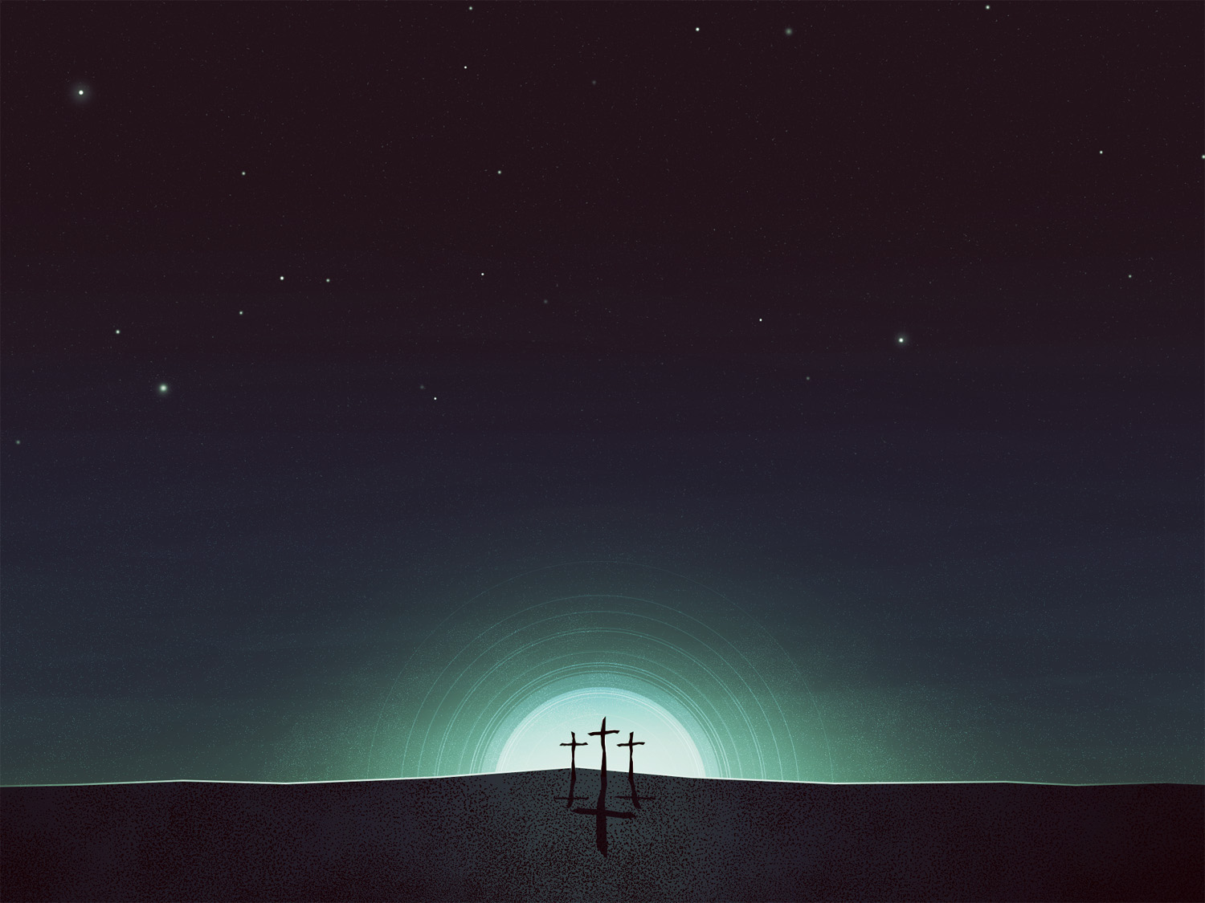
Parallels Between
Eden and the Temple
1) God’s Presence (Gen. 3:8 , Lev. 26:12, Deut. 23:14)
2) Priestly Cultivation and Care (Gen. 2:15 / Num. 3:7-8)
3) Tree of Life and the Lampstand (Gen. 2:9 / Ex. 25:31-36)
4) Garden Imagery in Temple (1 Kings 6:18,29, 32 / 7:20-26, 42, 49)
5) Eden (perhaps) on a Mountain (Gen. 2:10 / Ezek. 28: 13-16)
6) Cherubim Guarding the Entrance (Gen.3:24 / Ex. 25:18, 26: 1, 31 / Ezek. 28:14, 41:18 / Heb. 10: 19-22)
Eden, Angels, and Jesus

