Slide 1
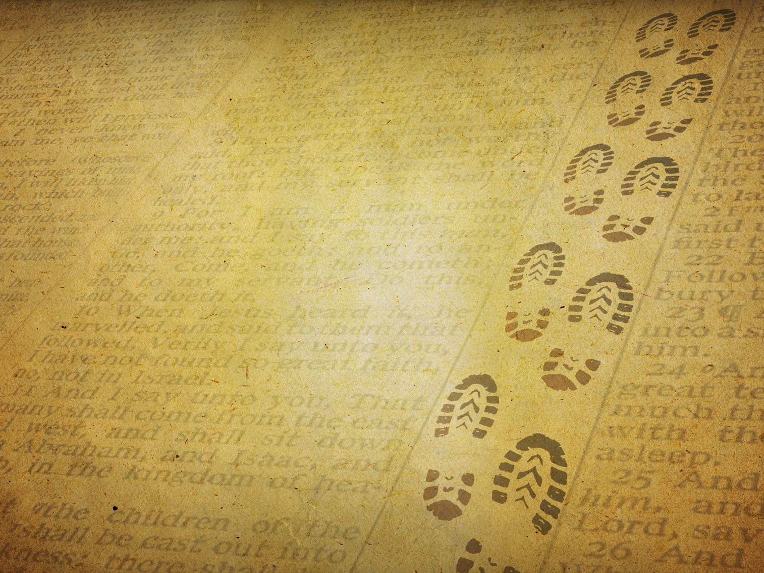
Read It Again
for the first time

Slide 2

Read It Again
for the first time
Motivation
Appreciation
Application
Genesis 26:18
Sometimes we need to dig the wells again!
We (or those we learn from) can be mistaken
Mark 4:24 / Mark 12:24 / 1 Peter 1:18
1 Corinthians 2:6 - 3:3
The mature can explore God’s wisdom and mind
Notice when Scripture says why it was written
John 20:30 / 2 Corinthians 12:19 / 1 Peter 5:12

