Slide 1
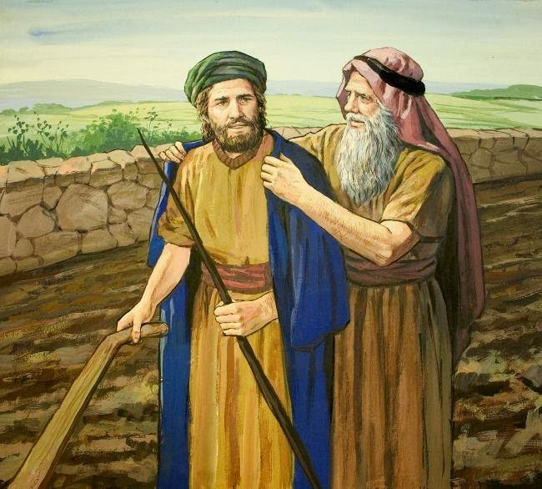
Passing The mantle
The Story of Elijah and Elisha

Slide 2
RECEIVING The mantle
The Story of Elijah and Elisha
The Story of The Mentor Leader

Slide 3
The mantle is passing to you
Youth and Young Adults:
A period of servanthood – (Proving yourself worthy of the mantle)
You Are Today’s Elisha or Gehazi

Slide 4
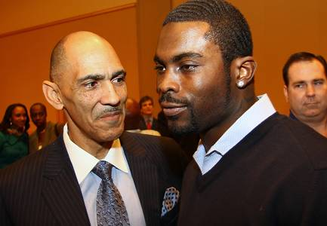
The mantle
The Story of The Mentor Leader
Tony Dungy Michael Vick

Slide 5
Elisha inherits Elijah’s mantle
1 Kings 19:19 So he departed from there, and found Elisha the son of Shaphat, who was plowing with twelve yoke of oxen before him, and he was with the twelfth. Then Elijah passed by him and threw his mantle on him.
I Need You
God Wants You

Slide 6
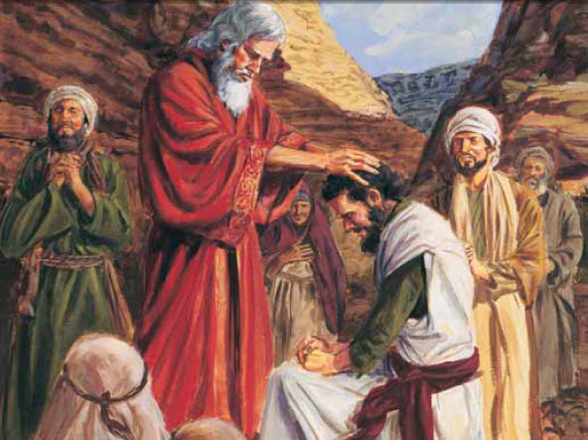
THROWING the mantle: my life impacts others
Biblical Mantles: Good Moses to Joshua Elijah to Elisha Jesus to Apostles Paul to Timothy
2 Tim 2:2 And the things that you have heard from me among many witnesses, commit these to faithful men who will be able to teach others also.

Slide 7
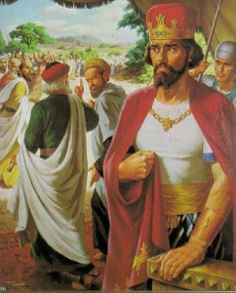
THROWING the mantle: my life impacts others
Biblical Mantles: Bad Solomon to Jeroboam (I Kg 11) 1 K 11:28 The man Jeroboam was a mighty man of valor; and Solomon, seeing that the young man was industrious, made him the officer over all the labor force of the house of Joseph. Jeroboam to Israel’s Kings (I Kg 13)

Slide 8
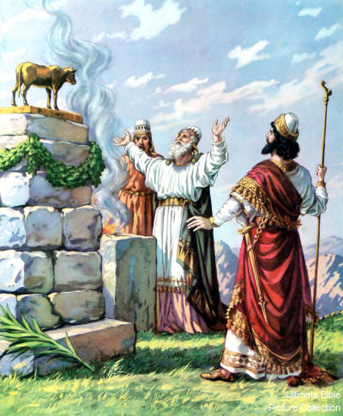
WHAT MIGHT HAVE BEEN: THE TRAGEDY OF JEROBOAM
1 Kgs 13 Name lives in infamy (15x)
13:33 After this event Jeroboam did not turn from his evil way, but again he made priests from every class of people for the high places; whoever wished, he consecrated him, and he became one of the priests of the high places. 34 And this thing was the sin of the house of Jeroboam, so as to exterminate and destroy it from the face of the earth.
“And he did evil in the sight of the LORD; he did not depart from all the sins of Jeroboam the son of Nebat, who had made Israel sin.”

Slide 9
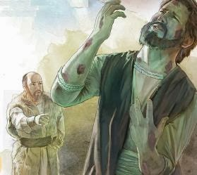
WHAT MIGHT HAVE BEEN: The Tragedy of gehazi
5:22-27 Gehazi’s Lost Mantle (lost to Coveting) Elisha’s Mantle for Naaman’s 2 Garments and Leprosy
TRAGIC LOST MANTLE’S: Esau’s birthright (lost to coveting) Achan’s victory (lost to coveting) Judas’ ministry (lost to coveting)

Slide 10
WHAT MIGHT HAVE BEEN: The Tragedy of ?
Church Directory Since 1986
Would’a, Could’a, Should’a

Slide 11
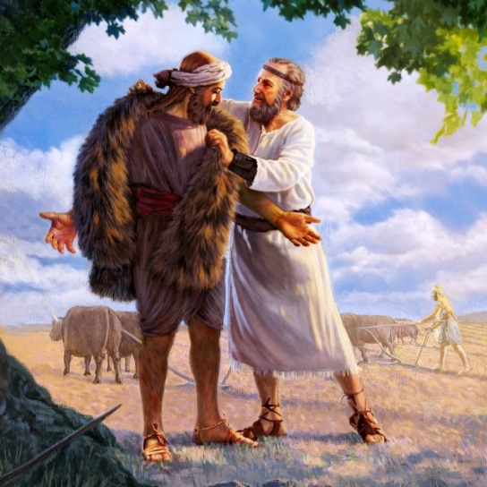
INHERITING THE MANTLE: Elisha’s RESPONSE
Obedient: Immediately and Boldly (Slaughter oxen, Burned plow)
Luke 9:62 But Jesus said to him, "No one, having put his hand to the plow, and looking back, is fit for the kingdom of God.“
Matt 4:19-20 Then He said to them, "Follow Me, and I will make you fishers of men.“ They immediately left their nets and followed Him.

Slide 12
INHERITING THE MANTLE: Elisha’s RESPONSE
2. Passionate: Single-Mindedness “Then he arose and followed Elijah, and became his servant”
Isa 6:8 Isaiah “Also I heard the voice of the Lord, saying: "Whom shall I send, And who will go for Us?" Then I said, "Here am I! Send me.“
Philip 2:20-22 Timothy: “For I have no one like-minded, who will sincerely care for your state. But you know his proven character, that as a son with his father he served with me in the gospel.

Slide 13
INHERITING THE MANTLE: Elisha’s response
3. Faithful: “I will not leave you” (2:2,4,6)
Ruth 1:16 But Ruth said: "Entreat me not to leave you, Or to turn back from following after you; For wherever you go, I will go; And wherever you lodge, I will lodge; Your people shall be my people, And your God, my God. 17 Where you die, I will die, And there will I be buried. The LORD do so to me, and more also, If anything but death parts you and me."

Slide 14
Inheriting your mantle: will you respond to the challenge?
Obedient: Immediately and Boldly Mission-ary “a step of faith”
Passionate: Single-Mindedness Eccl 11:9-10; 12:1
Faithful: I will not leave you Rev 2:10

Slide 15
The mantle is passing to you
Youth and Young Adults: A period of servanthood – (Proving yourself worthy of the mantle) “Obey your father and mother” (Eph. 6:1-3) “Remember … Obey … Greet those who rule over you” (Heb 13:7, 17, 24)
AreYou Today’s Elisha ? … or Gehazi ?

Slide 16
WEARING YOUR MANTLE: Blessing your generation
Whose Mantle Will You Wear? Parent Grand-parent Teacher Elder Deacon Preacher Older Mentor (Tit. 2)
2 Kgs 2:14 “Then he took the mantle of Elijah that had fallen from him, and struck the water”

