Slide 1
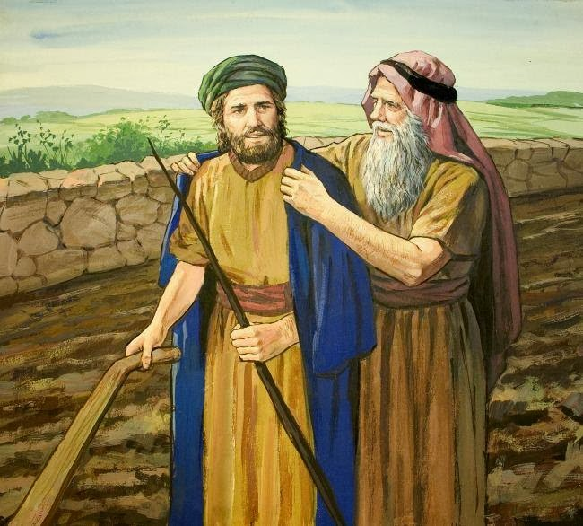
Passing The mantle
The Story of Elijah and Elisha & The Story of My Life

Slide 2
Elisha inherits Elijah’s mantle I Kings 19:9-21
1 Kings 19:19 So he departed from there, and found Elisha the son of Shaphat, who was plowing with twelve yoke of oxen before him, and he was with the twelfth. Then Elijah passed by him and threw his mantle on him.

Slide 3
ADULT GENERATION: I AM WEARING A MANTLE NOW!
My Life = My Mantle
Legacy: Who I Am What I Will Be Remembered For
Prov 23:6 Do not eat the bread of a miser, Nor desire his delicacies; 7 For as he thinks in his heart, so is he.

Slide 4
ADULT GENERATIONS
G. I. Gen (“Greatest Gen” 1920-1945) 69-94 yrs old
Baby Boomer Gen (1946-1964) 50-68 yrs old
Gen X (1965-1980) 34-49 yrs old

Slide 5
YOUNGER GENERATION: What Mantle will you inherit?
The Next Generation For God: Gen Y (Millennials) 1981-2000’s teens – 33 yrs old
Seeing your place in God’s plan
Preparing yourself to take the mantle

Slide 6
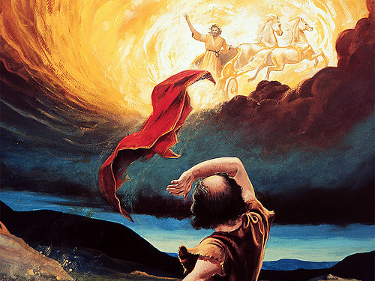
“Please let a double portion of your spirit be upon me."?” (2 Kgs 2:9)
Elijah’s Life = Elijah’s Mantle
Elijah’s Miracles & Glory
History’s Reputation of Elijah: Mal 4:5 Behold, I will send you Elijah the prophet Before the coming of the great and dreadful day of the LORD. Matt 16:14 So they said, "Some say John the Baptist, some Elijah, and others Jeremiah or one of the prophets.“ Matt 17:2 and He was transfigured before them. His face shone like the sun, and His clothes became as white as the light. And behold, Moses and Elijah appeared to them, talking with Him.

Slide 7
“Please let a double portion of your spirit be upon me."?” (2 Kgs 2:9)
Reputation of Elijah During His Life: 1 K. 18:17 Then it happened, when Ahab saw Elijah, Ahab said to him, "Is that you, O troubler of Israel?“ 1 K. 19:2 Then Jezebel sent a messenger to Elijah, saying, "So let the gods do to me, and more also, if I do not make your life as the life of one of them by tomorrow about this time.“ 1 K. 19:14 And he said, "I have been very zealous for the LORD God of hosts; because the children of Israel have forsaken Your covenant, torn down Your altars, and killed Your prophets with the sword. I alone am left; and they seek to take my life."

Slide 8
“Please let a double portion of your spirit be upon me."?” (2 Kgs 2:9)
Elijah’s Legacy In Eyes of Elisha
Like Apostles Asking Jesus To Be “Greatest” In The Kingdom Mark 10 37 They said to Him, "Grant us that we may sit, one on Your right hand and the other on Your left, in Your glory.“ But Jesus said to them, "You do not know what you ask. Are you able to drink the cup that I drink, and be baptized with the baptism that I am baptized with?“ They said to Him, "We are able." So Jesus said to them, "You will indeed drink the cup that I drink, and with the baptism I am baptized with you will be baptized!”

Slide 9
“Please let a double portion of your spirit be upon me."?” (2 Kgs 2:9)
How It Really Was To Be An Apostle: I Cor. 4 9 For I think that God has displayed us, the apostles, last, as men condemned to death; for we have been made a spectacle to the world, both to angels and to men. 10 We are fools for Christ's sake, … We are weak, … we are dishonored! 11 To the present hour we both hunger and thirst, and we are poorly clothed, and beaten, and homeless. 12 And we labor, working with our own hands. Being reviled, we bless; being persecuted, we endure; 13 being defamed, we entreat. We have been made as the filth of the world, the offscouring of all things until now.

Slide 10
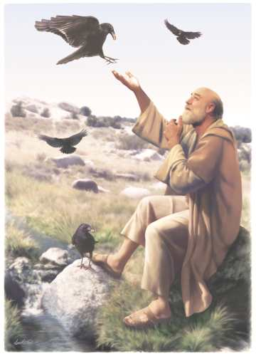
“Please let a double portion of your spirit be upon me."?” (2 Kgs 2:9)
Elijah’s Life: Destroy Idolatry!
Miracles: God’s Finger of Authority 1. Long drought of 3 ½ yrs (17:1; Jam. 5:17) 2. The ravens feeding bread/meat (17:2-7) 3. The meal and oil of widow & son (17:8-16) 4. The resurrection of widow’s son (17:17f) 5. Mt. Carmel showdown (18:1-39)

Slide 11
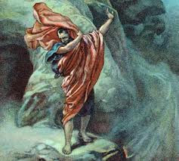
“Please let a double portion of your spirit be upon me."?” (2 Kgs 2:9)
Elijah’s Miracles (mission: destroy idols!) 6. The 2 angelic meals – 40 days (19:1-18) 7. Divine manifestation – wind, quake, fire, voice (19:9-18) 8. Fire from heaven kills 100 soldiers (2Kgs 1:9-15) 9. Jordan River divided (2:1-8) 10. Chariot into heaven (2:9-11)

Slide 12
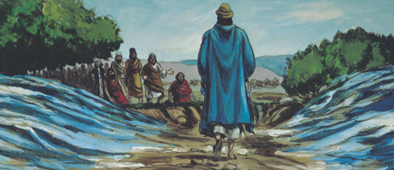
“And Elisha saw it, and he cried out, "My father, my father, the chariot of Israel and its horsemen!"(2 Kgs 2:12-15)
Mantle = Adoption of his life, lifestyle, mission. Carry on the legacy to next gen.
“The spirit of Elijah does rest on Elisha!” (2 Kg 2:15)

Slide 13
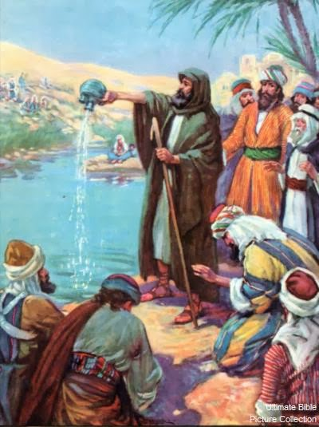
“Tell me all the great things Elisha has done?” (2 Kgs 8:4)
2 Kings 1-13 (Using the Mantle’s “double portion”)
More than 16 miracles to prove to Israel that Jehovah is THE God

Slide 14
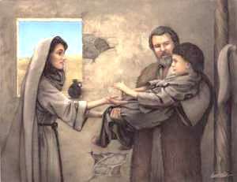
“Tell me all the great things Elisha has done?” (2 Kgs 8:4)
2:13-15 Elijah’s Mantle Parts The Jordan
2:19-22 Elisha’s Salt Recipe To Heal Poison Water
2:23-25 The Bad News Bears (Gang o’ 42)
3:1-27 The Silent Flood / The Mirage
4:1-7 Widow Prophet-ing from Oil
4:8-37 Shunnamite’s Son Raised
4:38-41 Death in the Pot – Soups On
4:42-44 Food for 100 Prophets

Slide 15
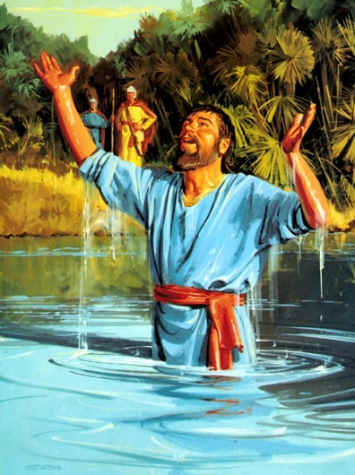
“Tell me all the great things Elisha has done?” (2 Kgs 8:4)
5:1-25 A Leper Changes Spots (Naaman)
5:26-27 Gehazi’s Leprosy
6:1-7 Floats A Loaner (Ax Head)
6:8-23 Seeing Is Believing (“open his eyes”)
6:24-7:6 God’s Special Effects: Syrian Flight
7:7-20 Israel Stampede (tramples scoffer)
8:7-15 Foretells Hazael Assassinating Ben-Hadad

Slide 16
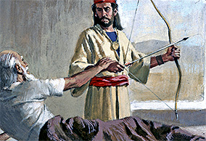
“Tell me all the great things Elisha has done?” (2 Kgs 8:4)
13:14-19 Three Strikes – You’re Out!
13:20-21 A Voice From The Grave: Resurrection!

Slide 17
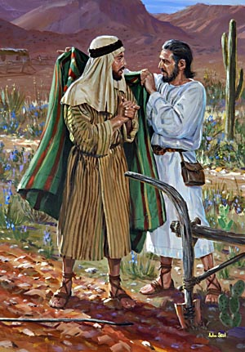
THROWING (Giving) the mantle
I Kgs 19:15-21 “Elijah…threw his mantle on him (Elisha)”
2 Kgs 2 Faithful unto … (Life) Elijah’s 40 years of service Elisha’s 60 years of service!

Slide 18
THROWING the mantle: WHAT AM I GIVING?
My Life’s Work
My Legacy (being defined)
Who Am I? What Have I Done? What Will I Give To The Next Gen?

Slide 19
THROWING the mantle: TO WHOM AM I GIVING IT?
Look Around At The Next Generation
Who Will Receive My Mantle?

