Slide 2
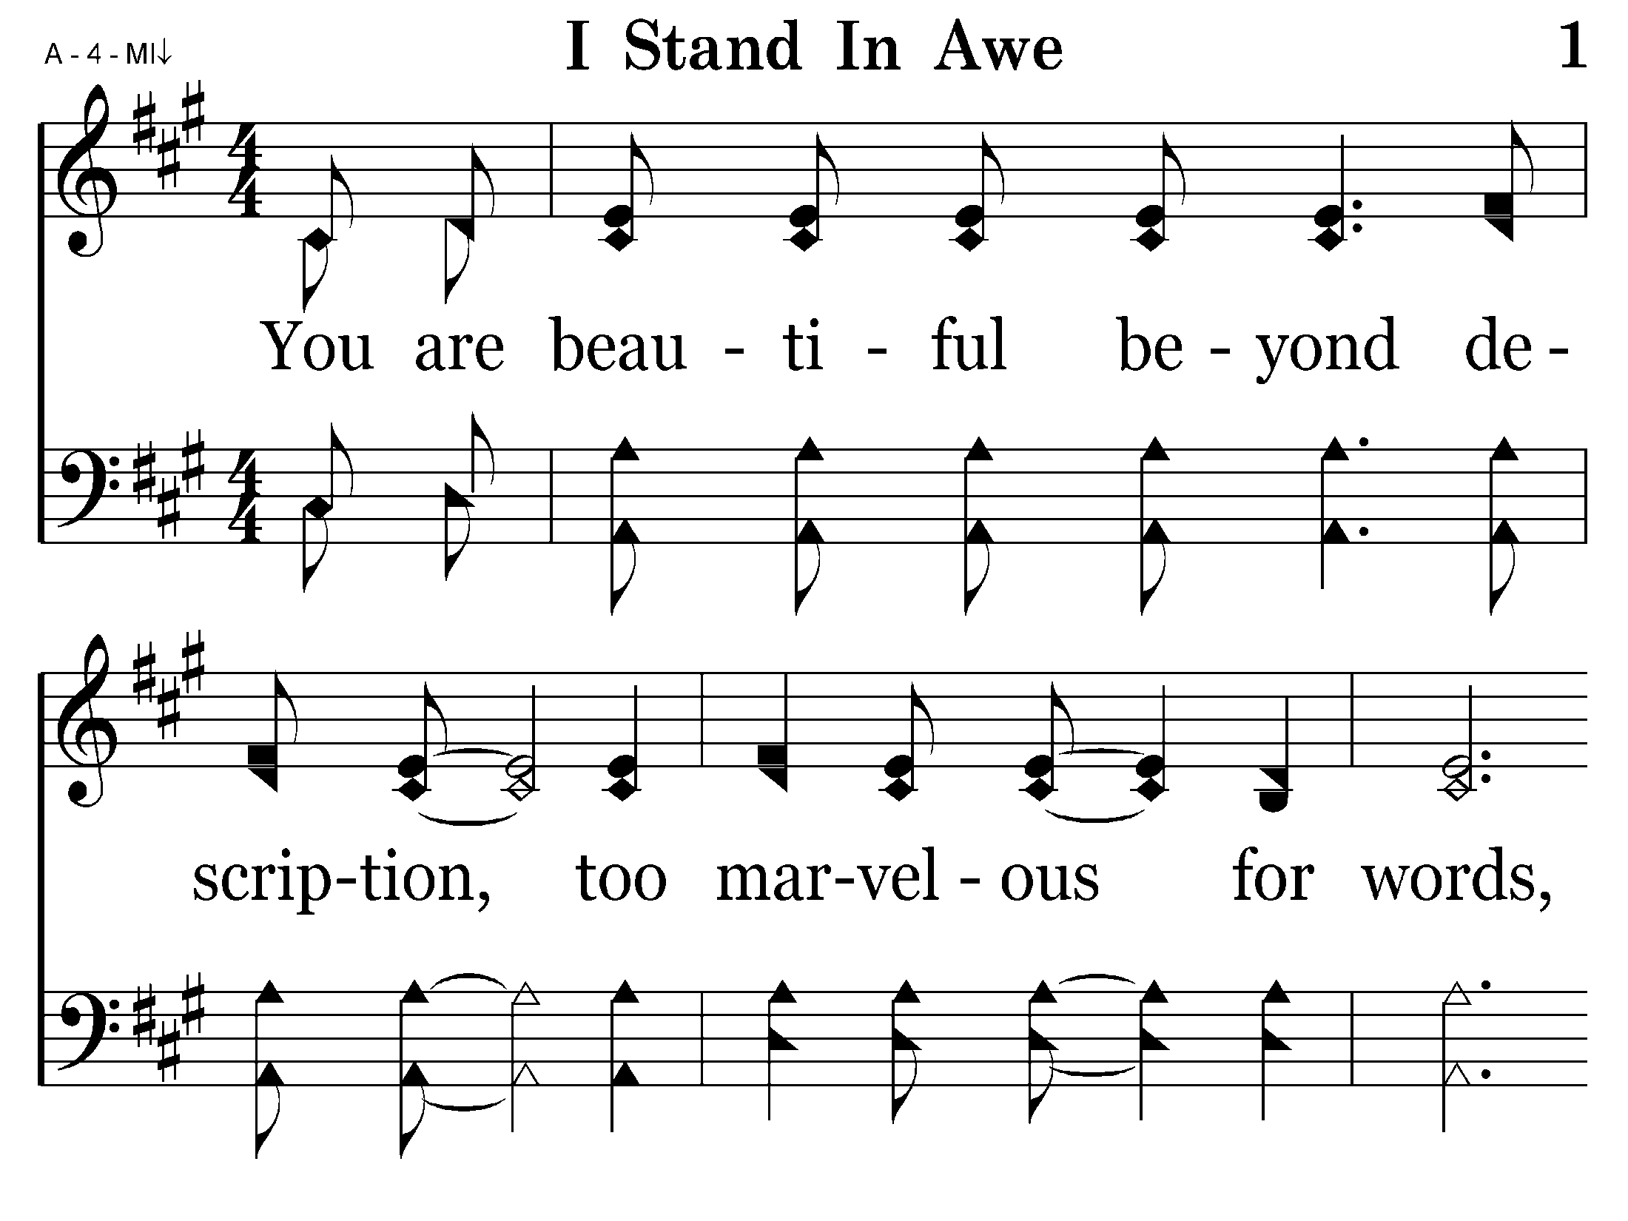
001 - I Stand In Awe - 1.1

Slide 3
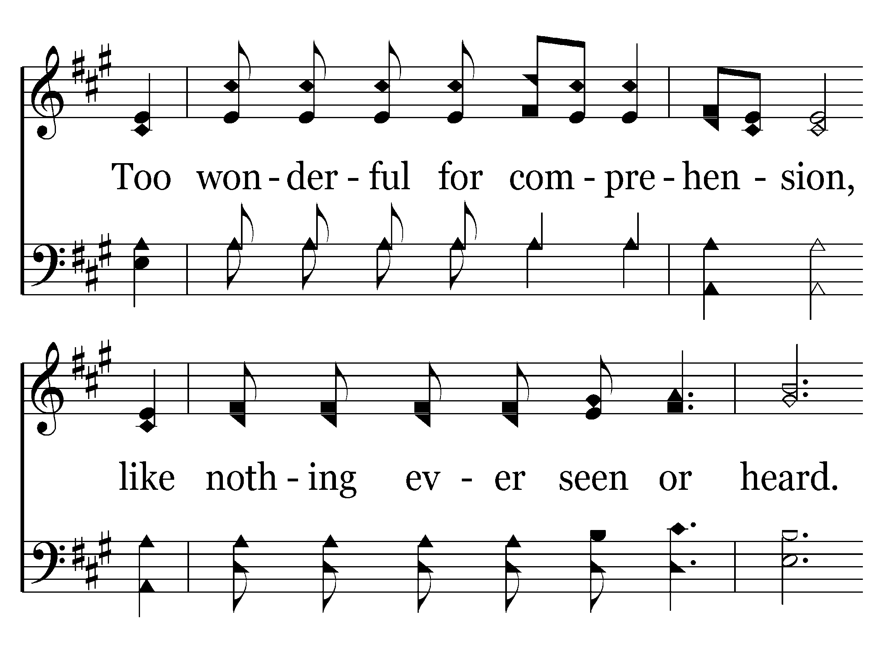
001 - I Stand In Awe - 1.2

Slide 4
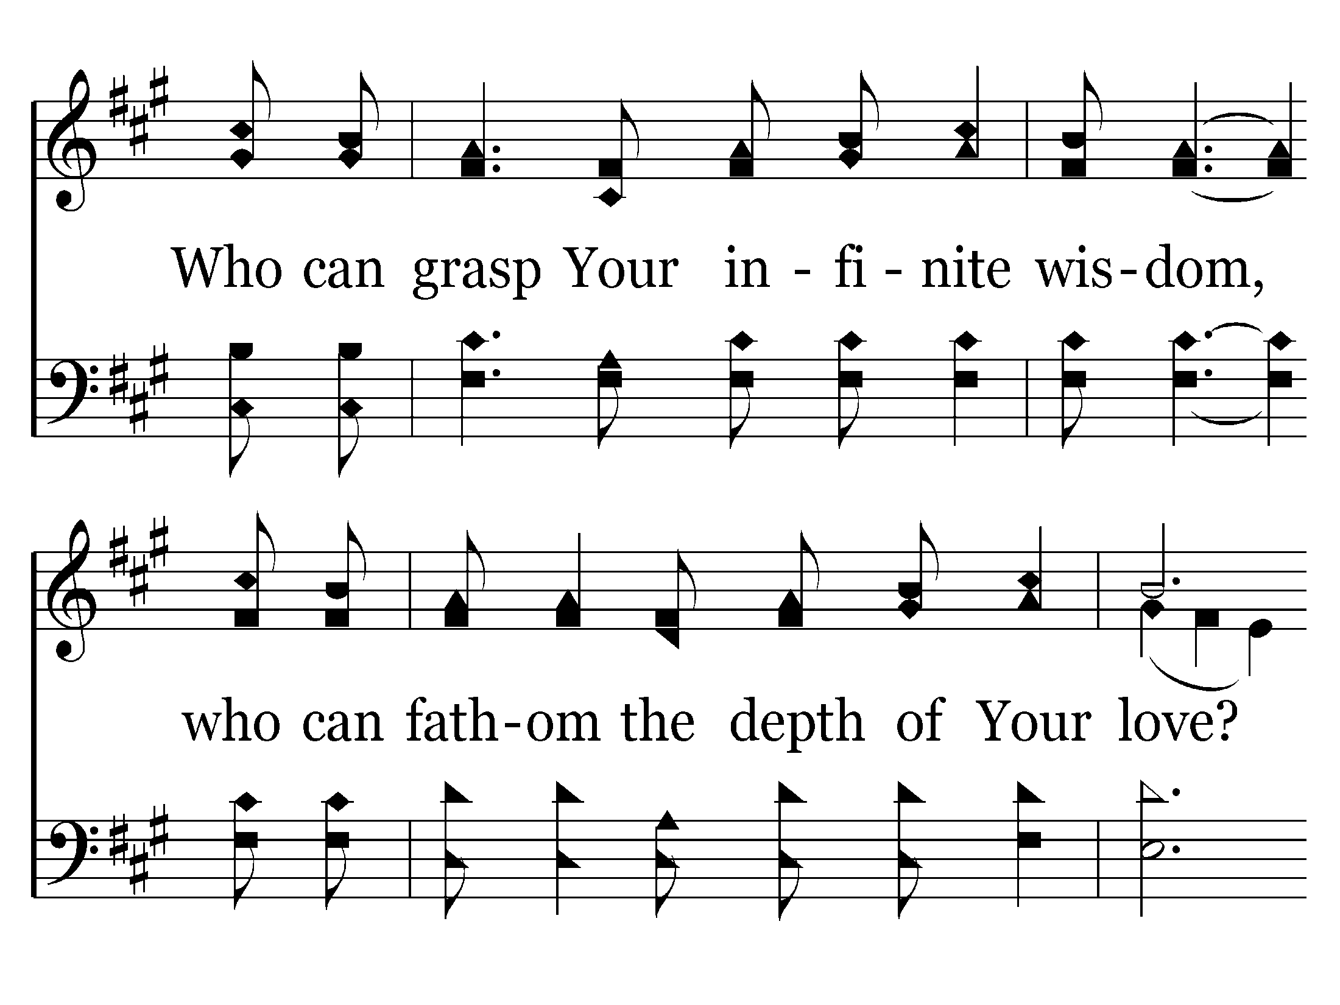
001 - I Stand In Awe - 1.3

Slide 5
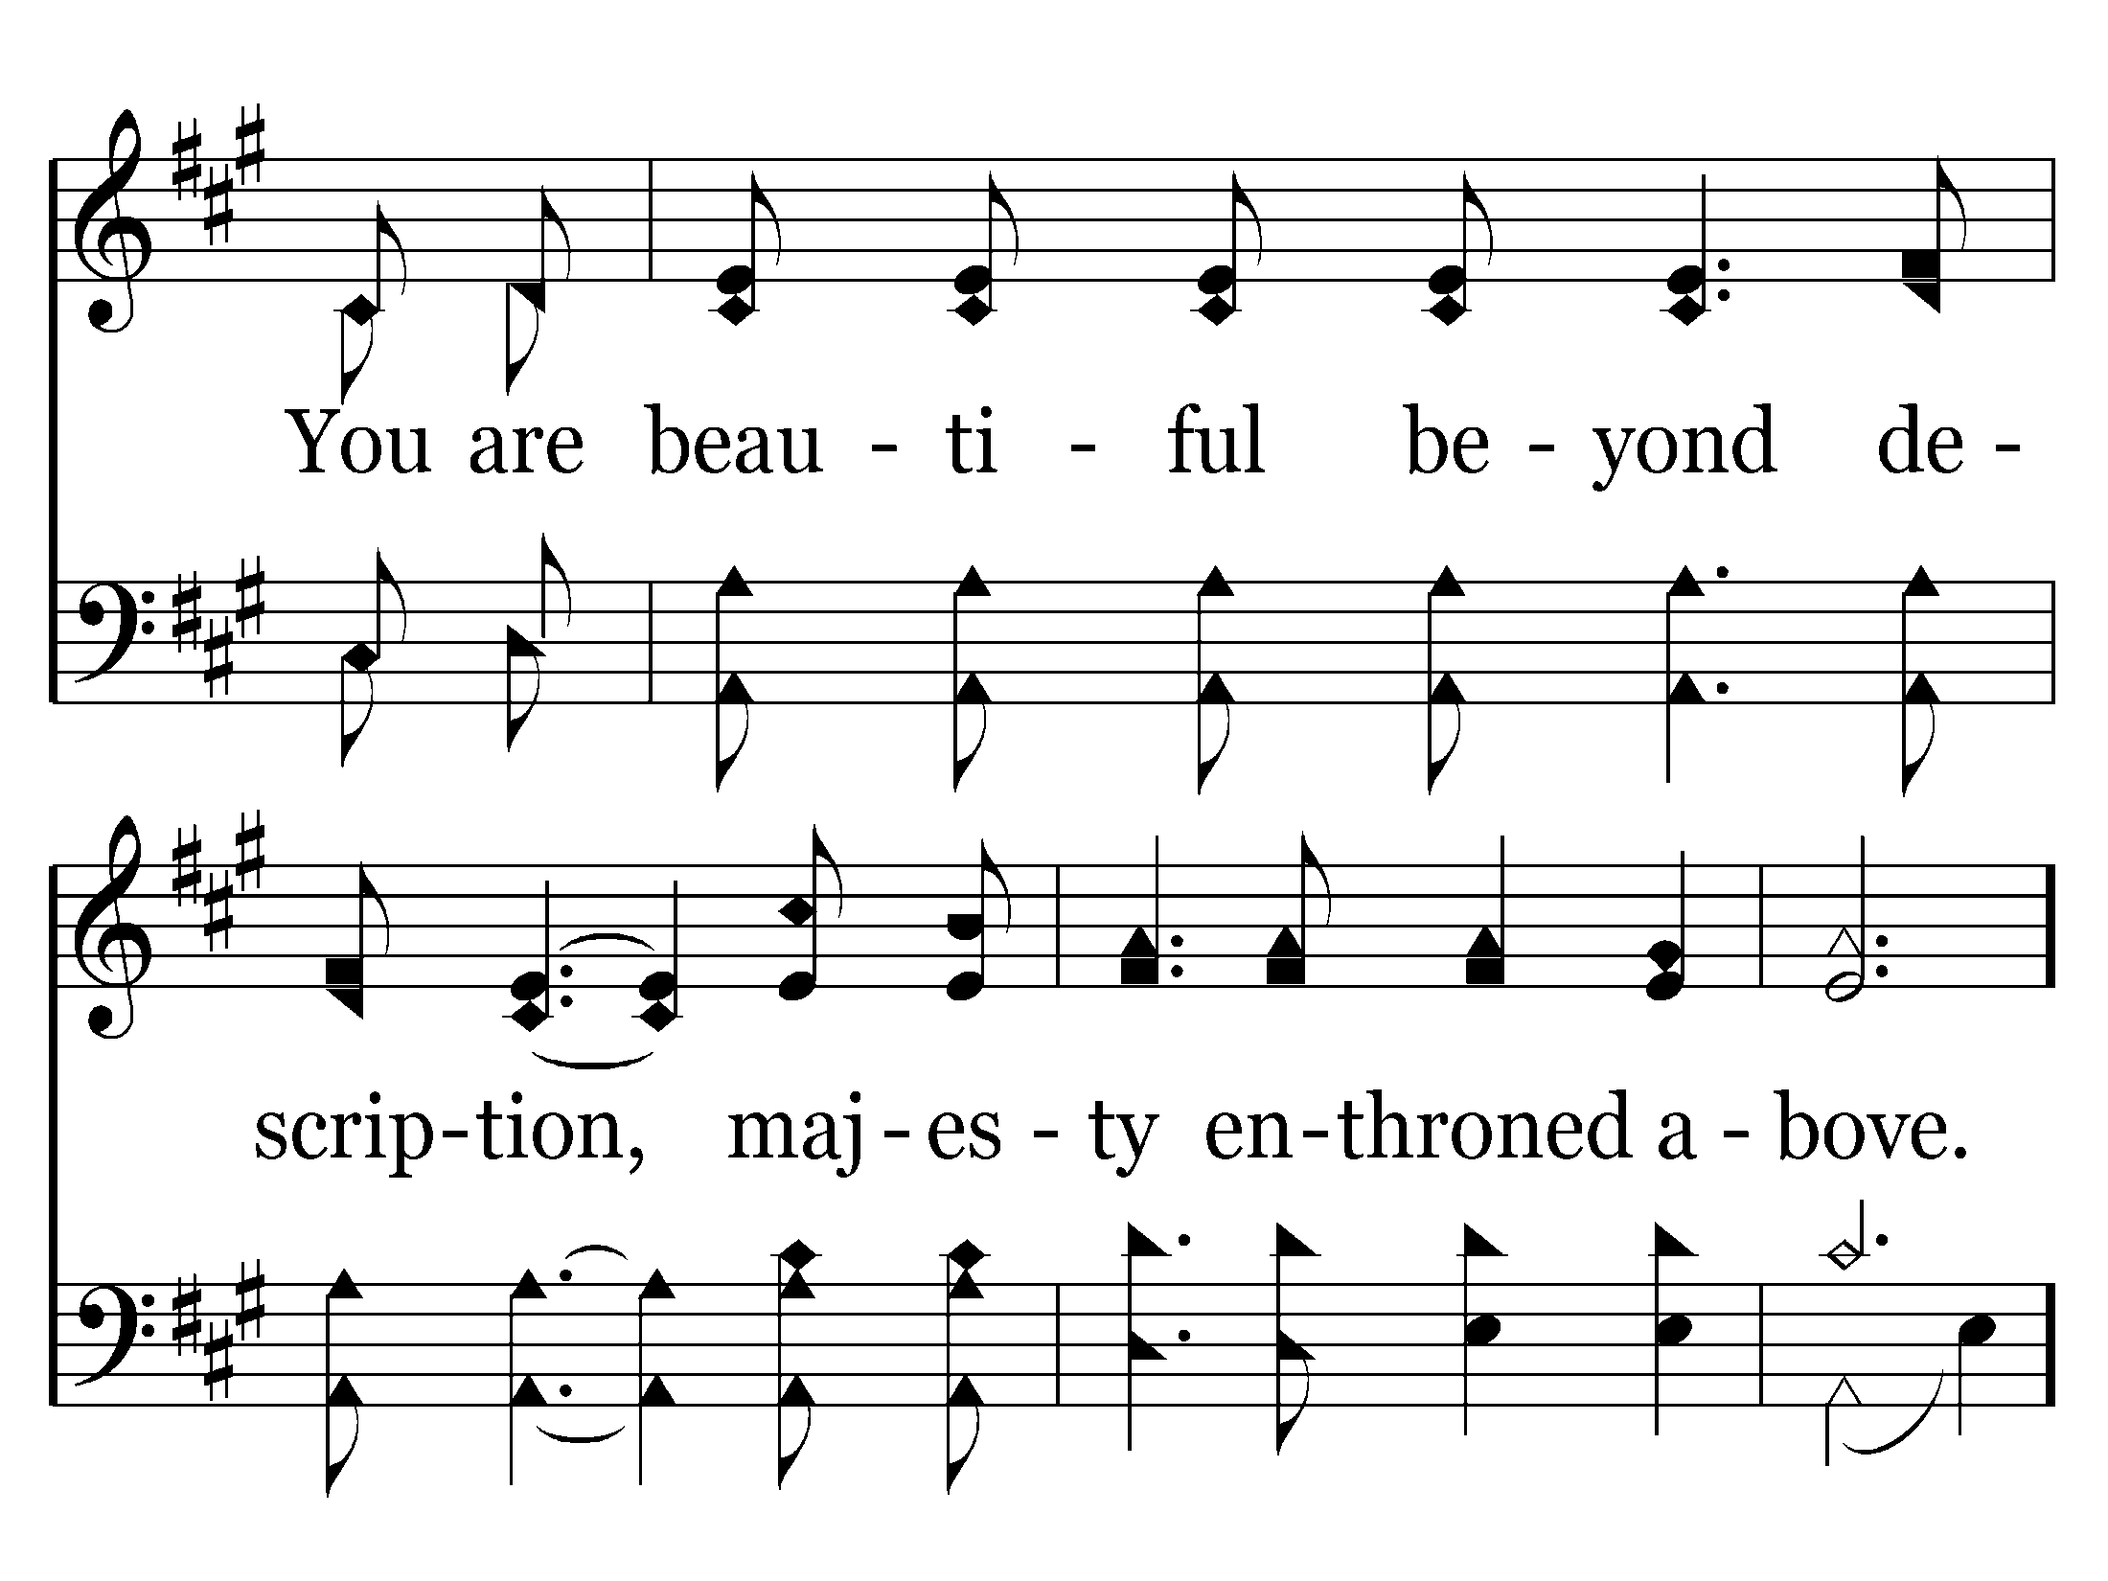
001 - I Stand In Awe - 1.4

Slide 6
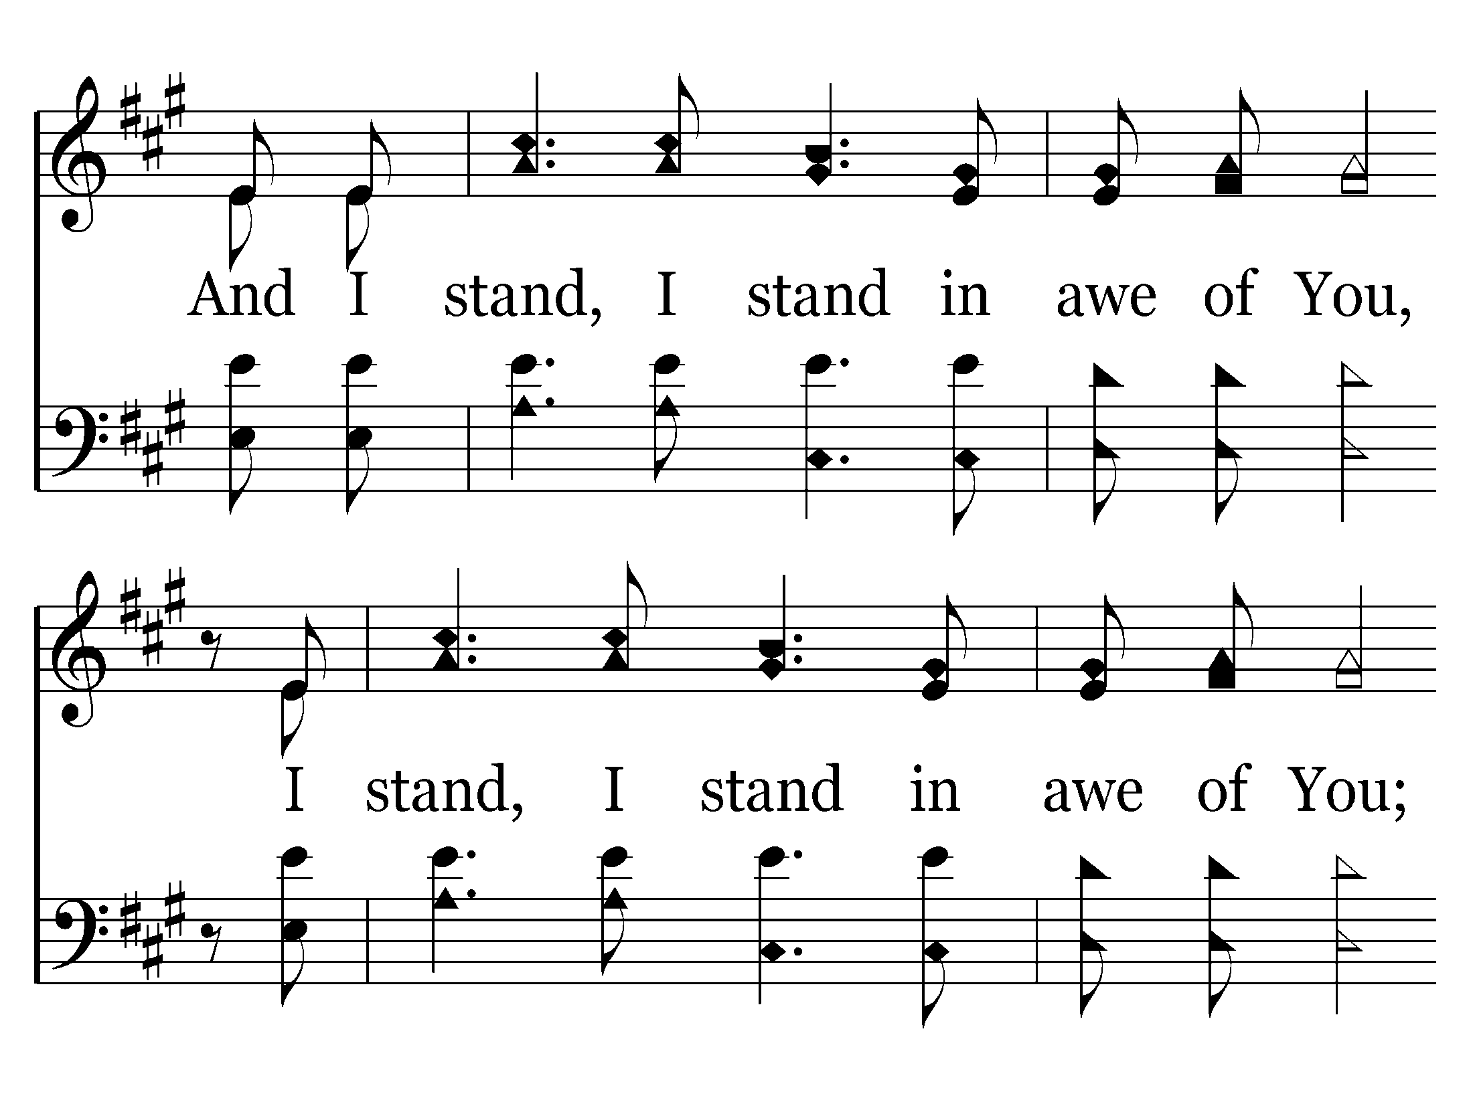
001 - I Stand In Awe - 1.5

Slide 7
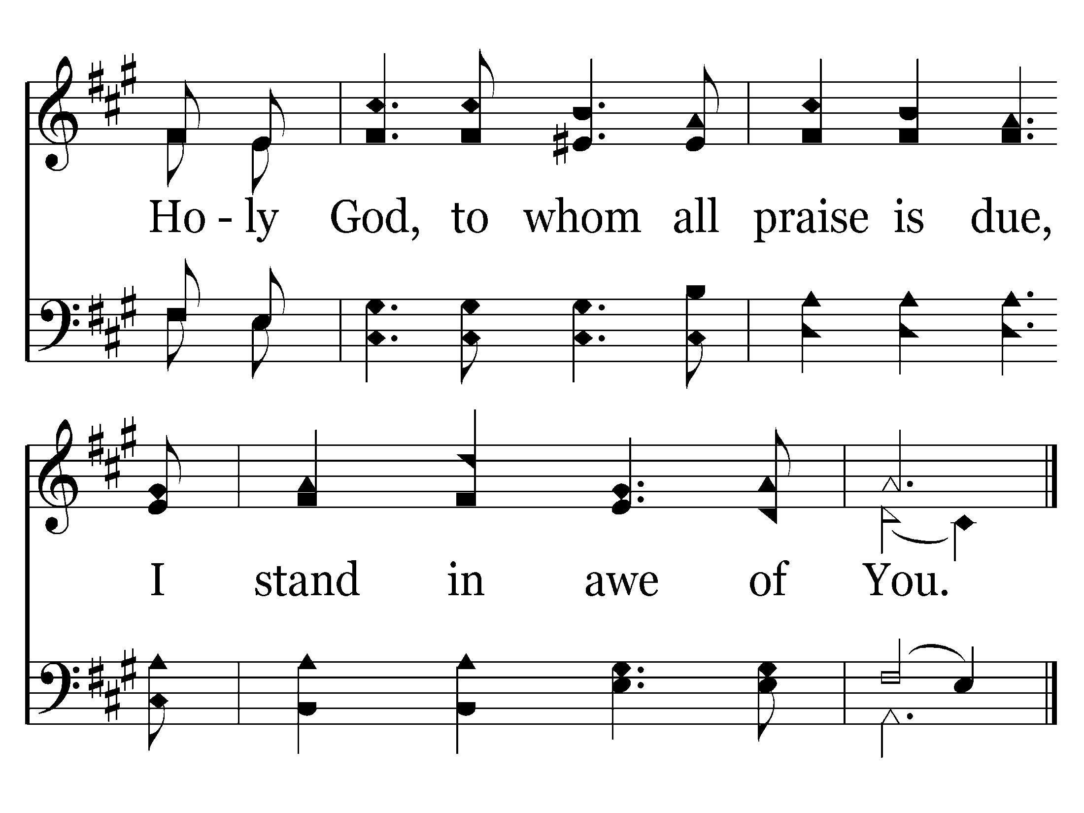
001 - I Stand In Awe - 1.6
End of Song

Slide 9
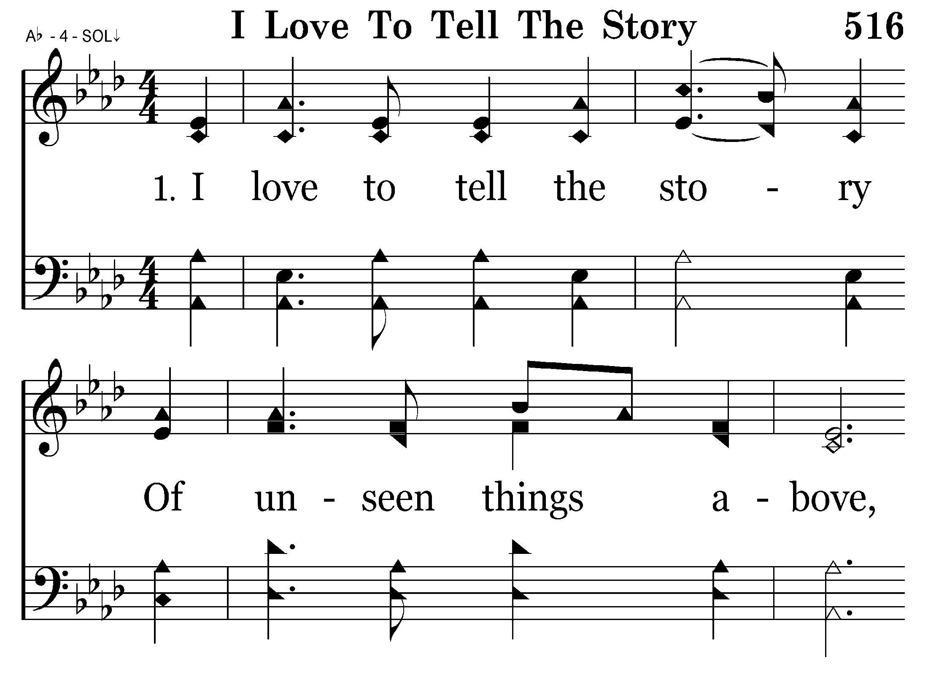
516 - I Love To Tell The Story - 1.1

Slide 10
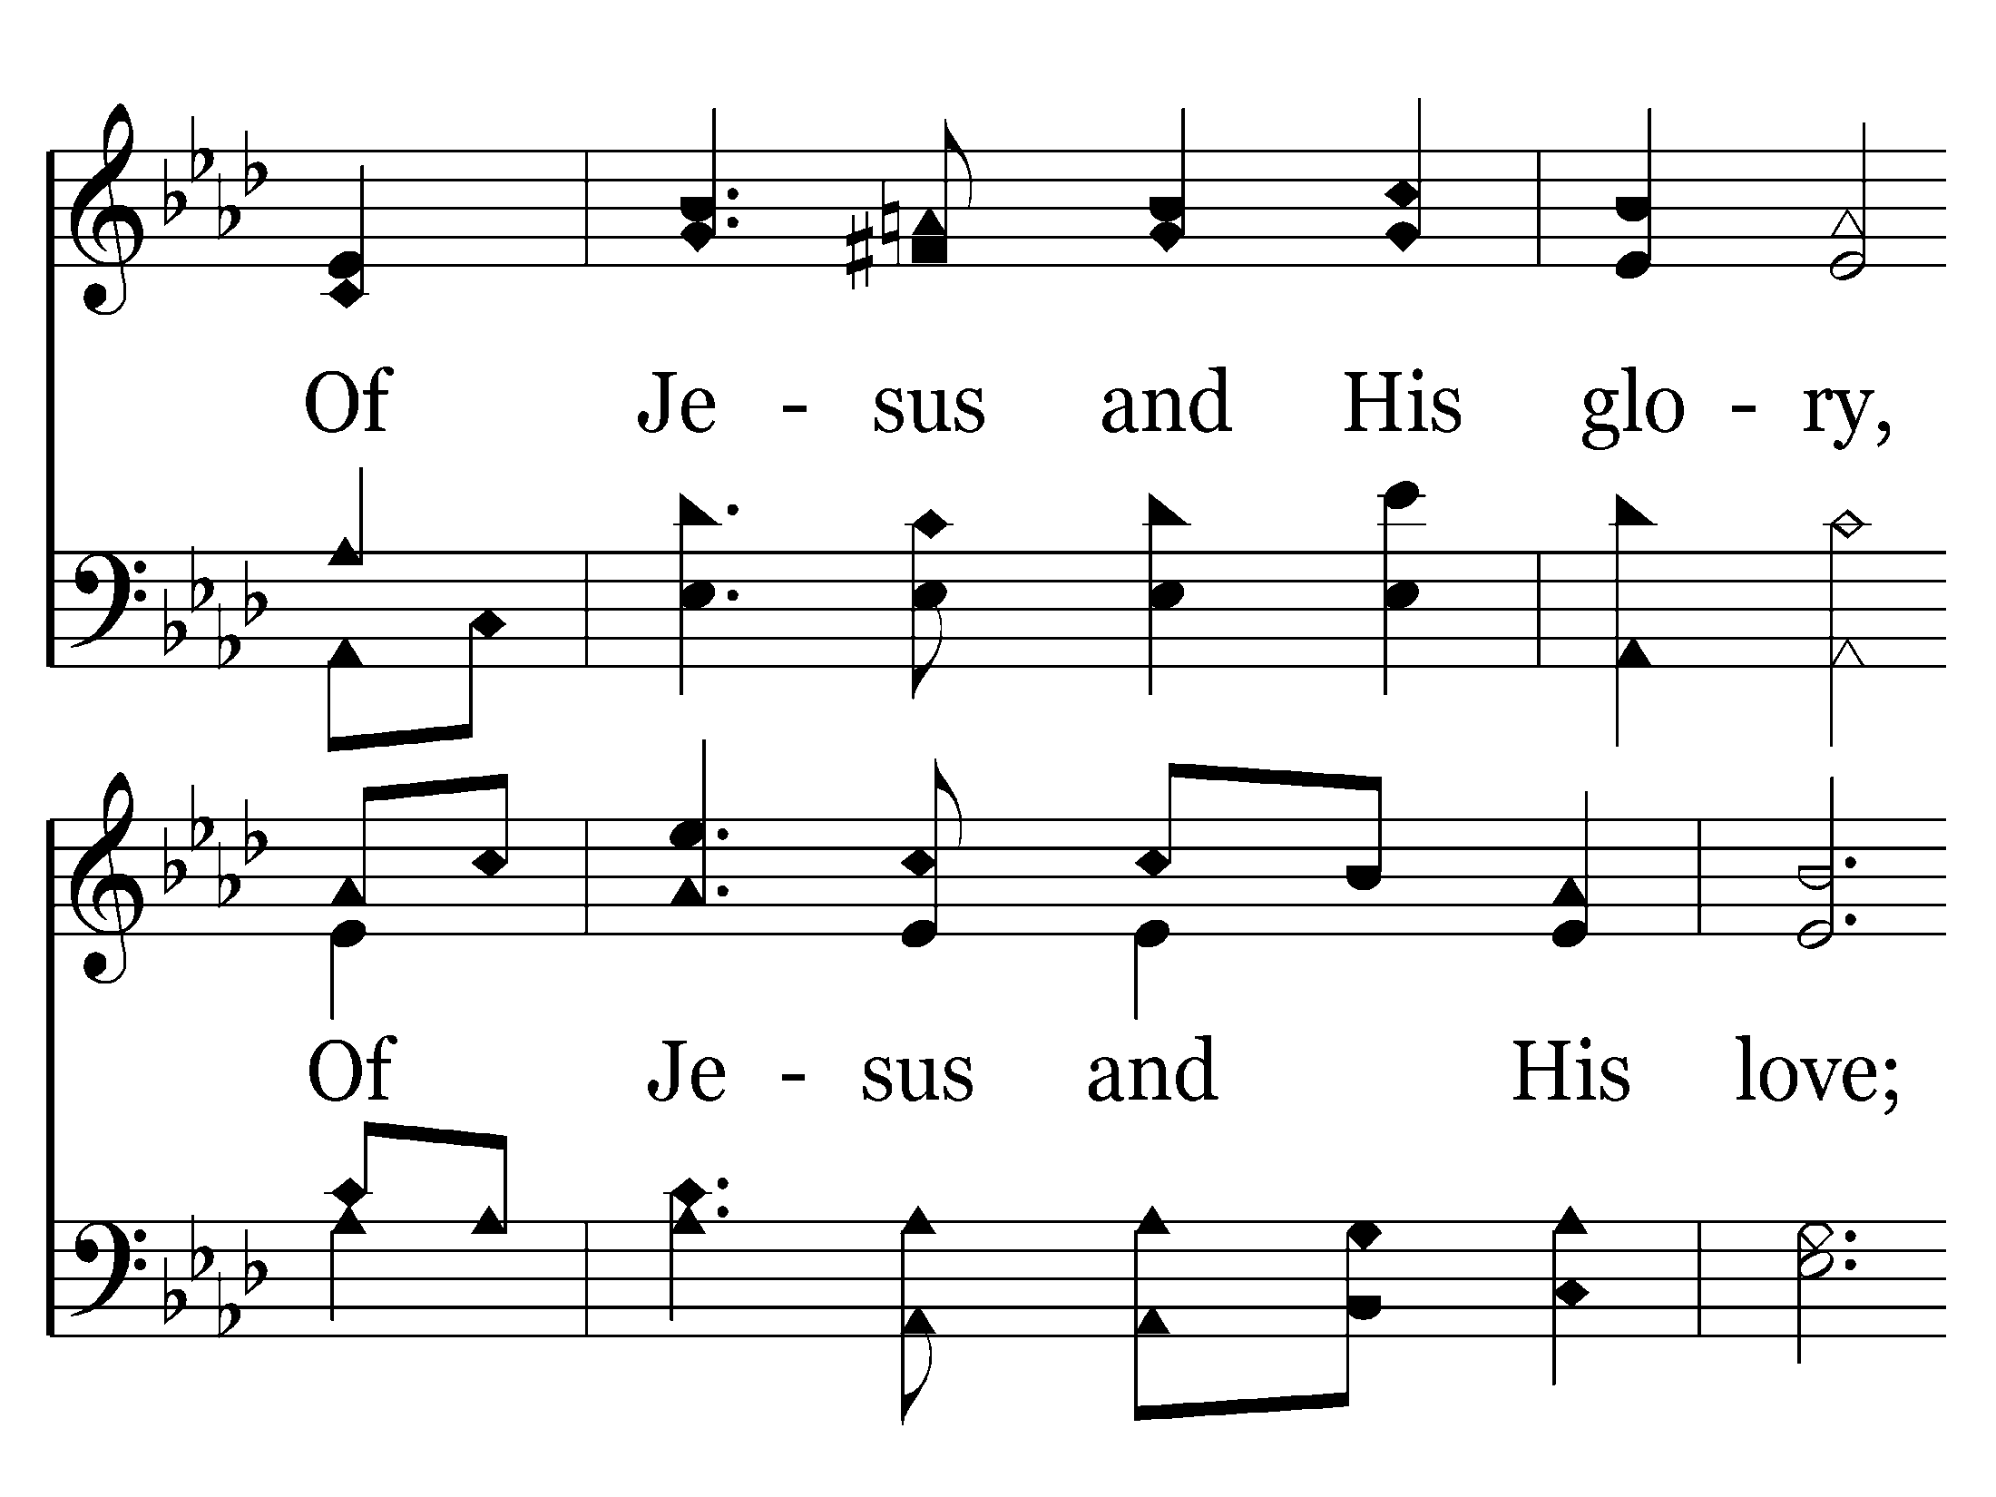
516 - I Love To Tell The Story - 1.2

Slide 11
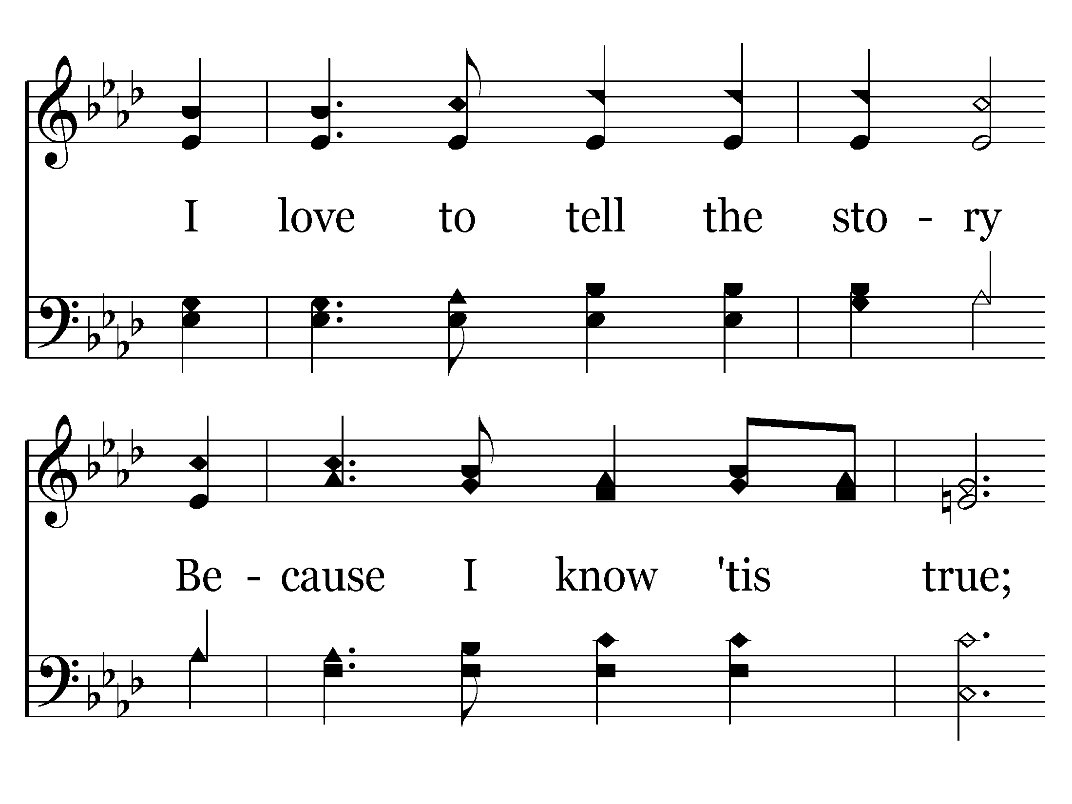
516 - I Love To Tell The Story - 1.3

Slide 12
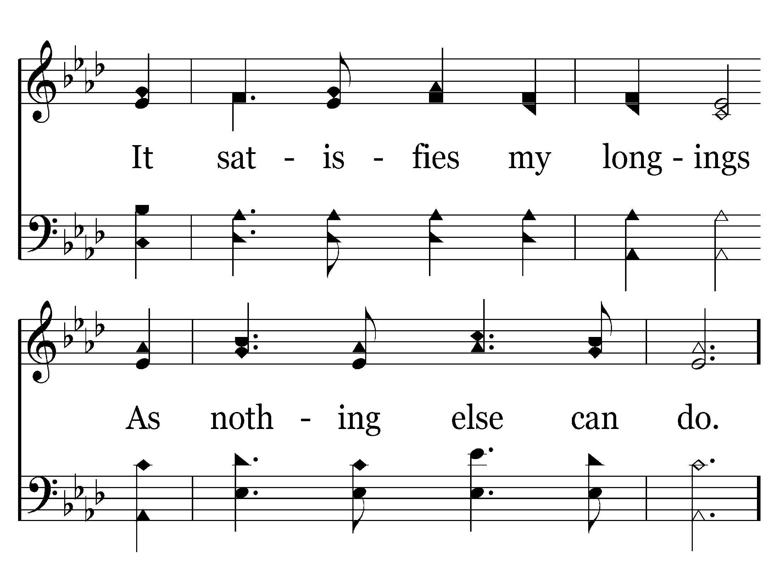
516 - I Love To Tell The Story - 1.4

Slide 13
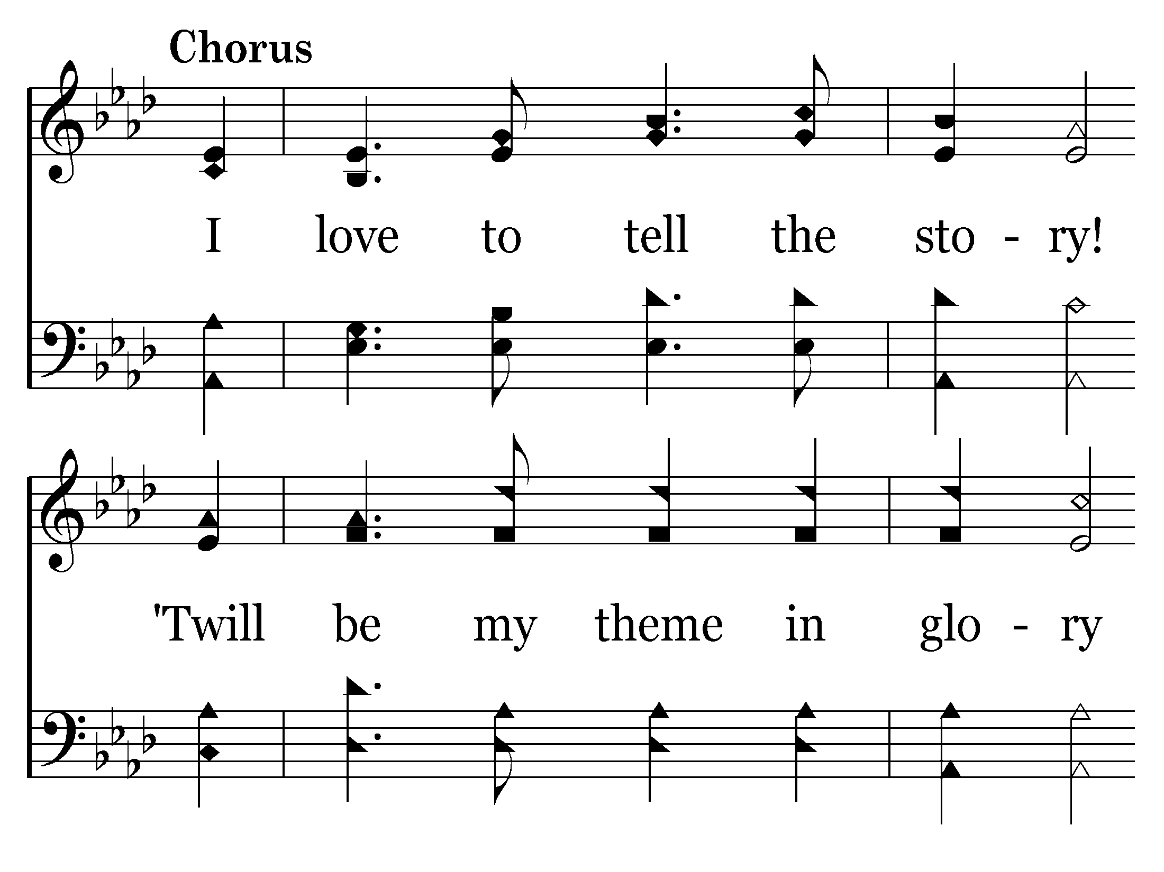
516 - I Love To Tell The Story - C.1

Slide 14
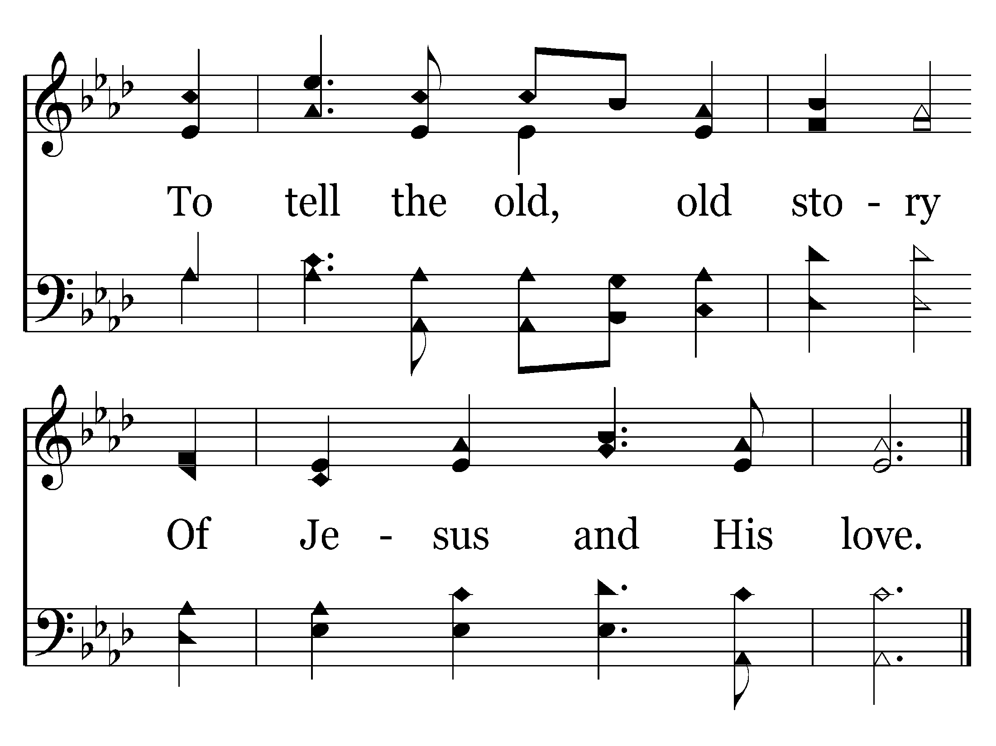
516 - I Love To Tell The Story - C.2
End of Verse 1

Slide 15
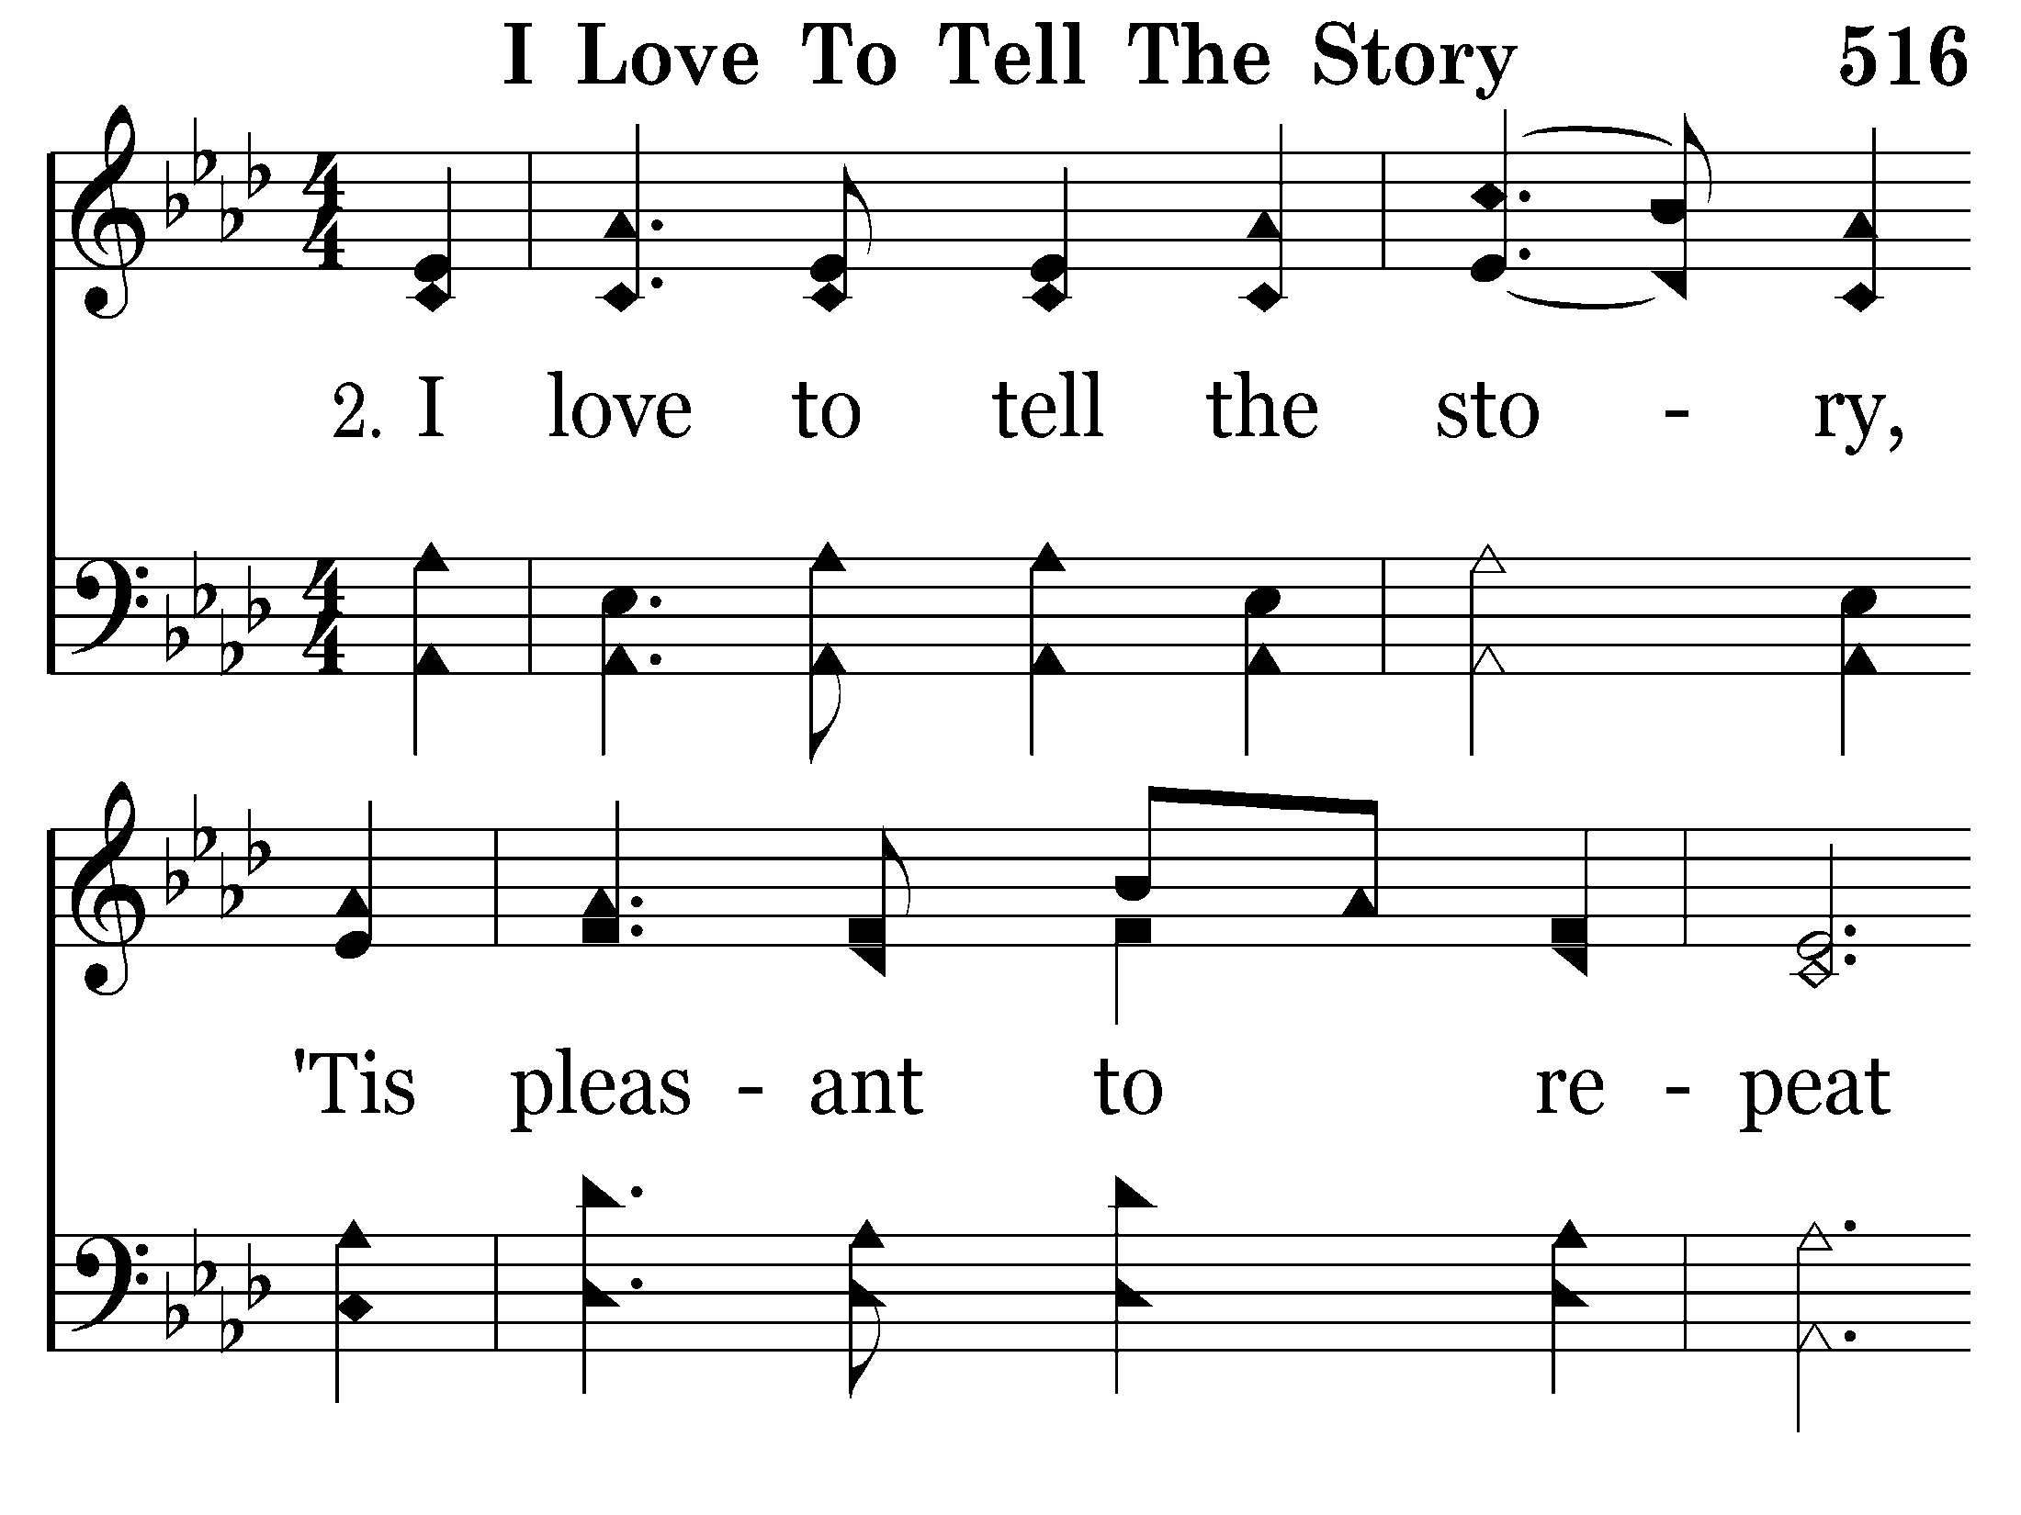
516 - I Love To Tell The Story - 2.1

Slide 16
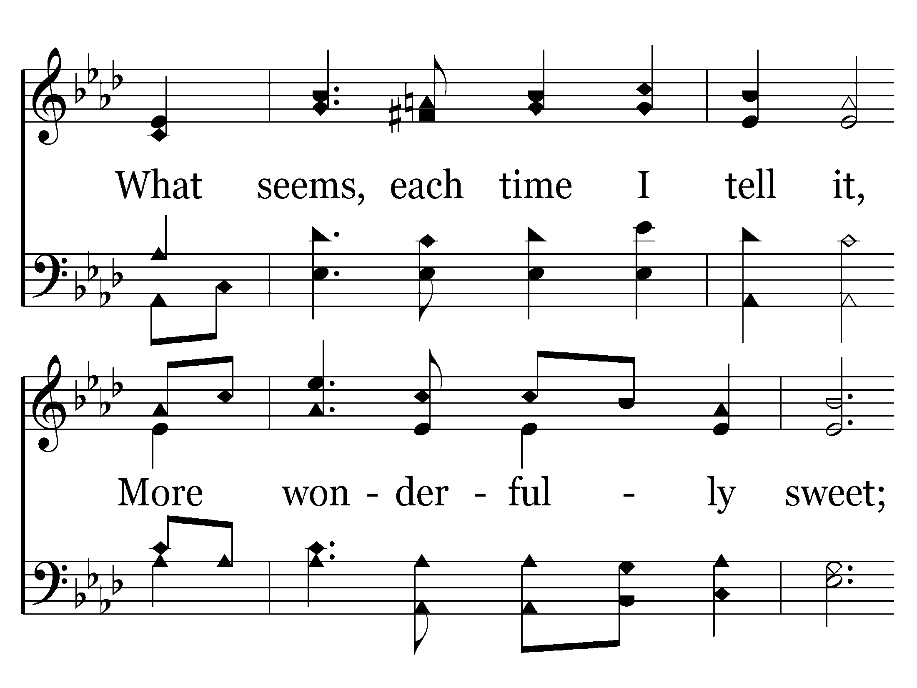
516 - I Love To Tell The Story - 2.2

Slide 17
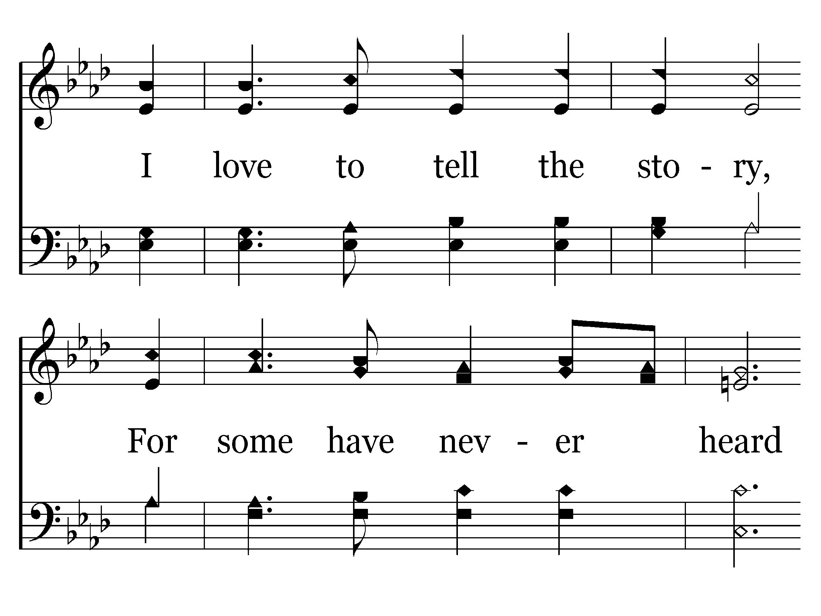
516 - I Love To Tell The Story - 2.3

Slide 18
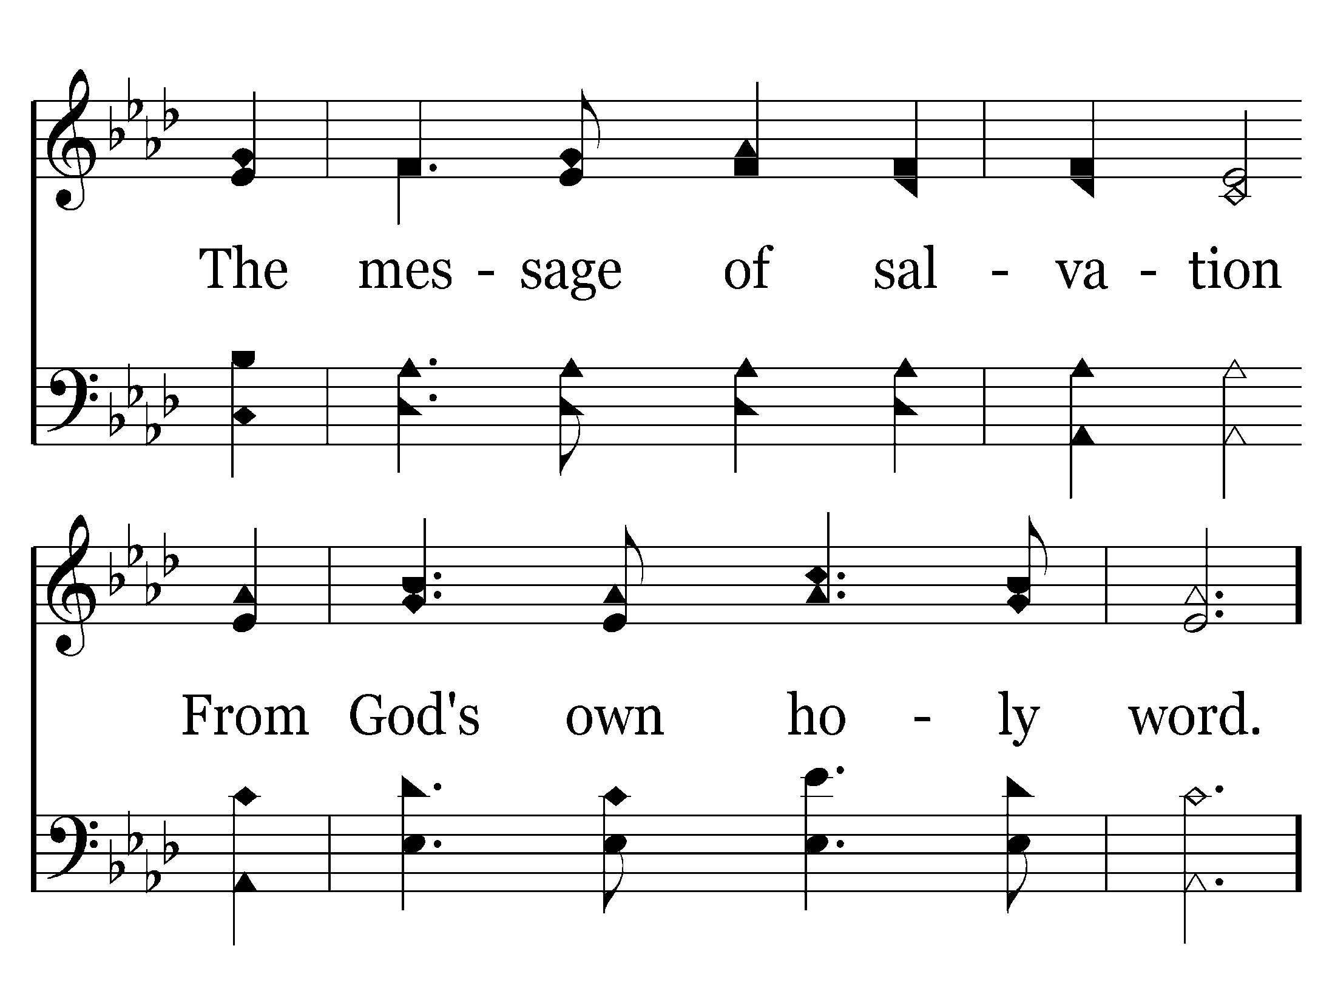
516 - I Love To Tell The Story - 2.4

Slide 19
516 - I Love To Tell The Story - C.1

Slide 20
516 - I Love To Tell The Story - C.2
End of Verse 2

Slide 21
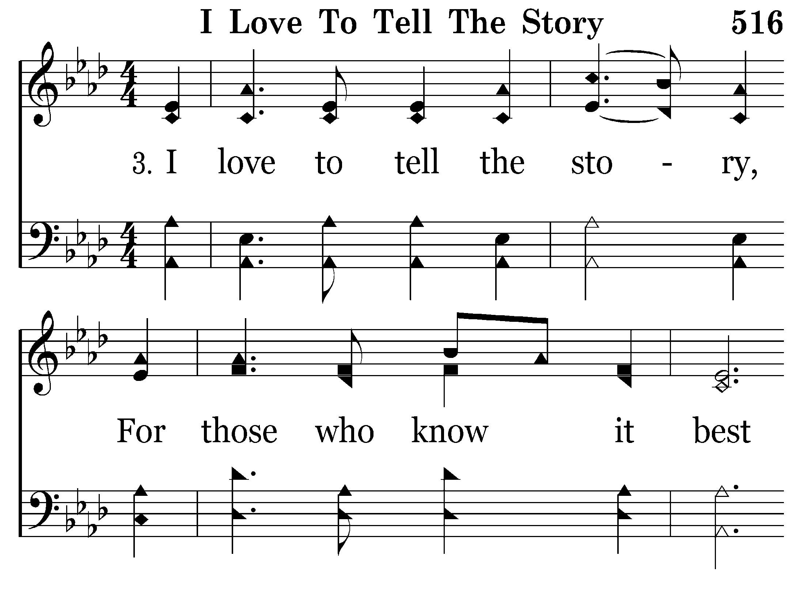
516 - I Love To Tell The Story - 3.1

Slide 22
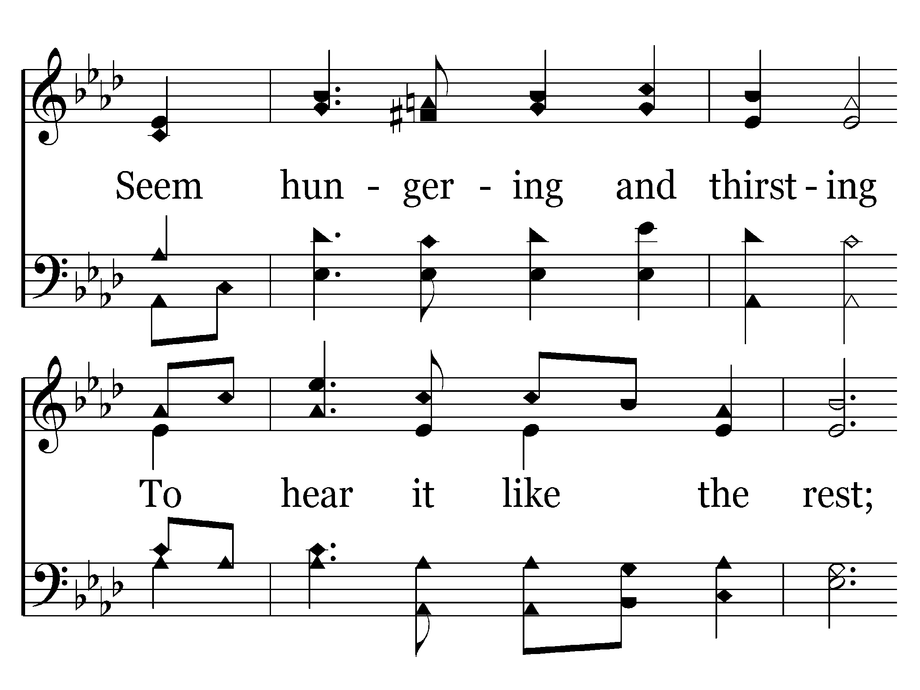
516 - I Love To Tell The Story - 3.2

Slide 23
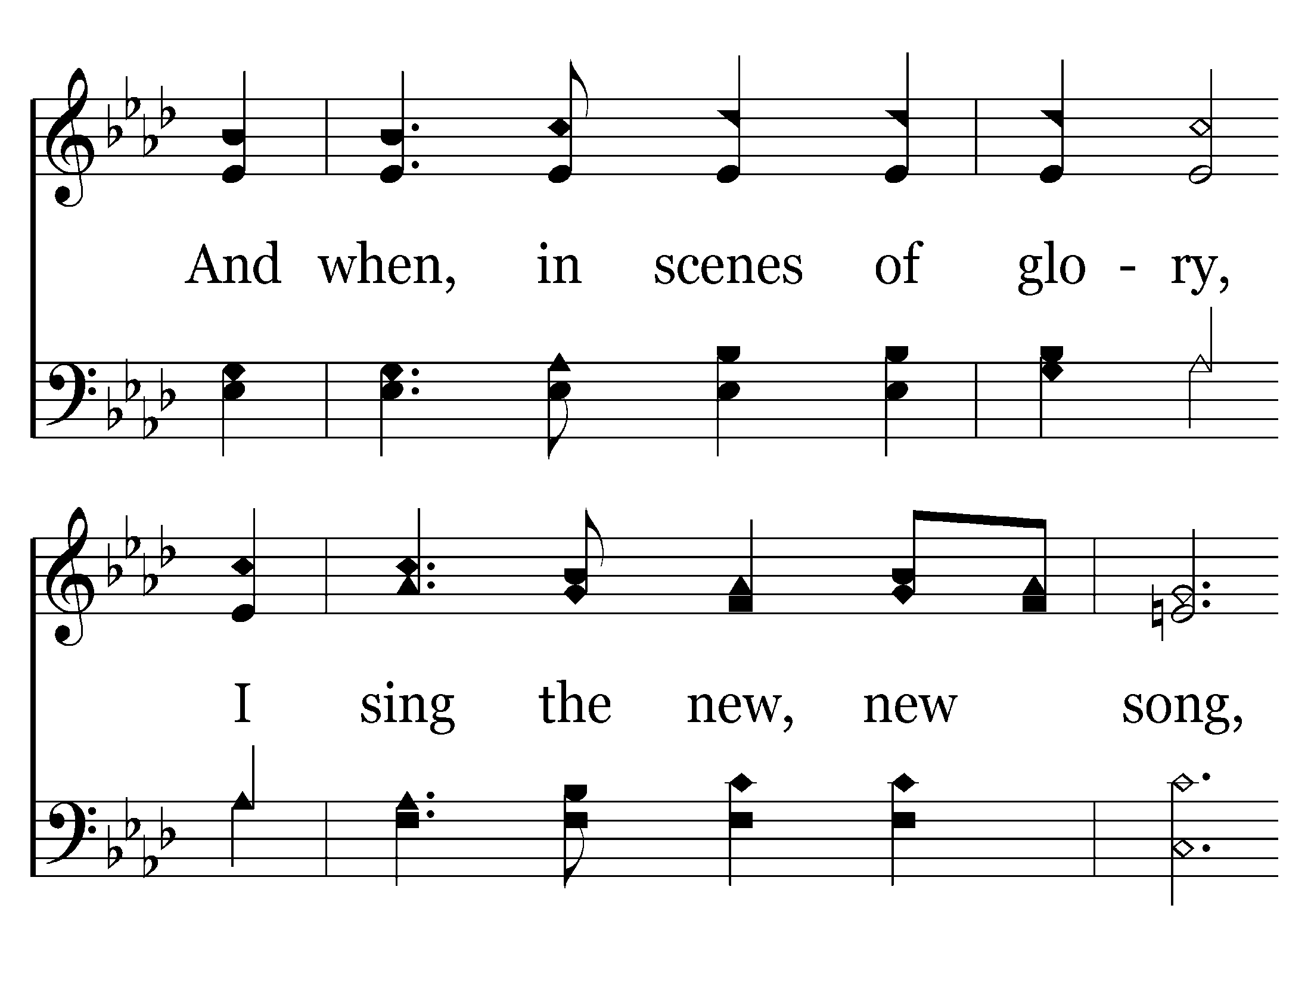
516 - I Love To Tell The Story - 3.3

Slide 24
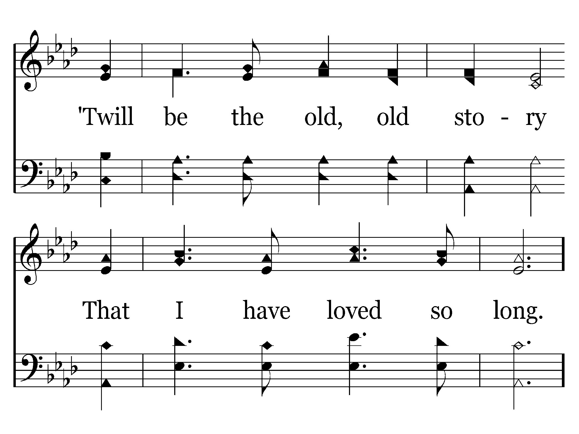
516 - I Love To Tell The Story - 3.4

Slide 25
516 - I Love To Tell The Story - C.1

Slide 26
516 - I Love To Tell The Story - C.2
End of Song

Slide 27
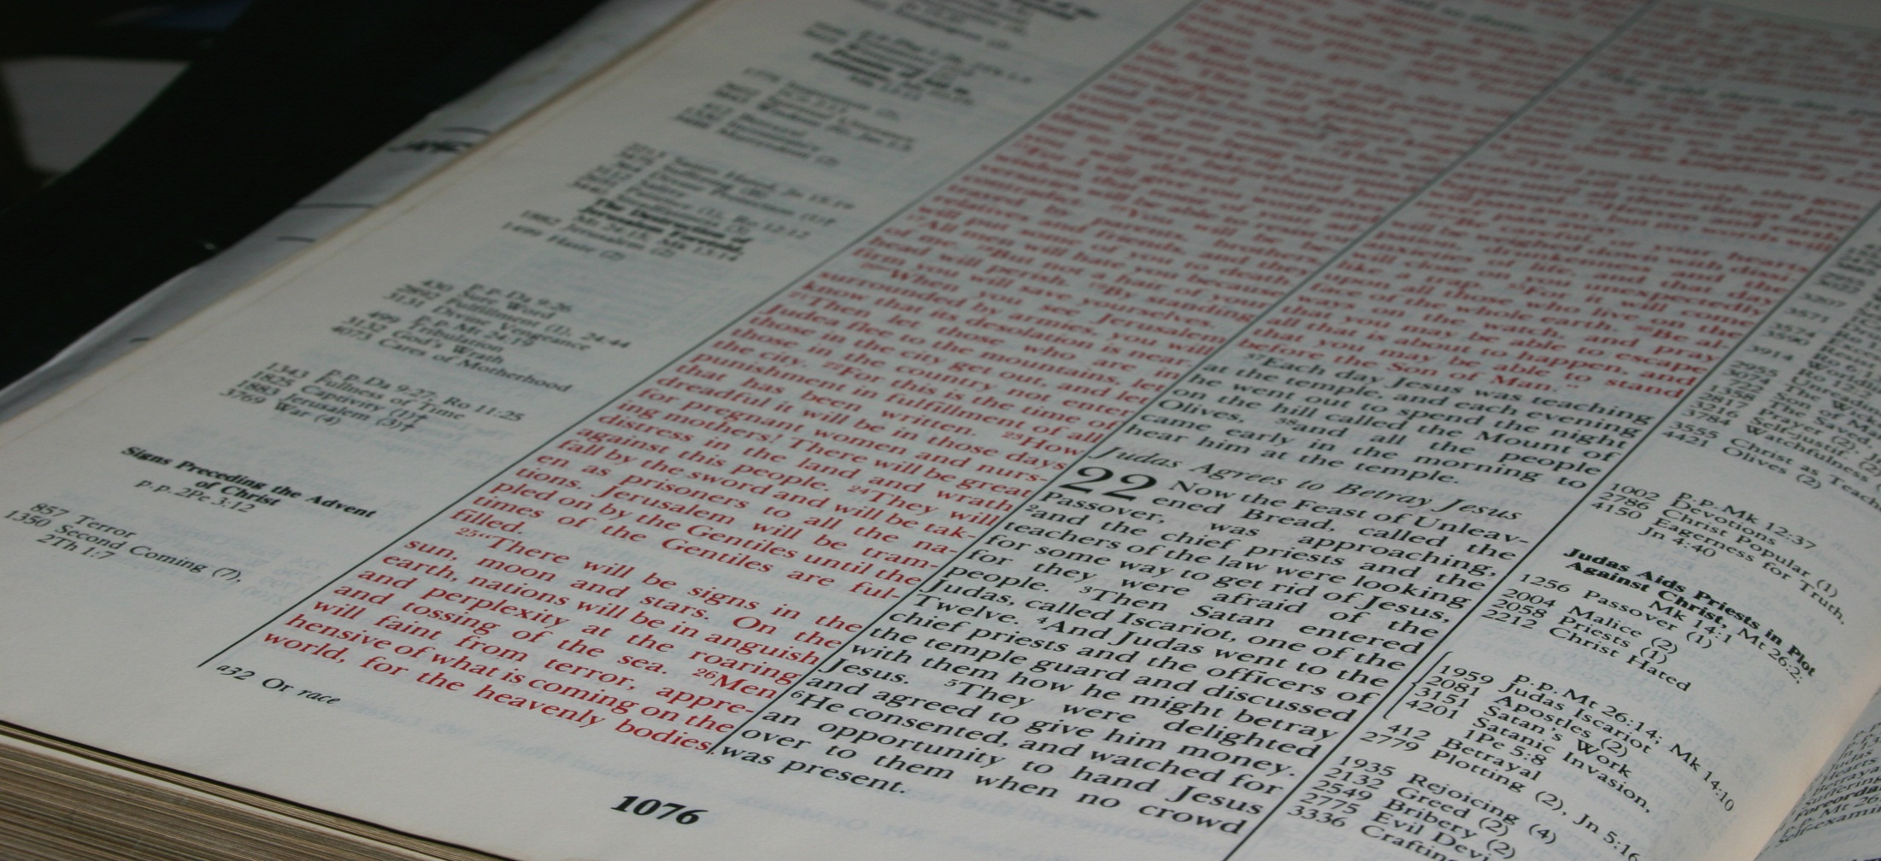
But I do not want you to be ignorant, brethren, concerning those who have fallen asleep, lest you sorrow as others who have no hope.
1 Thessalonians 4:13
Real Life For Everyone!
Northwest Church of Christ April 20-25, 2014

Slide 28

Why Do You Need To Be A Christian?
“right thing to do”
“true way in life”
“better person”
“help my family”
“success in life”
“influence for good”
“strength in trials”
"…whoever hears these sayings of Mine, and does them, I will liken him to a wise man…"
Matthew 7:24
I rejoiced greatly that I have found some of your children walking in truth, as we received commandment from the Father.
2 John 4
Therefore, as we have opportunity, let us do good to all men, especially to those who are of the household of faith.
Galatians 6:10
Children, obey your parents in the Lord, for this is right.
And you, fathers, do not provoke your children to wrath, but bring them up in the training and admonition of the Lord.
Ephesians 6:1, 4
Recompense to no man evil for evil. Provide things honest in the sight of all men.
Romans 12:17
THE GOSPEL OF JESUS CHRIST PROVIDES THE ONLY HOPE FOR ANY OF US WHEN WE DIE!
Let your light so shine before men, that they may see your good works, and glorify your Father which is in heaven.
Matthew 5:16
Blessed be God, even the Father of our Lord Jesus Christ, the Father of mercies, and the God of all comfort.
2 Corinthians 1:3
>>> <<<
Because You Are Going To Die!

Slide 29
Why Do You Need To Be A Christian?
"O Death, where is your sting? O Hades, where is your victory?"
The sting of death is sin, and the strength of sin is the law. But thanks be to God, who gives us the victory through our Lord Jesus Christ.
1 Corinthians 15:55-57
ARE WE LIKE THE WORLD AROUND US?
No one has power over the spirit to retain the spirit, And no one has power in the day of death. There is no release from that war, And wickedness will not deliver those who are given to it.
Ecclesiastes 8:8
But I do not want you to be ignorant, brethren, concerning those who have fallen asleep, lest you sorrow as others who have no hope.
1 Thessalonians 4:13
… through death He might destroy him who had the power of death, that is, the devil, and release those who through fear of death were all their lifetime subject to bondage.
Hebrews 2:14-15
But I do not want you to be ignorant, brethren, concerning those who have fallen asleep, lest you sorrow as others who have no hope.
1 Thessalonians 4:13
"Blessed are the dead who die in the Lord from now on." "Yes," says the Spirit, "that they may rest from their labors, and their works follow them."
Revelation 14:13
ARE YOU READY TO DIE?
Christ will be magnified in my body, whether by life or by death. For to me, to live is Christ, and to die is gain.
Philippians 1:20-21
"I am He who lives, and was dead, and behold, I am alive forevermore. Amen. And I have the keys of Hades and of Death."
Revelation 1:18
For I know that You will bring me to death, And to the house appointed for all living.
Job 30:23
… it is appointed for men to die once, but after this the judgment.
Hebrews 9:27
What man can live and not see death? Can he deliver his life from the power of the grave?
Psalm 89:48
We are confident, yes, well pleased rather to be absent from the body and to be present with the Lord.
2 Corinthians 5:8
Deny reality of death
Consider death a loss
Morbidly fear death
>>> <<<
Because You Are Going To Die!

Slide 30
Why Do You Need To Be A Christian?
“right thing to do”
“true way in life”
“better person”
“help my family”
“success in life”
“influence for good”
“strength in trials”
ARE YOU READY TO DIE?
>>> <<<
Because You Are Going To Die!

Slide 31
Why Do You Need To Be A Christian?
"…for the Son of Man has come to seek and to save that which was lost."
Luke 19:10
"Blessed are the dead who die in the Lord…that they may rest from their labors..."
Revelation 14:13
Jesus said to her, "I am the resurrection and the life. He who believes in Me, though he may die, he shall live.
"And whoever lives and believes in Me shall never die. Do you believe this?"
John 11:25-26
ARE YOU READY TO DIE?
>>> <<<
Because You Are Going To Die!

Slide 32
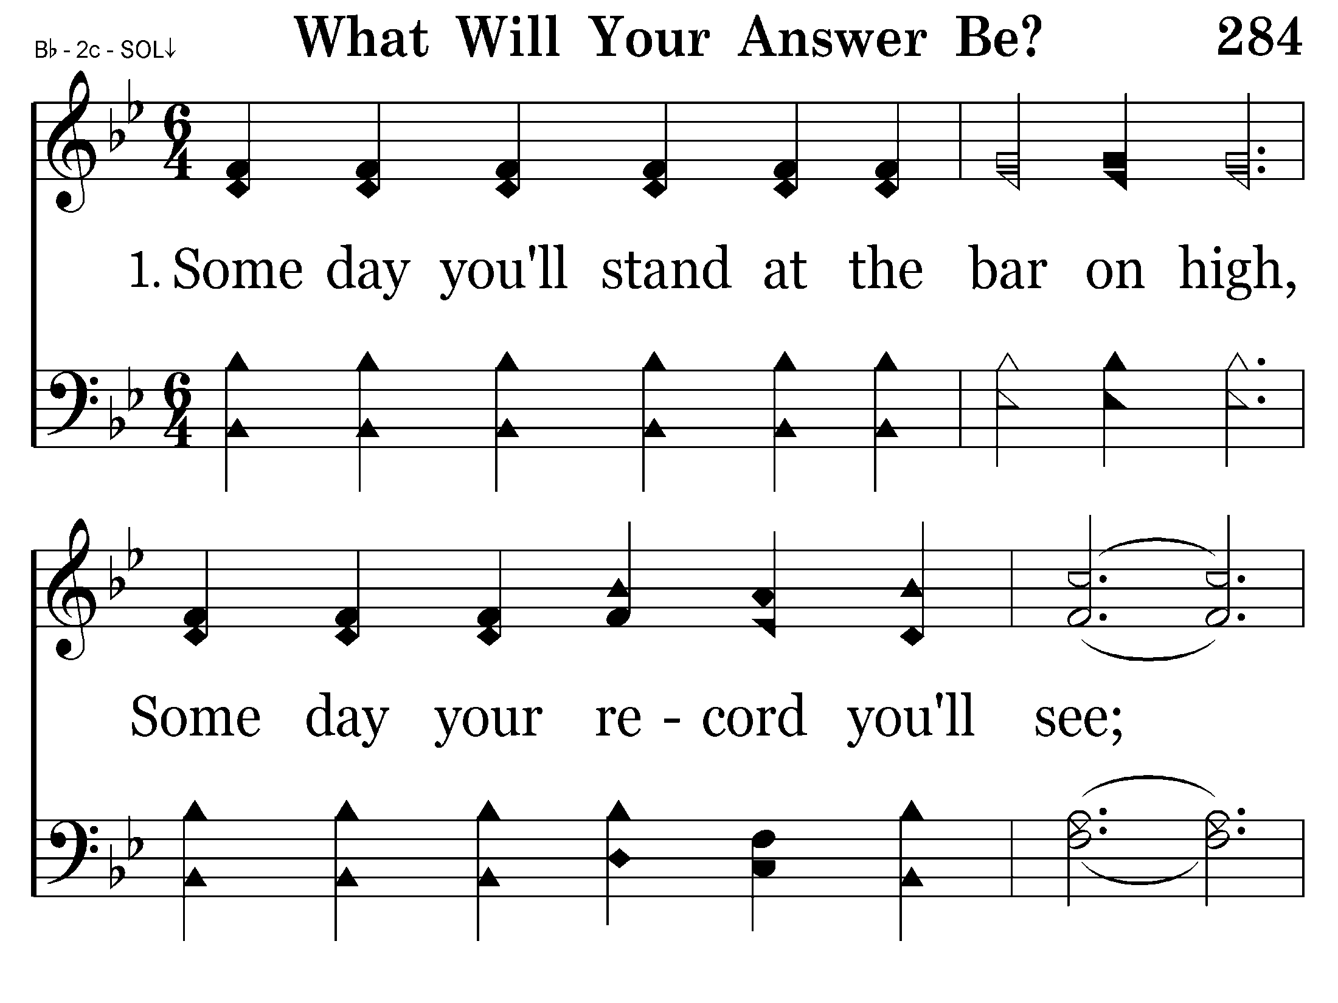
284 - What Will Your Answer Be - 1.1

Slide 33
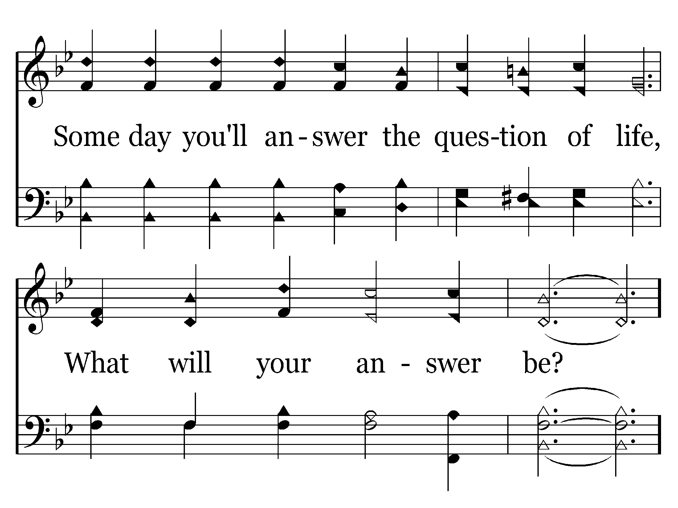
284 - What Will Your Answer Be - 1.2

Slide 34
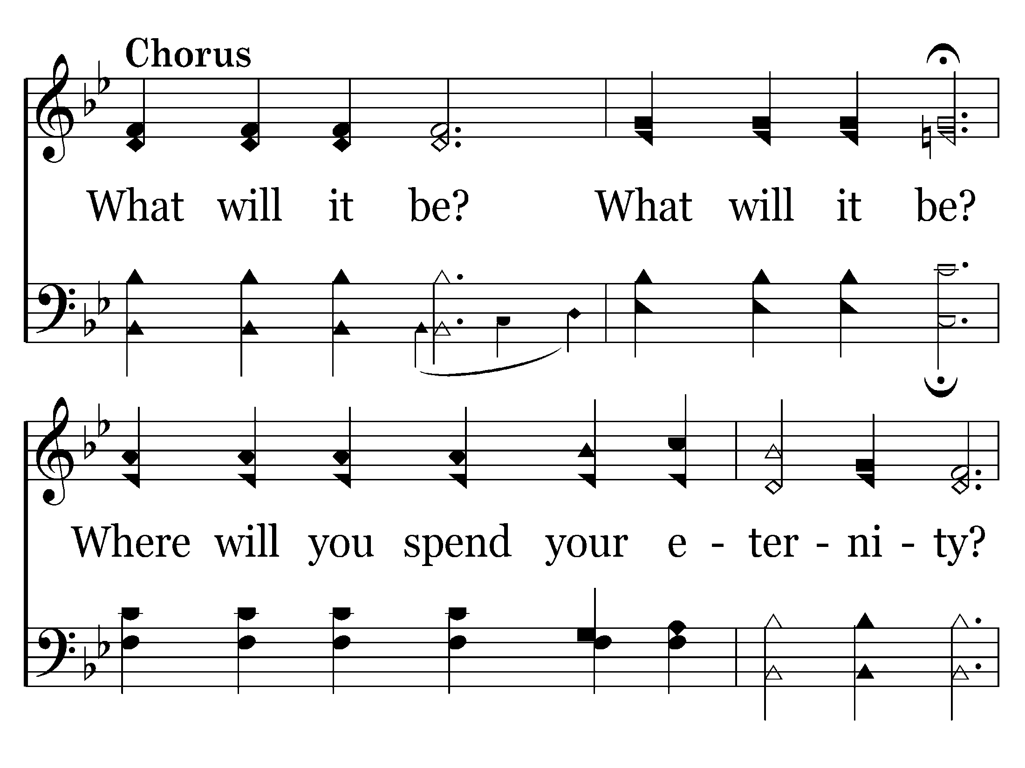
284 - What Will Your Answer Be - C.1

Slide 35
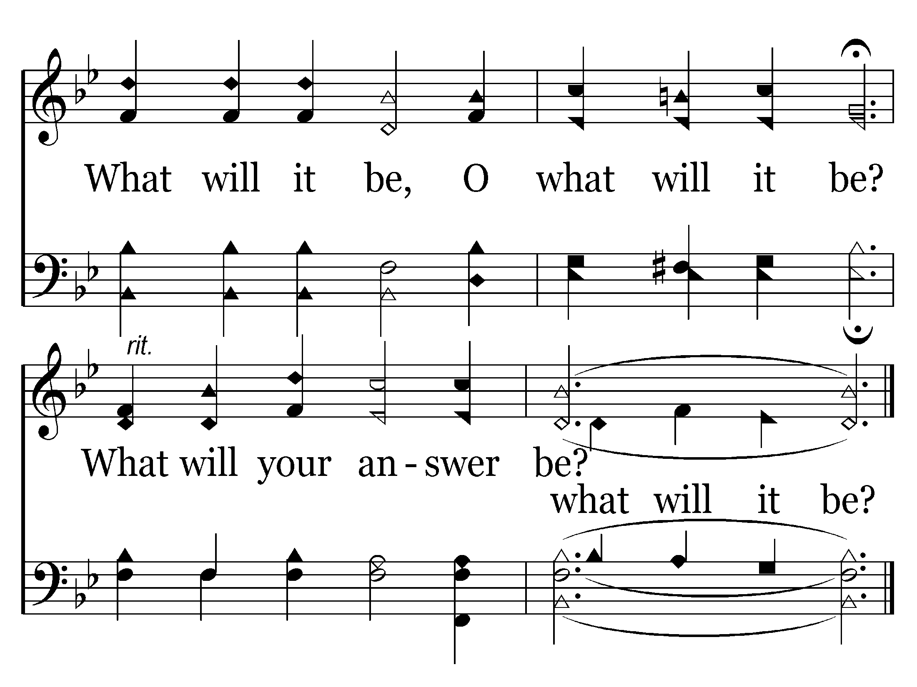
284 - What Will Your Answer Be - C.2
End of Verse 1

Slide 36
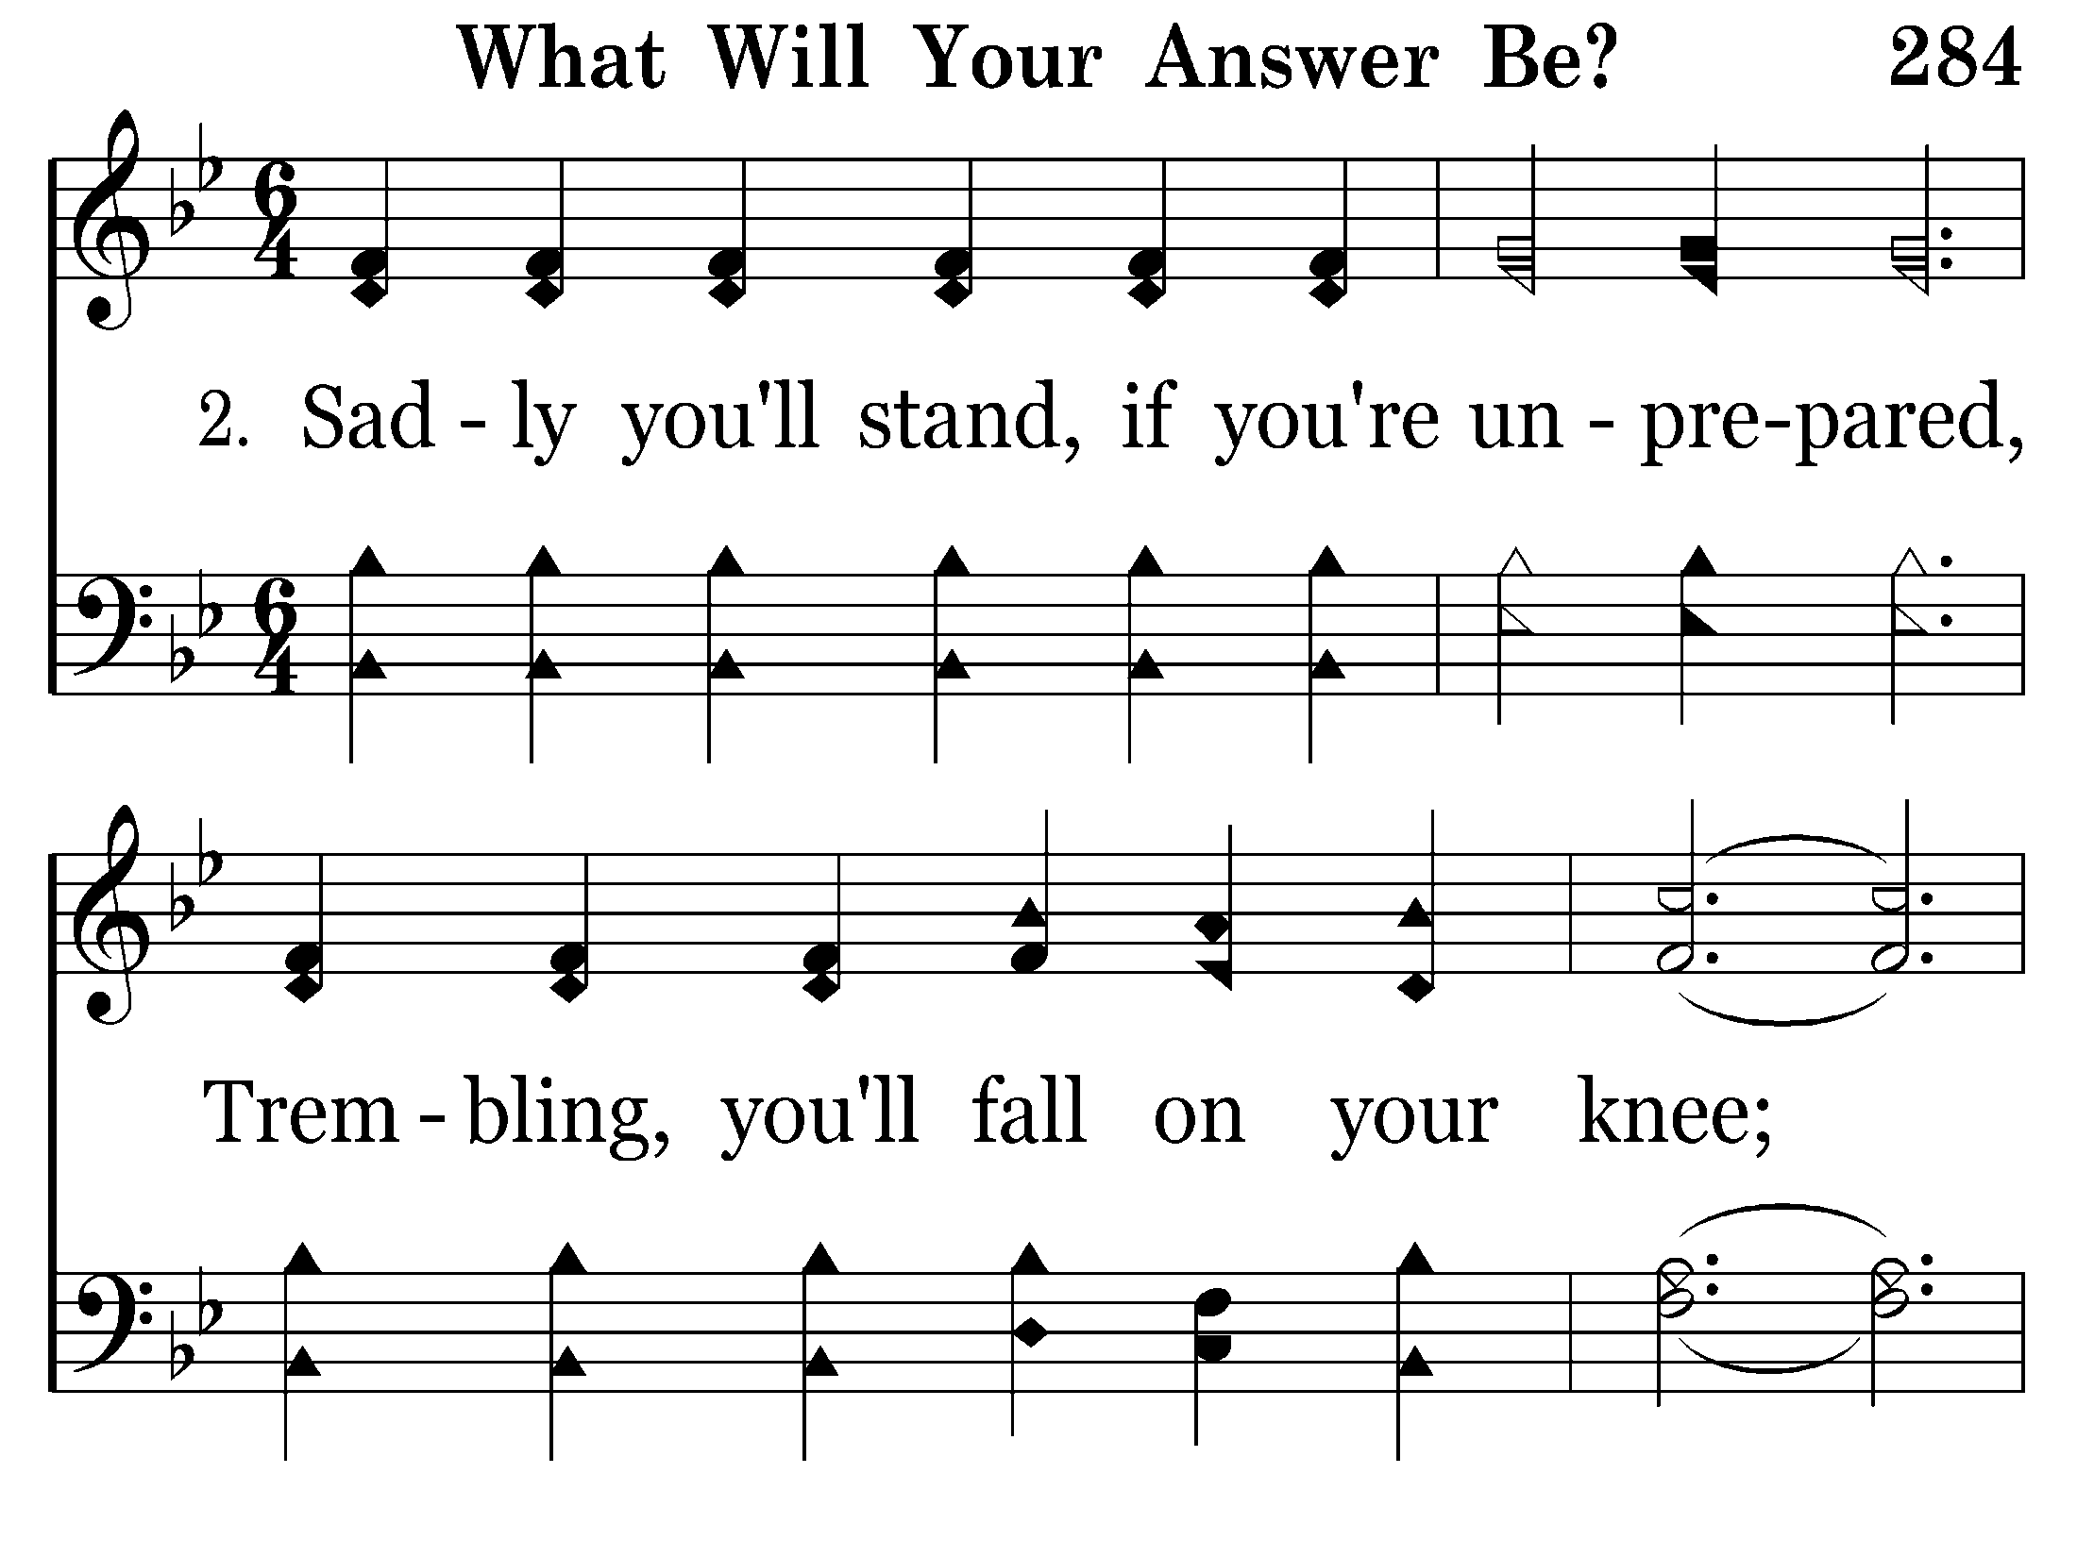
284 - What Will Your Answer Be - 2.1

Slide 37
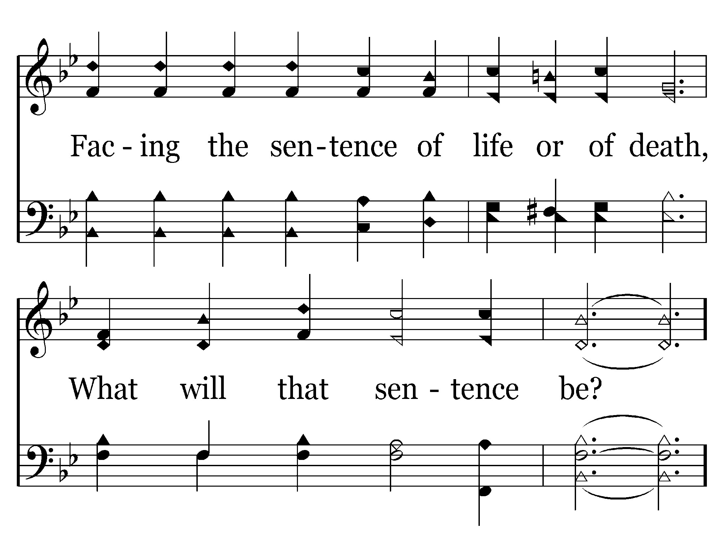
284 - What Will Your Answer Be - 2.2

Slide 38
284 - What Will Your Answer Be - C.1

Slide 39
284 - What Will Your Answer Be - C.2
End of Verse 2

Slide 40
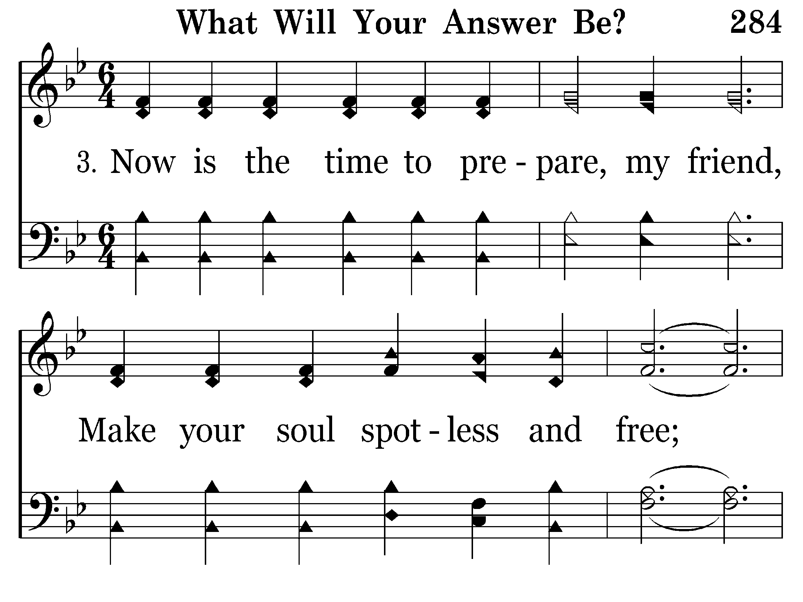
284 - What Will Your Answer Be - 3.1

Slide 41
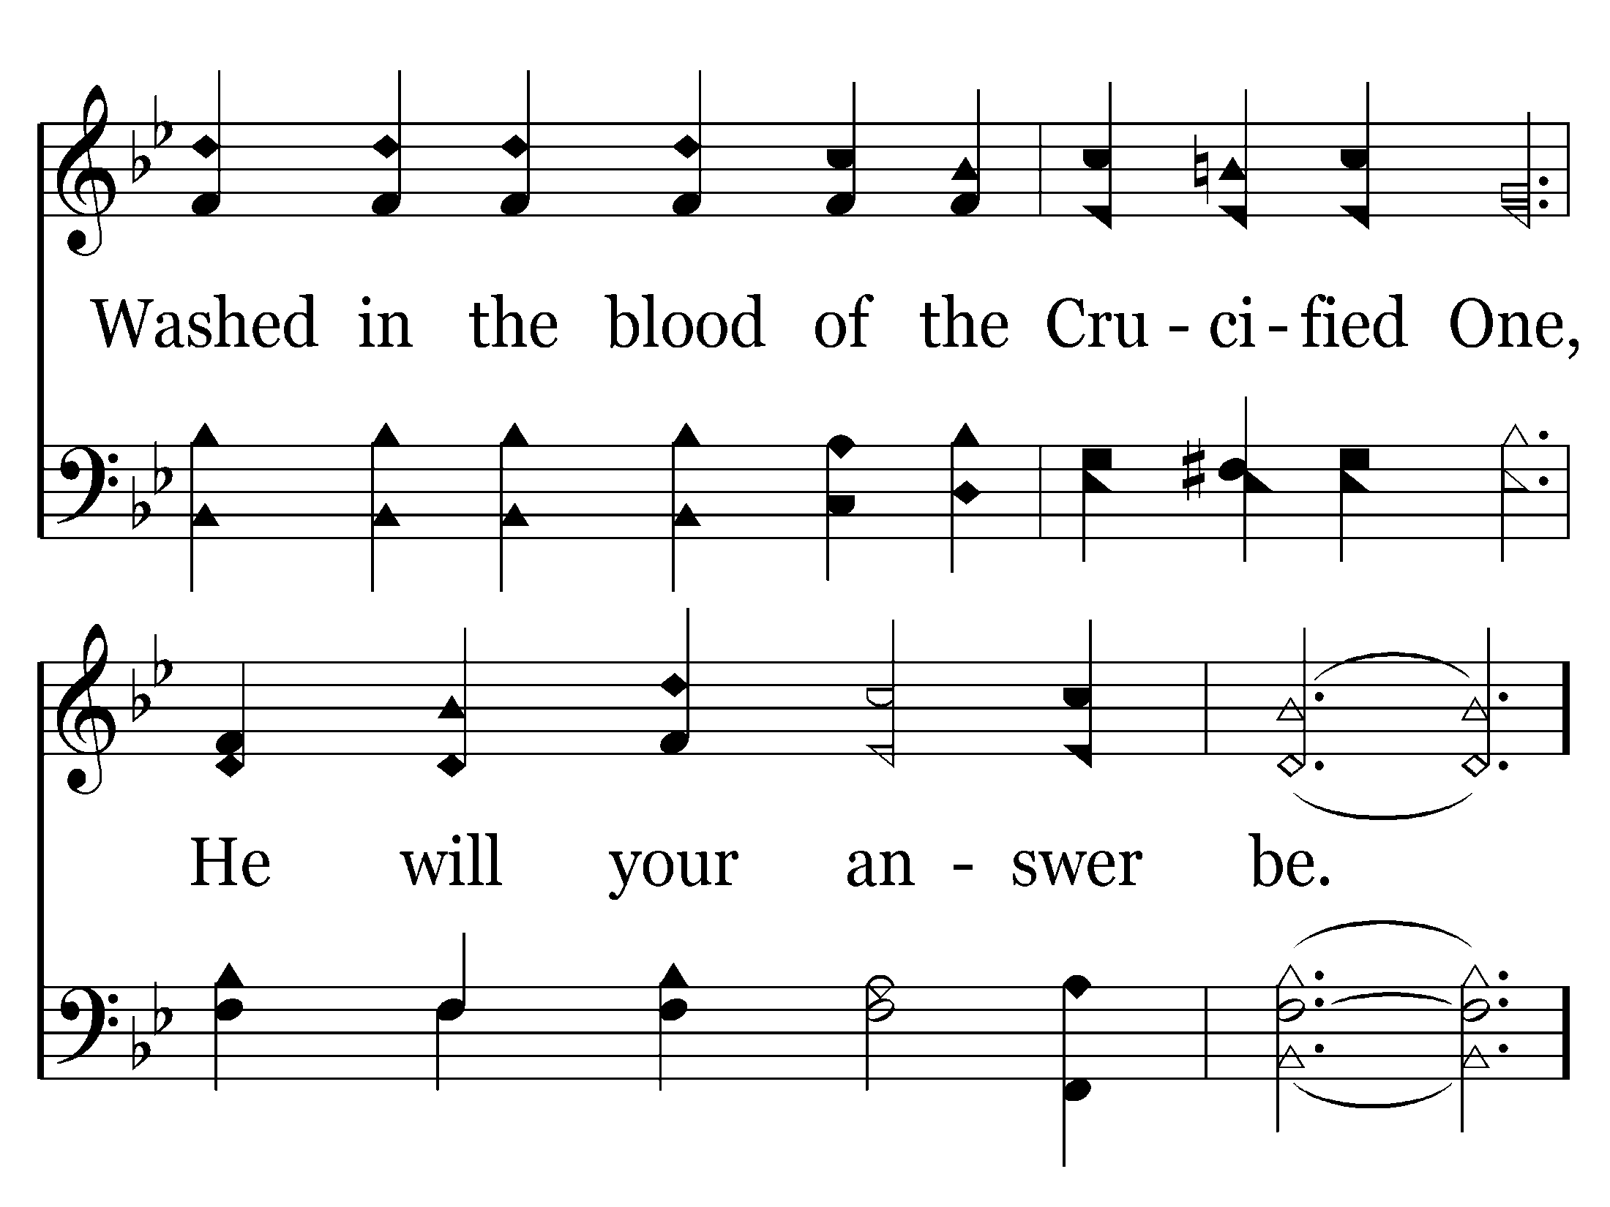
284 - What Will Your Answer Be - 3.2

Slide 42
284 - What Will Your Answer Be - C.1

Slide 43
284 - What Will Your Answer Be - C.2
End of Song

