Slide 2
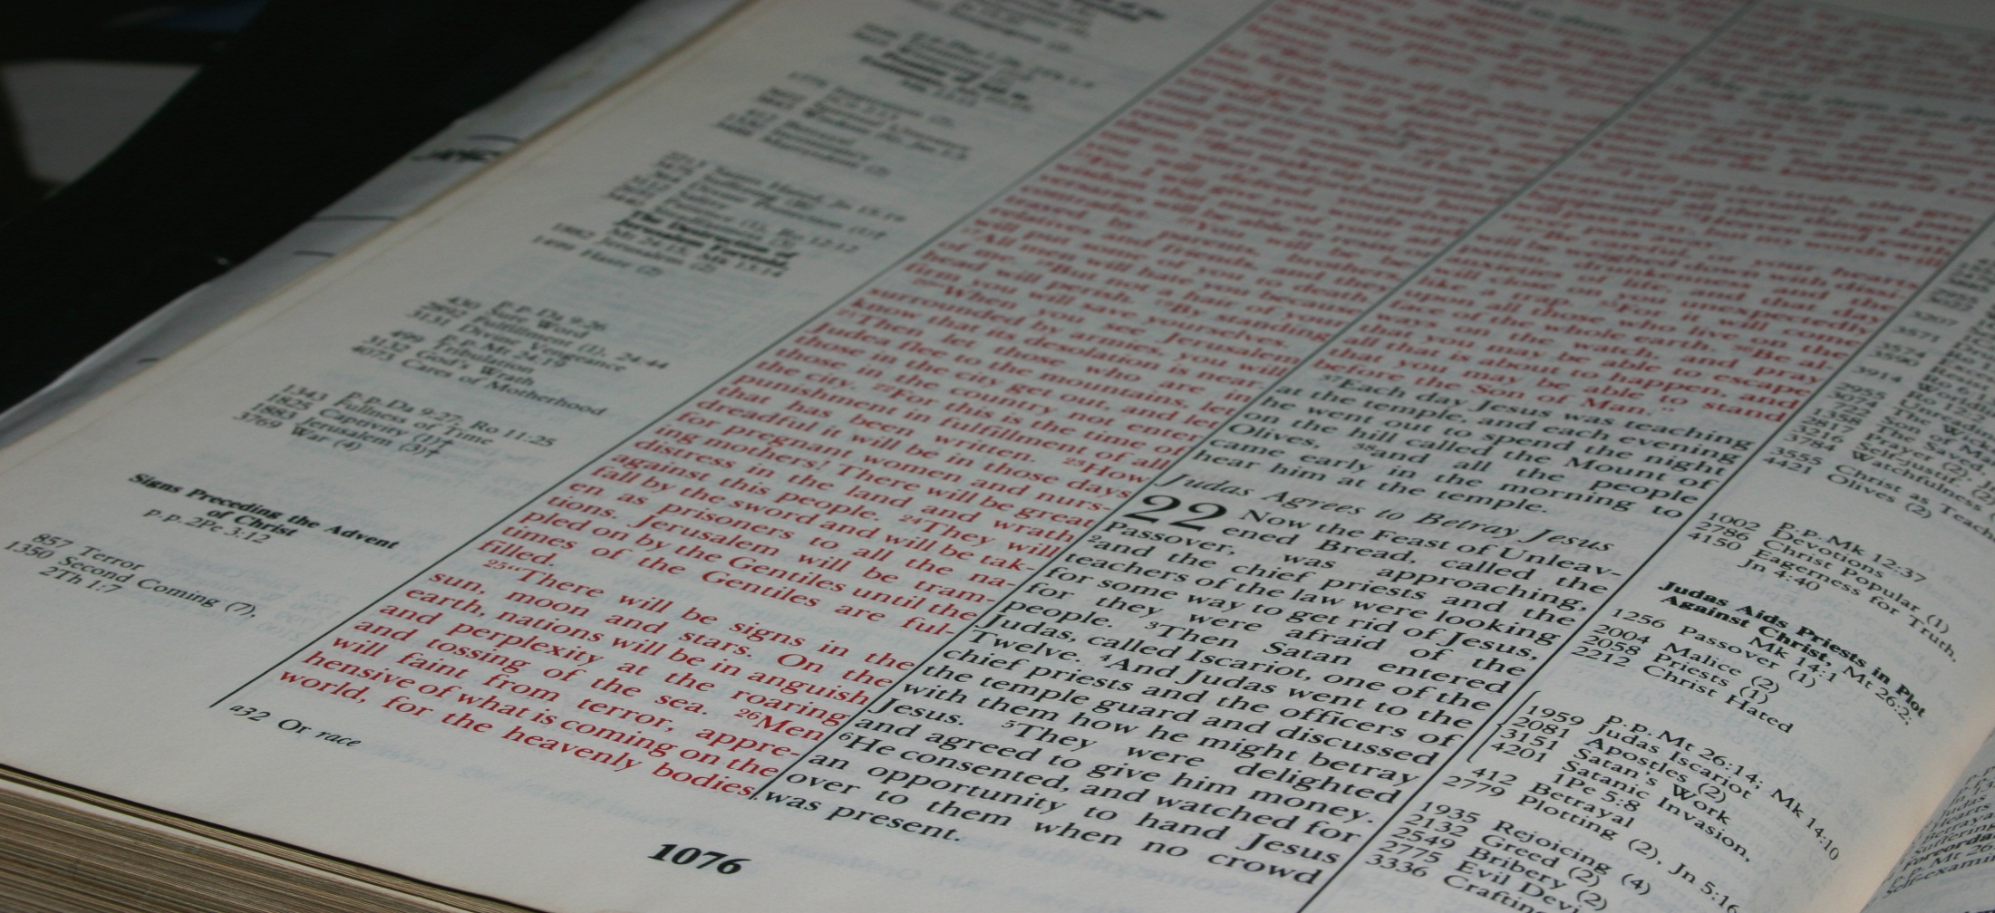
Then those who gladly received his word were baptized; and that day about three thousand souls were added to them.
Acts 2:41
Real Life For Everyone!
Northwest Church of Christ April 20-25, 2014

Slide 3
EVANGELISM: GOD’S GREAT WORK
Acts 2:41 -- Then those who gladly received his word were baptized; and that day about three thousand souls were added to them.

Slide 4
Acts 2:41 -- three thousand souls
Acts 2:47 -- praising God and having favor with all the people. And the Lord added to the church daily those who were being saved.

Slide 5
Acts 2:41 -- three thousand souls
Acts 2:47 -- added to the church daily
Acts 4:4 -- However, many of those who heard the word believed; and the number of the men came to be about five thousand.

Slide 6
Acts 2:41 -- three thousand souls
Acts 2:47 -- added to the church daily
Acts 4:4 -- about five thousand
Acts 5:14 -- And believers were increasingly added to the Lord, multitudes of both men and women.

Slide 7
Acts 2:41 -- three thousand souls
Acts 2:47 -- added to the church daily
Acts 4:4 -- about five thousand
Acts 5:14 -- believers…added…multitudes
Acts 6:1 -- Now in those days, when the number of the disciples was multiplying, there arose a complaint against the Hebrews by the Hellenists, because their widows were neglected in the daily distribution.

Slide 8
Acts 2:41 -- three thousand souls
Acts 2:47 -- added to the church daily
Acts 4:4 -- about five thousand
Acts 5:14 -- believers…added…multitudes
Acts 6:1 -- the number…was multiplying
Acts 6:7 -- Then the word of God spread, and the number of the disciples multiplied greatly in Jerusalem, and a great many of the priests were obedient to the faith.

Slide 9
Acts 2:41 -- three thousand souls
Acts 2:47 -- added to the church daily
Acts 4:4 -- about five thousand
Acts 5:14 -- believers…added…multitudes
Acts 6:1 -- the number…was multiplying
Acts 6:7 -- the number multiplied greatly …a great many of the priests
Acts 8:4 -- Therefore those who were scattered went everywhere preaching the word.

Slide 10
Acts 2:41 -- three thousand souls
Acts 2:47 -- added to the church daily
Acts 4:4 -- about five thousand
Acts 5:14 -- believers…added…multitudes
Acts 6:1 -- the number…was multiplying
Acts 6:7 -- the number multiplied greatly …a great many of the priests
Acts 8:4 -- went everywhere preaching
1st Century Church: Our Model?

Slide 11
Potential Advantages Of Growth:
Need for association better met.
Greater people resources.
Greater financial resources.
More efficient use of media.
More efficient Bible classes.
Increase in edification.
Better equipped to reach the lost.
1st Century Church: Our Model?

Slide 13
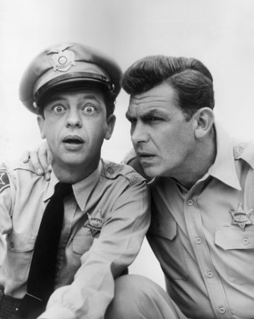
Momma said,
“Don’t mess with the knobs!”

Slide 14
THE LORD’S WAY
What happened in Jerusalem…
EVANGELISM 101
Acts 2:41 -- three thousand souls
Acts 2:47 -- added to the church daily
Acts 4:4 -- about five thousand
Acts 5:14 -- believers…added…multitudes
Acts 6:1 -- the number…was multiplying
Acts 6:7 -- the number multiplied greatly …a great many of the priests
Acts 8:4 -- went everywhere preaching
… is still God’s plan today!

Slide 15
Potential Advantages Of Growth:
Need for association better met.
Greater people resources.
Greater financial resources.
More efficient use of media.
More efficient Bible classes.
Increase in edification.
Better equipped to reach the lost.
“Has somebody been messing with the knobs?”
1st Century Church: Our Model?

Slide 16
THE LORD’S WAY
What happened in Jerusalem…
EVANGELISM 101
Acts 2:41 -- three thousand souls
Acts 2:47 -- added to the church daily
Acts 4:4 -- about five thousand
Acts 5:14 -- believers…added…multitudes
Acts 6:1 -- the number…was multiplying
Acts 6:7 -- the number multiplied greatly …a great many of the priests
Acts 8:4 -- went everywhere preaching
“Has somebody been messing with the knobs?”
… is still God’s plan today!

Slide 17
SHINE
SPEAK
Our daily lives must reflect the better way Jesus offers.
Spiritual things should naturally come out in our conversations with others.
4
Simple Things
You Can Do In
Your Mission Field
INVITE
WELCOME
As we speak
positively about spiritual things, invite others to come and see for themselves.
We must
make sure that those who come to visit us are warmly welcomed as honored guests.

