Slide 1
“As Was His Custom”
Jesus’ Habits &
My Resolutions

Slide 2
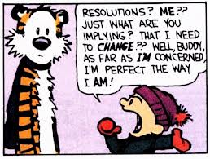
Resolutions

Slide 3
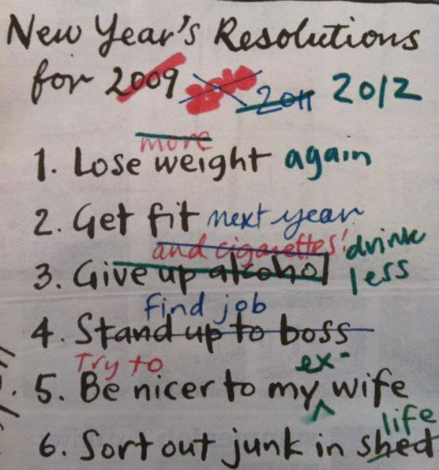

Slide 4
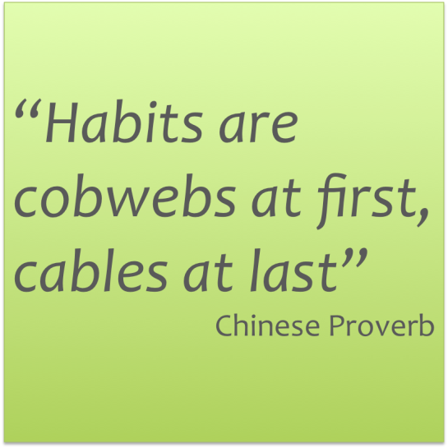
Motivators

Slide 5
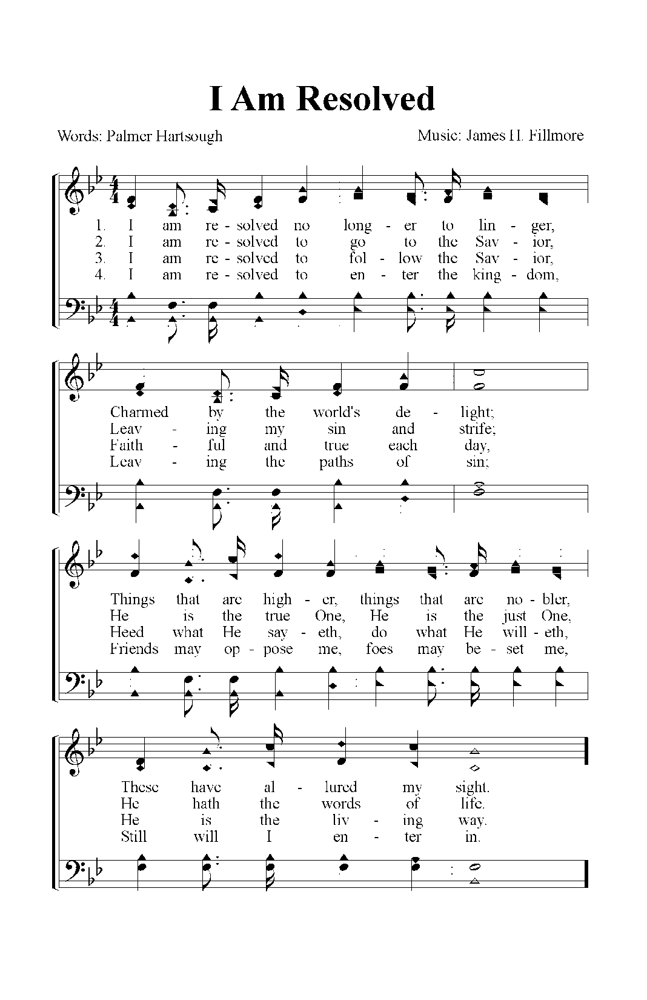
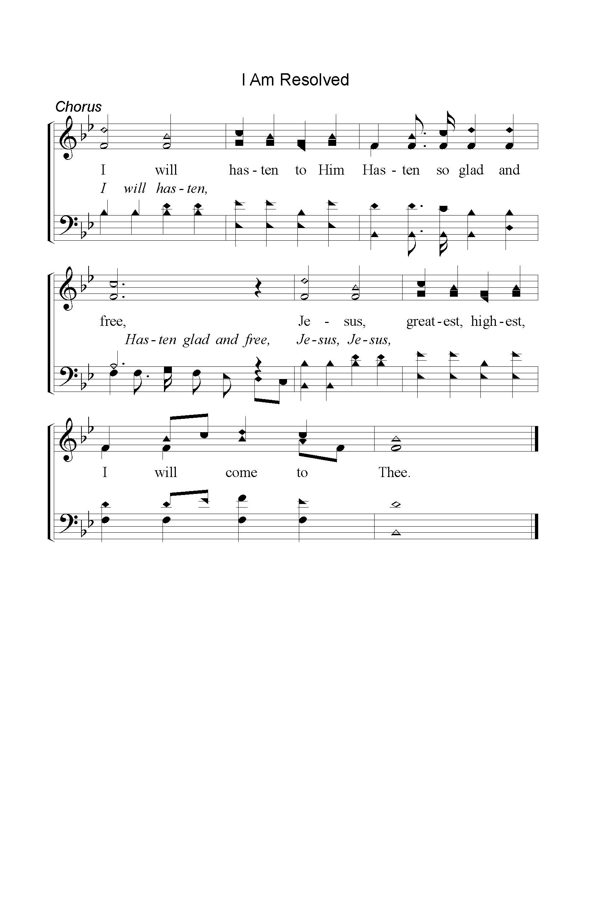
I Am Resolved
325

Slide 6
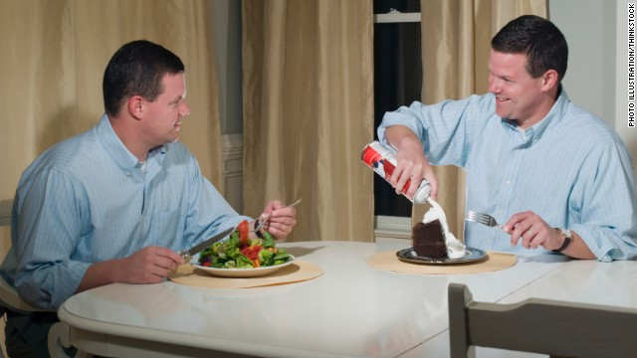
Resolution = Habit
Resolve: “to make a definite and serious decision to do something”
Habit: “a usual way of behaving : something that a person does often in a regular and repeated way”

Slide 7
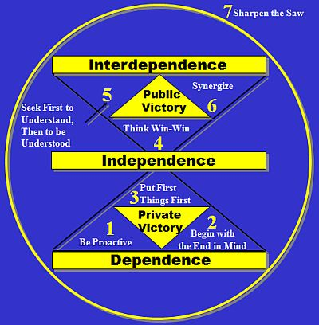
7 Habits Of Highly Effective People
Stephen Covey
Be Proactive
Begin with end in mind
Put first things first
Think Win-Win
Seek first to Understand Then to be Understood
Synergize
Sharpen the Saw
COMPLICATED

Slide 8
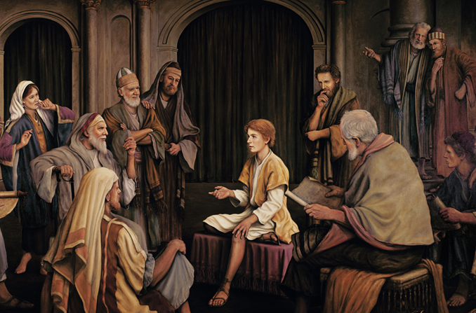
Jesus’ Boyhood
Luke 2:42-47
42 And when He was twelve years old, they went up to Jerusalem according to the custom of the feast. …
46 Now so it was that after three days they found Him in the temple, sitting in the midst of the teachers, both listening to them and asking them questions.

Slide 9
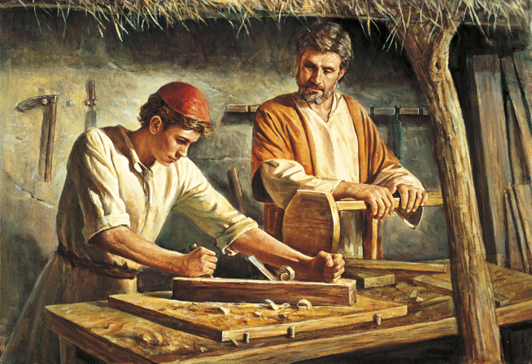
Jesus & Habits
Luke 2:52 And Jesus increased in wisdom and stature, and in favor with God and men.
Mental
Physical
Spiritual
Social

Slide 10
A Simple Resolution A Lifelong Habit
Prayer
Luke 22:39 Coming out, He went to the Mount of Olives, as He was accustomed (“as was His custom” RSV) and His disciples also followed Him.
John 18:2
And Judas, who betrayed Him, also knew the place; for Jesus often met there with His disciples.

Slide 11
A Simple Resolution A Lifelong Habit
Prayer
Mark 1:35 Now in the morning, having risen a long while before daylight, He went out and departed to a solitary place; and there He prayed.
Luke 5:16
So He Himself often withdrew into the wilderness and prayed.
Luke 6:12
Now it came to pass in those days that He went out to the mountain to pray, and continued all night in prayer to God.
Mark 6:46
And when He had sent them away, He departed to the mountain to pray.
Mark 13:33
"Take heed, watch and pray; for you do not know when the time is.
Luke 9:18
And it happened, as He was alone praying …
Luke 9:28
Now it came to pass, about eight days after these sayings, that He took Peter, John, and James and went up on the mountain to pray.

Slide 12
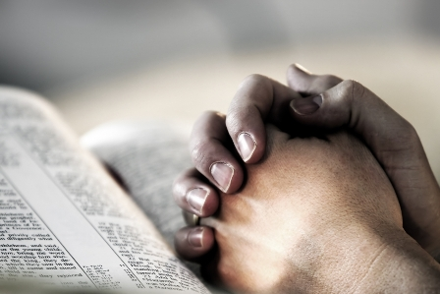
A Simple Resolution A Lifelong Habit
Prayer
Daniel 6:9-10
Therefore King Darius signed the written decree.
Now when Daniel knew that the writing was signed, he went home. And in his upper room, with his windows open toward Jerusalem, he knelt down on his knees three times that day, and prayed and gave thanks before his God, as was his custom since early days.

Slide 13
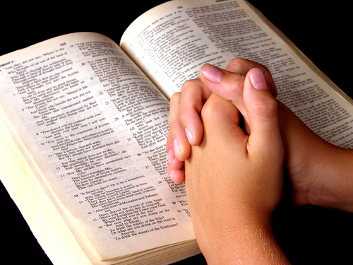
A Simple Resolution A Lifelong Habit
Prayer
Psalm 55:16-17
As for me, I will call upon God, And the LORD shall save me.
Evening and morning and at noon I will pray, and cry aloud, And He shall hear my voice.

Slide 14
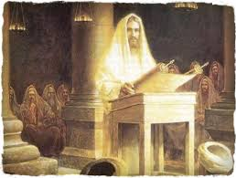
A Simple Resolution A Lifelong Habit
Worship
Luke 4:14-16
“… And He taught in their synagogues … So He came to Nazareth, where He had been brought up. And as His custom was, He went into the synagogue on the Sabbath day, and stood up to read.

Slide 15
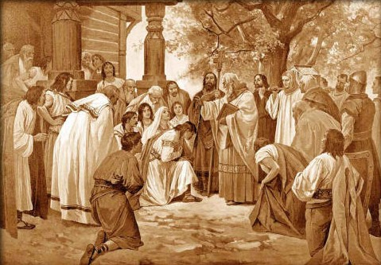
A Simple Resolution A Lifelong Habit
Worship
Acts 2:41-47
42 And they continued steadfastly in the apostles' doctrine and fellowship, in the breaking of bread, and in prayers.
46 So continuing daily with one accord in the temple, and breaking bread from house to house, they ate their food with gladness and simplicity of heart

Slide 16
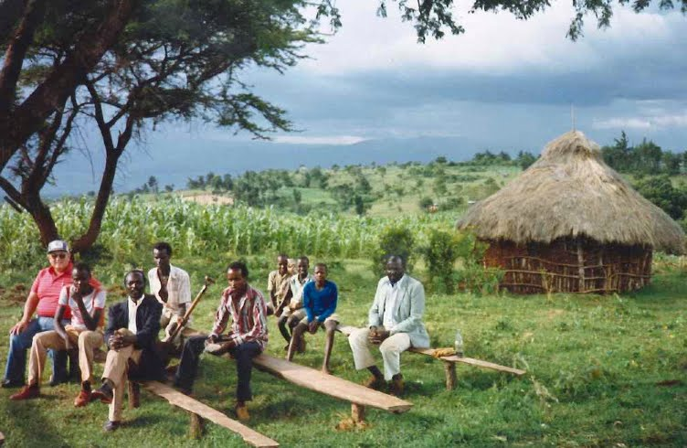
A Simple Resolution A Lifelong Habit
Worship
Hebrews 10:22-25
“not forsaking the assembling of ourselves together, as is the manner of some, but exhorting one another, and so much the more as you see the Day approaching.
as is the habit of some - RSV
as the custom of some is - ASV

Slide 17
“As was His custom”
Prayer
Worship

