Slide 1
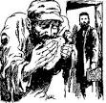
Benevolence In The New Testament
“I was hungry
And you gave me something to eat”
Matthew 25:35

Slide 2
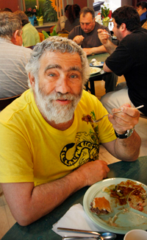
Judged by Caring Heart
Matthew 25:31-46
34 "Then the King will say to those on His right hand…inasmuch as you did it to one of the least of these My brethren, you did it to Me.'
41 "Then He will also say to those on the left hand…inasmuch as you did not do it to one of the least of these…”

Slide 3
One – AND – The Other
Matthew 23:23 "Woe to you, scribes and Pharisees, hypocrites! For you pay tithe of mint and anise and cummin, and have neglected the weightier matters of the law: justice and mercy and faith. These you ought to have done, without leaving the others undone.
Doctrinal purity + Benevolent heart = Honor God

Slide 4
Individual Action & Church Action
Clear Distinction
1 Timothy 5:16 If any believing man or woman has widows, let them relieve them, and do not let the church be burdened, that it may relieve those who are really widows.

Slide 5
Treasuries
Church: First Day of Week Contribution (Only)
I Corinthians 16:1-2 Now concerning the collection for the saints, as I have given orders to the churches of Galatia, so you must do also: On the first day of the week let each one of you lay something aside, storing up as he may prosper, that there be no collections when I come.

Slide 6
Treasuries
Individual: By Honest Labor
Ephesians 4:28 Let him who stole steal no longer, but rather let him labor, working with his hands what is good, that he may have something to give him who has need.

Slide 7
My Treasury to Lord’s Treasury
2 Corinthians 9:6-7
“So let each one give as he purposes in his heart…”

Slide 8
Church Funds
Titus 1:7 “For a bishop must be blameless, as a steward of God…”
1 Timothy 3:1,5 This is a faithful saying: If a man desires the position of a bishop, he desires a good work… 5 (for if a man does not know how to rule his own house, how will he take care of the church of God?)
Acts 11:29-30 “Then the disciples, each according to his ability, determined to send relief to the brethren dwelling in Judea. This they also did, and sent it to the elders by the hands of Barnabas and Saul.

Slide 9
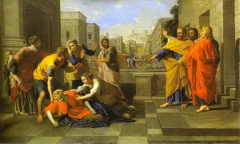
Individual’s Own Funds
Acts 5:3-4 But Peter said, "Ananias, why has Satan filled your heart to lie to the Holy Spirit and keep back part of the price of the land for yourself? "While it remained, was it not your own? And after it was sold, was it not in your own control? Why have you conceived this thing in your heart? You have not lied to men but to God."

Slide 10
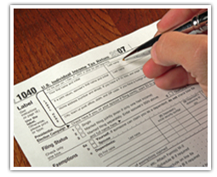
Individual’s Own Funds
Pay Taxes Romans 13:7 “Render therefore to all their due: taxes to whom taxes are due, customs to whom customs…”

Slide 11
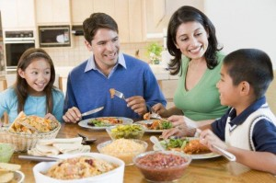
Individual’s Own Funds
Provide for Family 1 Timothy 5:8 But if anyone does not provide for his own, and especially for those of his household, he has denied the faith and is worse than an unbeliever.

Slide 12
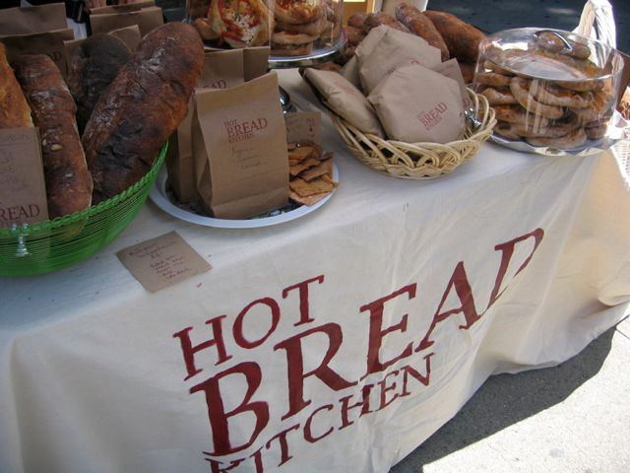
Individual’s Own Funds
Do Good Works 1 Timothy 6:17-18 Command those who are rich in this present age not to be haughty, nor to trust in uncertain riches but in the living God, who gives us richly all things to enjoy. Let them do good, that they be rich in good works, ready to give, willing to share

Slide 13
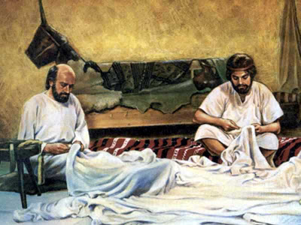
Individual’s Own Funds
Paul’s Example Acts 20:34-35 "Yes, you yourselves know that these hands have provided for my necessities, and for those who were with me. "I have shown you in every way, by laboring like this, that you must support the weak. And remember the words of the Lord Jesus, that He said, 'It is more blessed to give than to receive.'"

Slide 14
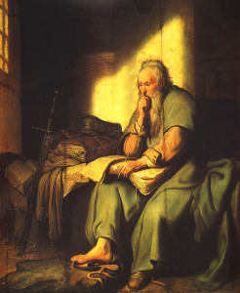
Church Funds
Preaching The Gospel
Philippians 4:15-16 Now you Philippians know also that in the beginning of the gospel, when I departed from Macedonia, no church shared with me concerning giving and receiving but you only. For even in Thessalonica you sent aid once and again for my necessities.
2 Corinthians 11:8 I robbed other churches, taking wages from them to minister to you.

Slide 15
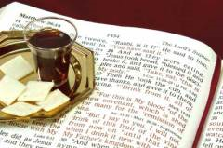
Church Funds
Edifying One Another
1 Corinthians 11:20, 33-34 Therefore when you come together in one place, it is not to eat the Lord's Supper… Therefore, my brethren, when you come together to eat, wait for one another. But if anyone is hungry, let him eat at home, lest you come together for judgment. And the rest I will set in order when I come.

Slide 16
Church Funds
Caring For The Saints
Acts 4:32-34 Now the multitude of those who believed were of one heart and one soul; neither did anyone say that any of the things he possessed was his own, but they had all things in common. … Nor was there anyone among them who lacked; for all who were possessors of lands or houses sold them, and brought the proceeds of the things that were sold, and laid them at the apostles' feet; and they distributed to each as anyone had need.

Slide 17
Individual Benevolence
Imitate God
Acts 14:17 "Nevertheless He did not leave Himself without witness, in that He did good, gave us rain from heaven and fruitful seasons, filling our hearts with food and gladness."
Matthew 5:44-45 "But I say to you, love your enemies, bless those who curse you, do good to those who hate you, and pray for those who spitefully use you and persecute you, "that you may be sons of your Father in heaven; for He makes His sun rise on the evil and on the good, and sends rain on the just and on the unjust.

Slide 18
Individual Benevolence
Imitate Barnabas & Dorcas
Acts 4:36-37 Barnabas …(which is translated Son of Encouragement)… having land, sold it, and brought the money and laid it at the apostles' feet.
Acts 9:36,39 Tabitha (which is translated Dorcas) This woman was full of good works and charitable deeds which she did… all the widows stood by him weeping, showing the tunics and garments which Dorcas had made while she was with them.

Slide 19
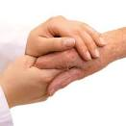
Individual Benevolence
Imitate Paul & Stephanas
Acts 20:34 "I have shown you in every way, by laboring like this, that you must support the weak. And remember the words of the Lord Jesus, that He said, 'It is more blessed to give than to receive.'“
I Corinthians 16:15-16 I urge you, brethren--you know the household of Stephanas, that it is the firstfruits of Achaia, and that they have devoted themselves to the ministry of the saints-- that you also submit to such, and to everyone who works and labors with us.

Slide 20
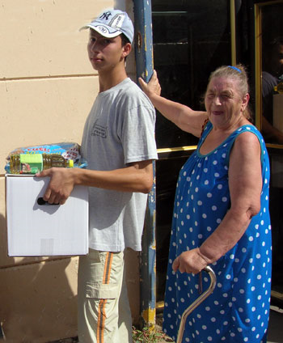
Individual Benevolence
Pure Religion
James 1:27 Pure and undefiled religion before God and the Father is this: to visit orphans and widows in their trouble, and to keep oneself unspotted from the world.
Galatians 6:6,10 Let him who is taught the word share in all good things with him who teaches… Therefore, as we have opportunity, let us do good to all, especially to those who are of the household of faith.

Slide 21
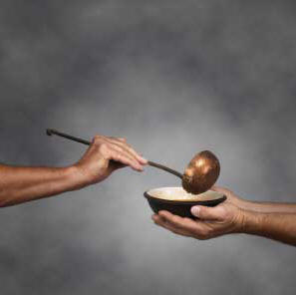
Individual Benevolence
Faith in Action
James 2:15-18 15 If a brother or sister is naked and destitute of daily food, and one of you says to them, "Depart in peace, be warmed and filled," but you do not give them the things which are needed for the body, what does it profit? Thus also faith by itself, if it does not have works, is dead. But someone will say, "You have faith, and I have works." Show me your faith without your works, and I will show you my faith by my works.

Slide 22
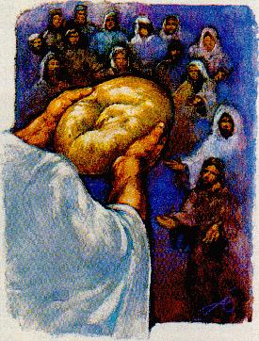
Church Benevolence
Specific Examples: AD 46 Famine
Acts 11:27-30 And in these days prophets came from Jerusalem to Antioch. Then one of them, named Agabus, stood up and showed by the Spirit that there was going to be a great famine throughout all the world, which also happened in the days of Claudius Caesar. Then the disciples, each according to his ability, determined to send relief to the brethren dwelling in Judea. This they also did, and sent it to the elders by the hands of Barnabas and Saul. (example of deacons assisting – Acts 6:1-6)

Slide 23
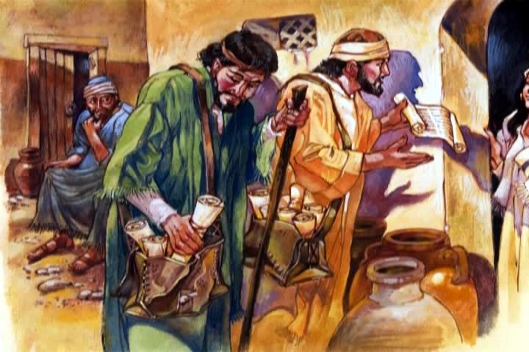
Church Benevolence
Specific Examples: AD 57
I Cor 16:1-2; 2 Cor 8-9; Rom 15:25-26 Churches of Macedonia and Achaia To church in Jerusalem for poor Note: Each church made its own decision on: 1) Money sent 2) Messengers sent

Slide 24
Lessons Learned
Great Need For Benevolence In Our World
Clear Distinction of Individual Funds & Church Funds
May I Do My Part in BOTH
Respect God’s Authority !

